Slide 1

June 6, 2018

Slide 2
Agenda
Annual Renewals
Supervisor ID Updates
OPS Project Updates
Careers at UF Updates
Benefits Updates
Important Dates

Slide 3
Annual Renewals

Slide 4
Perquisite Renewals
Departments have been sent a summary report of perquisites approved during the 2017-2018 fiscal year.
To renew, delete, or make changes to perquisites for the 2018-2019 fiscal year, departments should use the report and instructions provided and submit renewal information to Classification and Compensation no later than July 1.
Requests for new perquisites should be submitted as a new request using the Request for Approval of Perquisites or Sale of Goods and Services form.
Questions may be directed to Classification and Compensation at (352) 273-2842 or by email at compensation@ufl.edu.

Slide 5
Alternate Work Location Agreements
Alternate work location agreements that will continue into the 2018-2019 fiscal year should be submitted to UFHR by July 1st.
The renewal process is an opportunity to evaluate the success of the work arrangement and make modifications as appropriate.
Form location: http://hr.ufl.edu/wp-content/uploads/forms/recruitment/alternate.pdf.
Dean/Director and VP Approval and Signature.
Questions may be directed to Classification and Compensation at (352) 273-2842 or by email at compensation@ufl.edu.

Slide 6
HR-600 Renewals
Departments must renew extra state compensation commitments that extend into the new fiscal or academic year.
For new or existing commitments for Additional University Employment, complete a Request for Approval of Additional University Employment (HR-600) form and submit it to: HR600Request@ad.ufl.edu.
Questions may be directed to Classification and Compensation at (352) 273-2842 or by email at compensation@ufl.edu.

Slide 7
DocuSign
UF has implemented an electronic signature service that allows users to sign and initial an electronic document instead of a paper copy.
By using the “envelope” feature, you can send electronic documents for signature-to one person or many people-and easily see that status of the documents you send.
DocuSign can be utilized for all human resource forms such as HR600s, Alternative Work Location Agreements, and SPI’s.
Additional information can be found at https://it.ufl.edu/ufdocusign
https://www.docusign.com/ .

Slide 8
Supervisor ID Updates

Slide 9
Supervisor Updates
Definition of a Supervisor:
The person directly responsible for providing oversight for, or directing the work of, another UF faculty or staff member. This typically includes clarifying performance and assignment expectations; providing feedback; approving vacation requests and time worked; and completing the faculty or staff member’s performance evaluation.
For tenure-track faculty appointed to a center, list the academic chair (or center director if tenure is held in the center).
For non-tenure tract faculty appointed to a center, list the center director.
For department chairs, list the dean.
For center directors, list either dean or SVP, depending upon to whom the person reports.

Slide 10
Supervisor Updates (continued)
Supervisory pairings to avoid:
TEAMS supervising Faculty.
Employee supervising another in a lateral or identical classification.
Office support employee supervising management.
Office support employee supervising field staff at another location.
Non-exempt employee supervising exempt employee.
Temporary (OPS) employee supervising a permanent TEAMS/Faculty position.
Supervisor is from a different campus unit.
9/10-month employee supervising a 12-month employee.
Please contact compensation@ufl.edu with questions regarding these occurrences.

Slide 11
OPS Project Updates

Slide 12
OPS
Review File-opened April 20th and closed May 4th . A total of 415 inactive OPS employees were terminated effective May 18th.
We will do a file every 6 months to capture inactive employees.

Slide 13
OPS Job Code File
In May, we created 10 new job codes to provide clarity on our temporary workforce.
OPS job code file opened May 21st and closes on June 8th.
Once the file closes, we will work with College/Unit admins regarding those that are not in one of the 9 new job codes.
Fall 2018, Guidelines for OPS employment.

Slide 14
Careers at UF
Upcoming Changes

Slide 15
Design Refresh
PageUp will be updating the user interface to simplify and streamline the look and feel of the system.
Users will have an easier access to all features via all mobile, tablet, and desktop devices.
All pages will be WCAG 2.0 compliant.

Slide 16
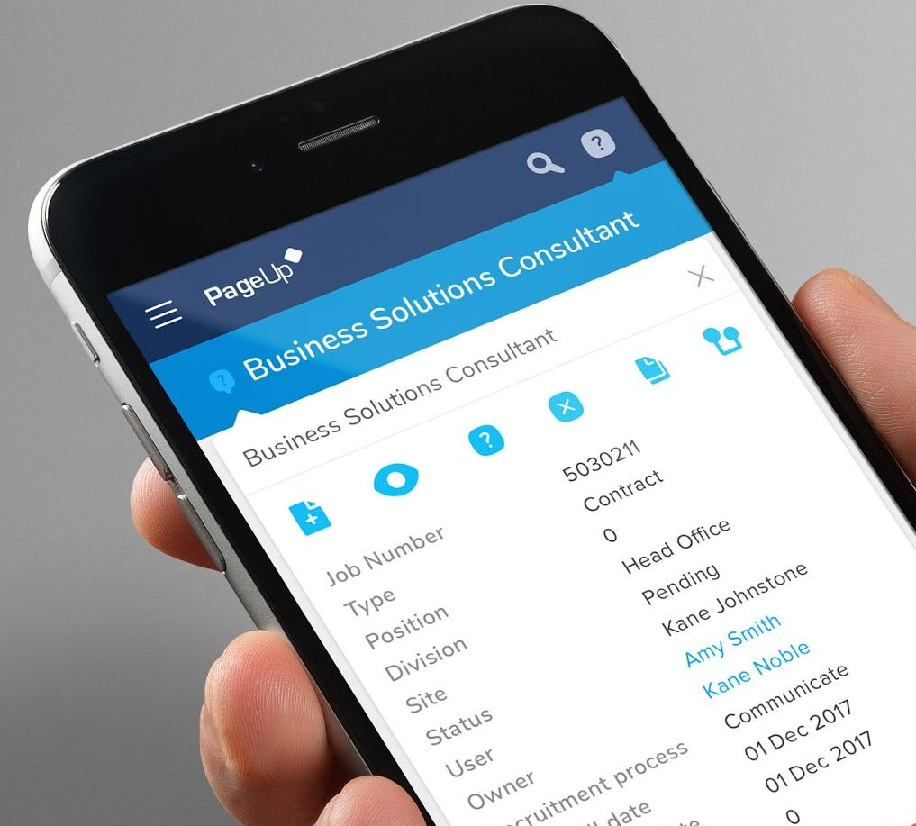
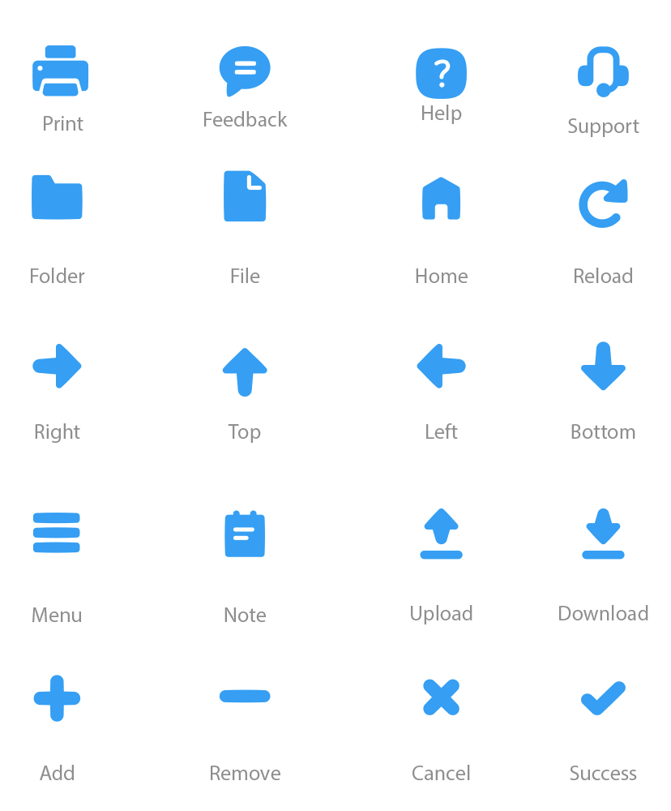
Iconography
A new consistent set of iconography to be used across the system

Slide 17
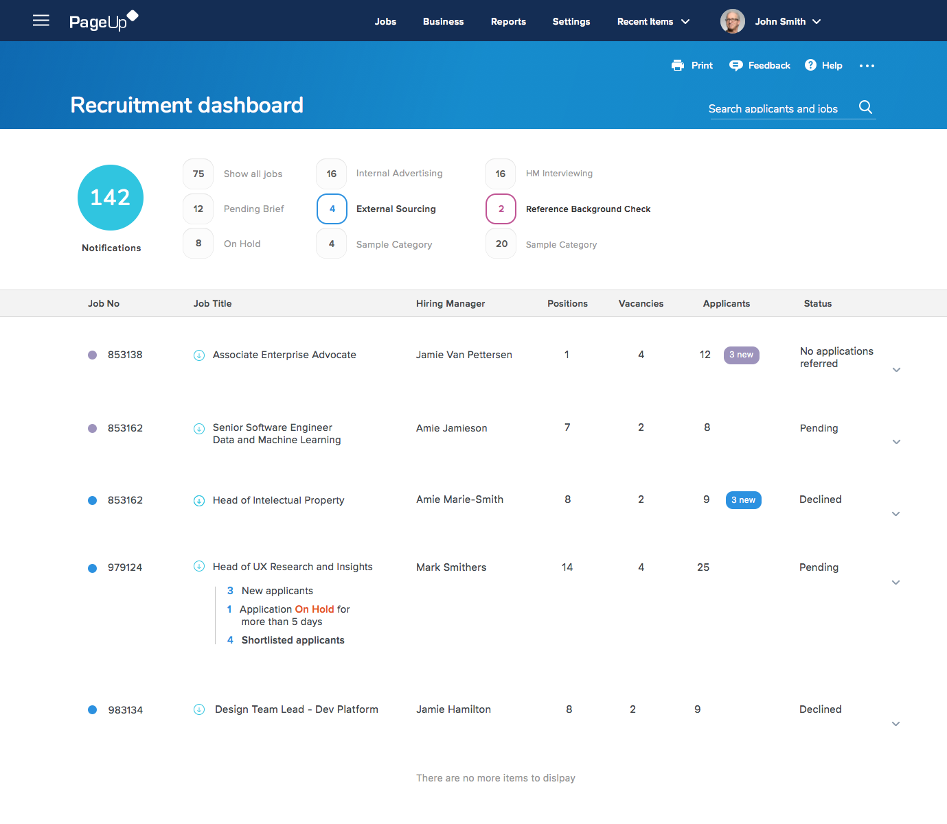

Slide 18
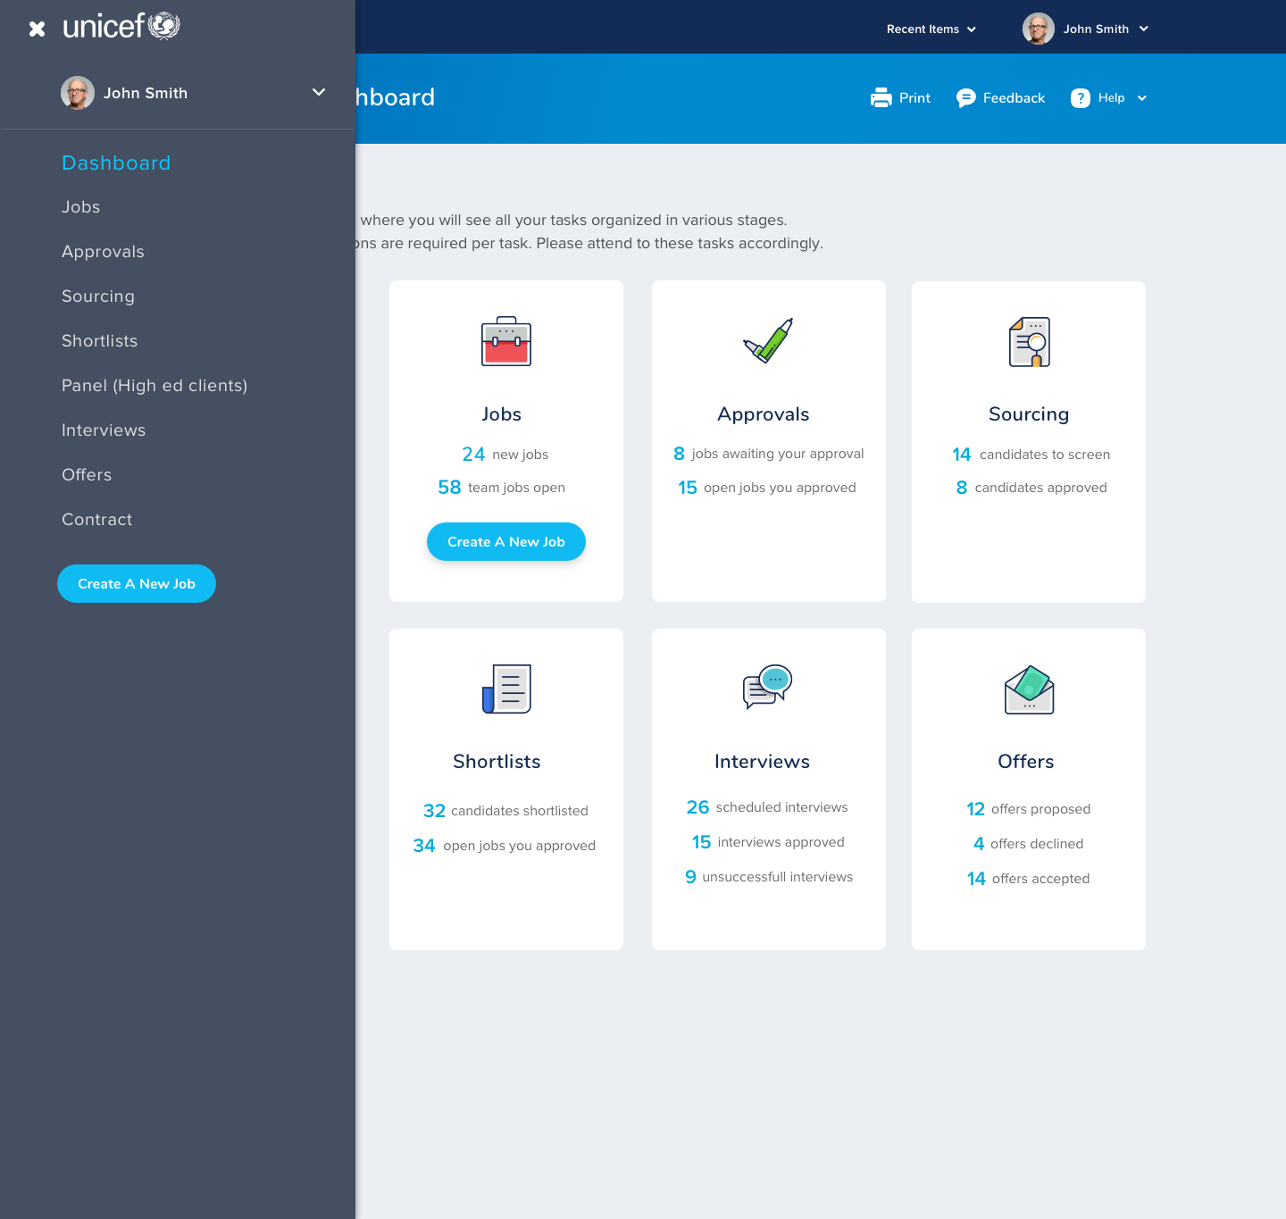

Slide 19
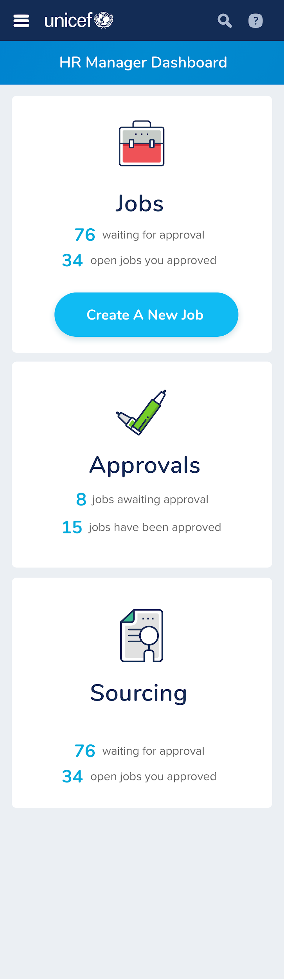
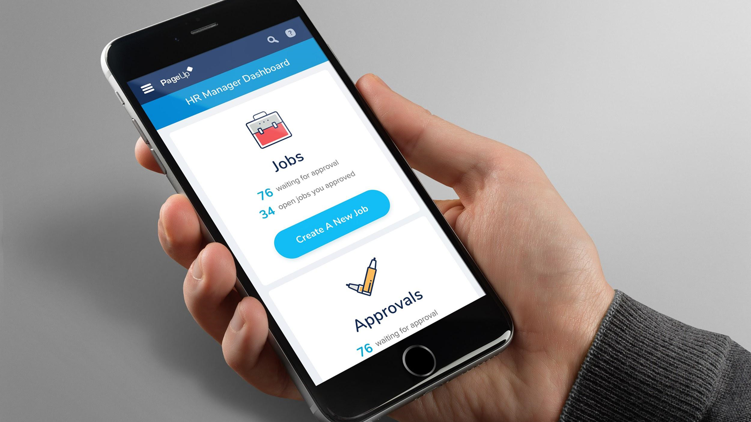
Mobile

Slide 20
Timeline
Changes will be implemented in small batches.
First batch will affect the menu and the navigation bar for originators and level 1 approvers.
Anticipating to launch on July 4.

Slide 21
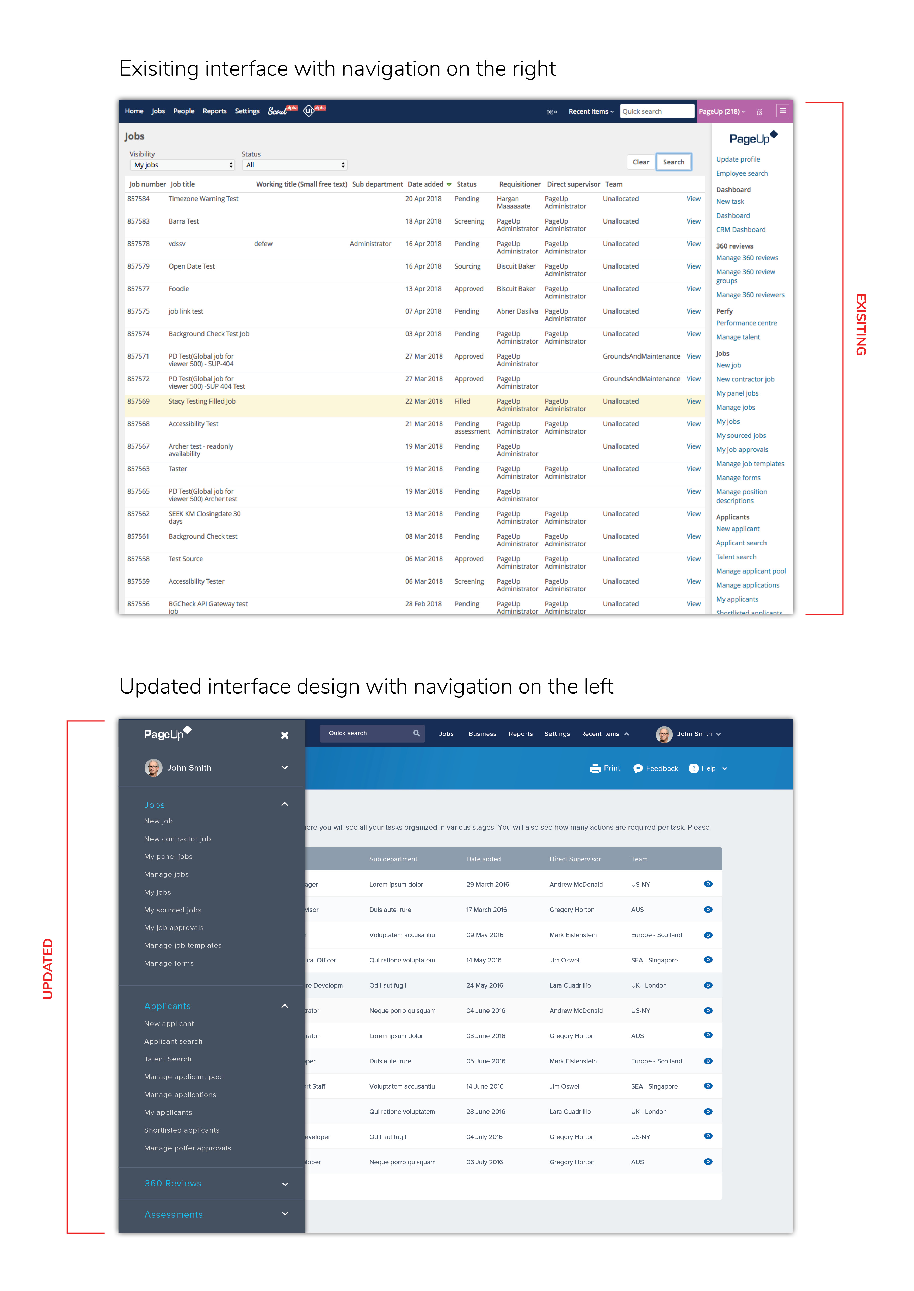
Existing

Slide 23
Additional updates at the next HR Forum
Please forward your inquiries to employment@ufl.edu

Slide 24
Benefits Updates

Slide 25
Leave

Slide 26
Personal Holidays (USPS) and
December Personal Leave Days
(TEAMS & Eligible Faculty)
“Use it or lose it” – days must be used by June 30 or days will expire.
USPS Personal Holidays—must use full day increments.
December Personal Leave Days—may use less than full day increments.
Questions? Contact central-leave@ufl.edu or call (352) 273-2840.

Slide 27
Dependent Eligibility Verification Audit (DEVA)

Slide 28






DEVA for State Plans
Last chance--HMS sending final notice.
Please remind your employees to respond.
Employees must send documentation by June 19!
Mail documentation directly to HMS or upload on HMS web portal https://verifyos.com/.
Questions about documentation?
Contact HMS Call Center
(877) 577-4549
Additional info online: https://www.mybenefits.myflorida.com/
(enter DEVA in the search box)

Slide 29
Benefits Considerations for New Hires

Slide 30
Benefits Considerations for New Hires
Date of hire may impact benefits effective dates.
Choose early to mid-month hire dates to allow time to process job appt.
Avoid hire dates late in the month or on the last day of the month.
Use current toolkits and Letter of Appointment documents on HR website.

Slide 31
Benefits Considerations for New Hires
(continued)
Inform hires about when coverage may reasonably begin.
Recommend new hires complete benefits enrollment early.
New hires may need to check with the prior employer for coverage end dates and COBRA availability.

Slide 32

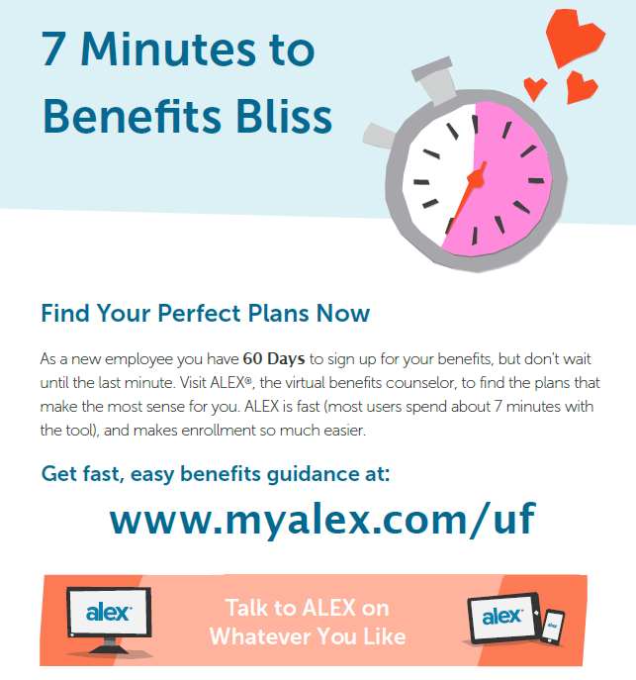
Benefits Considerations for New Hires
(continued)
Recommend new hires use ALEX, UF’s virtual benefits counselor.
Available 24/7.
Helps employees choose the best benefits.
Use ALEX, then complete benefits enrollment online.

Slide 33
Benefits Considerations for New Hires
(continued)
Considerations for state plan enrollment & eligibility:
Job data not in the UF or People First systems by the end of month may delay coverage by at least one month for state plans.
Prior OPS employment (UF or other agencies) may impact benefits eligibility—more on OPS to follow.
Job data must be in both PeopleSoft and People First before the employee can access their online enrollment.

Slide 34
Benefits Considerations for New Hires
(continued)
Timeframe to enroll in state & UF Select plans -Employees have 60 calendar days from hire date or qualifying event date to enroll or make changes.
Using Plan Coverage - Coverage can be used once premium is posted and insurance ID cards are received.

Slide 35
OPS Benefits Eligibility

Slide 36
OPS Benefits Eligibility
OPS employees eligible for benefits when expected to work 30+ hours on average.
Applicable to:
New hires.
Internal promotions.
Movement to/from other state agencies.
Increase in hours without position change.
Note: Increase in hours may need to be reported to People First Service Center by Benefits Office.
OPS may elect early effective date on health insurance only.

Slide 37

Benefits Questions?
UF HR Benefits has answers!
Email us: | benefits@ufl.edu
Call us: | (352) 392-2477
Visit us: | Schedule appointment online
Other benefits resources:
(online “virtual benefits counselor”)
UF HR Benefits & Rewards website
UF at Work newsletter articles

Slide 38
Important Dates
GBAS/RAFT “It’s a Team Effort!” Event – July 17, 2018.
For staff who support 9-month Faculty
Next HR Forum – August 1, 2018

Slide 39


