Slide 1
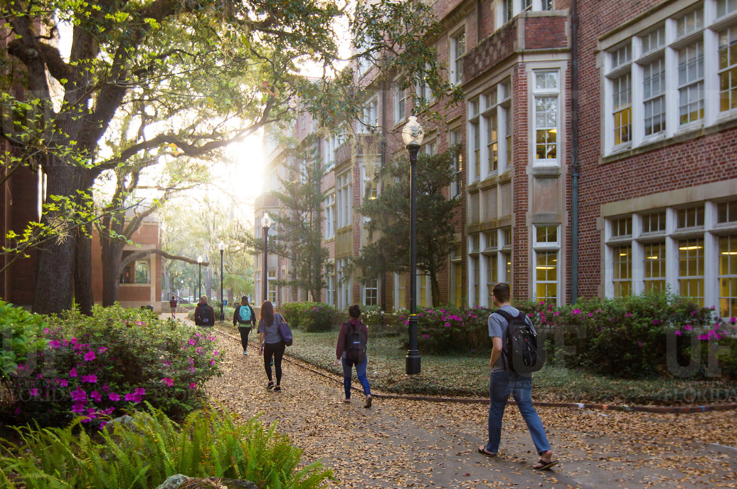
HR Forum
December 5, 2018

Slide 2
Today’s Agenda Items
Introductions
Academic and Professional Assembly (APA)
Recruitment & Staffing Updates
Classification & Compensation Updates
Benefits Updates
Important Dates
UFHR preeminence through people

Slide 3
Introductions
nice to meet you!
Deanna Nelson, who has accepted the position of Faculty Relations Coordinator. Deanna will oversee the online promotion & tenure process and assist with other faculty-related projects. Welcome, Deanna!
Verlissa Ford, who is T&OD’s new Education Programs Coordinator. Verlissa’s core responsibilities include managing the Employee Education Program, Higher Education Opportunity, Prudential Productivity Awards, Meritorious Service Awards, and Service Recognition Program. Welcome, Verlissa!
UFHR preeminence through people

Slide 4
Mission:
To promote communication, recognition, professional networking, and service opportunities for professional staff across campus

Slide 5
Why staff get involved
Connect
Network
Collaborate
Build relationships and partnerships
Professional development
Learn and share resources
Build awareness
Give back to community
Build skills
“To meet and network with faculty/staff from across campus whom I might not otherwise meet.”
“I want to be more connected to the university as a whole and have the opportunity to learn something new and network with my fellow colleagues.”
“I wanted UF to feel smaller by meeting people and learning about the resources available.”
“Contributing to the success of APA … Presenting APA’s achievements to potential members to increase buy-in and involvements for future achievements as a group.”
“To network with people from other colleges/schools, professions, and expertise.”
“To network with other staff at UF and learn how each area fits into the UF community.”
Notes:
For those of you who weren’t able to make it to the last meeting, these are some of the reasons for the group wanting to get more involved with APA – you’ll see they revolve around connecting, networking, collaborating, etc.

Slide 6
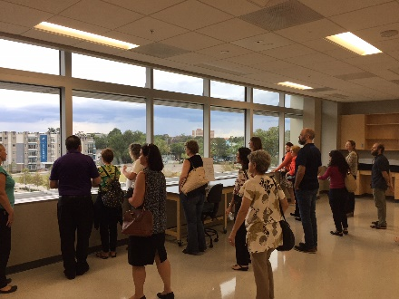
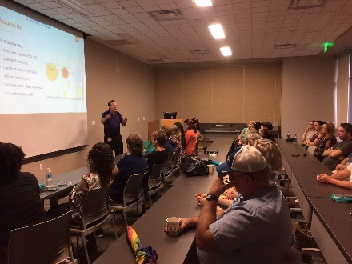
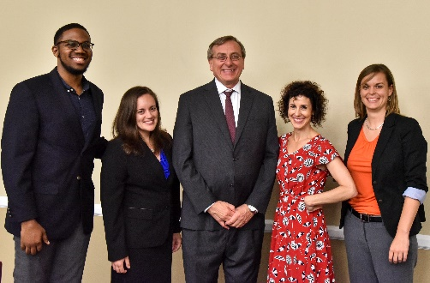
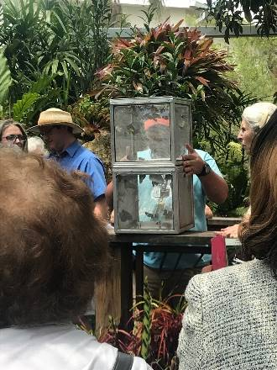
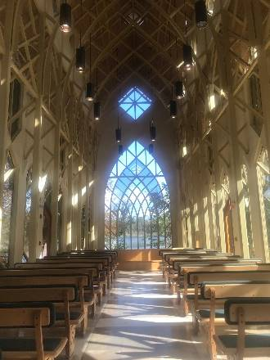
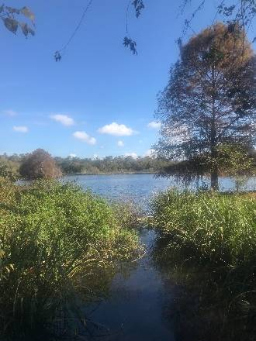
APA programming
I enjoyed being in the same space with people I would have otherwise probably not crossed paths with -- taking part in a fun activity, lighthearted conversation, and friendly atmosphere. - Florencia Otegui, Special Assistant, UF Online [Bowling with Strangers]
I honestly had no idea going in what they did at the UF Innovate The Hub. I feel more knowledgeable now about what takes place there and thought it was very interesting. Loved the tour of the facility as well. - Rebecca Kidwell, Field Experience Coordinator, College of Education [UF Innovate, The Hub]
This event was a well-executed, high-level lecture that was meant to encourage perspective-taking, making connections, and as a brief overview of the new CDO's process. It was excellent in communicating the deep complexity of the work involved in changing culture on a renowned university campus. Farias is inspiring in his ability to inspire and challenge the audience, and I'm looking forward to his work here at UF. - Jason Arnold, Director for E-Learning, Technology, and Communication Services, College of Education

Slide 7
Focus on welcoming new staff
Ambassador program
Targeted outreach
Event invitations

Slide 8
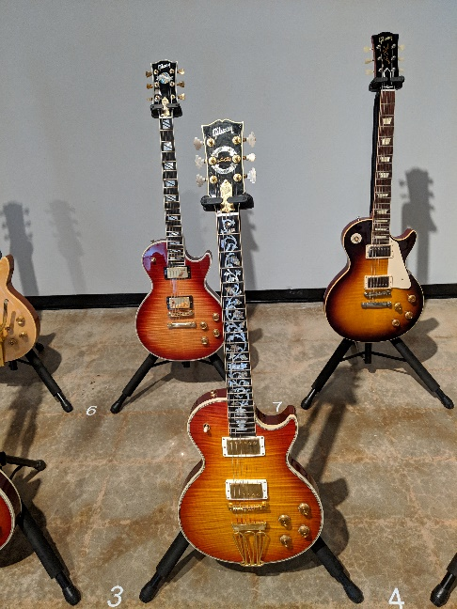
Upcoming events
12/6 – Get to Know Campus Tour: Career Connections Center (8:30 a.m.)
1/25 – APA Gallery Hour (brown bag lunch at the University Galleries; will feature guitars from the Henry Lowenstein Collection)
More to come!
Notes:
This is a quick recap of the goal areas for the year – thank you all for indicating your interest in each on the Google Doc. We want to make sure that you have the chance to contribute to goals you’re passionate about or feel your skills could really suit, and we want to make it clear who is working on each goal.

Slide 9
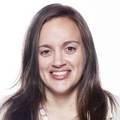
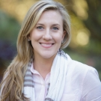
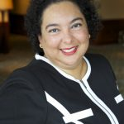
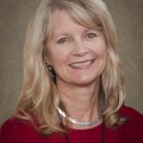
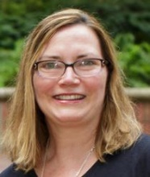
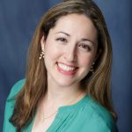
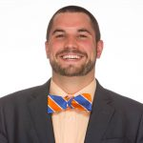
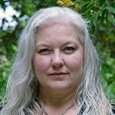
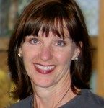
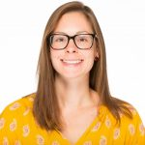
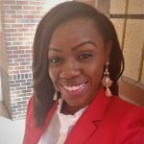
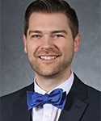
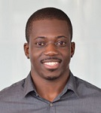
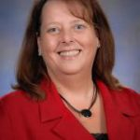
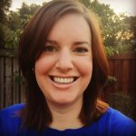
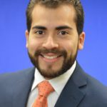
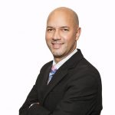
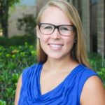
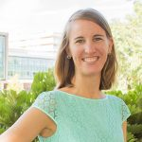
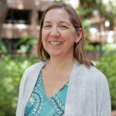
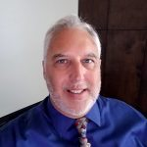
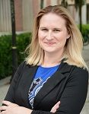
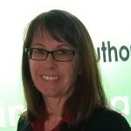
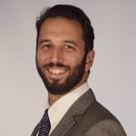
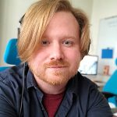
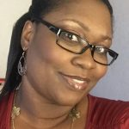
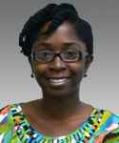
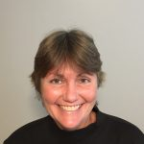
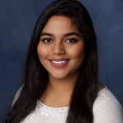
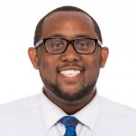
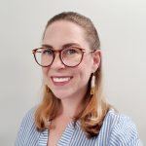
APA leadership
2018-2019 team:
40+ officers and committee/workgroup members
25+ colleges/departments represented
https://apassembly.ufl.edu/

Slide 10
Recruitment & Staffing
Recruitment & Background Check Deadlines
Recruitment Resources
Interfolio Tips

Slide 11
Recruitment & Background Check Deadlines

Slide 12
Posting, Background Check & ePAF
Service | Date
Job Posting/Careers at UF | Wednesday, December 19
Clearance for Hire | Monday, December 17
AOL/FDLE | Thursday, December 13
FBI Livescan | Fingerprinted by Monday, December 17
435 Livescan | Fingerprinted by Monday, December 10
HireRight (USA) | Consent from applicant by Friday, December 14
ePAF Approval | Arrive to HR for approval by Wednesday, December 12 (for PP 12/14 -12/27)

Slide 13
Recruitment Resources

Slide 14
Find Yourself Here
Updated recruitment brochures available
Provides high level introduction to the University of Florida, Gainesville, and our faculty
Pocket in back for individualization

Slide 15
Guide to Greater Gainesville
2018 Guide now available
Excellent in-depth resource about Gainesville for candidates
Digital version also available
www.guidetogreatergainesville.com

Slide 16
Interfolio Tips

Slide 17
Interfolio
Sunsetting faculty postings in PageUp
New instruction guides available
Using Disposition Codes
Closing a Position
Recap of demo sessions on Nov.14-15 and thank you to hosts

Slide 18
Class and Comp
2018-2019 Pay Program Update
Florida Minimum Wage Increase
January GA Increases

Slide 19
2018-19 Pay Program
In November, UF and the United Faculty of Florida (UFF) reached a tentative agreement regarding the 2018-2019 pay program.
Last week, the tentative agreement was ratified by the union membership and the UF Board of Trustees (BOT) is expected to approve the agreement later this week.
Once approved by the BOT, UFHR will execute the one-time payments in myUFL this week.

Slide 20
Florida Minimum Wage
On January 1, 2019, the state minimum wage will increase from $8.25 to $8.46 per hour and applies to all employees including FWSP, STAS, and OPS.
UFHR will process pay increases for all employees currently below $8.46 with an effective date of January 1, 2019.
The University’s minimum hourly wage for TEAMS and USPS employee will remain $13.00.

Slide 21
GA Salary Increases
The current multiyear collective bargaining agreement (CBA) between UF and GAU includes a $225 raise for continuing graduate assistants effective January 1, 2019.

Slide 22
Timeline
GA Salary and FL Minimum Wage Increase Implementation Timeline
Wednesday, January 2, 2019 – UFHR & UFIT will begin implementing the GA and FL Minimum Wage Increases
Note: Departments may submit job edits and other ePAF actions with job dates effective on or before January 1st through the end of business on January 1st.
Friday, January 18, 2019– performance payments included in employee paychecks

Slide 23
Questions
If you have questions, please contact Classification and Compensation at (352) 392-2477 or by email at salaryincrease@ufl.edu

Slide 24
Benefits
Retirement
Leave
Benefits

Slide 25
Retirement

Slide 26
2019 IRS Contribution Limits
 | 2018 | 2019
403(b) Elective Deferral (Traditional & Roth) | $18,500 | $19,000
457(b) Deferred Compensation Plan | $18,500 | $19,000
Age-based Catch-up (age 50 by 12/31) | $ 6,000 | $ 6,000
415 Annual Addition Limit (ER + EE) | $55,000 | $56,000
Source: https://www.irs.gov/newsroom/401k-contribution-limit-increases-to-19000-for-2019-ira-limit-increases-to-6000
Notes:
Source: https://www.irs.gov/newsroom/401k-contribution-limit-increases-to-19000-for-2019-ira-limit-increases-to-6000

Slide 27
2019 IRS Contribution Limits
403(b) includes SUSORP voluntary and UF 403(b)
403(b) and 457(b) are separate limits allowing an employee to contribute the maximum in each plan
Age-based catch-up applies separately to both 403(b) and 457(b) allowing contributions up to $25,000 in each plan
415 limit includes SUSORP, UF 403(b) and UF AEF 403(b)
Notes:
Source: https://www.irs.gov/newsroom/401k-contribution-limit-increases-to-19000-for-2019-ira-limit-increases-to-6000

Slide 28
Time Away (Leave)

Slide 29
Year-End Vacation Leave Conversion
The annual conversion for accrued vacation leave over the maximum will occur after the pay period ending January 10, 2019
Accruals over the max amounts convert to sick leave
Annual maximum hours are as follows:
TEAMS and out-of-unit faculty 352
In-unit faculty 480
USPS 240

Slide 30
Reviewing Leave Balances
Employees may review their leave balances in PeopleSoft:
Main Menu > My Self Service > Payroll and Compensation > UF Leave History
Payroll Processors may review employee leave balances as follows:
PeopleSoft:
Main Menu > Human Resources > Benefits > Manage Leave Accruals > Review Accrual Balances
Enterprise Reporting:
Access Reporting ‎> Human Resources Information ‎> Benefit Information ‎> Leave > Leave Accruals, Usage, and Balances By Pay Period, Department

Slide 31
December Personal Leave
Holiday closing period from 12/26 – 12/31
Personal leave days auto-populated for eligible TEAMS and Academic Personnel records by 12/7
System does not require approval for personal leave days for exempt employees -- hours automatically populated
Time reporting code (TRC) – DPL-270
NOTE: Departments with employees hired after November 29th must contact Leave Administration to manually load DPL hours

Slide 32
December Personal Leave
Instruction guide “Personal Leave Days” found online here: http://training.hr.ufl.edu/instructionguides/time&labor/personal_leave_days.pdf
Questions? Email central-leave@ufl.edu or call (352) 392-2477

Slide 33
Benefits

Slide 34
Payroll Deductions for Benefits
December & January payroll deductions reflect Open Enrollment elections:
State / People First Deductions
Most plans paid a month in advance
December 7 & December 21 paychecks pre-pay for January 2019 coverage
OE changes to reimbursement accounts reflected beginning on the January 4 paycheck (i.e. Medical Reimb., Dependent Care, Limited Purpose, and Health Savings Accounts)
UFSelect and GatorCare Deductions
Paid month of coverage, not paid in advance
Changes made during OE reflected in paycheck beginning January 4

Slide 35
Questions
If you have questions, please contact Benefits at (352) 392-2477 or by email at benefits@ufl.edu

Slide 36
Important Dates
Holiday Closing Period – December 25-31
New Year’s Holiday – January 1, 2019
Effective Date for Benefits Elections made during Open Enrollment – January 1, 2019
Martin Luther King, Jr. Birthday Holiday – January 21, 2019
Next HR Forum – February 6, 2019

Slide 37
Thank you for attending the HR Forum

