Slide 1

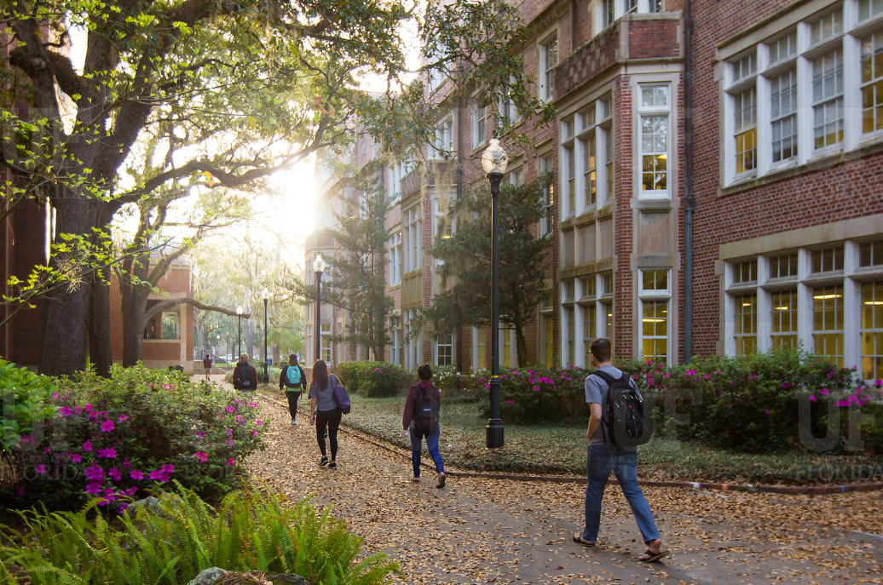

HR Forum
February 6, 2019

Slide 2
Today’s Agenda Items
Introductions
GBAS Spring Workshop
Employee & Labor Relations Updates
Service Recognition Program
HR Project Team Updates
Talent Acquisition & Onboarding Updates
Classification & Compensation Updates
Benefits Updates
Important Dates
UFHR preeminence through people

Slide 3

Introductions
nice to meet you!
Melissa Curry, has accepted the position of Assistant Vice President for UF Human Resources. Congratulations, Melissa!
UFHR preeminence through people

Slide 4
GBAS Workshop
February 28th - 8:30 to 11:30am
Straughn Center - 2142 Shealy Drive
Cultivating Judgment:
Critical Thinking Skills for Complex Work Environments
Registration is open until February 15 in myTraining. UF_GBS350
For more information email: gcadwallader@ufl.edu
UFHR preeminence through people
Notes:
Join your colleagues and engage in an opportunity to learn and practice a structured model for critical think and problem-solving.
Things change rapidly and continually at work which requires us to address unanticipated, uncertain, time-pressured and complex problems and decisions. In this session we will consider how critical thinking, along with self-awareness and understanding of the mental shortcuts we often, and unknowingly, take can be integrated into a process to help cultivate good judgment.

Slide 5
Employee & Labor Relations
UF Engaged

Slide 6
UF Engaged
UFHR preeminence through people

Slide 7
UF Engaged
With aspirations to become a Top 5 academic institution, we must redefine how performance is managed
The current performance appraisal process is not optimal for evaluating staff performance
We must transform the culture of performance management at UF
UFHR preeminence through people

Slide 8
UF Engaged
More frequent conversations about performance are needed to strengthen a meaningful relationship built on mutual respect between employees and their supervisors, as well as recognize excellence and redirect employee efforts when necessary.
UFHR preeminence through people

Slide 9
UF Engaged
UF Engaged represents a culture of engagement through the collective efforts of leaders, supervisors, and contributors needed to reach unprecedented success as a university.
UF Engaged will be achieved through constructive and continuous engagement between the employee and the supervisor.
UFHR preeminence through people

Slide 10
UF Engaged
The Philosophy of UF Engaged
Align efforts and needs of individual employees with the needs and direction of the organizational unit
UFHR preeminence through people

Slide 11
UF Engaged
Features of UF Engaged:
A foundational effort to foster a culture of engagement
A structured quarterly check-in with the dates tied to the anniversary date of the employee entering the position
No complicated categories or ratings
How am I doing?
What do I need to keep doing?
What do I need to do differently?
ePerformance will be implemented to support the engagement and communication process
Department evaluation methods will be complemented by UF Engaged
UFHR preeminence through people

Slide 12
UF Engaged
A key performance indicator of UF Engaged is that supervisors and employees will engage in proactive, constant, and valuable information exchange to provide effective outcomes on an ongoing basis.
UFHR preeminence through people

Slide 13
UF Engaged
Timeline for Rollout of UF Engaged
February 2019-Communication to campus
February HR Forum and UF at Work
April 2019-Rollout of UF Engaged philosophy
May 2019-Training for campus supervisors and employees
June 2019-Transition to Anniversary Dates
July 2019-Implementation of ePerformance
UFHR preeminence through people

Slide 14

UFHR preeminence through people

Slide 15

UF Service Recognition Program Your years of service. Our deepest thanks.
The UF Office of the President and UF Human Resources (UFHR) are pleased to announce a new Service Recognition program that re-envisions the way we recognize our staff for their years of service to the university.
The new Service Recognition program is developed based on feedback collected from survey results provided by Service Recognition Liaisons, in conjunction with a comparison study benchmarking other preeminent universities and their service recognition programs.
UFHR preeminence through people

Slide 16

UF Service Recognition Program Your years of service. Our deepest thanks.
The former Service Pin program was designed to recognize years of employment of USPS and TEAMS employees.
Service pins were distributed biannually, and awarded in five-year increments (5, 10, 15, etc.)
Service Pins recipients were individually recognized by their Colleges and Departments for their years of service to the university.
A special reception, hosted by the Office of the President, honored employees with 35 years of service.
UFHR preeminence through people

Slide 17
UF Service Recognition Program Your years of service. Our deepest thanks.
The new program builds on the former “Service Pin” program to provide a more robust celebration of UF staff.
The Service Recognition program will continue to recognize USPS and TEAMS employees in five-year increments, based on continuous service, starting from an employee’s most recent date of hire at UF.
The Office of the President and UFHR have partnered with the UF Bookstore for this new program. Award recipients may choose from a selection of gifts at the UF Bookstore, based on their years of service. Service pins are available as a gift selection.
UFHR preeminence through people
Notes:
Remove 5-year graphic
Show some of the gift choices? Is it possible to show an example website from another school?

Slide 18
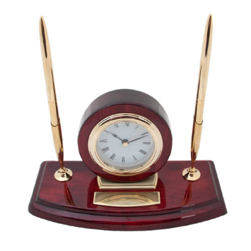
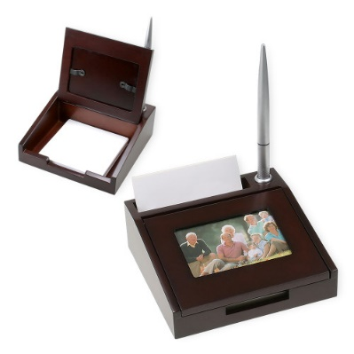
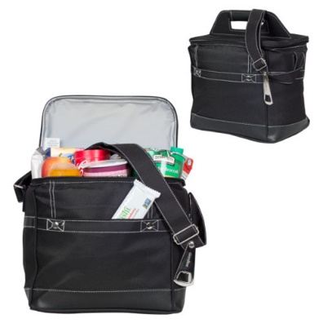
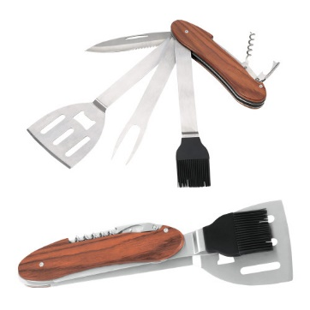
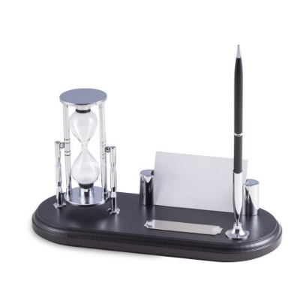
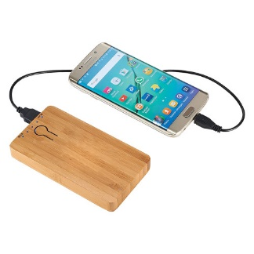

UF Service Recognition Program Your years of service. Our deepest thanks.
Beginning this year, during the employee’s anniversary month, recipients will receive an email (e-card) from the bookstore inviting them to select an anniversary gift.
A link will be provided in the e-card that directs recipients to a Service Recognition webpage on the bookstore website, where they can select their gift.
Recipients have the option to pick up their gift at the UF Bookstore or have it shipped to an address of their choice.
UFHR preeminence through people

Slide 19
UF Service Recognition Program Your years of service. Our deepest thanks.
Employees being recognized for 25 and 30 years of service as of 12/31/18 will be honored at an evening event hosted by the President’s Office later this spring.
This year, a special luncheon will be hosted by the President’s office to honor all employees for service years 31-35 (as of 12/31/18), to ensure employees do not miss their opportunity to participate in this special honor as we transition to the new program.
Enhancements to the Service Recognition program do not replace current employee recognition activities hosted by colleges and departments.
UFHR preeminence through people

Slide 20
UF Service Recognition Program Your years of service. Our deepest thanks.
An information session will be held for Service Recognition Liaisons on Friday February 15 at the Bridges Sunshine Skyway conference room.
More details to follow.
Please contact Verlissa Ford at 352-392-4626 or via email v.ford@ufl.edu
https://learn-and-grow.hr.ufl.edu/awards-recognition/service-recognition-program/
UFHR preeminence through people

Slide 21
HR Project Team
Meet the HR Project Team
Join the Leave Redesign Discussion

Slide 22
HR Project Team
Amber Wuertz
HR Management Analyst
Shay Potts HR Project Manager
Juliana Bunn
HR Data Analyst
Contact:
HRInitiatives@hr.ufl.edu
UFHR preeminence through people

Slide 23
Join the Discussion
UFHR preeminence through people

Slide 24
We want to hear from you.
As part of UFHR’s strategic commitment to be agile, forward-thinking and bold, we are beginning a discussion of ways to redesign what paid time off looks like for faculty and staff. Our goal is to modernize our leave offerings and create a program that is more responsive to the needs of our employees.
Please take a moment and participate in the discussion.
https://ufl.qualtrics.com/jfe/form/SV_5u3FTcAZ04AIAdL

Slide 25
Talent Acquisition & Onboarding
Lessons Learned from OFCCP Audit
The Chronicle of Higher Education
Careers at UF Updates

Slide 26
Lessons Learned from OFCCP Audit
UFHR preeminence through people

Slide 27
Who is Office of Federal Contractor and Compliance Programs (OFCCP)?
Ensures federal government contractors and subcontractors are “complying with legal requirement to take affirmative action and not discriminate on the basis of race, color, sexual orientation, gender identity, religion, national origin, disability, or status as a protected veteran.”
Monitors compliance by routinely conduct audits with existing federal contractors and subcontractors
Works with other agencies, including Department of Justice and Solicitor of Labor, in reconciling findings of discrimination, including debarment
UFHR preeminence through people

Slide 28
Why audit the University of Florida?
Works for federal agencies as a federal contractor
Receives multi-million federal dollars for various active federal contracts
Is up for another review (minimally every two years)
Audited over six years ago
UFHR preeminence through people

Slide 29
What was the process?
Received notice in May 2017
Employed outside attorney to assist with desk audit
Responded to significant and extensive data requests
Received Notice of Compliance in November 2018
UFHR preeminence through people

Slide 30
What was outcome?
Uncovered some items to address:
Applicant/application statuses incomplete
Delay in closing requisitions
Impact of erroneously assigned applicant statuses
Multiple hires with one posting
Requisitions missing or incorrect positon numbers
Searches or hires conducted outside of Careers at UF
UFHR preeminence through people

Slide 31
Outcome: Applicant/Application Status and Impact
UFHR will be reviewing current list of statuses to ensure correct/accurate information is captured.
UFHR will monitor closely the number of interviews for each pool by HR.
ePAFs will not be approved until requisition is closed out and applicants are dispensed accurately.
Over the next two months, we will be working with you to close outstanding active postings.
Hiring departments must be sure to select the correct final application status
Withdrawn, Hiring Manager Review Unsuccessful, Interview Unsuccessful, Offer Declined, Offer Accepted
UFHR preeminence through people

Slide 32
Staff Postings: Application Status in PageUp
Instruction guide “Why Should I Use the Applicant Statuses During My Recruitment Process?” is available by visiting Careers at UF toolkit, https://learn-and-grow.hr.ufl.edu/toolkits-resource-center/human-resources-toolkits/careers-at-uf/.
UFHR preeminence through people

Slide 33
Outcome: Multiple hires with one posting
Hiring departments will need to indicate the correct position number for the faculty or staff hire within Careers at UF
All hires for the posting must be assigned with the appropriate application status
Can be moved at different time
UFHR preeminence through people

Slide 34
Outcome: Searches and Hires outside of Careers at UF
Hiring departments must complete a compliance report for each search –successful or unsuccessful – outside of Careers at UF
Normally occurs for recruitment using external search firms
A completed compliance report should be submitted to your UFHR talent consultant at the end of each search in order for UFHR to complete our documentation for the UF’s annual Affirmative Action Plan.
All approved faculty search waivers should be uploaded into ePAF.
UFHR preeminence through people

Slide 35
The Chronicle of Higher Education
Pricing Structure and Agreement
UFHR preeminence through people

Slide 36
Chronicle Vitae
UFHR has been renewing our institution-level unlimited online posting agreement with the Chronicle of Higher Education for several years.
It allowed UF hiring departments to announce their faculty and staff job opportunities to those in academia and to satisfy permanent residence/green card filing requirements.
The Chronicle has implemented various features to drive more traffic to their online job posting site, Chronicle Vitae.
UFHR preeminence through people

Slide 37
Application vs Hire
Faculty
Outcome/Calendar Year | 2016 | 2017 | 2018
Application | 6.16% | 6.52% | 10.36%
Offer | 2.99% | 1.99% | 0.2%
Staff
Outcome/Calendar Year | 2016 | 2017 | 2018
Application | 0.02% | 1.17% | 0.4%
Offer | 0% | 0.39% | 0.09%
UFHR preeminence through people

Slide 38
New Pricing Structure
Effective October 19, 2019, UFHR will no longer be able to retain our current institutional unlimited online posting package.
The Chronicle underwent a new pricing restructuring and will no long offer institutional unlimited level package to institutions that have more than 1,500 FTEs.
However, each college or a department within a college can establish its own package with the Chronicle.
For 4-Year Institutions
FTE | Price
300 or less | $3,500
301 – 500 | $4,500
501 – 900 | $6,000
900 – 1,200 | $8,000
1,201 – 1,500 | $10,000
UFHR preeminence through people

Slide 39
Careers at UF Updates
UFHR preeminence through people

Slide 40
Faculty Postings: Feed to the Chronicle
The Chronicle of Higher Education utilizes scraping methodology to pull postings from Interfolio to Chronicle.
Postings scraped today will appear tomorrow on the Chronicle’s job listing site, ChronicleVitae.
Postings can be found by using keywords, position type, location, date posted, institution type, and employment type.
UFHR preeminence through people

Slide 41
Faculty Postings: Feed to the Chronicle
Late last year, some postings were assigned to the incorrect academic category.
It did not prevent a person from finding UF postings, as long as candidates did not refine their search by academic category.
In working with Chronicle, HR has implemented a solution to mitigate this issue from occurring.
Solution: “#category=“ and a number; will appear at the bottom of the Application Instructions section.
It is important not to remove this code.
UFHR preeminence through people

Slide 42
Faculty Postings: Nepotism Question
During the implementation process for Interfolio, the question regarding nepotism was not included on the application.
This was to simplify the application process for faculty applicants.
Now, this question will be placed back on the application as a result of feedback UFHR received from various colleges.
UFHR preeminence through people

Slide 43
Staff Postings: Supplemental Questions in PageUp
Supplemental Question
It will provide you the opportunity to create customized job specific questions to inquire from applicants.
You can sort your applicant listing based on applicants’ answers.
Hiring department will be able to begin using it on February 18.
Instruction guide will be available on February 18 in Careers at UF toolkit.
UFHR preeminence through people

Slide 44
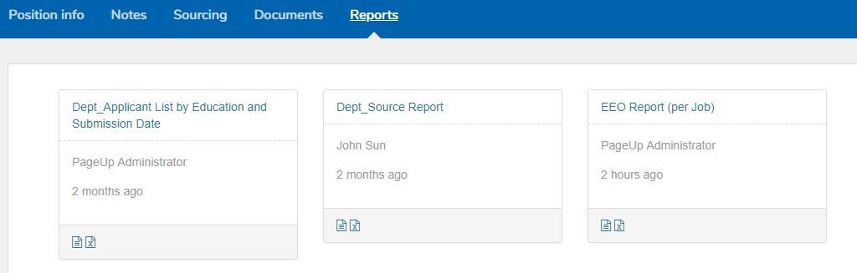
Staff Postings: EEO Summary Report in PageUp
EEO Summary Report
It will provide you a summarized EEO information for your pool.
This report can be found by going to your posting and then click on the “Reports” tab.
UFHR preeminence through people

Slide 45
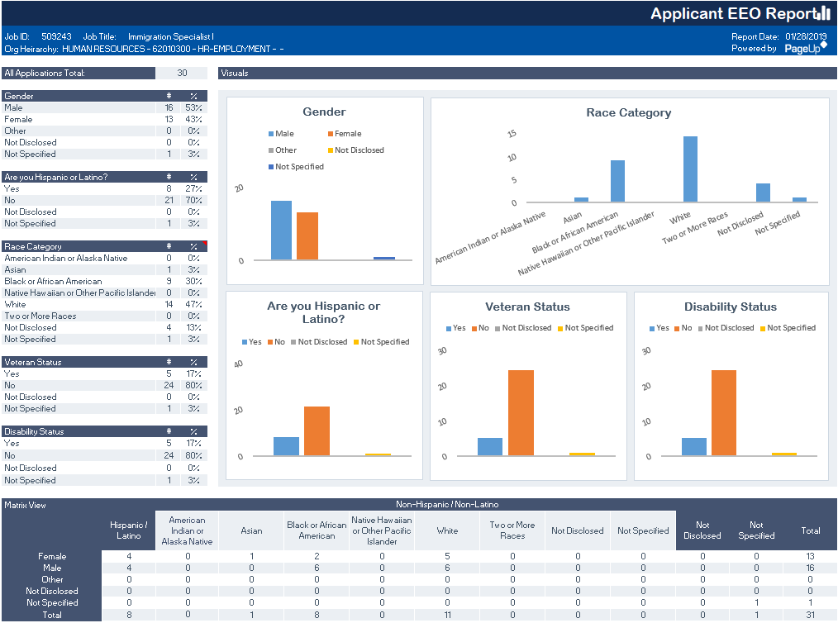

Slide 46
Class and Comp
Florida Minimum Wage and GA Increases

Slide 47
FL Minimum Wage and GA Increases
Effective January 1, 2019, UFHR executed a $225 raise for continuing graduate assistants.
Effective January 1, 2019, the state minimum wage increased from $8.25 to $8.46 per hour. In early January, UFHR processed salary increases for all employees who earned less than $8.46 per hour.
Raise files are available for review in myUFL.
Security Roles Required:
UF_EPAF_Department Admin
UF_EPAF_Level 1 Approver
UFHR preeminence through people

Slide 48
FL Minimum Wage and GA Increases
To access the GA Raise file:
Raise type = GAR
Effective Date = 01/01/19
To access the Minimum Wage Raise File:
Raise type = MHO
Effective Date = 01/01/19
UFHR preeminence through people

Slide 49
FL Minimum Wage and GA Increases
Questions?
If you have questions, please contact Classification and Compensation at (352) 392-2477 or by email at salaryincrease@ufl.edu.
UFHR preeminence through people

Slide 50
Benefits
Flexible Spending Accounts
IRS Reporting Form 1095-C
Marketplace Tax Credit Notices
GatorPerks Discount Program
UFHR Benefits Resources

Slide 51
Flexible Spending Accounts
Healthcare FSA and Limited Purpose FSA Plans
Carryover feature permits up to $500 of unused money to carry into the next plan year
Turn in claims by 4/15/19 for expenses incurred by 12/31/18
Dependent Care FSA Plan
Grace period that allows you to incur eligible expenses through 3/15/19
Additional 30 days to turn in claims (submit by 4/15/19 )
FSA Questions?
Contact Chard Snyder 855-824-9284 or FloridaAskPenny@chard-snyder.com
UFHR preeminence through people

Slide 52

IRS Reporting Form 1095-C
Employer Provided Insurance Offer and Coverage
Reports employees’ health insurance information for prior calendar year
State of Florida and GatorCare plan participants will receive forms by early March
Employees may file income tax returns prior to receiving 1095-C if they know they had coverage for the entire year
Employees enrolled in ACA Marketplace plans must report UF’s offer of employer-sponsored health coverage to IRS
UFHR preeminence through people

Slide 53
Marketplace Tax Credit Notices
Employees using Healthcare Marketplace may qualify for premium tax credit
UF is subject to penalty if full-time employee offered coverage by UF receives the tax credit
If tax credit notice received by departmental UF campus location, forward to UFHR Benefits immediately (fax, email, or postal mail):
Physical Address:
UFHR Benefits
Attn: Stewart V. King
903 W. University Ave.
Gainesville, FL 32606
Campus Mailing Address:
UFHR Benefits
Attn: Stewart V. King
P.O. Box 115007
Email: svking91@ufl.edu
Fax: (352) 392-5166
UFHR preeminence through people

Slide 54

GatorPerks Discount Program
GatorPerks offers exclusive discounts for UF faculty and staff
Savings on travel, entertainment, restaurants, wellness, retail, and more!
Visit the GatorPerks website to find out more and sign up for the newsletter:
https://benefits.hr.ufl.edu/gatorperks/discount-program/
UFHR preeminence through people

Slide 55


UFHR Benefits Resources
(online virtual benefits counselor)
UFHR Benefits & Rewards website “Latest News”
UF at Work newsletter articles
Contact a UFHR Benefits Specialist:
Call (352) 392-2477
Email benefits@ufl.edu
Schedule an appointment
Use our Contact Form (found on UFHR Benefits website)
UFHR preeminence through people

Slide 56
HR Building Renovation
We are targeting to be out of the HR building by March 1
720 Building (Ayers Building), including benefits and background checks
Training and Org Development—East campus
Employee Relations—Yon Hall (satellite offices will not be disrupted)
All phone numbers and emails will stay the same
Expect to be back onsite in early Fall Semester
HR Forum will be at Smathers Library, Room 100
March through October
No media-site will be available, but the PPTs will be displayed after
UFHR preeminence through people

Slide 57
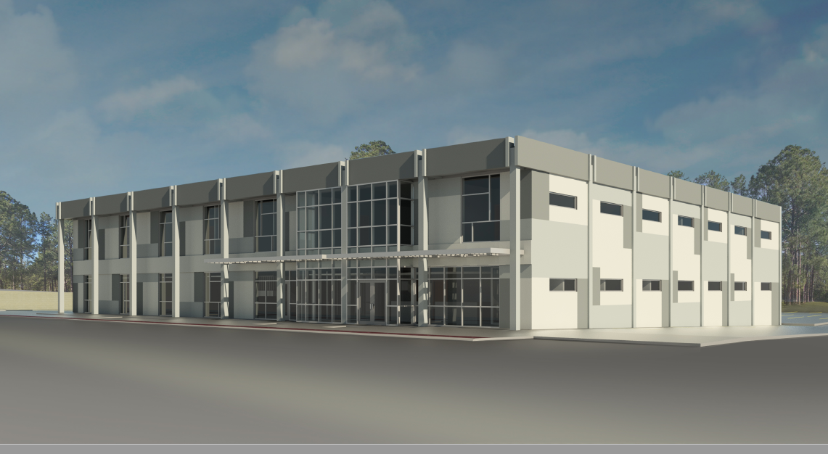
UFHR preeminence through people

Slide 58
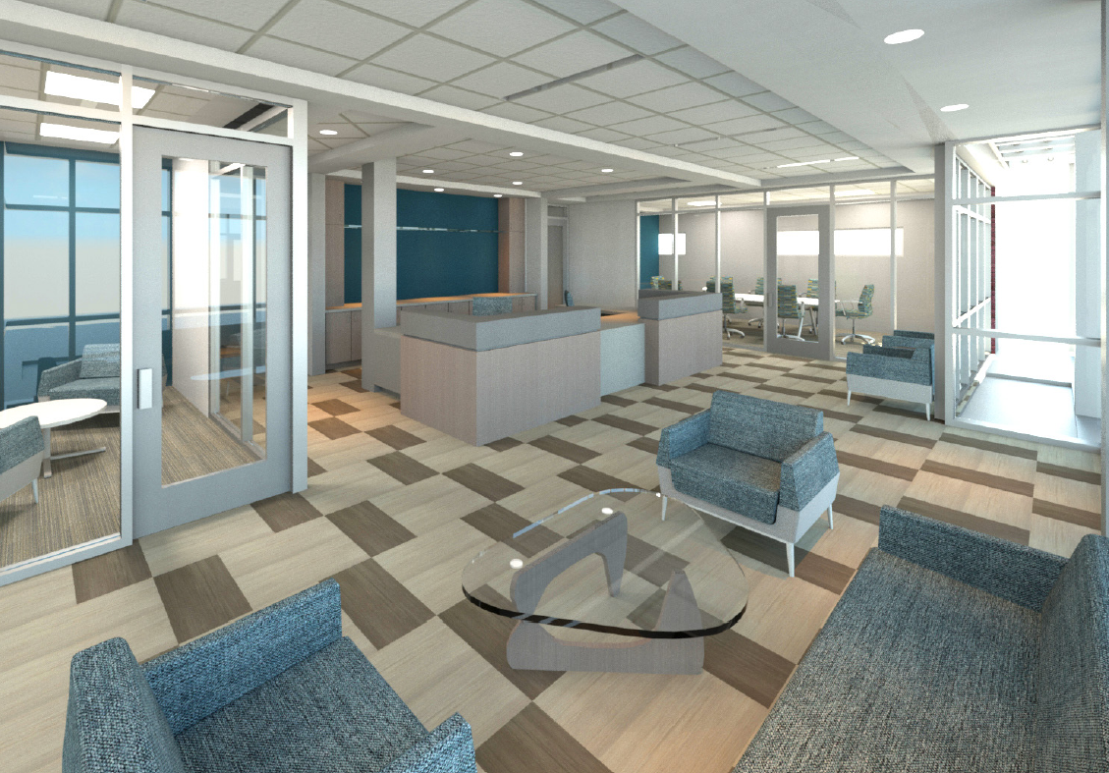
UFHR preeminence through people

Slide 59
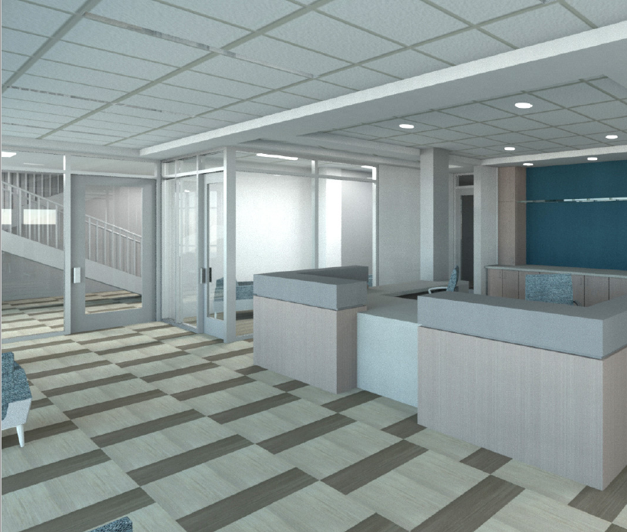
UFHR preeminence through people

Slide 60
Important Dates
GBAS Workshop – February 28, 2019; 8:30-11:30 a.m.; Straughn Center, 2142 Shealy Drive
Next HR Forum – March 6, 2019 – Smathers Library-Room 100

Slide 61

Thank you for attending the HR Forum

