Slide 1
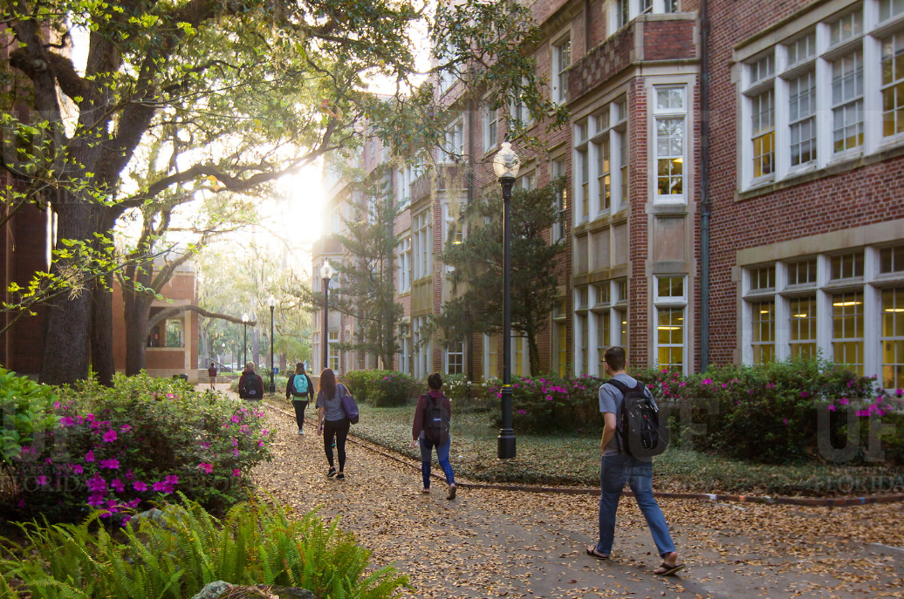
HR Forum
April 3, 2019

Slide 2
Today’s Agenda Items
Introductions
Academic & Professional Assembly (APA)
Office of Youth Compliance Services
Talent Acquisition & Onboarding Updates
Employment Operations & Records Updates
Training & Organizational Development Updates
Classification & Compensation Updates
Benefits Updates
Important Dates
UFHR preeminence through people

Slide 3
Mission:
To promote communication, recognition, professional networking, and service opportunities for professional staff across campus

Slide 4
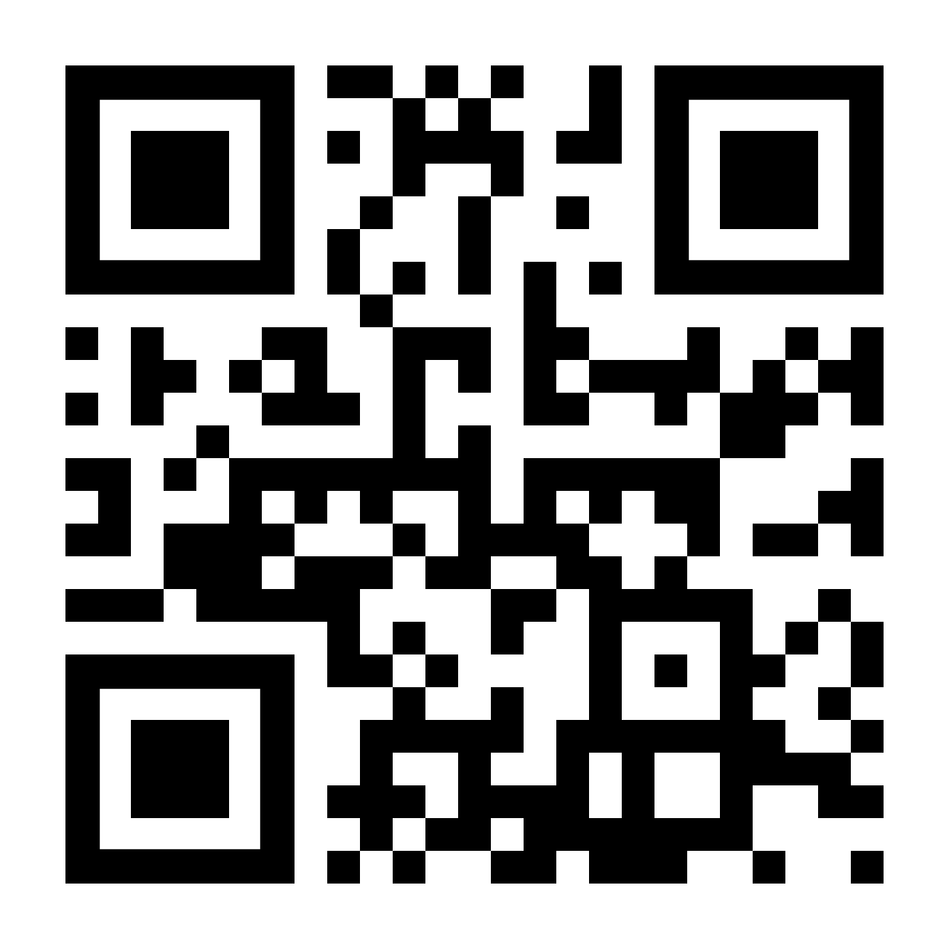
Recruiting for 2019-2020 Board
Leadership roles
Committee members to work on specific projects
Representatives from every department/unit/college across campus
Serving on the board is an opportunity to contribute talents toward APA's mission of building a community of staff across the university, to further develop specific skills, and to meaningfully connect with peers.
Submit interest forms by April 12th at 5 p.m. – http://bit.ly/AP1920
How can you help?
Forward our call for board members to TEAMS Professional staff in your areas!
Reach out with any specific nominations
Notes:
This is a quick recap of the goal areas for the year – thank you all for indicating your interest in each on the Google Doc. We want to make sure that you have the chance to contribute to goals you’re passionate about or feel your skills could really suit, and we want to make it clear who is working on each goal.

Slide 5
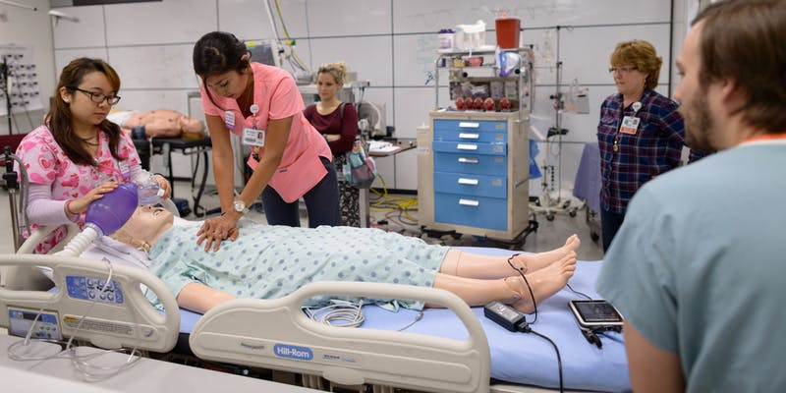
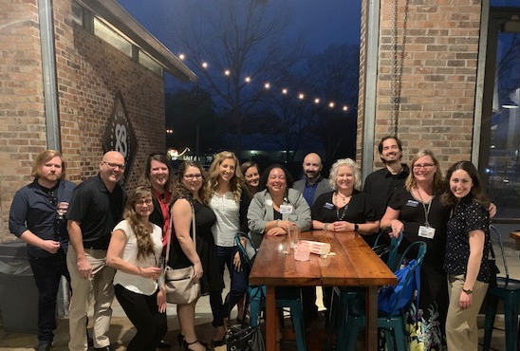
Upcoming events
April 12 – 4:00 p.m., Get to Know Campus Tour: Harrell Medical Education Building Simulation Lab
April 17 – 5:30 p.m., Monthly Mingle at Cypress & Grove
April 23 – 8:00 a.m., Annual Business Meeting with Jodi Gentry, VP, Human Resources
More coming soon!
Notes:
This is a quick recap of the goal areas for the year – thank you all for indicating your interest in each on the Google Doc. We want to make sure that you have the chance to contribute to goals you’re passionate about or feel your skills could really suit, and we want to make it clear who is working on each goal.

Slide 6
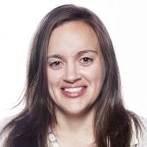
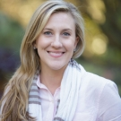
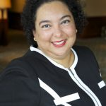
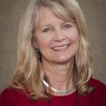
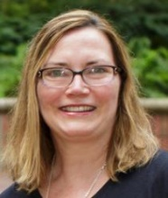
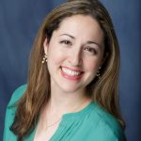
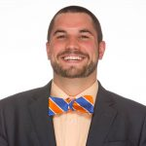
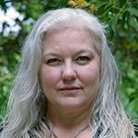
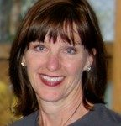
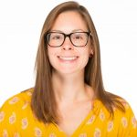
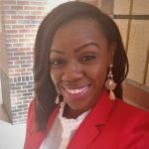
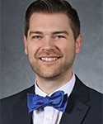
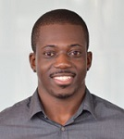
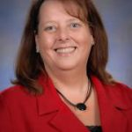
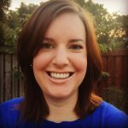
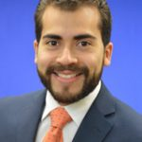
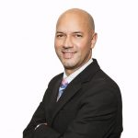
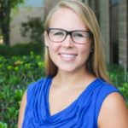
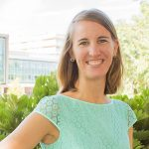
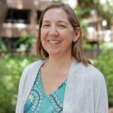
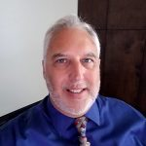
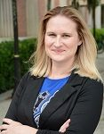
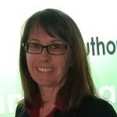
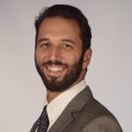
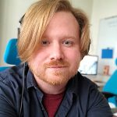
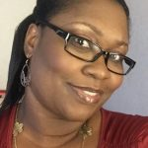
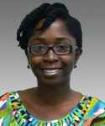
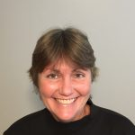
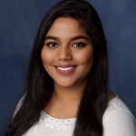
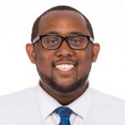
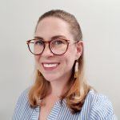
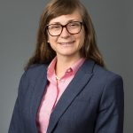
APA leadership
2018-2019 team:
40+ officers and committee/workgroup members
25+ colleges/departments represented
https://apassembly.ufl.edu/

Slide 7
Office of Youth Compliance Services
Year Round Office for Youth Activities

Slide 8
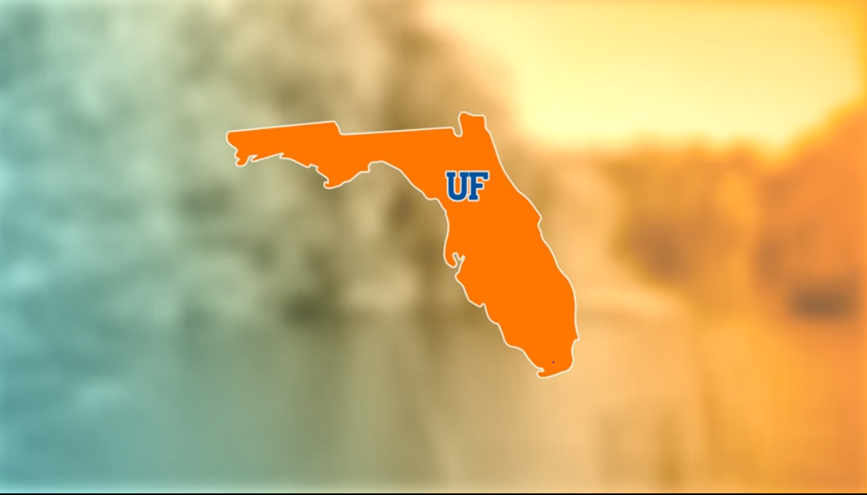
SCOPE
Education
Registration / Tracking
Compliance
UFHR preeminence through people
Notes:
The overall scope of the office revolves around 3 central themes and those are:
ED – We develop and deliver educational resources on youth protection strategies, applicable policies and laws, and mandatory reporting requirements.
Tracking – We equip youth programs with a vehicle to centrally track youth activities and those involved.
Compliance - We provide guidance on compliance requirements for UF-affiliated youth activities, assist programs with navigating through methods for reporting child abuse or neglect, and conduct internal monitoring activities to ensure compliance.

Slide 9
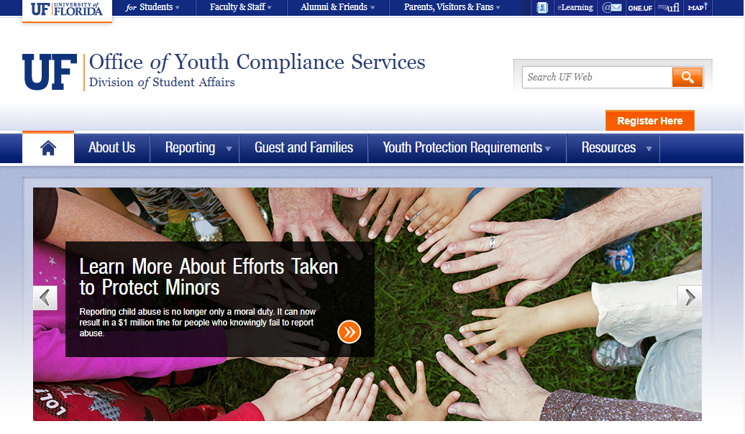
Youth Activity Requirements
Central Registration
Youth Protection Training
Background Checks
UFHR preeminence through people
Notes:
So if you area is hosting a youth activity involving children or youth, they are a set requirements that should be met 3 months in advance of program operations.

Slide 11
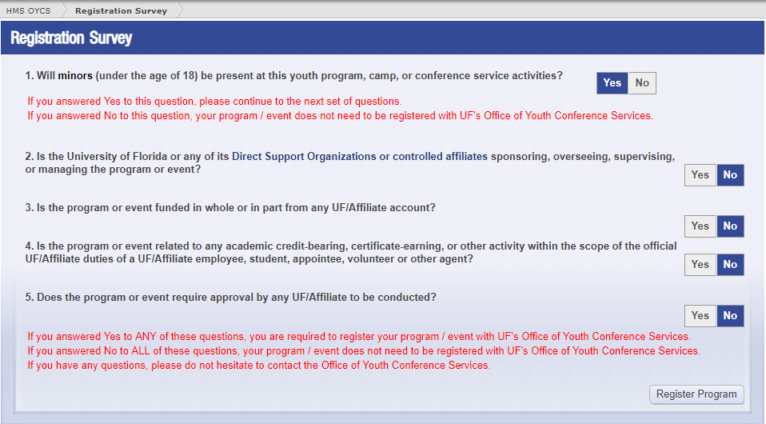
Central Registration
Prior to events
3 Months
Youth Activities
Short & Long Term
UFHR preeminence through people
Notes:
So if you area is hosting a youth activity involving children or youth, they are a set requirements that should be met 3 months in advance of program operations.

Slide 12
Supervision
Limit 1:1 Interactions
UFHR preeminence through people
Notes:
Activities must be coordinated in a way that eliminates one-on-one interactions and ensures that adequate staff-to-participant ratios are in place at all times (including when overnight accommodations or transportation is needed).
We work with groups to evaluate the best procedure for the pick-up and drop-off of program participants

Slide 14
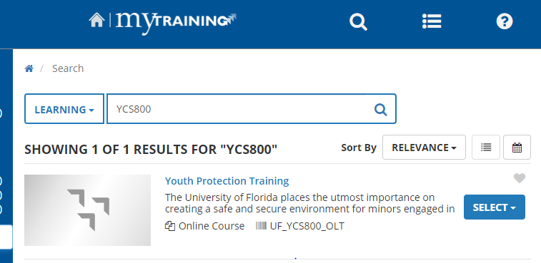
Youth Protection Training
Employees
Non- Employees
Volunteers
Students
UFHR preeminence through people
Notes:
Annual Training for anyone working in association with youth activities.

Slide 15
BACKGROUND CHECKS
Notes:
We work closely with UFHR on this process to make sure people know where to go and how to get background checks.
We are notified if someone if pinged and can no longer work with youth activities.
We do not see them.

Slide 17
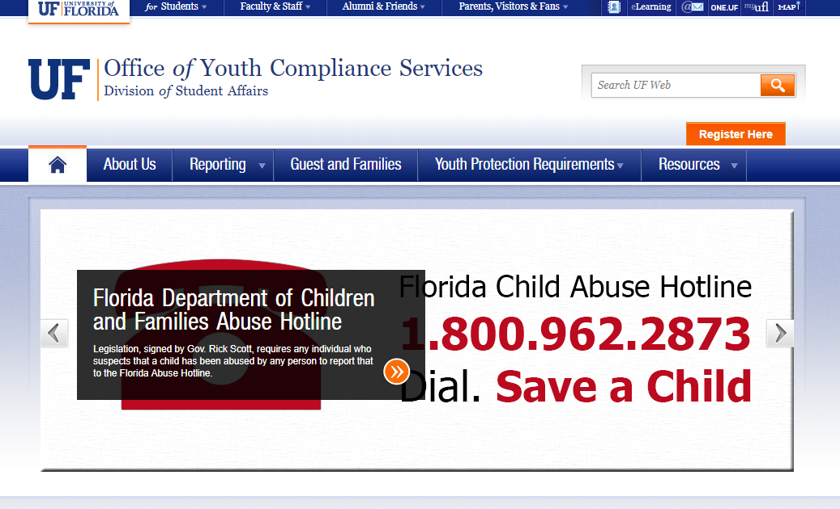
Reporting
Florida Mandatory
Reporting Requirements
$1 Million
Third Degree Felony
UFHR preeminence through people
Notes:
In 2012, Florida enacted what at least many refer to as the one of the toughest child abuse reporting law in the nation.
The new provisions impose financial and criminal implications for universities and individuals who deliberately fail to report known or suspected child abuse.
This is the $1 million dollar fine and Individuals who fail to report can be charged with a third degree felony which includes jail time.
More information related to this law and recommended steps for reporting child abuse can be found in the youth protection training and on our website.
By being aware of these type of provisions, employees will be better prepared to comply with their legal obligations and detect, prevent, and respond to instances of child abuse.

Slide 18
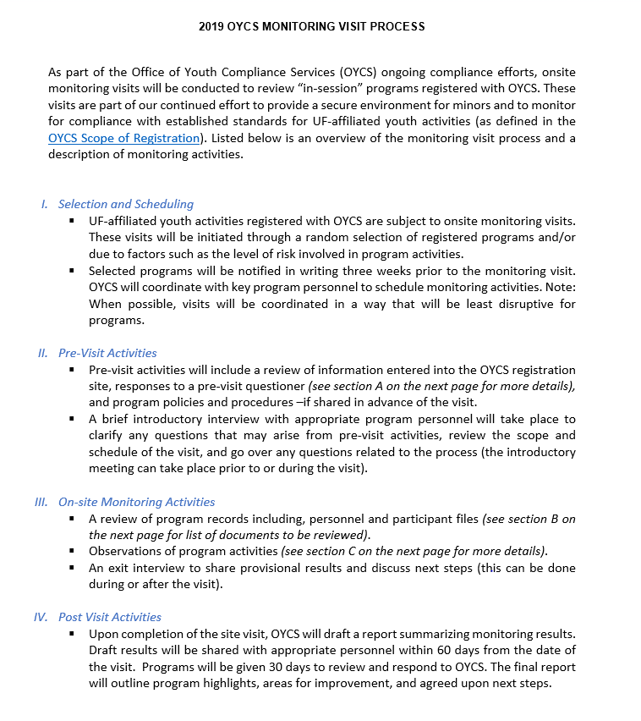
On-Site Visits & Consulting
Pre-Activity
On-Site
Post-Activity
UFHR preeminence through people
Notes:
In 2012, Florida enacted what at least many refer to as the one of the toughest child abuse reporting law in the nation.
The new provisions impose financial and criminal implications for universities and individuals who deliberately fail to report known or suspected child abuse.
This is the $1 million dollar fine and Individuals who fail to report can be charged with a third degree felony which includes jail time.
More information related to this law and recommended steps for reporting child abuse can be found in the youth protection training and on our website.

Slide 19
https://oycs.ufsa.ufl.edu/
352-846-4698
Carolynnk@ufsa.ufl.edu

Slide 20
Talent Acquisition & Onboarding
Criminal Background Checks
Careers@UF: Faculty & Postdoc Searches

Slide 21
Youth Activities and Camps
To ensure minors are receiving the best experience at the University of Florida, all youth activities affiliated with UF should register with the Office of Youth Compliance Services.
UF 4-H programs should consult with UF IFAS 4-H State Headquarter.
UFHR preeminence through people

Slide 22
Criminal Background Check Requirements
Level 2 screening (fingerprinting) will be required for all employees and volunteers participating in a youth activity/camp.
Affidavit of Good Moral Character must be completed by youth activity/camp personnel and retained by the camp director/coordinator for future inspection.
UFHR preeminence through people

Slide 23
Criminal Background Check Requirements
There are two types of level 2 screenings.
FBI Livescan
435 Livescan
Type of level 2 screening is dependent on the timing of the youth activity/camp.
Non-Summer Period (September 2 through March 30)
FBI Livescan
Summer Period (April 1 through September 1)
435 Livescan
UFHR preeminence through people

Slide 24
UFHR preeminence through people

Slide 25
Summer Youth Activity/Camp
435 Livescan screening can begin 60 days prior to beginning employment or volunteering.
Determination is made by DCF usually within 3 to 7 business days, depending on their volume.
Clearance must be obtained from DCF before employees and volunteers start.
Employee profile must be in the Florida Department of Children and Families (DCF) Clearinghouse before fingerprinting and taking a photo of the candidate.
UFHR preeminence through people

Slide 26
Process
Submit “Background Screening for Youth Camps and Activities” form
Criminal Background Check Team from UF HR Talent Acquisition and Onboarding will send out a confirmation email upon receipt of the request.
Submit Clearinghouse Applicant Request Form and Clearinghouse Privacy Statement
Fax, campus mail, or in person
Contains personal identification information
Complete Affidavit of Good Moral Character
HR Forms website, www.hr.ufl.edu/forms
UFHR preeminence through people

Slide 27
Process
The Criminal Background Check team will verify with DCF Clearinghouse to determine if fingerprinting is required.
New to the clearinghouse
Up for five-year renewal
Fingerprinting appointments can be made online, https://booknow.appointment-plus.com/7ryk7y2x/.
UFHR preeminence through people

Slide 28
Assistance
Criminal Background Check team with UFHR Talent Acquisition and Onboarding
Phone: 352-392-2477
Fax: 352-846-3058
Email: HRSBackgrounds@admin.ufl.edu
UF Office of Youth Compliance Services
Phone: 352-846-4698
Email: oycs@ufsa.ufl.edu
UFHR preeminence through people

Slide 29
Careers@UF: Faculty & Postdoc Searches
Update position and applicant statuses as the search process proceeds through different stages
Notify applicants no longer being considered promptly
Assign suitable disposition codes to applicants
Remove posting from web or set end date when sufficient applicant pool achieved
Close out posting, indicate individual(s) hired
UFHR preeminence through people

Slide 30
Questions
Consult the Careers@UF Toolkits
Using Disposition Codes
Closing a Position
Contact your recruiter
UFHR preeminence through people

Slide 31
Employment Operations & Records
I-9 Reverification Process
Name and/or Gender Change Form
Short Work Break for 9/10- Month Employees
Faculty & GA Summer Appointments
Scanning Requests

Slide 32
I-9 Reverification Process
In an effort to make this process efficient, electronic, and speedy - EOR has a new I-9 reverification process.
During the last couple of months, we’ve been piloting a new way of submitting I-9 reverification instead of fax or mail.
We want to thank the College of Medicine for being our partners in this pilot!
UFHR preeminence through people

Slide 33
I-9 Reverification Process: Department
Complete Section 3 of a new I-9, Starting with box C.
Attach the completed Section 3 of the I-9, along with the document that was updated to the most recent ePAF.
Email employment@ufl.edu to notify EOR.
Include employee’s UFID number, visa type, and the ePAF number used to submit the reverification in the email.
UFHR preeminence through people

Slide 34
I-9 Reverification Process: EOR Staff
EOR staff updates the employee’s record and/or contacts the department if additional information is needed. The update may take 5 -7 business days.
The reverification paperwork is re-indexed in OnBase so it is properly listed in the employee’s personnel file.
An email is sent to the department and Payroll Services once the update is completed.
UFHR preeminence through people

Slide 35
I-9 Reverification Process
This process is available immediately.
Beginning May 1, 2019 this will be the only method we will accept reverifications.
Updated instruction guide can be found: http://training.hr.ufl.edu/instructionguides/gatorstart/i9reverification.pdf
Questions?
UFHR preeminence through people

Slide 36
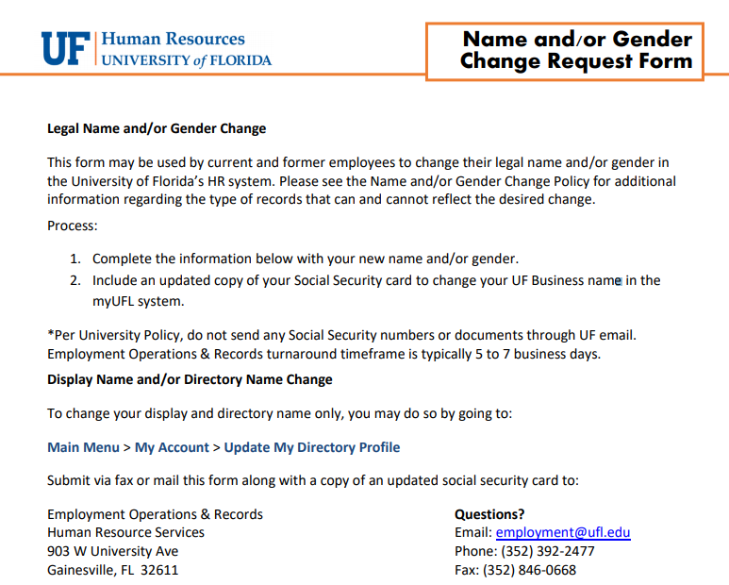
Name and/or Gender Change Form
In line with changes experienced by our employee population
Appropriately capture changes that may impact an employee’s benefits
Required:
Completed form
Copy of SSN
Questions?
UFHR preeminence through people

Slide 37
Short Work Break for 9/10- Month Employees
9- and 10-month employees (faculty, graduate assistants and TEAMS) will be put on Short Work Break in the myUFL system for the Summer semester.
The file will be available in myUFL system
Main Menu > Enterprise Reporting > Access Reporting > Human Resources > Workforce Information
Effective dates for Short Work Break
9-month: 5/16/19 – 8/15/19
10-month: 6/4/19 – 8/15/19
UFHR preeminence through people

Slide 38
Short Work Break for 9/10- Month Employees
Time Reporting will be inactivated during the Short Work Break period.
Please review employees to ensure these employees do not continue to be paid beyond the Spring semester.
ALERT! Please enter any terminations for employees who will not go on short work break prior to 4/10/2019 so there are no rows affecting your termination ePAFs.
Questions?
UFHR preeminence through people

Slide 39
Faculty and GA Summer Appointments
Summer appointments for faculty and graduate assistants may be processed via the summer job file.
Summer appointments can also be entered through an ePAF
The file will be available via myUFL system
Main Menu > Human Resources > Workforce Administration > Job Information > UF Summer Job Review
The file is expected to be available April 15-25, 2019.
Summer appointments will appear in myUFL in late April.
UFHR preeminence through people

Slide 40
Faculty and GA Summer Appointments
A termination row will be applied at the same time the summer appointment is applied in job data.
Reminder!
Enter distributions for summer appointments
Questions?
Employment@ufl.edu
392-2477
UFHR preeminence through people

Slide 41
Scanning Requests
Since we are temporarily out of our building, we cannot support paper scanning requests – please do not send via mail.
We will accept scanned records through Dropbox.
A new process and guidelines is forthcoming
Please email employment@ufl.edu so we can provide you more details on how to set this up.
Questions?
UFHR preeminence through people

Slide 42
Training & Organizational Development
Gator Business Administrator Services (GBAS)
Leadership Programs

Slide 43
April 17
8:30am – 3:30pm
Emerson Alumni Hall
President’s Ballroom
Registration closes April 5th in myTraining
UF_GBS250
Questions? Contact: gcadwallader@ufl.edu

Slide 44
UF Leadership Development Program Applications
“Leadership and learning are indispensable to each other.”—John F. Kennedy
UF leadership development programs are based on leadership competencies specifically identified as being important for success at UF
Now through May 1
We are accepting applications to the Managers Cohort, UF Academy and Advanced Leadership for Academics and Professionals

Slide 45
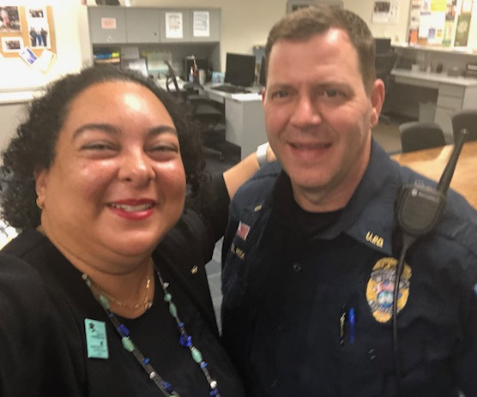
UF Leadership Development Program Applications
Managers Cohort
Entering its 9th year
Participants complete the “Managing at UF: The Supervisory Challenge” certificate with a cohort of peers
A 360-degree assessment is completed at the beginning and end of the program, to assist in directing your professional development

Slide 46
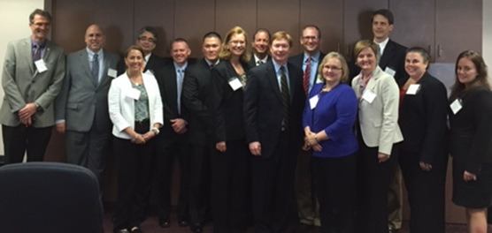
UF Leadership Development Program Applications
UF Academy
Entering its 15th year
Designed for faculty and professional staff who are “emerging leaders”
The UF Academy immerses participants in the university culture and organizational structures through interviews with cabinet members, job shadowing, interactive activities and a 360-degree assessment

Slide 47
UF Leadership Development Program Applications
Advanced Leadership for Academics and Professionals (ALAP)
Entering its 12th year
Designed for established UF professional and academic leaders looking to further develop leadership skills
Participants focus on the key leadership skills for UF through workshops, discussions with current UF leaders, case studies of key challenges, job shadowing, 360-degree assessment, and a team project

Slide 48
UF Leadership Development Program Applications
For more information or to access the application, visit the Leadership @ UF program page on the UFHR site http://hr.ufl.edu/leadership@uf/programs/

Slide 49
Class and Comp
Faculty Market Equity & Counter Offers
Voluntary FTE Change Form
Supervisor ID Updates
OPS Updates
Success @ Work
Proposed Changes to the FLSA

Slide 50
Faculty Market Equity & Counter Offers
The Office of the Provost & UF Human Resources are implementing a new SPI form for faculty market equity increases and counter offers.
The form is similar to the SPI form used for staff, but is only required for market equity increases and counter offers. Other increases, such as adding and removing administrative supplements, will be processed using existing processes.
The form is available on UFHR’s forms website found at https://hr.ufl.edu/forms-policies/forms-managers/.
UFHR preeminence through people

Slide 51
Faculty Market Equity & Counter Offers
If using external market data, please provide the market data source in the applicable field.
When selecting internal or external market data, please provide data consistent with the faculty member’s rank and/or discipline.
UFHR preeminence through people

Slide 52
Voluntary FTE Change Form
UFHR, in partnership with the Office of Provost, is implementing a voluntary FTE change form that will be used to document FTE changes for faculty and staff appointments.
This form will replace FTE change letters that were previously prepared by Employee Relations.
FTE changes for faculty appointments must be approved by the appropriate college/unit administrator and the Associate Provost for Academic and Faculty Affairs prior to the change in FTE.
UFHR preeminence through people

Slide 53
Voluntary FTE Change Form
In general, FTE changes should not have a retroactive effective date. Retroactive effective dates may result in under or overpayments and may have an impact on employee’s benefit premiums.
In the event that the unit needs to involuntarily reduce a faculty or staff member’s FTE, please contact Employee Relations.
The form is available on UFHR’s forms website found at https://hr.ufl.edu/forms-policies/forms-managers/.
UFHR preeminence through people

Slide 54
Supervisor ID Updates
In March, UFHR reviewed staff (TEAMS/USPS) supervisor ID information in myUFL and found that 433 employees (5%) are missing supervisor information.
Classification and Compensation will be contacting units to request units update the supervisor information for these employees.
UFHR preeminence through people

Slide 55
Supervisor ID Updates
Definition of a Supervisor:
The person directly responsible for providing oversight for, or directing the work of, another UF faculty or staff member. This typically includes clarifying performance and assignment expectations; providing feedback; approving vacation requests and time worked; and completing the faculty or staff member’s performance evaluation.
For tenure-track faculty appointed to a center, list the academic chair (or center director if tenure is held in the center)
For non-tenure track faculty appointed to a center, list the center director
For department chairs, list the dean
For center directors, list either dean or SVP, depending upon to whom the person reports
UFHR preeminence through people

Slide 56
Supervisor ID Updates
Supervisory pairings to avoid:
TEAMS supervising Faculty
Employee supervising another in a lateral or identical classification
Office support employee supervising management
Office support employee supervising field staff at another location
Non-exempt employee supervising exempt employee
Temporary (OPS) employee supervising a permanent TEAMS/Faculty position
Supervisor is from a different campus unit
9/10-month employee supervising a 12-month employee
UFHR preeminence through people

Slide 57
Supervisor ID Updates
Supervisor ID
To aid in updating and maintaining supervisor information in myUFL, a new report has been made available in Enterprise Reporting
myUFL / Main Menu / Enterprise Reporting / Access Reporting / Human Resources Information / Workforce Information / Staff List with Supervisor Info by Department
Depending on the number of reports available to you, you may have to advance to the next page to find the report
UFHR preeminence through people

Slide 58
OPS Update
Non-Student Hourly OPS Policy effective August 16, 2018, can be found at, https://hr.ufl.edu/wp-content/uploads/2018/08/Non-student-hourly-OPS-policy.pdf.
As a reminder, employees in the OPS Sponsored Project Non-Clerical and Clerical classifications are subject to the 4,176 hour threshold which will take effect on July 1, 2019.
Units with employees in these classifications who are at, or approaching the threshold, should begin working with their college/unit human resources team to develop a plan in order to achieve compliance.
UFHR preeminence through people

Slide 59
OPS Update
Supervisors and administrators can track OPS hours using the OPS Hours Report found in PeopleSoft.
Main Menu
Enterprise Reporting
Access Reporting
Human Resources Information
Workforce Information
Working Hours Report OPSN
UFHR preeminence through people

Slide 60
Success @ Work
The Success @ Work initiative is designed to identify the top 10 to 15 knowledge, skills, and abilities that make our employees successful in their current roles.
Last year, Class and Comp surveyed approximately 114 job classifications.
In March, Class and Comp began surveying positions that were not previously surveyed.
UFHR preeminence through people

Slide 61
Success @ Work
UFHR preeminence through people

Slide 62
Proposed Changes to the FLSA
On March 7, 2019, the Department of Labor (DOL) announced proposed changes to the Fair Labor Standards Act (FLSA).
The most notable change is that the DOL has proposed raising the salary threshold from the current level of $455/week ($23,660 annually), that was established in 2004, to $679/week ($35,308 annually).
Similar to the previous proposed rule, the current proposed rule does not make changes to the job duties tests.
Unlike the previous proposed rule, the current proposed rule does not include automatic adjustments to the salary threshold.
UFHR preeminence through people

Slide 63
Proposed Changes to the FLSA
The proposed rule is open for public comment until May 21, 2019.
After the public comment period, the DOL will review the comments and issue a final rule sometime later this year.
UFHR preeminence through people

Slide 64
Proposed Changes to the FLSA
As a refresher, in order to be exempt from the overtime provisions of the FLSA, a position must meet the following tests.
The employee must be compensated on a salary or fee basis at a rate not less than $455* per week
The employee’s primary duty must be the performance of duties that are Executive, Administrative, Professional, and/or meet another exemption under the DOL’s regulations.
The minimum salary threshold cannot be prorated based on an employee’s FTE.
*$679 per week if proposed rule is implemented
UFHR preeminence through people

Slide 65
Proposed Changes to the FLSA
Under the current provisions of the FLSA, some types of Professional Employees are exempted from the salary basis test.
Teachers - whose primary duty of teaching, tutoring, instructing, or lecturing in the activity of imparting knowledge who are employed and engaged in this activity as a teacher in an educational establishment.
Employees holding a valid license or certificate permitting the practice of law.
Employees holding a valid license or certificate permitting the practice of medicine.
An employee who holds the requisite academic degree for the general practice of medicine is exempt if he or she is engaged in an internship or resident program for the profession.
In addition, several categories of student classifications, such as Graduate Assistants and Pre-doctoral Fellows, are not expected to be impacted by the salary threshold.
UFHR preeminence through people

Slide 66
Questions
Please contact Classification & Compensation at compensation@ufl.edu or by phone at (352)273-2842.
UFHR preeminence through people

Slide 67
Benefits
Extended Leave of Absence Processing for Faculty
HealthCare Bluebook & SurgeryPlus
New Hire Benefits Enrollment
OPS Benefits Eligibility
Short Work Breaks
UFHR Benefits Resources

Slide 68
Extended Leave of Absence Processing for Faculty
When processing an Extended Leave of Absence for Faculty, Provost approval is required only for the following cases:
Any request for personal, unpaid leaves of absence
Any leave request for which the faculty member also requests an Extension of Tenure Probationary Period
Please note:
Routine leaves of absence, including those pertaining to FMLA, medical, or parental leaves, should NOT be submitted to Provost
For medical leave requests, do NOT include protected health information (PHI) or medical certification on form. Submit medical info directly to UFHR-Central Leave Administration
Questions? Call (352) 392-2477 or email central-leave@ufl.edu
UFHR preeminence through people

Slide 69
HealthCare Bluebook & SurgeryPlus
All state health insurance participants & dependents can use the following new services:
Online transparency portal through Healthcare Bluebook—use to shop for rewardable healthcare services
Bundled surgical services through SurgeryPlus eligible for reward
Receive a share of savings through financial rewards deposited into a saving & spending account of your choice
Have questions or need more information? https://www.mybenefits.myflorida.com/health/savings_and_spending_accounts
UFHR preeminence through people

Slide 70
New Hire Benefits Enrollment
Departmental considerations for new hires:
Job appt./actions must be active in all systems before the employee can complete enrollment online (2-3 days)
Choose early to mid-month hire dates—allows time to process in system
Avoid hire dates late in the month & last day of the month
Did you know? If new hire jobs are not in the UF and People First systems by the end of month, it can delay the coverage effective date by at least one month for state plans!
UFHR preeminence through people

Slide 71
New Hire Benefits Enrollment
Other departmental considerations for new hires:
Encourage new hires to complete benefits enrollment early
Inform hires about when coverage may reasonably begin or refer to UFHR Benefits for assistance
Health insurance premiums must be posted, and insurance ID cards received, before coverage can be used
New employees have 60 calendar days from hire date to enroll
UFHR preeminence through people

Slide 72
Benefits Effective Dates for New Hires & Qualifying Events*
State health & supplemental coverage can begin:
No earlier than hire date or qualifying event date
The 1st of the month after enrollment, provided 2 consecutive payroll deductions occur in the same month (early effective date available for health plan coverage only)
UFSelect & GatorCare Plans can begin:
New hires – on date of hire (will be retroactive)
Qualifying status changes (QSC)
On date of event when adding coverage
On 1st of month following event when removing coverage/terminating
*Benefits elections must be made within 60 days of hire date or QSC event date
UFHR preeminence through people

Slide 73
OPS Benefits Eligibility
OPS employees eligible for state benefits when expected to work 30+ hours on average (.75 FTE)
Applicable to:
New hires
Internal promotions
Movement to/from other state agencies
Increase in hours without position change (must be reported to PeopleFirst Service Center)
UFHR preeminence through people

Slide 74
Short Work Break for 9/10 Month Employees
SWB preserves benefits eligibility during the summer months
No deductions taken over the summer months for UFSelect, GatorCare, and state plans
Lapse in summer deductions for 9/10 month employees does not affect coverage
Last benefits deductions:
April 26 paycheck for UFSelect and/or GatorCare plans
May 10 paycheck for state plans
Normal deductions resume in September
UFHR preeminence through people

Slide 75
Short Work Break for 9/10 Month OPS Employees
OPS 9/10 month appointments returning for fall—place on SWB similar to regular 9/10 month faculty
SWB is not calculated in the OPS employee’s OE Measurement Period to determine benefits eligibility
9/10 month employee not returning immediately after the summer—job should be terminated in People Soft (benefits will terminate)
UFHR preeminence through people

Slide 76
UFHR Benefits Resources
(online virtual benefits counselor)
UFHR Benefits & Rewards website “Latest News”
UF at Work newsletter articles
Contact a UFHR Benefits Specialist:
Call (352) 392-2477
Email benefits@ufl.edu
Schedule an appointment
Use our Contact Form (found on UFHR Benefits website)
UFHR preeminence through people

Slide 77
Important Dates
Flexible Spending Account Claim Submission Deadline – April 15, 2019
GBAS Spring Institute – April 17, 2019; Emerson Hall-President’s Ballroom; 8:30 a.m.-3:30 p.m.; Contact: gcadwallader@ufl.edu
Next HR Forum – May 1, 2019 – 130 Bryan Hall (Warrington College of Business)

Slide 78
Thank you for attending the HR Forum

