Slide 1

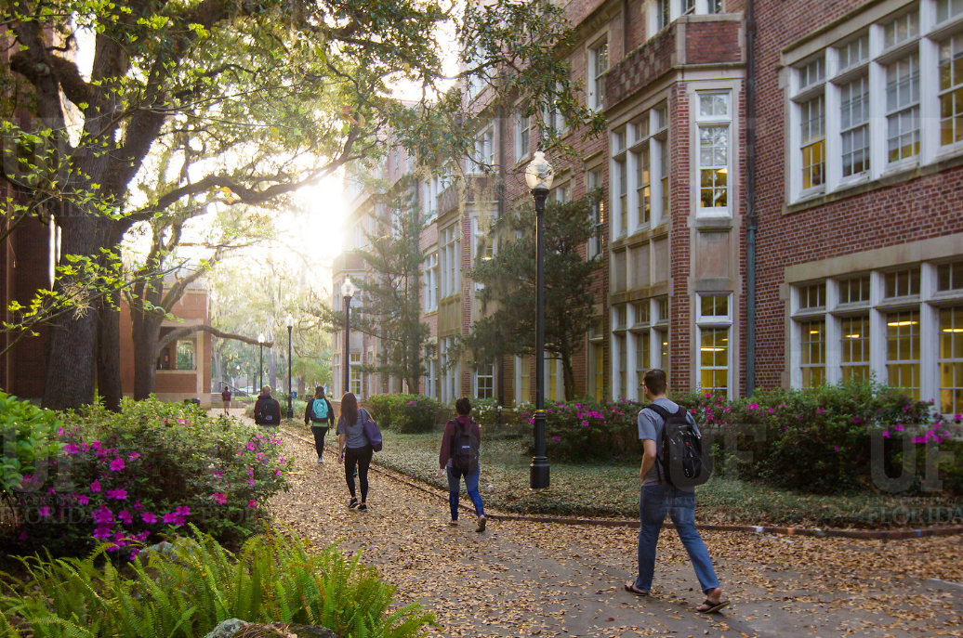

HR Forum
May 1, 2019

Slide 2
Today’s Agenda Items
Employee Disability Accommodations Update
Talent Acquisition & Onboarding Updates
Classification & Compensation Updates
Benefits Updates
Important Dates
UFHR preeminence through people

Slide 3
Employee Disability
Accommodations

Slide 4

Employee Disability Accommodations
UF ADA Coordinator Dr. Ken Osfield is retiring
Dr. Russ Froman will serve as UF’s ADA Coordinator
  He will establish Deputy ADA Coordinators, similar to Title IX structure
  Employee disability accommodations requests will be handled by Maureen De Armond in the short-term (eeo@ufl.edu)
  Requests for reconsideration will go to Russ
UFHR preeminence through people

Slide 5
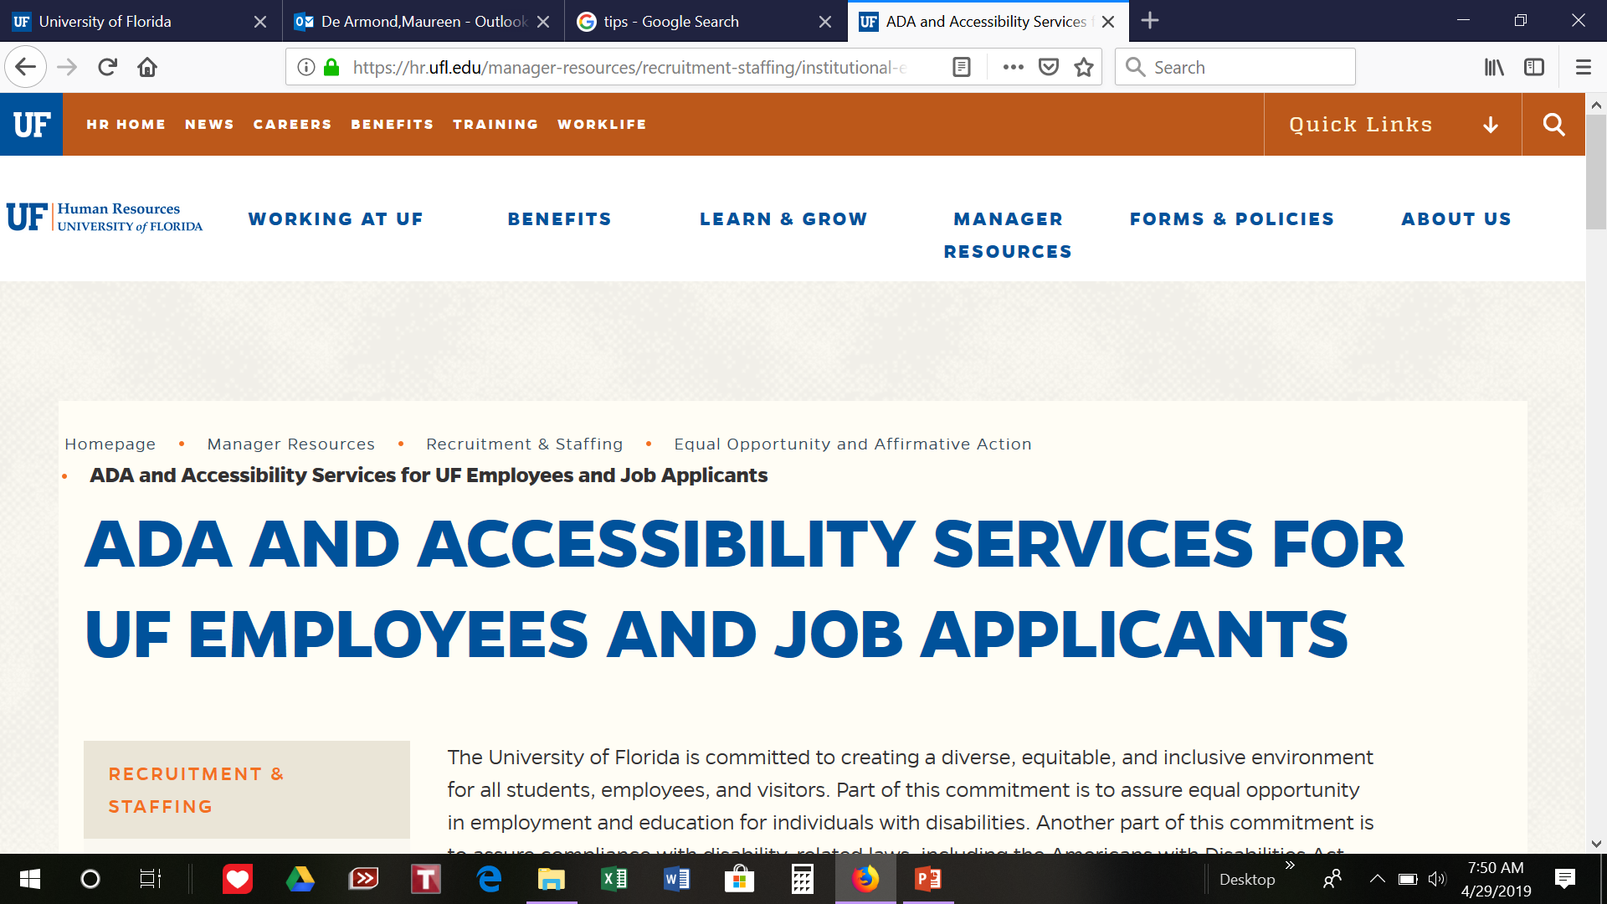
Employee Disability Accommodations
xxx
xxx
UFHR preeminence through people

Slide 6
Talent Acquisition
& Onboarding
HR Organizational Changes (Goodbye Recruitment & Staffing; Hello TAO & EOR)
Importance of Updated Data & Reporting

Slide 7
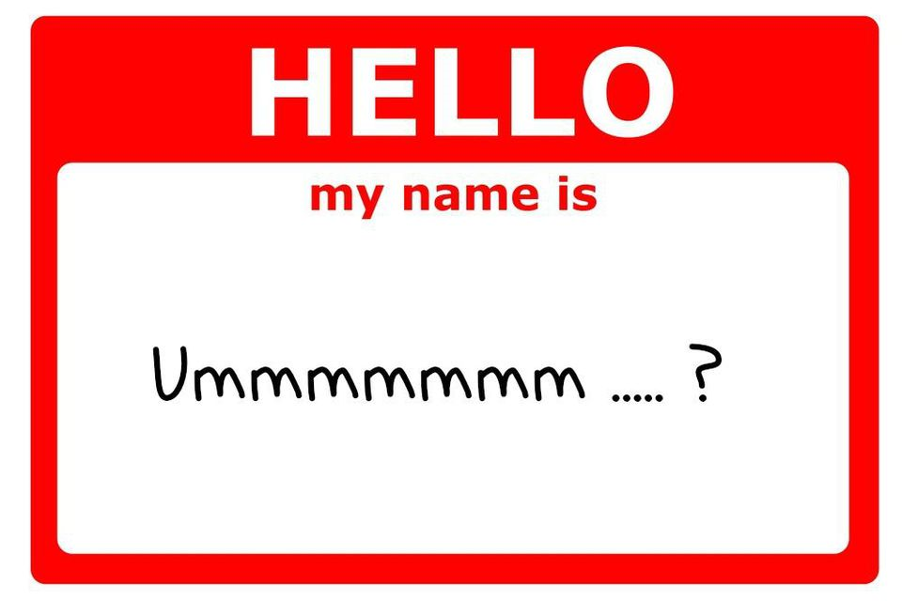
Recruitment and Staffing
Recruitment and Staffing has been separated into two new departments
  Talent Acquisition and Onboarding
    talent@hr.ufl.edu
  Employment Operations and Records
    employment@ufl.edu
UFHR preeminence through people

Slide 8
Data Integrity and Reporting
Talent Acquisition and Onboarding
  Update position and applicant statuses as the search process proceeds through different stages
  Notify applicants no longer being considered promptly
  Assign suitable disposition codes to applicants
  Close out posting, indicate individual(s) hired
UFHR preeminence through people

Slide 9
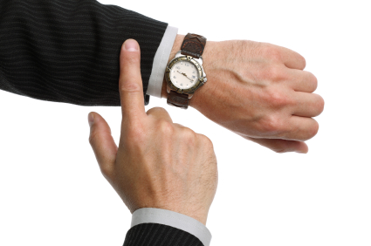
Data Integrity and Reporting
Employment Operations and Records
  ePAFs should be entered timely—on or before the effective date
  Please ensure the following information is correct:
    Name matches SSN card
    work location
    Home and work addresses
    E-mail address
    Supervisor
UFHR preeminence through people

Slide 10
Class and Comp
Supervisor ID Updates

Slide 11
Supervisor ID Updates
In April, UFIT assisted in a review of staff (TEAMS Only) supervisor ID information in myUFL and found that 216 employees are missing supervisor information.
The review identified 205 employees with supervisors who are no longer active in myUFL.
Classification and Compensation will be contacting units to request units update the supervisor information for these employees.
UFHR preeminence through people

Slide 12
Supervisor ID Updates
In April, the Employee Relations team began working with a consultant to assist in the implementation of UF Engaged.
We’ve identified two key takeaways for managing supervisors.
  In the event of vacancy, an interim supervisor will need to assigned in myUFL.
  In the event of extended leave, an interim supervisor will need to be assigned in myUFL.
UFHR preeminence through people

Slide 13
Supervisor ID Updates
We are currently testing settings that will allow UF Health supervisors to be entered into myUFL.
To be entered in myUFL, the individuals will need the following:
  A Person Of Interest (POI) record in myUFL
  Time and Labor approver security role
UFHR preeminence through people

Slide 14
Supervisor ID Updates
Definition of a Supervisor:
  The person directly responsible for providing oversight for, or directing the work of, another UF faculty or staff member. This typically includes clarifying performance and assignment expectations; providing feedback; approving vacation requests and time worked; and completing the faculty or staff member’s performance evaluation.
  For tenure-track faculty appointed to a center, list the academic chair (or center director if tenure is held in the center)
  For non-tenure track faculty appointed to a center, list the center director
  For department chairs, list the dean
  For center directors, list either dean or SVP, depending upon to whom the person reports
UFHR preeminence through people

Slide 15
Supervisor ID Updates
Supervisory pairings to avoid:
TEAMS supervising Faculty
Employee supervising another in a lateral or identical classification
Office support employee supervising management
Office support employee supervising field staff at another location
Non-exempt employee supervising exempt employee
Temporary (OPS) employee supervising a permanent TEAMS/Faculty position
Supervisor is from a different campus unit
9/10-month employee supervising a 12-month employee
UFHR preeminence through people

Slide 16
Supervisor ID Updates
Supervisor ID
To aid in updating and maintaining supervisor information in myUFL a new report has been made available in Enterprise Reporting
myUFL / Main Menu / Enterprise Reporting / Access Reporting / Human Resources Information / Workforce Information / Staff List with Supervisor Info by Department
Depending on the number of reports available to you, you may have to advance to the next page to find the report
UFHR preeminence through people

Slide 17
Questions
Please contact Classification & Compensation at compensation@ufl.edu or by phone at (352)273-2842.
UFHR preeminence through people

Slide 18
Benefits
Preparing for 2019 Fiscal Year End Leave
Keeping in Touch (Contact Information)

Slide 19
Preparing for 2019 Fiscal Year End Leave Processes
Special and Overtime Compensatory Leave Cash-Out
    Balances as of 5/30/19 will be cashed out on 6/21/19 paycheck
    Employees may use Special and Overtime (OT) Comp Leave until June 30
    Time must be entered in myUFL by 5 p.m. on Thursday, May 30
    Special and OT Comp Leave earned in PPE 5/30 rolls over to 2019-2020 balances
UFHR preeminence through people

Slide 20
Preparing for 2019 Fiscal Year End Leave Processes
Personal Holidays (USPS) and December Personal Leave Days (Teams & Eligible Faculty)
    USPS Personal Holidays must be used in full-day increments
    December Personal Leave Days can be used in less than full-day increments
    “Use it or lose it”--use by June 30, 2019 or it will expire
UFHR preeminence through people

Slide 21
Preparing for 2019 Fiscal Year End Leave Processes
myUFL Toolkit available (https://learn-and-grow.hr.ufl.edu/toolkits-resource-center/)
Human Resources Toolkits > Time & Labor > Time and Labor Approvers/Processors > Preparing for Fiscal Year Leave Processes
Questions or Concerns?
Contact Central Leave at (352) 392-2477 or central-leave@ufl.edu
UFHR preeminence through people

Slide 22
Keeping in Touch
Update Mailing Addresses in MyUFL
Current and correct mailing addresses are critical!
Returned mail examples:
Be sure your addresses are up-to-date in myUFL
Remind departmental employees to update addresses (including employees leaving UF)
    Tax documents
    Open Enrollment information
    Insurance ID cards
    COBRA notifications
UFHR preeminence through people

Slide 23
Keeping in Touch
How to Update Your Mailing Address in MyUFL
  Main Menu > My Account > Update My Directory Profile
  Make updates to addresses
  NOTE: Only enter on ADDRESS LINE 3 field
  Be sure to update your Emergency Contacts
Identity Coordinator list found here: http://files.it.ufl.edu/identity/cordlist.pdf
UFHR preeminence through people

Slide 24
Keeping in Touch
People First Email Contact Information
    Contact email used to authenticate identity for resetting your People First password
      Passwords expire every 90 days
      Online password reset--MUST have email address or mobile phone number (for text)
    You must take action to update your email in People First system—not automatic
    People First will send certain state health and insurance notices by email
UFHR preeminence through people

Slide 25
Keeping in Touch
How to Update People First Email Contact Information
    Login to People First system
    Click “Personal Info”
    Select “Contact Information”
    Select “Notification Email” and click “Edit” or “New”
    NOTE: Mailing addresses cannot be updated in People First—addresses transfer automatically to PeopleFirst once updated in UF PeopleSoft (myUFL) system
UFHR preeminence through people

Slide 26


Keeping in Touch
UF HR Benefits is here to help!
Email us: | benefits@ufl.edu
Call us: | (352) 392-2477
Visit us: | Schedule appointment online
    (online “virtual benefits counselor”)
    UF HR Benefits website
    UF at Work newsletter articles
UF Benefits
UFHR preeminence through people

Slide 27

Fond Farewell to
Stewart King

Slide 28
Important Dates
Next HR Forum – June 5, 2019 – 130 Bryan Hall (Warrington College of Business)

Slide 29

Thank you for attending the
HR Forum

