Slide 1
HR Forum
February 5, 2020

Slide 2
Today’s Agenda Items
UFHR Area Updates
Employee Relations – Brook Mercier and Jennifer Munroe
Training & Organizational Development – Jenny Seitz
Communications & WorkLife – Angie Brown
Employment Operations & Records – Cynthia Mendoza
Talent Acquisition & Onboarding – Melissa Curry and Audrey Gainey
Benefits & Leave – Shannon Edwards
Important Dates
UFHR preeminence through people

Slide 3
Employee Relations
UF Engaged

Slide 4
UFHR preeminence through people

Slide 5
University's Completion Rate
Overall Completion rate - 58%
Self Assessment Completion rate - 47%
Top 5 College/Admin unit
Stephen C. O'Connell Center - 94%
University of Florida Press - 86%
Office of Admissions - 85%
UF Human Resources - 84%
Student Financial Affairs - 83%
Data from October ‘19 through January ‘20

Slide 6
Align individual goals with your team’s purpose
ENGAGE YOUR EMPLOYEES
LIMIT THE SCOPE
SET EFFECTIVE GOALS
ENSURE A SENSE OF ALIGNMENT

Slide 7
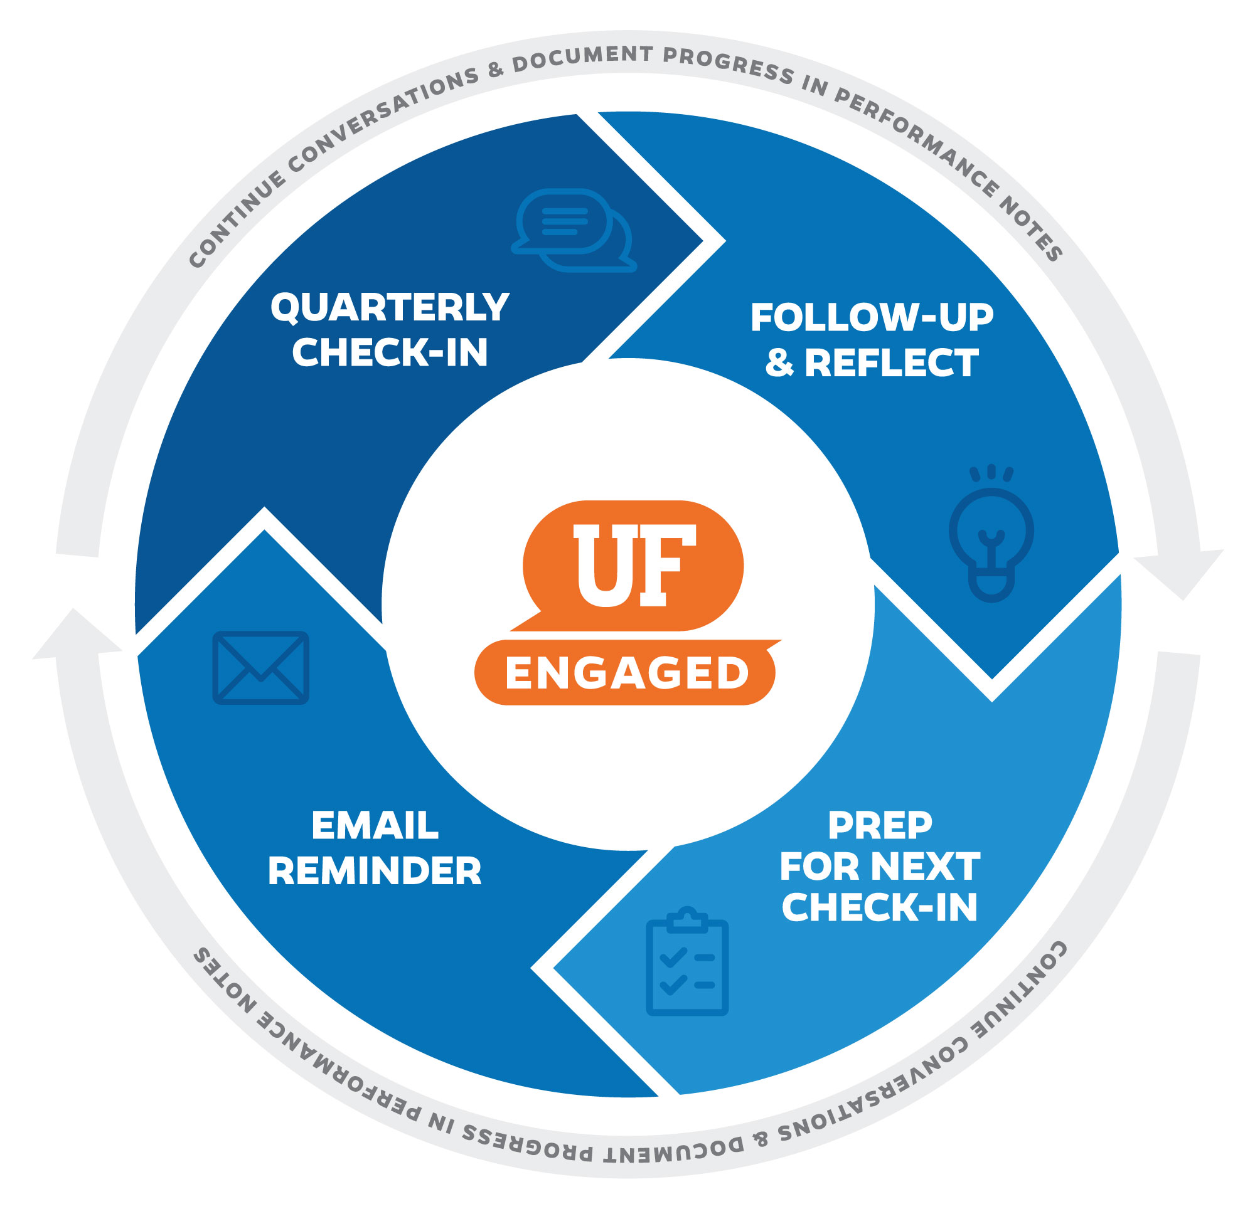

Slide 8
Email notifications not being received
Check “Junk Mail” and “Deleted Items”
If you find the email reminder there and you did not accidentally delete or move the email yourself.
You need to adjust a “Rule” or “Move” command within your personal email.
If you do not find the email reminder in your “Junk Mail” or “Deleted Items” and you have not cleared those boxes.
Check your business email within the PeopleSoft system to ensure it is accurate.
If you are still unable to locate the UF Engaged Notification contact your departmental IT.
Please note supervisors receive two emails, 1st email approximately 30 days out, 2nd email approx. 14 days out. Employees only receive one email, approx. 30 days out.

Slide 9
Make sure you save your content so you don’t lose it.
If you walk away without saving, the system may timeout and you will lose all content entered.
PeopleSoft does not have an auto save feature.
Performance Notes
Optional tool for Supervisors and Employees to keep personal notes about performance and track specific events
Used as a resource when preparing for Quarterly Check-ins
Content of Performance Notes and any attachments are only accessible to the user who entered the information

Slide 10
Supervisor IDs, keep them up-to-date.
UF Engaged pulls the supervisor ID from myUFL Job Data
If the supervisor ID is inaccurate, then an individual’s Quarterly Check-in will go to the wrong supervisor
IT’S JUST 15 MINUTES!!
Supervisors: Take advantage of these Check-ins to speak with your direct reports about their current performance, areas of development and growth opportunities. Regular Check-ins will help you develop your team, increasing productivity within your department/college and the University.

Slide 11
UF Engaged Website – offers a variety of guides, simulations, and available trainings to aid in the success of leaders and staff.
Utilize your Department Human Resources representative
Please email us with questions/feedback: UFEngaged@hr.ufl.edu

Slide 12
Training & Organizational Development
At-Risk Student Training

Slide 13
At-Risk Student Training
Part of effort to better identify and support students in distress
Expectation for all Florida universities and colleges from Board of Governors
Training assignment went out Friday to all faculty—Kognito (At-Risk for Faculty & Staff Training)
Faculty have until May 1 to complete
Important notes:
If they have completed within last year, no need to retake
Need to complete through myTraining—can use the link in system-generated email or directly in myTraining system (mytraining.hr.ufl.edu)
Use Chrome or Firefox for Kognito
UFHR preeminence through people

Slide 14
Communications & WorkLife
“Perk Up Your Summer” 2020
Wellness Wednesdays-2x/month
EAP: Reminder about feedback form

Slide 15
Summer Camps & GatorPerks Expo
Help spread the word… Perk Up Your Summer Tuesday, Feb. 25, 10-2 Champions Club, Ben Hill Griffin Stadium
Summer camps from throughout the area
GatorPerks vendors
Summer activities/events for all ages
UFHR preeminence through people

Slide 16
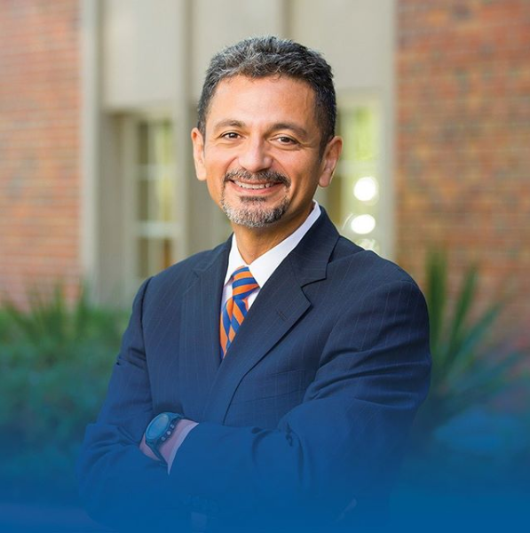
Wellness Wednesdays
Wellness Wednesdays — now twice a month!
One campus-based expert (join in-person or online)
One EAP expert (webinar only)
TODAY, 12-1 p.m. FEB. 19, 12-1 p.m. Embodied Difference Civility in the Workplace A Guide to Healthy Living in a EAP Webinar Multicultural World Online only Antonio Farias, UF CDO 120 HR Building or online
More information: https://wellness.hr.ufl.edu/initiatives/programs/wellness-wednesdays/
UFHR preeminence through people

Slide 17
Employee Assistance Program
How is it going? We want to hear from you and employees in your area
Online feedback form available at:
https://worklife.hr.ufl.edu/eap-feedback/
Feedback may be submitted anonymously or with contact info for follow-up.
Visit eap.ufl.edu/ for more info. Questions? Email eap-help@ufl.edu
UFHR preeminence through people

Slide 18
Employment Operations & Records
Change of Employment ePAF
Change to Hire ePAF
Change to Form I-9

Slide 19
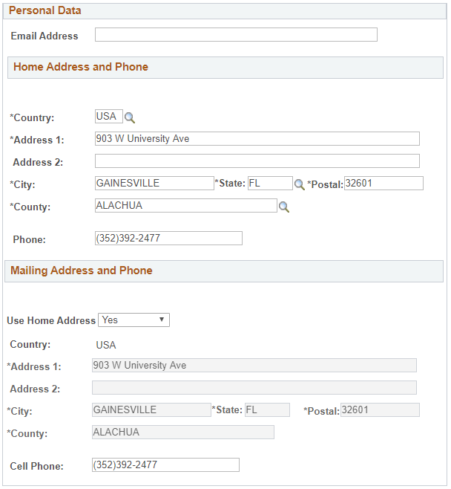
Change of Employment ePAF
Also known as “Termination ePAF”
Added new fields to complete:
Personal email address
Home and mailing address
Cell phone and home phone number
To capture critical information of exiting employees
UFHR preeminence through people

Slide 20
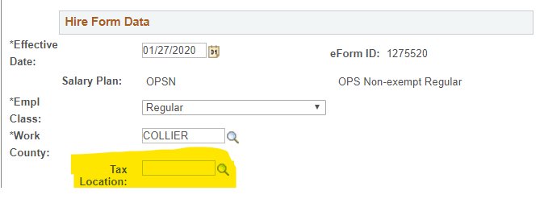
Change to Hire ePAF
As part of the ADP initiative, we’ve added the tax location field in the new hire ePAF
Help identify and correctly tax individuals working outside of the state
UFHR preeminence through people

Slide 21
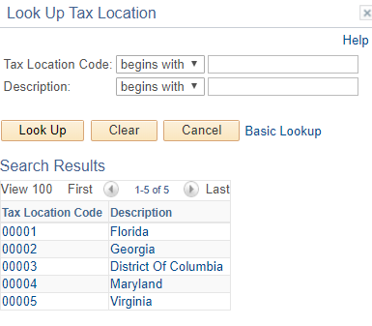
Change to Hire ePAF
The options available are where we’ve established a presence
Currently, that includes:
Florida
Georgia
District of Columbia
Maryland
Virginia
UFHR preeminence through people

Slide 22
Change to Hire ePAF
If you have an employee that is working in a state not listed, contact Payroll Services to request a new state to be added
UFHR preeminence through people

Slide 23
Change to Form I-9
A new form I-9 became effective on 1/31
Version date: 10/21/2019
The fields did not change in the actual form
In the smart form they updated the names of two countries
In the instructions:
Clarified who can act as an authorized representative on behalf of an employer
Updated USCIS website addresses
Provided clarifications on acceptable documents for Form I-9
Updated the process for requesting paper Forms I-9
Updated the DHS Privacy Notice
UFHR preeminence through people

Slide 24
Talent Acquisition & Onboarding
Introductions – Audrey Gainey
First Advantage Updates
Department Assignment Update
Travel Restrictions and Quarantines
Guide to Greater Gainesville

Slide 25
First Advantage Updates
UFHR preeminence through people

Slide 26
First Advantage Updates
Effective Monday, February 3, 2020, UFHR will be implementing a new process in conducting international criminal background check through First Advantage.
This is to enhance the onboarding process and rightsize the spending on criminal background checks.
Eliminate the unnecessary steps for our applicants in supplying required documents or materials for international checks
Reduce the money spent on conducting international criminal background checks, since none of the criminal background checks conducted in other countries returned with any criminal records
Packages are created to accommodate the new process – only conduct international criminal background check on those who have not lived in the U.S. for the last three years.
UFHR preeminence through people

Slide 27
Packages
Basic
New or returning OPS staff, students, and graduate assistants
Searches for criminal records within the U.S.
Optional: employees transferring from one department to another on the same pay plan
Basic – Int’l
New or returning OPS staff, students, and graduate assistants
Have not been in the U.S. for the last three years
Searches for criminal records within the U.S. and international
UFHR preeminence through people

Slide 28
Packages
Basic+Edu+Empl Verf
New or returning salary/regular faculty, TEAMS, Adjuncts, and PostDocs
Searches for criminal records within the U.S.
Able to verify education and employment outside of the U.S.
Basic+Edu+Empl Verf – Int’l
New or returning salary/regular faculty, TEAMS, Adjuncts, and PostDocs
Searches for criminal records within and outside of the U.S.
Able to verify education and employment outside of the U.S.
UFHR preeminence through people

Slide 29
Additional Questions?
UFHR Criminal Background Check Team
Phone Number: (352) 392-2477
Email Address: HRBackgrounds@admin.ufl.edu
UFHR preeminence through people

Slide 30
Department Assignment Update
UFHR preeminence through people

Slide 31
New Assignments
Assignment distribution by volume of postings
Addition of a new member – Brittany Law
List of three TAO Representatives
Christina Salva
Hal Courson
Brittany Law
Updated department assignment can be found by visiting the UF Careers at UF toolkit.
UFHR preeminence through people
Notes:
This was emailed out back on January 17

Slide 32
Travel Restrictions and Quarantines
The White House issued a presidential proclamation imposing travel restrictions and quarantines on travelers from China
This presidential proclamation temporarily bars the entry of foreign nationals coming from mainland China in the 14 days preceding their attempted admission to the United States
If you have foreign national faculty, staff or students that are currently in mainland China, their entry into the U.S. could be delayed
Please contact Immigration Compliance Services for employees and the International Center for scholars and students
UFHR preeminence through people
Notes:
This was emailed out back on January 17

Slide 33
Guide to Greater Gainesville
New publishing company will publish the next Guide to Greater Gainesville
Moving to academic year
2020-2021 version will be available in July
UFHR preeminence through people
Notes:
This was emailed out back on January 17

Slide 34
Benefits and Leave
Double Deductions for 9/10-Month Employees
IRS Reporting Form 1095-C
Marketplace Tax Credit Notices
Flexible Spending Accounts

Slide 35
Double Deductions for 9/10-Month Employees
Active 9/10-month employees have double premium deductions during the spring to cover summer when no payroll is issued
Double deductions begin on 2/14/20 and end on 5/8/20 paycheck
Departments with new 9/10-mo. employees whose hires are executed between February 1st and the start of the Fall term should advise their new hires to contact UFHR Benefits for assistance regarding benefit premiums
If no action is taken, premiums will be underfunded, and coverages may be suspended
Questions? Contact UFHR Benefits at (352) 392-2477 or email benefits@ufl.edu
UFHR preeminence through people

Slide 36
IRS Reporting Form 1095-C
Employer Provided Insurance Offer and Coverage
Reports employees’ health insurance information for prior calendar year
State of Florida and GatorCare plan participants will receive forms within the next several weeks
State 1095s available in PeopleFirst beginning 1/31, if you opted for electronic delivery
GatorCare 1095s are sent by postal mail only (no electronic option)
Employees may file income tax returns prior to receiving 1095-C if they know they had coverage for the entire year
Employees enrolled in ACA Marketplace plans must report UF’s offer of employer-sponsored health coverage to IRS
UFHR preeminence through people

Slide 37
Marketplace Tax Credit Notices
Employees using Healthcare Marketplace may qualify for premium tax credit
UF is subject to penalty if full-time employee offered coverage by UF receives the tax credit
If tax credit notice received by departmental UF campus location, forward to UFHR Benefits immediately (fax, email, or postal mail):
Physical Address:
UFHR Benefits
Attn: Shannon Edwards
903 W. University Ave.
Gainesville, FL 32601
Campus Mailing Address:
UFHR Benefits
Attn: Shannon Edwards
P.O. Box 115007
Email: shannon.edwards@ufl.edu
Fax: (352) 392-5166
UFHR preeminence through people

Slide 38
Flexible Spending Accounts
Healthcare FSA and Limited Purpose FSA Plans
Carryover feature permits up to $500 of unused money to carry into the next plan year
Turn in claims by 4/15/20 for expenses incurred by 12/31/19
Dependent Care FSA Plan
Grace period that allows you to incur eligible expenses through 3/15/20
Additional 30 days to turn in claims (submit by 4/15/20 )
FSA Questions?
Contact Chard Snyder 855-824-9284 or FloridaAskPenny@chard-snyder.com
UFHR preeminence through people

Slide 39
Important Dates
Next HR Forum – March 4, 2020 – UFHR Room 120.

Slide 40
Thank you for attending the HR Forum

