Slide 1

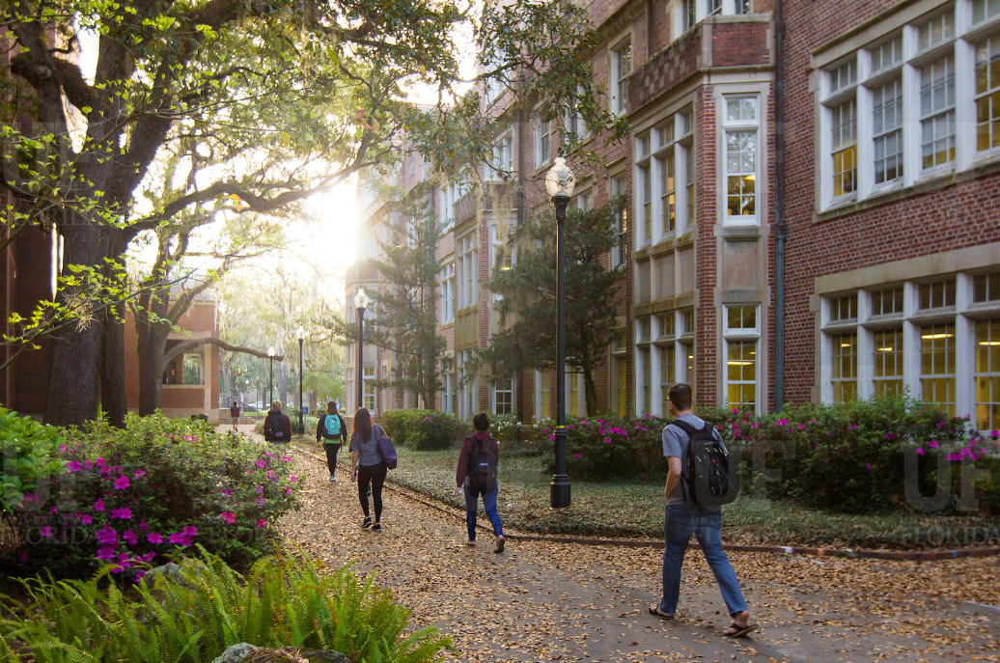

HR Forum
March 4, 2020

Slide 2
Today’s Agenda Items
COVID-19 Planning – Jodi Gentry
Academic and Professional Assembly (APA) – Corina Velasquez
Youth Activities & Summer Camp – Carolynn Komanski (Office of Youth Compliance Services)
UFHR Area Updates
Training & Organizational Development – Barb Mitola (GBAS) and Sarah Hanson (T&OD)
Benefits & Leave – Shannon Edwards
Important Dates
UFHR preeminence through people

Slide 3
COVID-19 Planning
Prevention is the key:
Stay home when sick
Appropriately cover coughs and sneezes
Clean frequently touched surfaces
Wash hands often
UF has cancelled all university travel to China, Iran, Italy, South Korea, and Japan
Open-ended timeframe at this time
14-day self-monitoring for those returning from those countries
Personally accrued paid leave, Occupational Health clearance required before returning to work
UFHR preeminence through people

Slide 4
COVID-19 Planning
Additional precautionary emergency planning is underway
Normal health precautions:
Staff and faculty should not attend class or work when sick
If an employee comes to work ill or becomes ill while at work (with any symptoms), they should go home
Employee Relations can help
http://www.ufl.edu/health-updates/
UFHR preeminence through people

Slide 5

APA… we are here for you!
The University of Florida Academic and Professional Assembly (APA) is an official UF organization sponsored by Human Resources.
Purpose statement:
To enrich the professional lives of UF staff by fostering an inclusive community through advocacy, education, and recognition.
Vision statement:
The APA is an influential and inclusive community, driving meaningful engagement and consistent advocacy for UF staff.

Slide 6

Recent events…
Visit our website for more information:
https://apassembly.ufl.edu/
Get to Know Campus Tour: Wilmot Botanical Gardens
Get to Know Campus Tour: Harn Museum
Work session and Focus groups on APA Strategic Plan
Get to Know Campus Tour: UF Historic District Walking Tour
Annual Bowling with Strangers
Resume Workshop at the Career Connections Center
Get to Know Campus Tour: IFAS Honey Bee Research & Extension Lab

Slide 7



Visit our website for more information:
https://apassembly.ufl.edu/
Upcoming events - Join Us!
March 18th @ 5:30pm
Monthly Mingle
March 19th @ 3:30pm
Get to Know Campus Tour @ Training Research & Education for Environmental Occupations (TREEO)
March 31st @ 3pm
Employee Education Program
Overview & Experiences
connect with new colleagues from across campus!
…and more!
Stay tuned for a “Warm Welcome” event coming soon

Slide 8
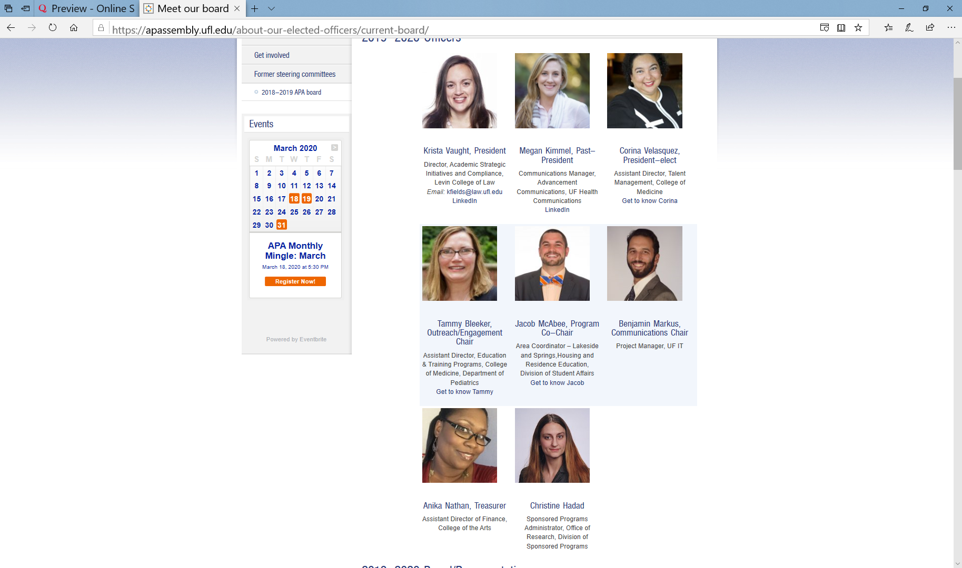
APA Leadership Team
Interested in a leadership role or committee?
If you are interested in getting involved in a leadership capacity, serving on a committee or project, or as a college/department representative, please submit our online interest form.

Slide 9
Office of YouthCompliance Services (OYCS)
Year-Round Office for Youth Activities
Notes:
GM all – Thank you for having me over.
I wanted to take a few minutes to get in front of you before the peak of the camps and conferences season to share a few key reminders related to the office of youth conference services.
My name is Carolynn Komanski, and today … I’ll briefly touch on the overall scope of the office, and then provide a summary of pre-program requirements as well as some of the processes involved in meeting such requirements.

Slide 10
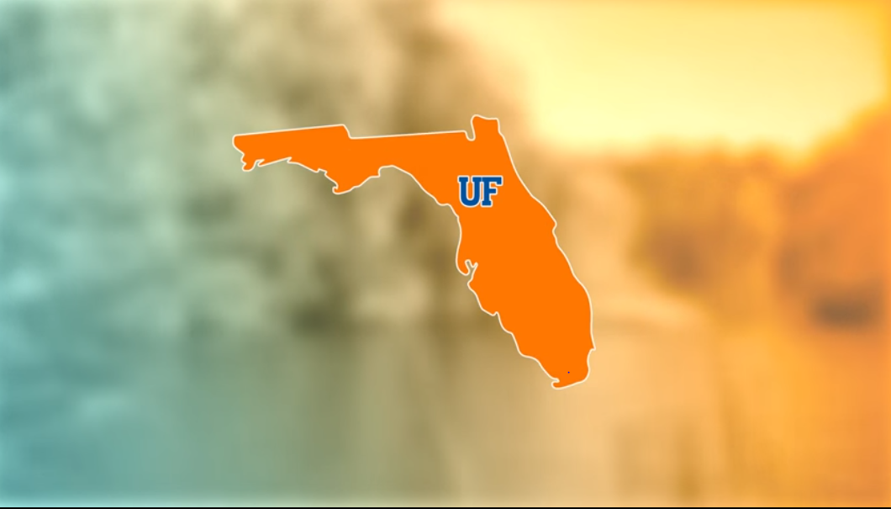
SCOPE
Education
Registration / Tracking
Compliance
UFHR preeminence through people
Notes:
The overall scope of the office revolves around 3 central themes and those are:
ED – We develop and deliver educational resources on youth protection strategies, applicable policies and laws, and mandatory reporting requirements.
Tracking – We equip youth programs with a vehicle to centrally track youth activities and those involved.
Compliance - We provide guidance on compliance requirements for UF-affiliated youth activities, assist programs with navigating through methods for reporting child abuse or neglect, and conduct internal monitoring activities to ensure compliance.

Slide 11
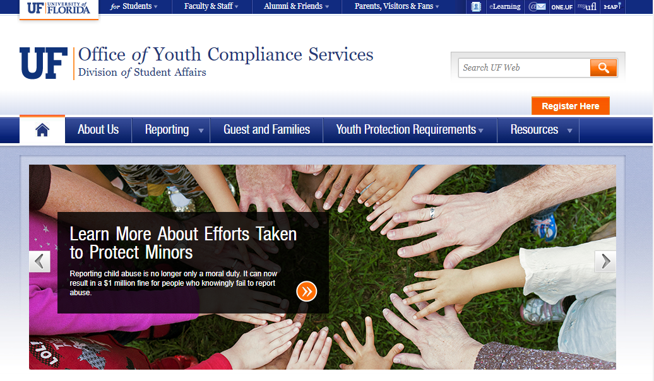
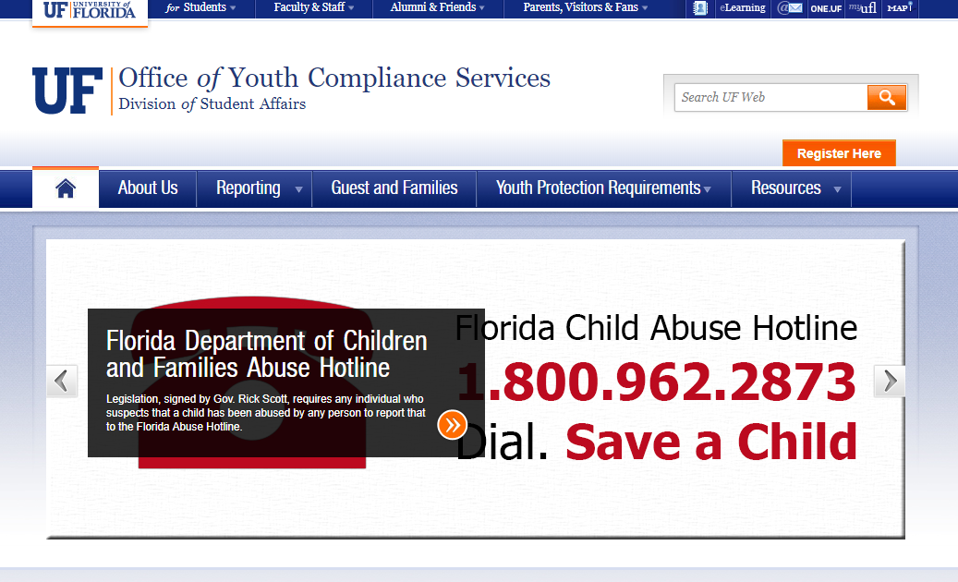
Youth Activity Requirements
Central Registration
Youth Protection Training
Background Checks
UFHR preeminence through people
Notes:
So if you area is hosting a youth activity involving children or youth, they are a set requirements that should be met 3 months in advance of program operations.

Slide 12


Slide 13
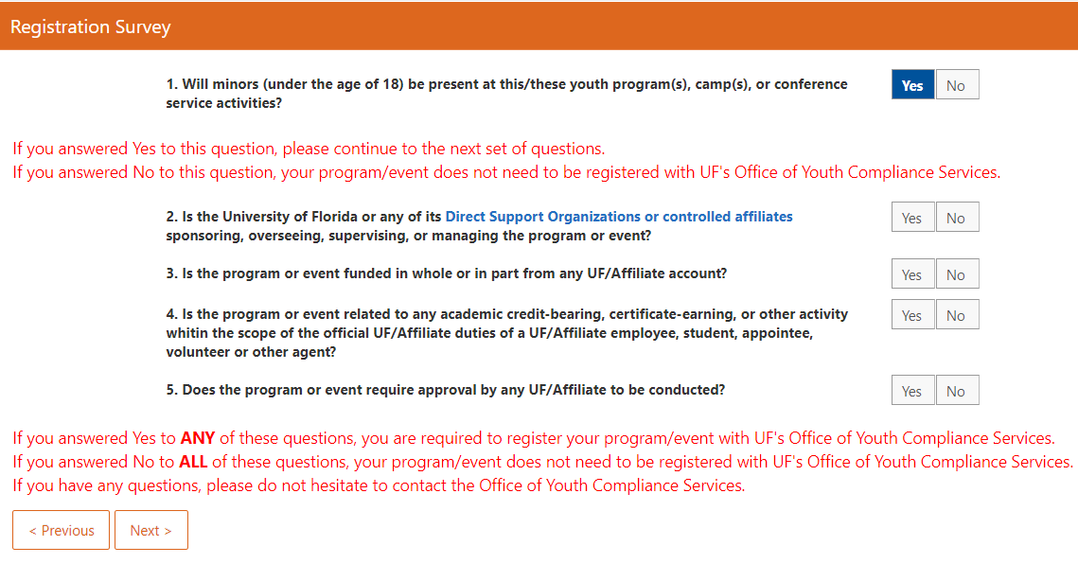
Central Registration
Prior to events
3 Months
Youth Activities
Short & Long Term
UFHR preeminence through people
Notes:
So if you area is hosting a youth activity involving children or youth, they are a set requirements that should be met 3 months in advance of program operations.

Slide 14
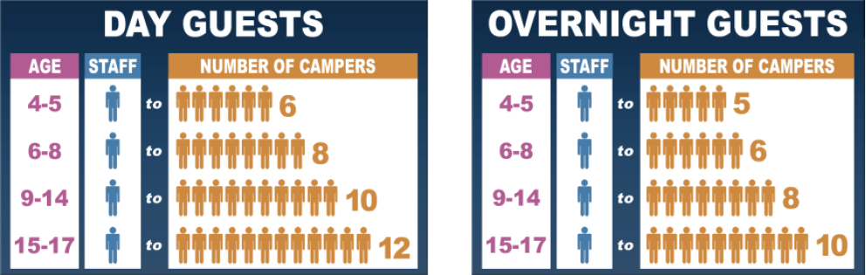
Supervision
Limit 1:1 Interactions
UFHR preeminence through people
Notes:
Activities must be coordinated in a way that eliminates one-on-one interactions and ensures that adequate staff-to-participant ratios are in place at all times (including when overnight accommodations or transportation is needed).
We work with groups to evaluate the best procedure for the pick-up and drop-off of program participants

Slide 15


Slide 16
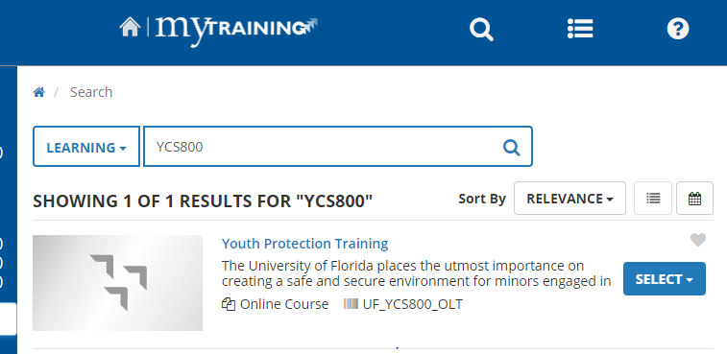
Youth Protection Training
Employees
Non- Employees
Volunteers
Students
Third Party
UFHR preeminence through people
Notes:
Annual Training for anyone working in association with youth activities.

Slide 17
BACKGROUND CHECKS
Notes:
We work closely with UFHR on this process to make sure people know where to go and how to get background checks.
We are notified if someone if pinged and can no longer work with youth activities.
We do not see them.

Slide 18


Slide 19
Reporting
Florida Mandatory
Reporting Requirements
$1 Million
Third Degree Felony
UFHR preeminence through people
Notes:
In 2012, Florida enacted what at least many refer to as the one of the toughest child abuse reporting law in the nation.
The new provisions impose financial and criminal implications for universities and individuals who deliberately fail to report known or suspected child abuse.
This is the $1 million dollar fine and Individuals who fail to report can be charged with a third degree felony which includes jail time.
More information related to this law and recommended steps for reporting child abuse can be found in the youth protection training and on our website.
By being aware of these type of provisions, employees will be better prepared to comply with their legal obligations and detect, prevent, and respond to instances of child abuse.

Slide 20
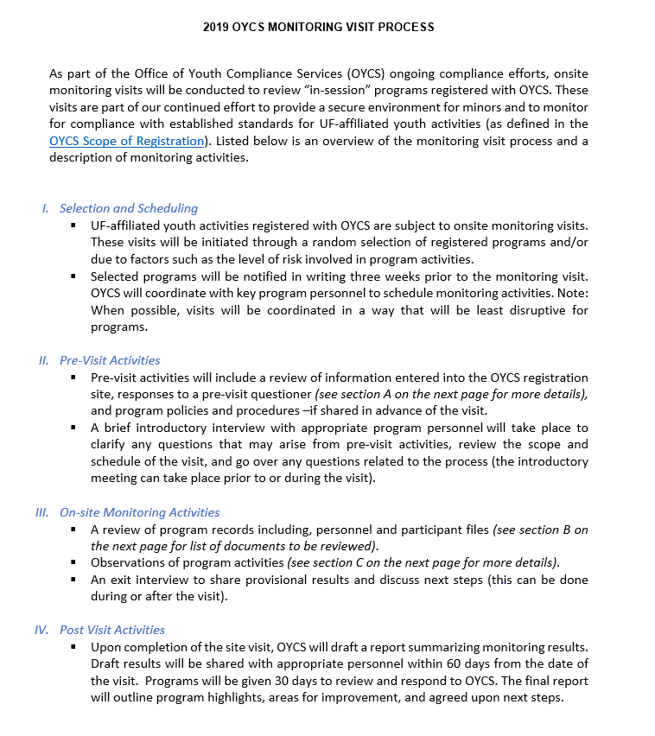
On-Site Visits & Consulting
Pre-Activity
On-Site
Post-Activity
UFHR preeminence through people
Notes:
In 2012, Florida enacted what at least many refer to as the one of the toughest child abuse reporting law in the nation.
The new provisions impose financial and criminal implications for universities and individuals who deliberately fail to report known or suspected child abuse.
This is the $1 million dollar fine and Individuals who fail to report can be charged with a third degree felony which includes jail time.
More information related to this law and recommended steps for reporting child abuse can be found in the youth protection training and on our website.

Slide 21

https://oycs.ufsa.ufl.edu/
352-846-4698
Ckomanski@ufl.edu

Slide 22
Training & Organizational Development
Gator Business Administrator Services (GBAS)
Team Competency Model

Slide 23
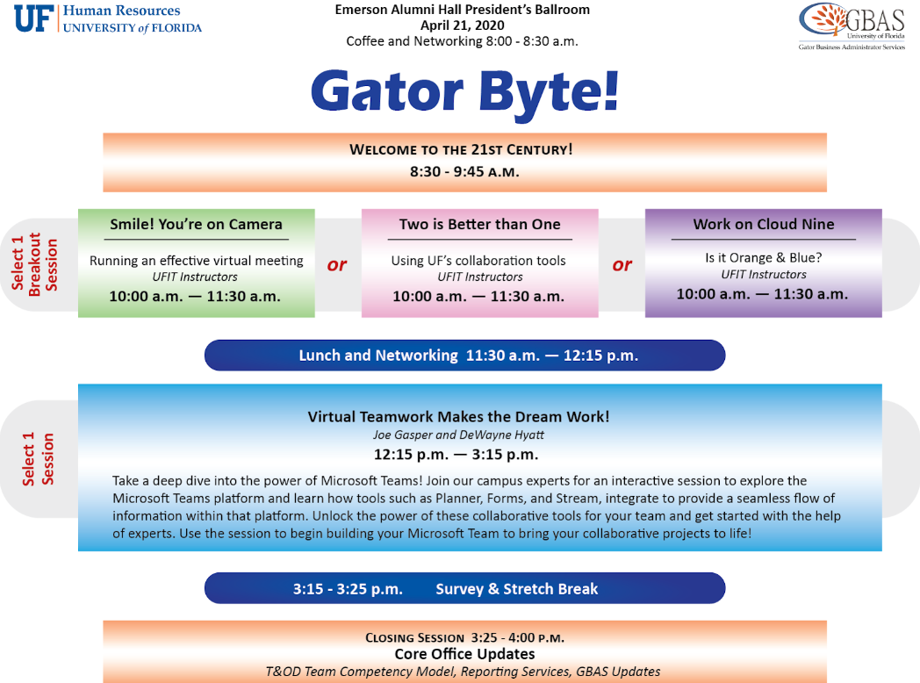
April 21
8:30am – 4:30pm
Emerson Alumni Hall
President’s Ballroom
Registration opens March 16th and closes April 2nd in myTraining
UF_GBS250
Questions? Contact: gcadwallader@ufl.edu

Slide 24

Teamwork & Collaboration Toolkit
Released 2.28.20
https://learn-and-grow.hr.ufl.edu
UFHR preeminence through people

Slide 25
Design and Development
Project Team: Bob Parks, Tricia Bachus, Sarah Hanson, Courtney Moon, Jenny Seitz, Becky Younglove
Review Research
Conduct Focus Groups
Send Surveys
Design Competency Model
Align Resources
Team Competency Toolkit
UFHR preeminence through people

Slide 26
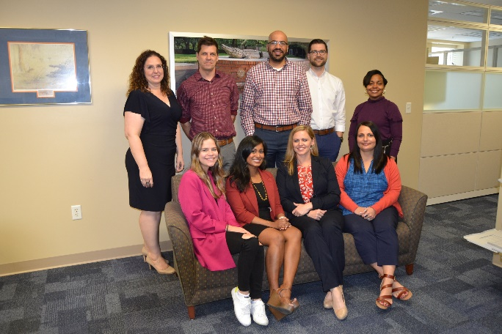
Toolkit Highlights!
Interactive Competency Model
Team Member/Leader Behaviors
Self-Assessment
Courses
Resources
Team Building Activities
UFHR preeminence through people

Slide 27
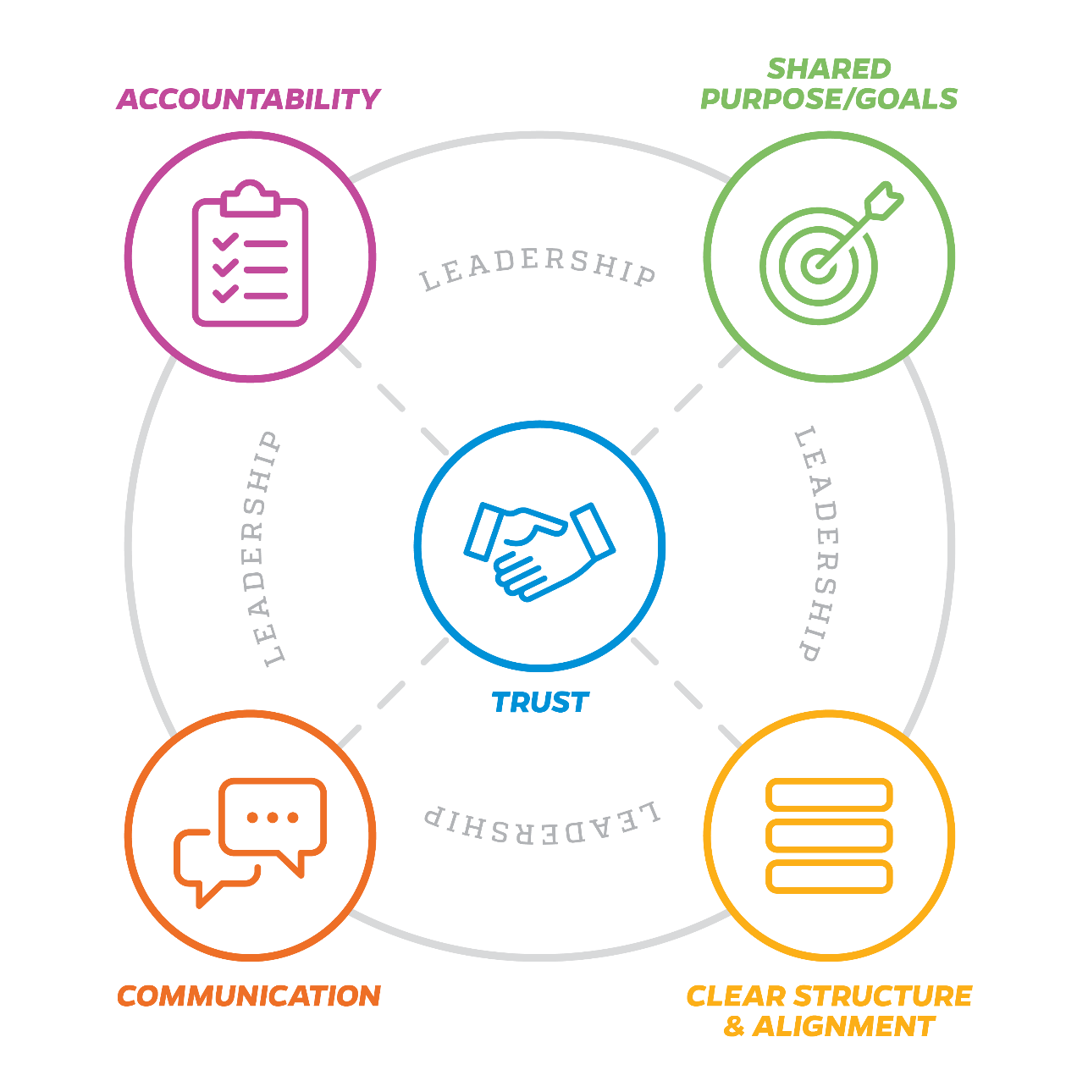

Interested in what great teamwork looks like at UF?
Want to complete an anonymous self-assessment to rate yourself in the 5 main team competency areas?
Visit the Teamwork & Collaboration Toolkit at http://learn-and-grow.hr.ufl.edu/
for an overview of the team competencies and behaviors as well as courses, resources, and a self-assessment to help cultivate these competencies.
UFHR preeminence through people

Slide 28
Benefits and Leave
IRS Form 1095-C
OPS Benefits Eligibility
New Hire Benefits Enrollment & Effective Dates
FY19-20 Comp Leave Cash-Out Changes

Slide 29
IRS Reporting Form 1095-C
Reports employees’ group health insurance information for prior calendar year
State 1095’s already sent by mail & are also available online through PeopleFirst
GatorCare plan participants will receive forms by postal mail within the next several weeks (no online option)
Employees do not need 1095-C to file income tax returns
Employees enrolled in ACA Marketplace plans must report UF’s offer of employer-sponsored health coverage to IRS
UFHR preeminence through people

Slide 30
OPS Benefits Eligibility Reminder
OPS employees eligible for state benefits when expected to work 30+ hours on average (.75 FTE)
Applicable to:
New hires
Internal promotions
Movement to/from other state agencies
Increase in hours without position change
Note: Increases/changes in FTE must be entered in PeopleSoft. This is reported to PeopleFirst as there may be an impact to benefits eligiblity.
UFHR preeminence through people

Slide 31
New Hire Benefits Enrollment
Departmental considerations for new hires:
Job appt./actions must be active in all systems before the employee can complete enrollment online (this takes about 2-3 days)
If possible, choose early to mid-month hire dates—allows time to process in system
Did you know? If new hire jobs are not in the UF and People First systems by the end of month, it can delay the employee’s insurance coverage effective date by at least one month for state plans!
UFHR preeminence through people

Slide 32
New Hire Benefits Enrollment
Other departmental considerations for new hires:
Encourage new hires to complete benefits enrollment early
Inform new hires about when coverage may reasonably begin (more on next slide) or refer them to Benefits staff for assistance
Health insurance ID cards are mailed once coverage is processed by the company
Employees have 60 calendar days* from hire date to enroll in benefits
UFHR preeminence through people

Slide 33
Benefits Effective Dates for New Hires
State health* & supplemental coverage can begin:
The 1st of the month after enrollment, provided 2 consecutive payroll deductions occur in the same month
No earlier than hire date (if job processed BEFORE date of hire)
*Early effective date available upon request for health plan coverage only. Health insurance premiums must be posted before coverage can be used.
UFSelect & GatorCare plan coverage is effective:
On date of hire, once enrolled (coverage is retroactive to hire)
Premiums owed for period coverage in effect & missed deductions are collected on future paychecks
Have questions about benefits eligibility, enrollment, or effective dates?
Contact the UF HR Benefits Office: benefits@ufl.edu or (352) 392-2477
UFHR preeminence through people

Slide 34
FY 19-20 Comp Leave Cash-Out Changes
Overtime, regular, and compensatory leave will be cashed out on the final paycheck of FY 19-20 (06/19/2020).
Accrued balances (less use) as of the end of PPE 5/28/20 will be paid out.
To prevent negative balances and payroll corrections, TRCs pertaining to comp leave will be unavailable during PP 05/29/20-06/11/20.
Employees will enter PP 06/12/20-06/25/20 with comp leave balances accrued during the previous payroll period.
UFHR preeminence through people

Slide 35
FY 19-20 Comp Leave Cash-Out Departmental Preparation
In most cases, units can adjust work schedules to prevent compensatory leave from accruing.
Accrued comp leave can be taken in place of other leave types.
Review accruals anytime (recommended on at least a per-pay basis): Enterprise Reporting > Access Reporting > Human Resources Information > Benefit Information > Leave > Leave Accruals, Usage, and Balances By Pay Period, Department - COMP ONLY.
Correct negative balances as quickly as possible.
UFHR preeminence through people

Slide 36
Important Dates
GBAS Spring Institute – April 21, 2020; Emerson Hall-President’s Ballroom; Contact gcadwallader@ufl.edu
Next HR Forum – April 1, 2020 – UFHR Room 120.

Slide 37

Thank you for attending the HR Forum

