Slide 1

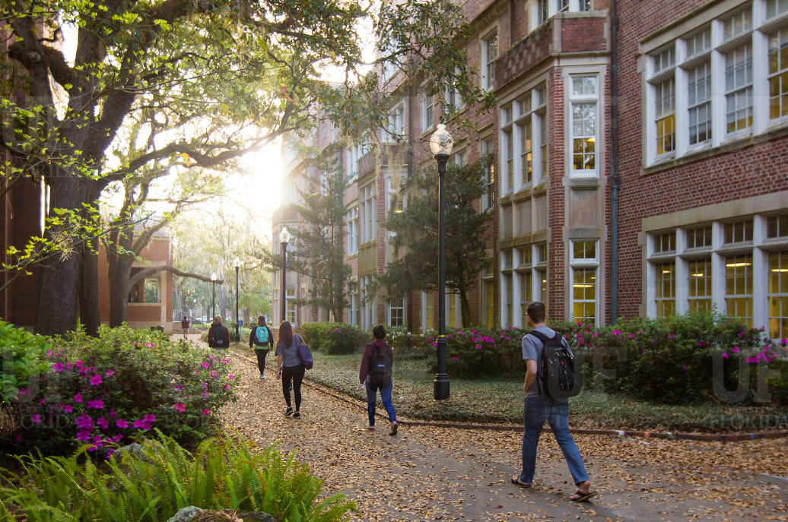

HR Forum
April 21, 2020

Slide 2
Today’s Agenda Items
COVID-19 Current State – Jodi Gentry
UFHR Area Updates
  Classification & Compensation – Brent Goodman
  Talent Acquisition & Onboarding – Audrey Gainey
  Benefits & Leave – Shannon Edwards
  Employee Relations – Brook Mercier
Important Dates
UFHR preeminence through people

Slide 3
Classification &
Compensation
DocuSign Update

Slide 4
DocuSign Update
Prior to COVID-19, the DocuSign project team received multiple inquiries from campus stakeholders regarding restricted data and protected health information (PHI).
With a significant population of the university working remotely, the ability to include restricted data and PHI has become a significant need.
In order to allow restricted data and PHI to be transmitted within DocuSign, effective April 24th, users will no longer receive a PDF attachment of the final document.
UFHR preeminence through people

Slide 5
DocuSign Update
Users will continue to receive notifications from DocuSign, which will include an embedded link that will allow users to retrieve the documents for storage.
As a reminder, DocuSign will only retain approved documents for 90 days.
Users are encouraged to limit restricted data and PHI to information required for approval of the requested document.
Additional information regarding the types of data that can be included can be found at https://it.ufl.edu/ufdocusign
UFHR preeminence through people

Slide 6
DocuSign Update
Questions
UFHR preeminence through people

Slide 7
Talent Acquisition &
Onboarding
Talent Share Program

Slide 8
Talent Share Program
What is Talent Share?
  Talent Share is a program designed to assist the UF community in connecting Faculty and Staff affected by the reduction in work with UF colleges and units who have temporary projects or assignments without change in job title or job structure.
How Does it Work?
  Supervisors and managers are able to look within their colleges and units to determine if there are employees there that can address short-term needs.
  Supervisors and managers are encouraged to complete a Talent Share Request Form to gain support with locating employees from other colleges and units from the Talent Acquisition and Onboarding’s Strategic Talent Group.
UFHR preeminence through people

Slide 9
Talent Share Program
How are Employees Referred?
  Supervisors and Managers may refer employees who are experiencing a reduction in work to complete a Talent Share Interest Form (Gatorlink Authentication Required) via PageUp.
  Once completed, a member of the Strategic Talent Group will assess that employee’s skills and match them with a work assignment throughout campus.
  Supervisors and Managers will have the opportunity to review referrals and make a selection.
Who do You Contact With Questions?
  Talent Acquisition and Onboarding @ talent@hr.ufl.edu

Slide 10
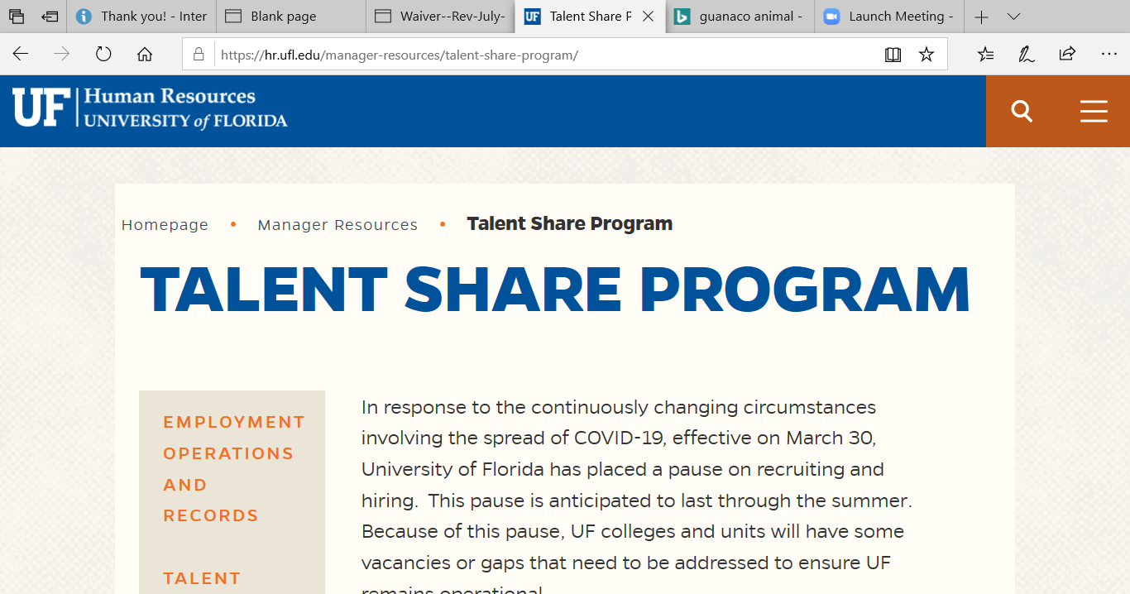
Talent Share Program Resources
https://hr.ufl.edu/manager-resources/talent-share-program/
UFHR preeminence through people

Slide 11
Benefits and Leave
Leave Donations
Aid-A-Gator

Slide 12
Leave Donations
Thank you to all who generously donated vacation and/or sick leave!
  Over 271,000 hours donated.
  Donated hours available to assist UF employees unable to work due to COVID-19.
  As of 4/17, over 70 requests received and nearly 3,000 hours awarded.
Questions? Email covid19leavedonation@hr.ufl.edu or call (352) 392-2477
UFHR preeminence through people

Slide 13

Employees experiencing an unforeseen, temporary financial hardship may apply for a grant through Aid-a-Gator at any time.
  As of 4/17/20:
      147 applications for aid received
      22 applications approved and $9,000 in aid provided
  Separate Aid-a-Gator program is available for students.
  This is another great opportunity to help your fellow Gator employees—please consider making a donation to Aid-a-Gator now or anytime!
More information is available on the Aid-a-Gator website
UFHR preeminence through people

Slide 14
Employee Relations
UFHR Guidance on COVID-19 Matrix

Slide 15
UFHR Guidance on COVID-19 Matrix
Guidance for addressing employees directly impacted by COVID-19 is found at https://hr.ufl.edu/ufhr-guidance-to-hr-liaisons-on-covid-19-response-for-employees/.
Please use the guidance matrix when communicating with employees and departments about potential impacts from COVID-19.
  Contains information about quarantine requirements
  Outlines the Return to Work process
Inform Employee Relations if employees test positive or are not positive but should be designated according to the guidance matrix.

Slide 16
Important Dates
Next HR Forum – May 6, 2020 - Zoom information will be provided.

Slide 17

Thank you for attending the
HR Forum

