Slide 1



HR Forum
April 1, 2020

Slide 2
Today’s Agenda Items
Current State – Jodi Gentry
UFHR Area Updates
  Employee Relations – Brook Mercier
  Training & Organizational Development – Bob Parks
  Employment Operations & Records – Cynthia Mendoza
  Talent Acquisition & Onboarding – Audrey Gainey/Melissa Curry
  Benefits & Leave – Shannon Edwards/Amber Wuertz
Important Dates
UFHR preeminence through people

Slide 3
Current State
UFHR preeminence through people

Slide 4
Employee Relations
UF Engaged

Slide 5

UFHR preeminence through people

Slide 6

UF Engaged is intact and still functioning:
  Now more than ever we need to be focused on communicating with our employees.
  Conduct Check-Ins by most efficient means possible: In person (while continuing social distancing), zoom, or phone, if possible.
If your employee is out of the office completely (and not working from home):
  Managers still complete, and submit, the Check-In while following quarterly deadlines based on performance/activity that occurred while they were working and/or in the office.
  Conduct In-person Check-In meeting upon their return to work in office or remotely as able.

Slide 7
  Probationary Employees
    If supervisor determines that the employee has successfully completed the requirements to complete the probationary period, a 6-month probationary Check-In should be competed.
    If supervisor determines that more time is needed to assess the employee in their role, they should complete the 6-month Check-In and extend the probation period
    Supervisors should avoid executing a probational dismissal unless conduct or other significant issues are evident.
    Consult with Employee Relations regarding any questions.

Slide 8
UFHR Guidance on COVID-19 Matrix
Guidance for addressing employees directly impacted by COVID-19 is found at https://hr.ufl.edu/ufhr-guidance-to-hr-liaisons-on-covid-19-response-for-employees/
Please use the guidance matrix when communicating with employees and departments about potential impacts from COVID-19.
  Contains information about quarantine requirements
  Outlines the Return to Work process
Inform Employee Relations if employees test positive or are not positive but should be designated according to the guidance matrix.

Slide 9
Training & Organizational Development
Leadership Programs
Training Programs
Moving Forward

Slide 10

Leadership Programs
Application period postponed for
2020-2021 cohorts
  Advanced Leadership for Academics and
  Professionals (ALAP)
  UF Academy
  Managers Cohort
Applications normally accepted in April—on hold and will open for applications at a later date
UFHR preeminence through people

Slide 11

Training Courses
Summer calendar of courses opens
for registration beginning April 6
Courses offered virtually for foreseeable
future
UFHR preeminence through people

Slide 12
Moving Forward
Training resources focused on working,
collaborating, managing & leading
remotely in our UF-specific environment
Stay tuned…
UFHR preeminence through people

Slide 13
Employment Operations and Records
Short Work Break for 9/10-Month Employees
Faculty & GA Summer Appointments
Employment of Relatives Portal
Spring Termination File Update

Slide 14
Short Work Break for 9/10- Month Employees
Short Work Break file will take place on April 24, 2020
9- and 10-month employees (faculty, graduate assistants and TEAMS) will be placed on Short Work Break in the myUFL system for the summer semester
  Individual is still an active employee
  Time Reporting is inactivated, and salary is not paid on this record during the short work break period
Effective dates for Short Work Beak
  9-month: 5/15/20
  10-month: 6/2/20
UFHR preeminence through people

Slide 15
Short Work Break for 9/10- Month Employees
Action Needed by Departments
  Verify all 9- and 10-month employees who will not return after Spring 2020 are terminated in myUFL
  If necessary, enter end-of-semester terminations PRIOR to April 24, 2020
To review employees on Short Work Break after April 24:
  Main Menu > Enterprise Reporting > Access Reporting > Human Resources > Workforce Information > Short Work Break – Return From Break Report
  Guide: http://training.hr.ufl.edu/instructionguides/job_position_actions/shortworkbreak.pdf
UFHR preeminence through people

Slide 16
Faculty and GA Summer Appointments
Summer appointments for 9-month faculty and graduate assistants may be processed via the summer job file
  Summer appointments can also be entered as a Hire ePAF
The file will be available April 24, 2020
The file will close on May 15, 2020
UFHR preeminence through people

Slide 17
Faculty and GA Summer Appointments
The file will be available via myUFL system
  Main Menu > Human Resources > Workforce Administration > Job Information > UF Summer Job Review
Summer appointments will be reflected in myUFL on May 25, 2020
Instruction Guide:
  http://training.hr.ufl.edu/instructionguides/job_position_actions/summerjobreview.pdf
UFHR preeminence through people

Slide 18
Faculty and GA Summer Appointments
A termination row will be applied at the same time the summer appointment is applied in job data
Reminder!
  Enter distributions for summer appointments
Questions?
  Ufhr-employment@ufl.edu
  392-2477
UFHR preeminence through people

Slide 19
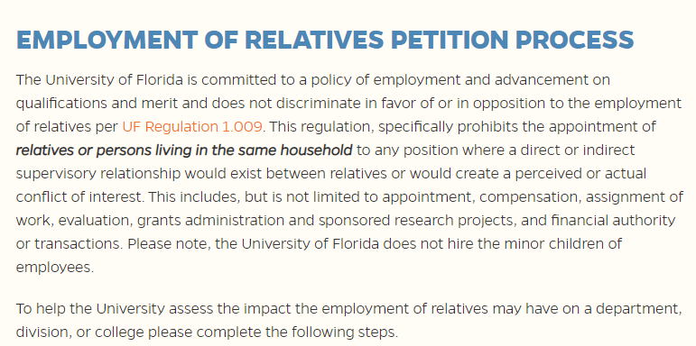
Employment of Relatives Portal
Available Now
  https://hr.ufl.edu/manager-resources/employment-operations-and-records/employment-of-relatives-petition/
UFHR preeminence through people

Slide 20
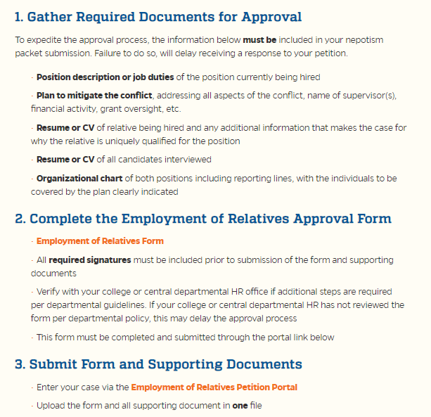
Employment of Relatives Portal
What’s Changed?
  Form is concise
  Submission is through a portal (1 packet)
  Response is electronic
  Approval time decreases
What is the Same?
  The regulation has not changed
  Applies to all salary plans with the exception of a student/student scenario
UFHR preeminence through people

Slide 21
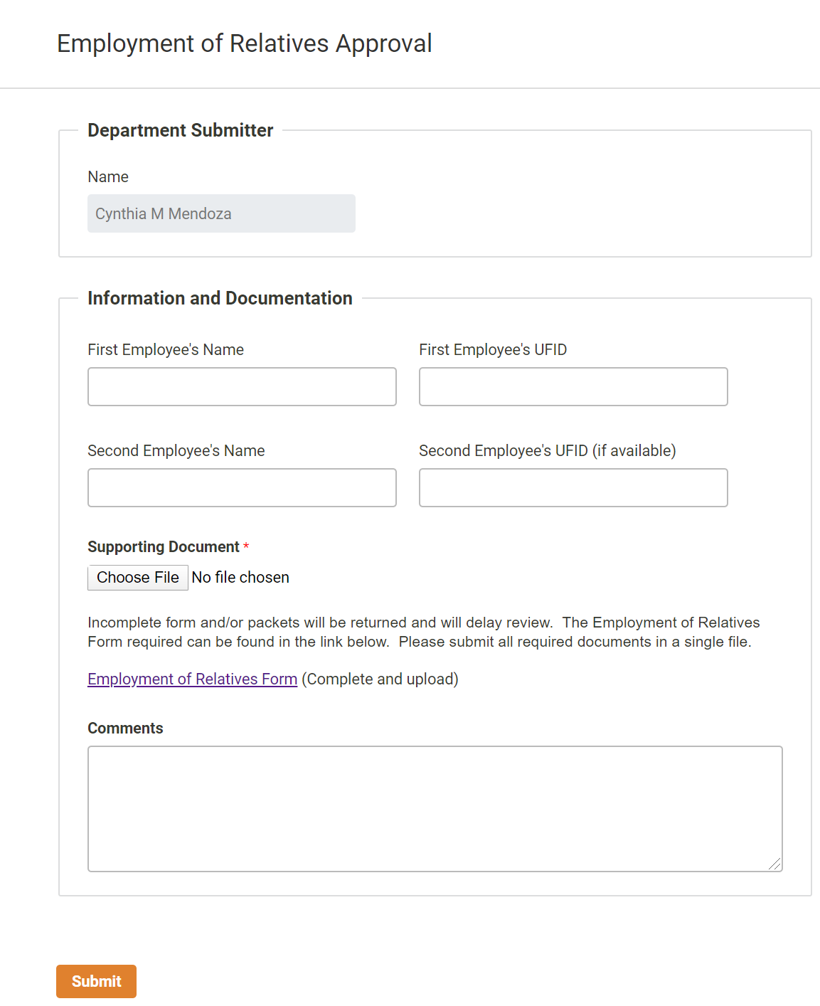

Slide 22
Spring Termination File
A total of 2819 employment records were processed through the termination file
This included the initial file started in February and the one opened in March
FWS employees were removed from the file completely
UFHR preeminence through people

Slide 23
Talent Acquisition & Onboarding
UF Hiring Pause

Slide 24
Hiring Pause
In response to the changing circumstances involving COVID-19, the University of Florida paused faculty and staff hiring effective Monday, March 30, 2020.
Positions Impacted
  All Faculty, Staff and OPS appointments with the exception of
    All contract and grant-funded positions, regardless of position type
    UF Health faculty and staff positions that are involved in the clinical enterprise
    Summer appointments of existing 9-month faculty
    Current searches for which offers already have been extended
UFHR preeminence through people

Slide 25
Hiring Pause
Notification to Applicants
  TA&O will notify applicants of delays in the selection and hiring process due to COVID-19 and place communication on the Careers @ UF website
Exceptions may be requested for the following reasons
  Campus and personal health and safety
  Compliance with federal, state, and local laws and regulations
  Delivery of essential University services
  Courses necessary for timely graduation
  Critical advancement of the university mission
UFHR preeminence through people

Slide 26
Hiring Pause
Exception to post and/or fill a position process
Hiring Pause Exception Request Form
  Can be found on the UFHR Forms (Managers) website
  Approval must be obtained from the appropriate dean and/or vice president
  Faculty and academic personnel must receive final approval from Dr. Joseph Glover or Dr. David Nelson, as appropriate.
  All staff postings will need final approval by the Vice President for Human Resources, Jodi Gentry.
UFHR preeminence through people

Slide 27
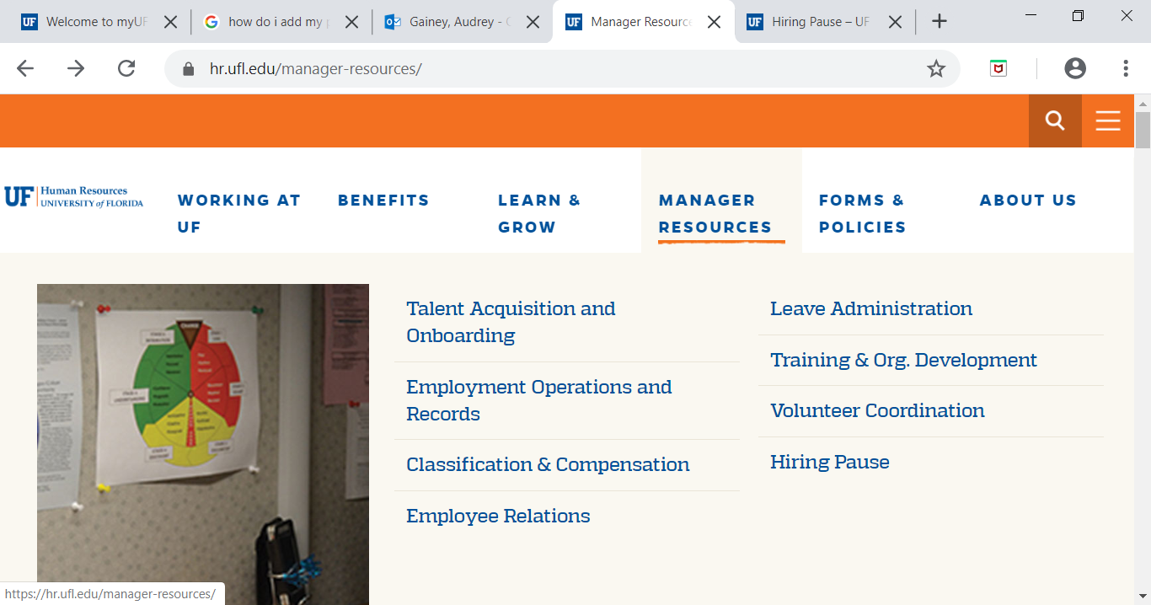
Manager Resources
https://hr.ufl.edu/manager-resources/
UFHR preeminence through people

Slide 28
Hiring Pause ePAF Changes
For positions with verbal offer prior to 3/30/20
  In ePAF comment: “Date of verbal offer made”
  When applicable: In offer letter include date of verbal offer made
For positions exempt per the Administrative Memo
  In ePAF comment: “Hiring pause exempt position per Admin Memo”
For positions approved for hiring pause exception
  In ePAF: Include Hiring Pause Exception Form and comment: “Exception form attached”
UFHR preeminence through people

Slide 29
Benefits and Leave
Emergency Paid Sick Leave
Expanded FMLA
CARES Act
Flex Spending Account Deadline

Slide 30
Emergency Paid Sick Leave
80 hours (pro-rated for part-time employees) of Emergency Paid Sick Leave will be provided to UF employees effective March 24, 2020.
Designed to allow employees to supplement or replace paychecks in the event they are unable to work or telework because the employee:
  Is subject to a federal, state, or local quarantine or isolation order related to COVID-19, including those unable to work due to the University’s reduction to essential operations on campus, or meet the criteria of the State Surgeon General Public Health Advisory.
  Has been advised by a health care provider to self-quarantine due to concerns related to COVID-19.
  Is experiencing COVID-19 symptoms and is seeking a medical diagnosis.
  Is caring for an individual who is subject to an order as described in (1) or self-quarantine as described in (2)
  Is caring for their child (under the age of 18) whose school or place of care is closed due to COVID-19 related reasons.
  Is experiencing any other substantially-similar condition specified by the US Department of Health and Human Services,
UFHR preeminence through people

Slide 31
Emergency Paid Sick Leave
Provides a greater benefit than required by the Emergency Paid Sick Leave Act, which has a daily benefit cap.
A unique TRC has been created for this leave: ESD.
  There are additional codes for international employees (ES7, ES8, ES9).
  Please do not use the standard ADMIN or Emergency Leave TRCs for this use.
USPS, TEAMS, Faculty, OPS, GA, Postdoc Associate, Student, and FWSP employees are eligible.
Employees should confirm eligibility and coordinate use with their supervisor and/or their HR liaison.
The amount of leave will be pro-rated based on FTE, i.e. a 0.5 FTE may record 40 hours.
UFHR-Central Leave will audit use and follow up with the appropriate HR Liaison in the event more than 80 hours are recorded.
UFHR preeminence through people

Slide 32
Emergency FMLA Expansion Act
Twelve weeks of EFMLEA will be provided to all eligible employees.
Eligibility has been extended to employees who have worked at UF for at least 30 days.
Only available to employees who cannot work or telework due to having to care for the child (under the age of 18) if the child’s school or place of care has been closed, or if the provider is unavailable due to the COVID-19 public health emergency.
Time taken under the EFMLEA will be factored into an employee’s annual FMLA entitlement
During the remaining 10 weeks, eligible employees will be provided with paid leave at 2/3 their normal rate of pay, capped at $200/day. Employees may use personally accrued leave to supplement the remaining 1/3 pay.
Additional information regarding recording this leave will be provided at the end of the week
UFHR preeminence through people

Slide 33
Coronavirus Aid, Relief, and Economic Security (CARES) Act : Retirement Impacts
In current form, allows participants to take penalty-free withdrawals from qualifying IRA, 401(k), 403(b), and 457(b) plans of up to $100,000 for those who meet certain eligibility criteria including:
  An individual diagnosed with COVID-19.
  An individual whose spouse or dependent is diagnosed with COVID-19.
  An individual who experiences adverse financial consequences as a result of being quarantined, furloughed, laid off, or having work hours reduced; and being unable to work due to a lack of childcare due to COVID-19, and other factors as determined by the Treasury Secretary.
Income tax on the distribution may be paid over a three-year period.
The 10% early withdrawal penalty will be waived.
UFHR preeminence through people

Slide 34
Coronavirus Aid, Relief, and Economic Security (CARES) Act : Retirement Impacts
Repayments are not subject to retirement plan contribution limits.
For the first 180 days from passing of the Act, loan limitations have been expanded from the lesser of $50,000 or 50% of the vested balance to the lesser of $100,000 or 100% of the vested balance.
Loan repayments due through December 31, 2020 are delayed for 1 year.
Required minimum distribution from defined contribution plans due in 2020 are waived.
Income tax on the distribution may be paid over a three-year period.
UFHR preeminence through people

Slide 35
HSA, HRA & FSA—CARES Act
The Coronavirus Aid, Relief, and Economic Security Act (CARES Act) signed into law contains important provisions that will affect HSAs, HRAs and FSAs.
Effective immediately:
  HSA-qualified health plans can now cover telehealth and other remote care service expenses below the HDHP statutory deductible limit, or at no or low-cost sharing, without affecting an account holder’s ability to continue contributing to their HSA. This provision will last until December 31, 2021.
  Over-the-counter drugs and medicines can be paid for or reimbursed through an FSA, HRA or HSA without a doctor’s prescription.
  Menstrual care products are now considered a qualified medical expense and are eligible for payment or reimbursement through an FSA, HRA or HSA. All expenses incurred after December 31, 2019 qualify, and the provision has no expiration date.
UFHR preeminence through people

Slide 36
COVID-19 Benefit Plan Changes
State Medical Plan Changes
Governor DeSantis increased access to care for all State Group Insurance Plan members
State HMO & PPO will allow for telehealth services and immunizations in retail pharmacies
Allows access to these services for the duration of the public health emergency period, if network providers are used
GatorCare Plan Changes
Early medication refill limits for 30-day prescriptions on maintenance medications have been waived
No copays for telehealth appointments related to COVID-19 symptoms
No copays and deductibles related to COVID-19 medical testing
UFHR preeminence through people

Slide 37
Flexible Spending Account
Claims Deadline Reminder
    Healthcare FSA and Limited Purpose FSA Plans
      Claims MUST be submitted by 4/15/20 for 2019 expenses
      Up to $500 of unused 2019 money may be used for 2020 expenses
      Dependent Care FSA Plan
      Claims MUST be submitted by 4/15/20
      May claim for eligible expenses incurred in 2019, and 2020 expenses through 3/15/20
  FSA Questions?
  Contact Chard Snyder 855-824-9284 or FloridaAskPenny@chard-snyder.com
UFHR preeminence through people

Slide 38
Important Dates
GBAS Spring Institute – April 21, 2020 – Canceled.
Contact gcadwallader@ufl.edu for future GBAS events.
Next HR Forum – May 6, 2020.

Slide 39

Thank you for attending the
HR Forum

