Slide 1



HR Forum
May 20, 2020

Slide 2
Today’s Agenda Items
UF Health COVID-19 Screening – Jodi Gentry, Amber Wuertz
UFHR Area Updates
  Employee Relations – Brook Mercier
  Employment Operations & Records – Melissa Curry
Important Dates
UFHR preeminence through people

Slide 3
UF Health COVID-19 Screening

Slide 4
Return to Work Process- Employee Experience
Step 1: Email from college/unit HR
Step 2: Email from UFHR
Step 3: Online UF Health COVID-19 Questionnaire
Step 4: Schedule COVID-19 swab test
Step 5: Await results
Step 6: Email from college/unit HR with instructions on when to return to on-campus location.
UFHR preeminence through people

Slide 5
Employees will receive an email from UFHR to login and complete the screening questionnaire.
Notes:
Let’s look at what this will look like for an employee. This is a screen capture of what the email looks like that will come from UFHR. There is instructions in the email routing the employee to the one.uf portal to complete the screening questionnaire. The email also includes information about the testing procedures. Upon receipt of the email

Slide 6
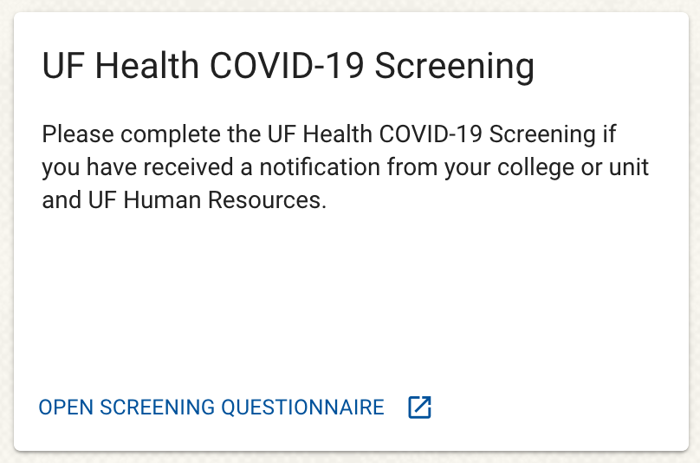
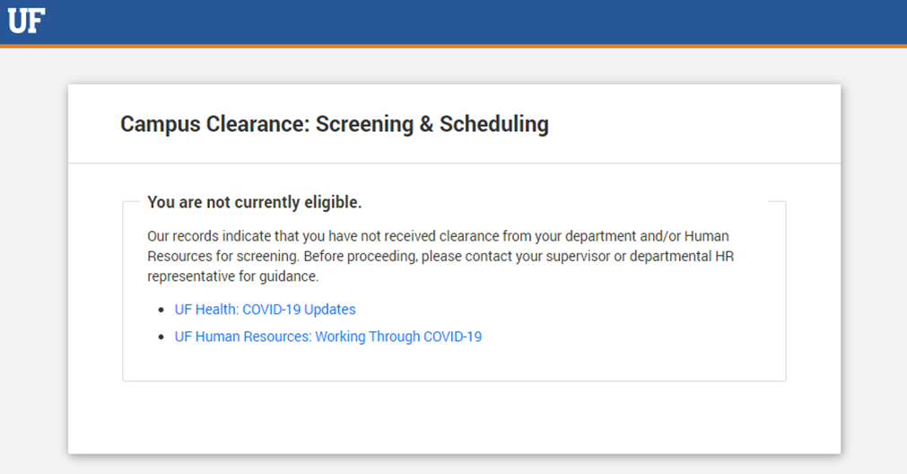
One.UF – UF Health COVID-19 Screening
NOTE: If an employee who has not received the email from UFHR attempts to open the screening questionnaire they will see the following:
Once employee's login to One.UF with their gatorlink credentials they will see the UF Health COVID-19 Screening and click Open Screening Questionnaire.
UFHR preeminence through people
Notes:
Once the employee enters the One.UF portal they will see the UF Health Covid-19 Screening card. Employees will click on the Open Screening Questionnaire. For those employees that have not yet received the email from UFHR try to complete the screening questionnaire they will see the following screen and should wait until prompted via email to complete the screening questionnaire.

Slide 7
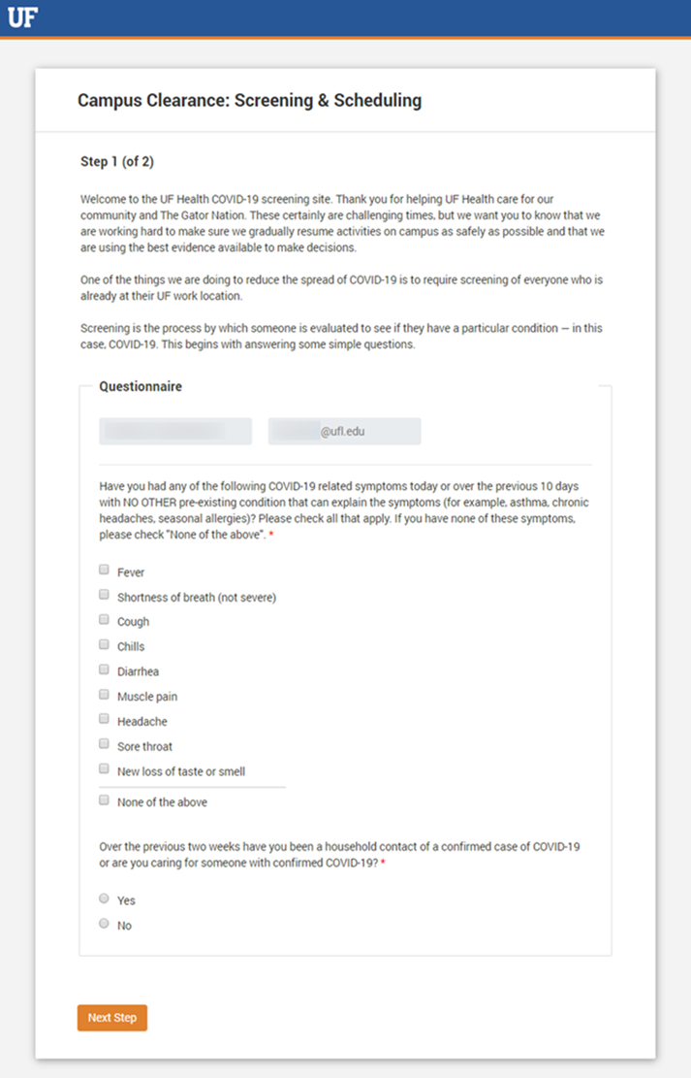
Employees will complete a brief questionnaire identifying if they have symptoms related to COVID-19.
Upon completing the questionnaire, the employee experience will differ based on answers.

Slide 8
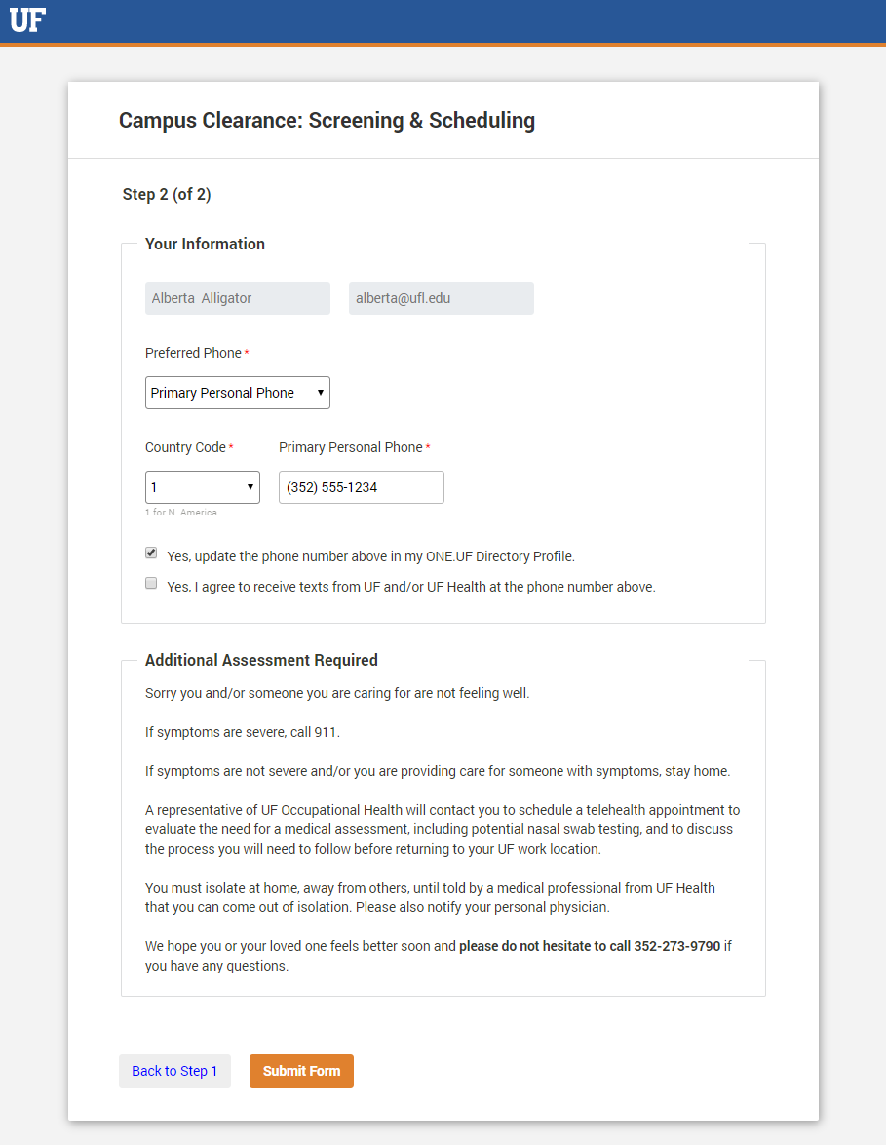
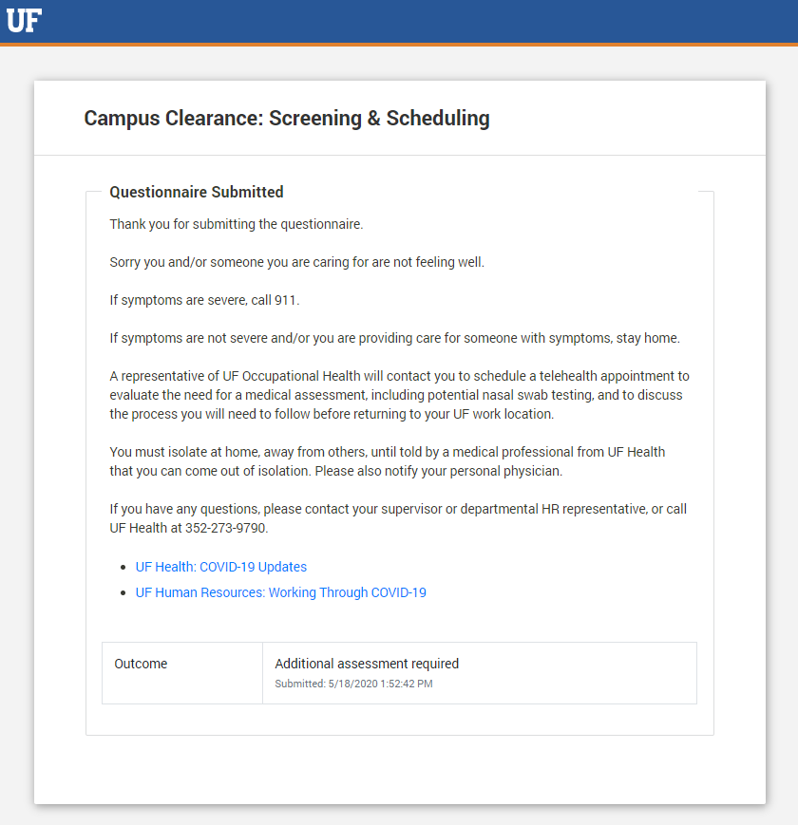
Questionnaire answers indicate symptoms of COVID-19
Symptomatic employees will be shown this screen and given the opportunity to update their phone number.
Once submitted they will see this screen
Notes:
A representative from UF Health will contact you to schedule a telehealth appointment and evaluate the need for medical assessment, including potential nasal swab testing, and to discuss the process you will need to follow before returning to your UF work location.

Slide 9
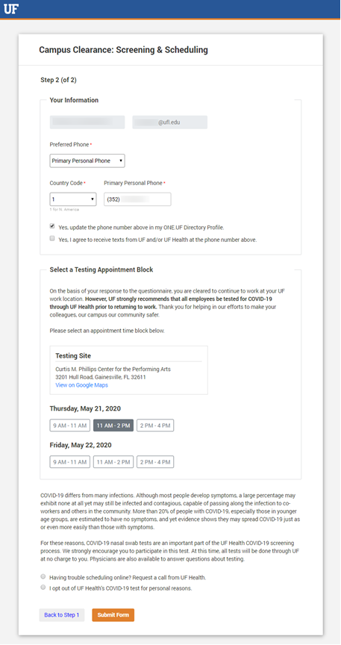
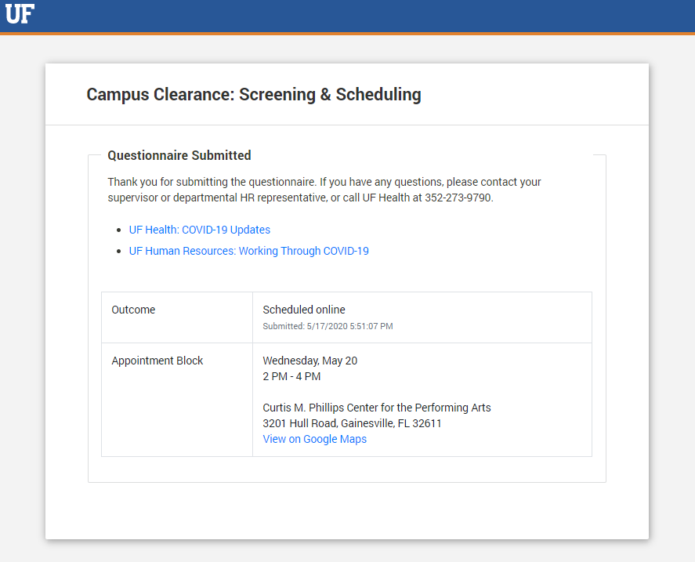
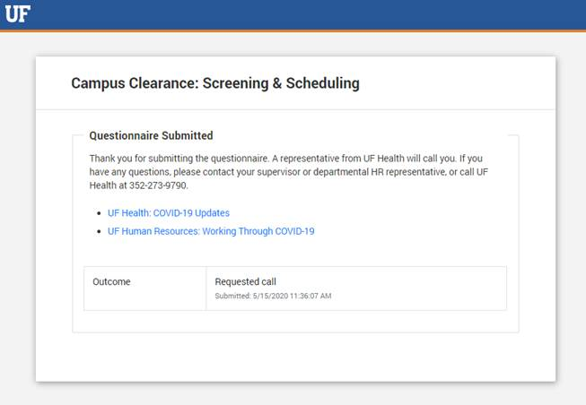
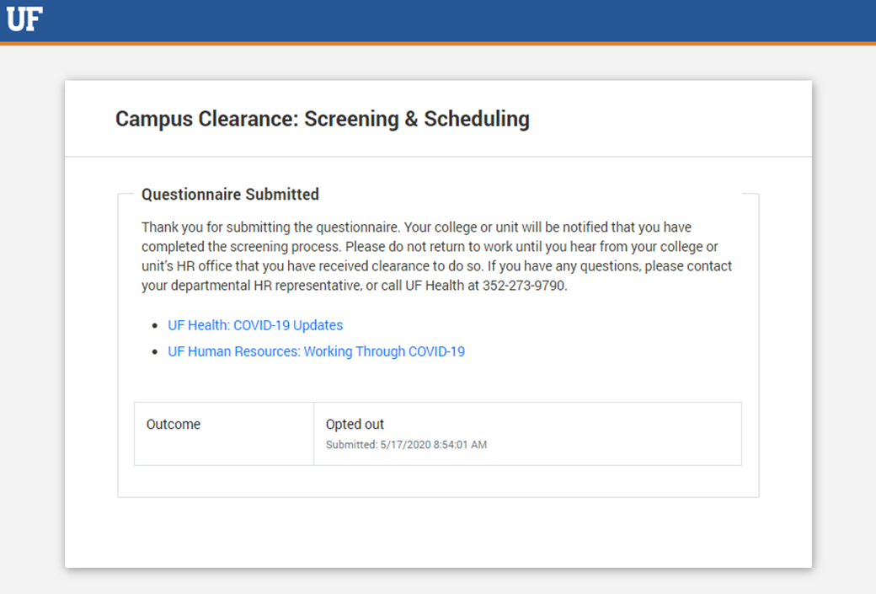
Questionnaire answers indicate NO symptoms of COVID-19
Scheduled online
Requested call for scheduling
Opted-Out

Slide 10
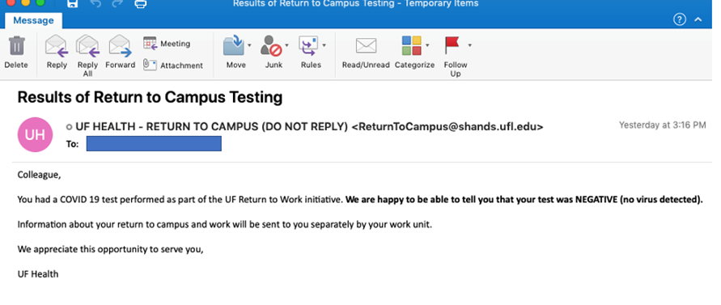

Results
Employees who test positive will receive a phone call from UF Health.
Negative test results are emailed directly to employees by UF Health.

Slide 11
Employee Relations
COVID-19: Institutional Recovery
and Return to the Workplace Policy

Slide 12
COVID-19: Return to the Workplace Policy
The policy provides guidance on what is required of UF employees for COVID-19 screening, returning to work, and working to create a safer environment
Employees are required:
  To be screened
  To return or continue to work in a UF work location after being cleared to do so
  Follow practices for promoting a safer work environment

Slide 13
COVID-19: Return to the Workplace Policy
Screening for COVID-19
UF employees who are returning to UF work locations must be screened for COVID-19 and cleared prior to returning to work.
Essential employees who are already working at a UF location will be screened in accordance with this policy and scheduling priorities.
Employees who are screened but not cleared to return to work must isolate at home, notify their supervisor and follow instructions from UF Health, and cannot return to work until cleared.

Slide 14
COVID-19: Return to the Workplace Policy
Screening for COVID-19
Employees are required to complete a COVID-19 Screening Questionnaire. As part of the screening process, it is UF policy that the employee also take a free COVID-19 nasal swab test administered through UF Health.
Outside of the return to work determination described in the policy, COVID-19 testing samples will only be used in accordance with Florida Department of Health rules and regulations.
Employees may elect to opt out of the COVID-19 test.

Slide 15
COVID-19: Return to the Workplace Policy
Return to the UF Work Location
After employees have been individually notified of the requirement to return to the workplace, they are expected to return after they have been screened and cleared to return.

Slide 16
COVID-19: Return to the Workplace Policy
Employee Responsibility for Working Safely
A face mask or cloth face covering will be required everywhere on campus and other UF work locations except when in a private office, a work area separated by at least six (6) feet from others or in an outdoor area separated by at least six (6) feet from others.
Employees not using a face mask or covering (outside of the exceptions noted) will be asked to put one on or leave the area to help maintain the safety of our staff, faculty and students.

Slide 17
COVID-19: Return to the Workplace Policy
Employee Responsibility for Working Safely
If employees are feeling sick, they must stay home until better, and consult with their physician if necessary.
If employees are experiencing COVID-19 related symptoms or have had prolonged exposure to someone who has tested positive, they are required to report this to their supervisor and HR Liaison, and may not report to work on campus or other University of Florida facility. Employees who test positive for COVID-19 must be cleared by UF Occupational Medicine.

Slide 18
COVID-19: Return to the Workplace Policy
Employees who seek an accommodation to the policy through the Americans with Disabilities Act (ADA) shall submit a Request for Reasonable Accommodation Based on Disability Form to the ADA Compliance Office.
Failure to adhere to the policy may result in:
  Being asked to leave the work location
  Letter of counsel, or disciplinary action, up to and including dismissal

Slide 19
COVID-19: Return to the Workplace Policy
The Policy is posted at:
https://hr.ufl.edu/forms-policies/policies-managers/institutional-recovery-and-covid-19-return-to-workplace/
For more information, contact:
  HR Liaison
  Employee Relations contact
  UFReturnToWork@hr.ufl.edu

Slide 20
Employment Operations
& Records
Two-Factor Authentication Updates

Slide 21
Two-Factor Authentication Updates
Two-factor authentication makes logins more secure by requiring two methods to verify your identity. For example,
  Username and password + smartphone app
  Username and password + phone call to landline
Why does UF use it?
  Helps to secure your logins from attackers exploiting weak or stolen credentials
  Helps fight against phishing, social engineering and password brute-force attacks
UFHR preeminence through people

Slide 22
Two-Factor Authentication Updates
In June 2020, enrollment in two-factor authentication will become a requirement
  All new employees will be prompted to enroll in two-factor authentication
  Current UF employees will also be required to enroll in two-factor – additional communication is forthcoming
What is needed?
  It is recommended to use the DUO mobile app
  A phone call to a landline can be used if the cellphone app is not a possibility
Additional information can be found at: https://it.ufl.edu/2fa/faqs/
UFHR preeminence through people

Slide 23
Important Dates
GBAS Virtual Series – The Power of MS Planner, May 21, 2020; 1:30-3:30 pm via Zoom
Upcoming HR Forums – Zoom information provided prior to each.
  June 3, 2020 – 10 a.m.
  June 16, 2020 – 1 p.m.
  July 1, 2020 – CANCELED
  July 9, 2020 – 1 p.m.
  July 20, 2020 – 2 p.m.
  August 5, 2020 – 10 a.m.

Slide 24

Thank you for attending the
HR Forum

