Slide 1
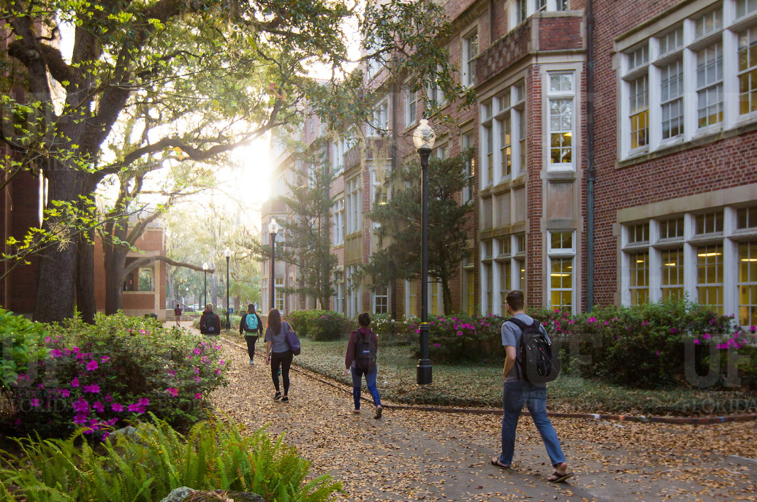
HR Forum
May 6, 2020

Slide 2
Today’s Agenda Items
COVID-19 Current State – Jodi Gentry
UFHR Area Updates
Training & Organizational Development – Bob Parks, Barb Mitola
Classification & Compensation – Matt Glicco, Brent Goodman
Benefits & Leave – Shannon Edwards
Important Dates
UFHR preeminence through people

Slide 3
Training & Organizational Development
Leadership Programs
Training Courses – Keep Growing
GBAS Virtual Training

Slide 4
Leadership Programs
Leadership program 2020-2021 cohorts
Advanced Leadership for Academics and Professionals
UF Academy
Managers Cohort
Programs will have a later application period (August/September) and later start than normal
Will announce details through this Forum and UF at Work later this summer
UFHR preeminence through people

Slide 5
Training Courses
Summer calendar of courses all offered remotely—spaces still available for most
Keep Growing: Offerings designed with a particular focus on needs of this moment—webinars, strategy sharing sessions, online articles, job aids, etc.
https://learn-and-grow.hr.ufl.edu/keep-growing/
UFHR preeminence through people

Slide 6
The Power of MS Planner
May 21, 2020, from 1:30 to 4:30pm
Level: beginners, intermediate, and advanced. Attend with your coworkers if possible.
Overview of Microsoft Planner
Integration with Teams
Sample Planners for HR and Fiscal tasks
Build a Planner for your area
Register in myTraining: UF_GBS600
Contact: gcadwallader@ufl.edu
UFHR preeminence through people
Notes:
Join your GBAS colleagues to explore the Power of Microsoft Planner. We will start with an overview of the Planner app and discuss how it integrates with many other Microsoft features to improve the efficiency of your workflow.
We will explore the thinking behind several Planners built for Fiscal and HR tasks. Then you will interact with a group to build a practice planner before you select a project or process from your area. Working collectively, your group will build a Planner for your process/project/work and share your thinking with the large group.
If you can attend as a team, you will get a start on ways to organize and manage the work in your area.

Slide 7
Classification & Compensation
TEAMS Titles Website Update
Organizational Chart Instruction Guide
Perquisite Renewals
Alternate Work Location Agreement Renewals
HR-600 Renewals

Slide 8
TEAMS Titles Website Update
What is it? Where to find it https://teams-titles.hr.ufl.edu/
Overview of recent Class & Comp projects and connection to UFHR Strategic Commitment
Preeminence through people → On Target Project → Compensation Project (Sibson Consulting) → Competency Project (Success @ Work)
Share screen updated TEAMS Titles page
UFHR preeminence through people

Slide 9
TEAMS Titles website update
New format, Pay Grades easily accessible, links to UFHR Career Maps and other UFHR core offices.
Staff Competencies with Behavior Statements & Interview Questions. Included T&OD Leadership, Libraries, and Advancement*.
Valuable resource in many business processes
Career development for employees
Management, employee development, and recruitment tool for supervisors
UFHR preeminence through people

Slide 10
Organizational Charts
Using supervisor information from myUFL, departments can generate organizational charts automatically using various tools such as Visio.
Class & Comp has published an instruction guide that provides step by step instructions using Visio and the Staff List with Supervisor Report that is available in Enterprise Reporting.
The instruction guide is found at http://training.hr.ufl.edu/instructionguides/job_position_actions/creating_org_chart_with_visio.pdf
UFHR preeminence through people

Slide 11
Organizational Charts
Tips
Make sure to remove duplicate employees from the file.
In some cases, you may have two employees with the same name but different UFIDs. You can address these instances by adding a “.” to the employee’s name.
Organizational charts generated using this approach will not include vacant positions, but they can be manually added.
Charts can be saved as PDF documents and saved with users who do not have Visio.
UFHR preeminence through people

Slide 12
Organizational Charts
UFHR preeminence through people

Slide 13
Organizational Charts
Organizational charts are useful when evaluating the organizational structure of a unit.
Class and Comp plans to begin using organizational charts as a tool when evaluating reclassification requests and new position actions for leadership roles.
UFHR preeminence through people

Slide 14
Organizational Charts
In reviewing UF’s current span of control, we found that 26% of staff supervisors have one direct report and 57% have less than three or less direct reports.
Having too few employees per supervisor, a narrow span of control, often indicates that there are too many staff with supervisory responsibilities which can adversely affect the efficiency and productivity of an organization.
For example: narrow spans of control can result in too much focus on internal reporting through the supervisor chain rather than high-value work.
UFHR preeminence through people

Slide 15
Organizational Charts
Appropriate spans of control vary based on a number of factors including:
Complexity of tasks
Geographic distribution of direct reports
Workload
Qualifications of the supervisor
Benchmarks adopted by other higher education institutions range form 6 – 7 direct reports per supervisor for complex functions (e.g. human resources, information technology, etc.) and 11 – 13 direct reports per supervisor for task-based functions (e.g. maintenance, grounds keeping, custodial services).
Source: Joint Legislative Audit and Review – Addressing the Cost of Public Higher Education in Virginia, November 2014 http://jlarc.virginia.gov/pdfs/reports/Rpt461.pdf
UFHR preeminence through people

Slide 16
Perquisite Renewals
As part of this year’s perquisite process, we are implementing a new perquisite form and transitioning perquisite records to OnBase.
The new form is found at form location: https://hr.ufl.edu/wp-content/uploads/2018/04/perquisites.pdf
As part of the transition, we will be asking units to redocument existing perquisites.
To ease the approval process, we have setup a DocuSign template and are currently working with the OnBase team to develop an online tool that will allow units to submit approved perquisites through a web application.

Slide 17
Alternate Work Location Agreements
Alternate work location (AWL) agreements that will continue into the 2020-2021 fiscal year should be submitted to UFHR by July 1.
All employees working from an AWL, including those approved as part of our response to COVID-19, will require approval using the traditional AWL agreement.
Faculty who will be working out-of-state during the summer should submit an AWL agreement
Faculty working internationally may require additional approval from UF Research and UF Human Resources
The renewal process is an opportunity to evaluate the success of the work arrangement and make modifications as appropriate.
Form location: https://hr.ufl.edu/wp-content/uploads/2020/01/Alternate-Work-Location-Agreement-Form.pdf
Dean/Director and VP Approval and Signature

Slide 18
HR-600 Renewals
Departments must renew extra state compensation commitments that extend into the new fiscal or academic year.
An updated HR-600 form and DocuSign template is available
The updated form clarifies that a Dean’s approval is required for faculty appointments.
UF Research, Grants Accounting, has been added as an additional approver for requests funded from 201 and 209 funds.
Requests can be sent to BA-CFO-CG-Mgmt@mail.ufl.edu

Slide 19
HR-600 Renewals
Form location: https://hr.ufl.edu/wp-content/uploads/2018/04/requestaddcomp.pdf
For new or existing commitments for Additional University Employment, complete a Request for Approval of Additional University Employment (HR-600) form and submit it to: HR600Request@ad.ufl.edu

Slide 20
Questions
Please contact Classification & Compensation at compensation@ufl.edu or by phone at (352)273-2842.
UFHR preeminence through people

Slide 21
Benefits and Leave
COVID-19 Retirement Incentive for Staff
EFMLEA Updates
Dependent Care FSA – Making Mid-Year Changes
FY19-20 Comp Leave Cash-Out Changes
Preparing for 2020 Fiscal Year End Leave
Short Work Break

Slide 22
COVID-19 Retirement Incentive for Staff
Eligible employees will receive payment for at least ¼ of their accrued sick leave balance, up to 480 hours.
Colleges and units may create additional sick leave incentive (i.e. payment of additional hours) if consistently applied. Notify UFHR-Benefits by COB May 11th if you plan to do so.
Retirees must provide notice by June 30th and retire/exit DROP from UF and the State between May 4th and September 30th.
UFHR preeminence through people

Slide 23
COVID-19 Retirement Incentive for Staff
TEAMS employees with 10 years of creditable service with UF and/or the State (which need not be consecutive) are eligible.
Payment for unused sick leave will be made, after mandatory and statutory deductions, to the bank account of record. Vacation funds in excess of $5,000 will route to the Special Pay Plan.
If approved by the department, an employee may use up to 160 vacation hours upon notice of termination. Retirees wishing to do so may not use these hours to extend employment past September 30th.
UFHR preeminence through people

Slide 24
COVID-19 Retirement Incentive for Staff
UFHR-Benefits staff are available to assist employees and departments through the retirement process.
Individual virtual and tele-conferences may be booked directly at https://benefits.hr.ufl.edu/contact/. We are also available at benefits@ufl.edu and at 352-392-2477.
Overview available online at https://hr.ufl.edu/covid-19/covid-19-retirement-incentive-for-staff/.
Contact Benefits immediately if an employee on GatorCare expresses interest in participation.
UFHR preeminence through people

Slide 25
EFMLEA Updates
As of the beginning of the week, UFHR has received over 230 requests for EMFLEA leave.
Prior, departments were advised to use the Reason Code ‘Medical’ when entering the Change of Employment Status ePAF.
A new code ‘EFMLEA’ has been created to more accurately track these leaves of absence.
UFHR-Central Leave will update those already submitted, but please use the new code for all new qualifying leaves.
UFHR preeminence through people

Slide 26
Dependent Care FSA—Making Mid-Year Changes
Employees may make changes to their Dependent Care FSA outside open enrollment ONLY if they have experienced a qualifying status change (QSC) event:
Reductions in a childcare provider’s availability
Change in employment status (increase or decrease of hours) for enrollee or spouse
Begin Family and Medical Leave Act (FMLA) leave of absence
Change of cost from the provider
Change of provider resulting in change of cost
May decrease the amount of their annual contribution to no less than the amount they have contributed as of the date of the request
Documentation of QSC event may be required
UFHR-Benefits contacted enrollees by UF email April 29, 2020
QSC and request to update contributions must be reported to PeopleFirst (866-663-4735) within 60 days of event
UFHR preeminence through people

Slide 27
FY 19-20 Comp Leave Cash-Out Changes
Overtime, regular, and compensatory leave will be cashed out on the final paycheck of FY 19-20 (06/19/2020).
Accrued balances (less use) as of the end of PPE 5/28/20 will be paid out.
To prevent negative balances and payroll corrections, TRCs pertaining to comp leave will be unavailable during PP 05/29/20-06/11/20.
Employees will enter PP 06/12/20-06/25/20 with comp leave balances accrued during the previous payroll period.
UFHR preeminence through people

Slide 28
Preparing for 2020 Fiscal Year End Leave Processes
Personal Holidays (USPS) and December Personal Leave Days (Teams & Eligible Faculty)
USPS Personal Holidays must be used in full day increments
December Personal Leave Days can be used in less than full-day increments
“Use it or lose it”--use by June 30, 2020 or will expire
UFHR preeminence through people

Slide 29
Preparing for 2020 Fiscal Year End Leave Processes
myUFL Toolkit available (https://learn-and-grow.hr.ufl.edu/toolkits-resource-center/)
Human Resources Toolkits > Time & Labor > Time and Labor Approvers/Processors > Preparing for Fiscal Year Leave Processes
Questions or Concerns?
Contact Central Leave at (352) 392-2477 or central-leave@ufl.edu
UFHR preeminence through people

Slide 30
Short Work Break for 9/10 Month Employees
SWB preserves benefits eligibility during the summer months for active 9/10 month employees
No benefit deductions taken over the summer months, even if additional compensation is provided (such as OPS employment)
Benefit coverage extends through September for those who have had all deductions taken
Last benefits deductions for 9/10 month employees:
April 24 paycheck for UFSelect and/or GatorCare plans
May 8 paycheck for State plans and GatorGradCare (GA plan)
Normal deductions resume in September.
UFHR preeminence through people

Slide 31
Important Dates
GBAS Virtual Series – The Power of MS Planner, May 21, 2020; 1:30-3:30 pm via Zoom
Next HR Forums – Zoom information provided prior to each.
May 20, 2020 – 10 a.m.
June 3, 2020 – 10 a.m.
June 16, 2020 – 1 p.m.
July 1, 2020 – CANCELLED
July 9, 2020 – 1 p.m.
July 20, 2020 – 2 p.m.
August 5, 2020 – 10 a.m.

Slide 32
Thank you for attending the HR Forum

