Slide 1

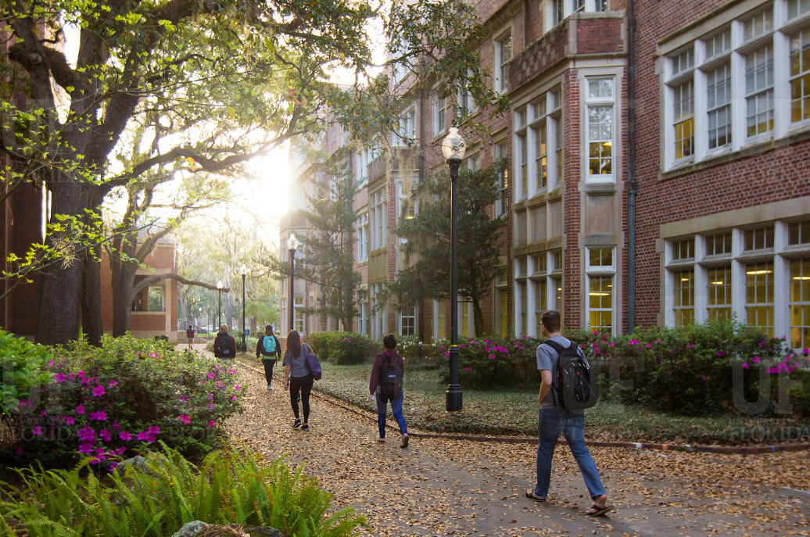

HR Forum
June 16, 2020

Slide 2
Today’s Agenda Items
COVID-19 - Return to Work – Jodi Gentry, Brent Goodman
UFHR Area Updates
Benefits & Leave – Shannon Edwards
Important Dates
UFHR preeminence through people

Slide 3
This Week’s Screening Schedule
Sending 6,063 screening questionnaires
Wednesday 6/17/2020
Remaining Faculty/Staff/OPS in the following colleges/units will be sent screening questionnaires:
Health Affairs
COTA
O’Connell Center
Natural History Museum
Office of the Provost
Nursing
UF Research
UFHR
HHP
Law
UFIT
Housing & Residence Education
Vet Med
University of Florida Press
Student Financial Affairs
Reitz Union
College of Business
Office of the President
CJC
Monday 6/15/2020
Remaining Faculty/Staff/OPS in the following colleges were sent screening questionnaires:
IFAS
College of Engineering
College of Public Health & Health Professions
College of Education
CLAS
Tuesday 6/16/2020
Remaining Faculty/Staff/OPS in the following colleges/units will be sent screening questionnaires
College of Medicine
DOCE
Advancement
Various Centers
Office of Admissions
College of Dentistry
DCP
Student Affairs
Finance and Accounting
Business Services
Graduate School
Student Health Care Center
Business Affairs
General Counsel
Libraries
Planning Design & Construction
Student Government
International Studies
UPD
Emergency Management
Strategic Communications & Marketing
EHS
Pharmacy
Government & Community Relations
UFHR preeminence through people

Slide 4
Nonresponsive Employees
3,581 employees who have received the questionnaire have taken no action. Emails went out Friday to each unit/college with a list of these employees.
Reminder: Communicate directly with these employees to be clear about your expectations that they must complete the screening now. The timing of the screening can be separate from the timing of your return to workplace/access to workplace/remote work location decisions. All UF employees are required to participate in the screening process under UF policy:
https://hr.ufl.edu/forms-policies/policies-managers/institutional-recovery-and-covid-19-return-to-workplace/
HR Liaisons and Supervisors should remind employees
Letter of counsel is the next step
Unauthorized leave without pay and dismissal may occur if an employee does not follow through
UFHR preeminence through people

Slide 5
Processes being addressed
Employee who do not show for scheduled appointments or cancel their appointments and do not schedule will receive a new screening questionnaire from UF Human Resources.
Employees who indicate symptoms and have a telescreen appointment and are cleared to continue the process will receive a new screening questionnaire from UF Human Resources.
UFHR preeminence through people

Slide 6
Benefits & Leave
COVID-19 Retirement Incentive for Staff
COVID-19 Leave Donations
COVID-19 Aid-A-Gator

Slide 7
COVID-19 Retirement Incentive for Staff
Eligible employees will receive payment for at least ¼ of their accrued sick leave balance, up to 480 hours.
Colleges and units may create additional sick leave incentive (i.e. payment of additional hours) if consistently applied. Units should have notified UFHR-Benefits by May 11th if providing additional incentive.
Retirees must provide notice by June 30th and retire/exit DROP from UF and the State between May 4th and September 30th.
So far, 63 employees have taken advantage of the incentive, representing a total annual salary savings of $3.892M.
UFHR preeminence through people

Slide 8
COVID-19 Retirement Incentive for Staff
TEAMS and USPS employees with 10 years of creditable service with UF and/or the State (which need not be consecutive) are eligible.
Payment for unused sick leave will be made, after mandatory and statutory deductions, to the bank account of record. Vacation funds in excess of $5,000 will route to the Special Pay Plan.
If approved by the department, an employee may use up to 160 vacation hours upon notice of termination. Retirees wishing to do so may not use these hours to extend employment past September 30th.
UFHR preeminence through people

Slide 9
COVID-19 Retirement Incentive for Staff
UFHR-Benefits staff are available to assist employees and departments through the retirement process.
Individual virtual and tele-conferences may be booked directly at https://benefits.hr.ufl.edu/contact/. We are also available at benefits@ufl.edu and at 352-392-2477.
Overview available online at https://hr.ufl.edu/covid-19/covid-19-retirement-incentive-for-staff/.
Contact Benefits immediately if an employee on GatorCare expresses interest in participation.
UFHR preeminence through people

Slide 10
COVID-19 Leave Donation Update
We are grateful to all who generously donated vacation and/or sick leave to help our fellow employees!
Over 271,000 hours donated
Donated hours available to assist UF employees unable to work due to COVID-19
As of 6/10, 290 requests for hours were submitted and nearly 17,000 hours have been awarded
Any unused hours will be returned to the donors later in the year
Questions? Email covid19leavedonation@hr.ufl.edu or call (352) 392-2477
UFHR preeminence through people

Slide 11

Emergency grants provided to employees experiencing an unforeseen, temporary financial hardship
Employees may apply for a grant through Aid-a-Gator at any time
Since start of COVID-19 pandemic, 352 applications have been received and nearly $32,000 in aid disbursed to impacted employees
UF HR Benefits Office manages the Aid-a-Gator program for UF employees, and there’s a separate Aid-a-Gator program for students through UF Office for Student Financial Affairs
Aid-a-Gator is funded by donations--consider helping out your fellow Gator employees by making a donation to Aid-a-Gator now or anytime!
More information is available on the Aid-a-Gator website
UFHR preeminence through people

Slide 12
Important Dates
June 19 – Final paycheck for FY19-20. Overtime, regular, and compensatory leave will be cashed out on this check.
June 30
Last day to use Personal Holidays (USPS) and December Personal Leave Days (TEAMS & Eligible Faculty).
Last day for employees to provide notice of intent to take advantage of retirement incentive.
Upcoming HR Forums – Zoom information provided prior to each.
July 1, 2020 – CANCELED
July 9, 2020 – 1 p.m.
July 20, 2020 – 2 p.m.
August 5, 2020 – 10 a.m.

Slide 13

Thank you for attending the HR Forum

