Slide 1

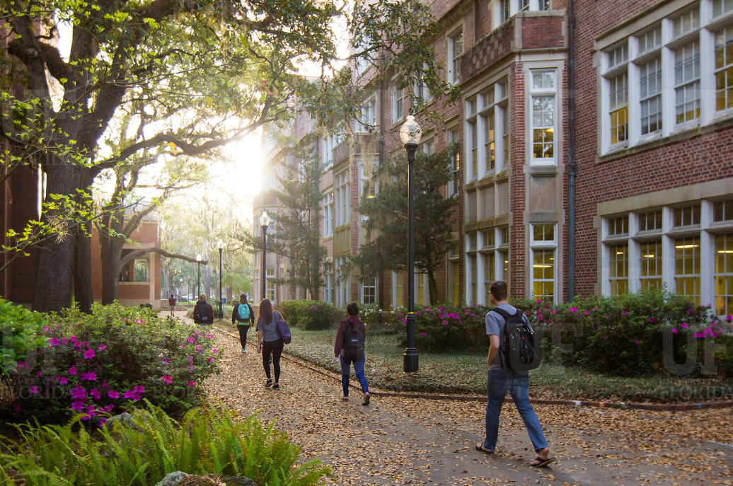

HR Forum
August 5, 2020

Slide 2
Today’s Agenda Items
Training and Professional Development to Address Racism, Inclusion, and Bias – Jodi Gentry
GBAS event announcement – Barb Mitola
Hiring During COVID-19 – Audrey Gainey
Interfolio Home Page Updates – Christina Salva
Supervisor ID Updates – Brent Goodman
COVID-19 Screening Questionnaire – Amber Wuertz
Important Dates
UFHR preeminence through people

Slide 3
Training & Organizational Development
Addressing Racism, Inclusion, and Bias
President Fuchs’ June Message:
UF will require training of all current and new students, faculty, and staff on racism, inclusion and bias

Slide 4
Racism, Inclusion, Bias
This fall: Online training will be required of all faculty, staff, and students
Diversity: Inclusion in the Modern Workplace
Diversity, Equity, and Inclusion for Students
Managing Bias
August 10—100 UF voices will begin efforts to identify a competency model and training/professional development for racial justice to cultivate ongoing and more robust learning
UFHR preeminence through people

Slide 5
Training & Organizational Development
Gator Business Administrator Services (GBAS)
GAME ON! Networking Event
Notes:
Section slide

Slide 6
August 13
3:30pm – 4:30pm
Inside GBAS Virtual Training Team in Microsoft Teams
NO Registration, just show up for some learning and networking.
Questions? Contact: gcadwallader@ufl.edu
GAME ON!
GBAS Escape Room
Networking Event to Explore and Learn in MS Teams
Notes:
Messaging – link was sent to the GBAs list serv.
Join the GBAS Community of Practice and reconnect with your colleagues across campus and the state on August 13th from 3:30 to 4:30pm. We will be hosting a networking event, where you can explore MS Teams and take on a challenge with your peers. Like an escape room, participants will try to solve clues while socializing with other business and research administrators.
Our purpose is three-fold, learn more about MS Teams, stay connected, and build new relationships.
No registration is required. Join us in the GBAS Virtual Team Training room.
NOTE: You will need access to Microsoft Teams for this event.

Slide 7
Talent Acquisition & Onboarding
Hiring During COVID-19
Interfolio Home Page Updates

Slide 8
Hiring During COVID-19
UFHR has established a process and best practices for initiating COVID-19 screening for new hires.
Origination of Hire ePAF:
The Hire ePAF should be originated as soon as possible to provide the new employee sufficient time to create their Gatorlink and be contacted to complete the questionnaire.
If the Hire ePAF is entered for the purpose of generating the Gatorlink invitation and it is not complete, add the following comment: “ePAF generated to trigger COVID-19 screening, please recycle”.

Slide 9
Hiring During COVID-19
Timelines:
Reports capturing pending ePAFs are generated every Monday (excluding holidays).
Allow 5 business days after the Hire ePAF is originated for the screening questionnaire to be emailed to the new employee.
Hires with effective dates of 7 days or less will be prioritized.
Once the new employee receives the screening questionnaire, they are instructed to complete it within 48 hours of the request.
If the new employee should opt to test, they will have a three-day testing block to select from. Once tested, 48 hours should be allowed for results.

Slide 10
Hiring During COVID-19
Clearance Notification:
UF Health provides clearance notification to UFHR
Level I Approvers view clearance in the Remote Work File
UF Health provides results to new employee
Hiring Department confirms with new employee start date on campus
ePAF Approval:
New hires must complete the COVID-19 screening and be cleared to return to campus prior to physically being on UF premises
ePAF can still be approved while waiting for COVID-19 screening clearance, but new employee would only be able to work remotely until the COVID-19 clearance is available

Slide 11
Hiring During COVID-19
Notes:
If they have issues receiving their Gatorlink email invitation, visit: http://identity.it.ufl.edu/process/gatorlink/create-account/ to resend the invitation
Required Security to access the file in myUFL: UF_EPAF_Department Admin –OR UF_EPAF_Level 1 Approver
To review a new hire's clearance to return to campus, visit the UF Remote Work file. my.ufl.edu navigation: Main Menu > Human Resources > Workforce Administration > Job Information > UF Remote Work
Academic letters (Faculty and graduate assistants) will not change start effective dates.

Slide 12
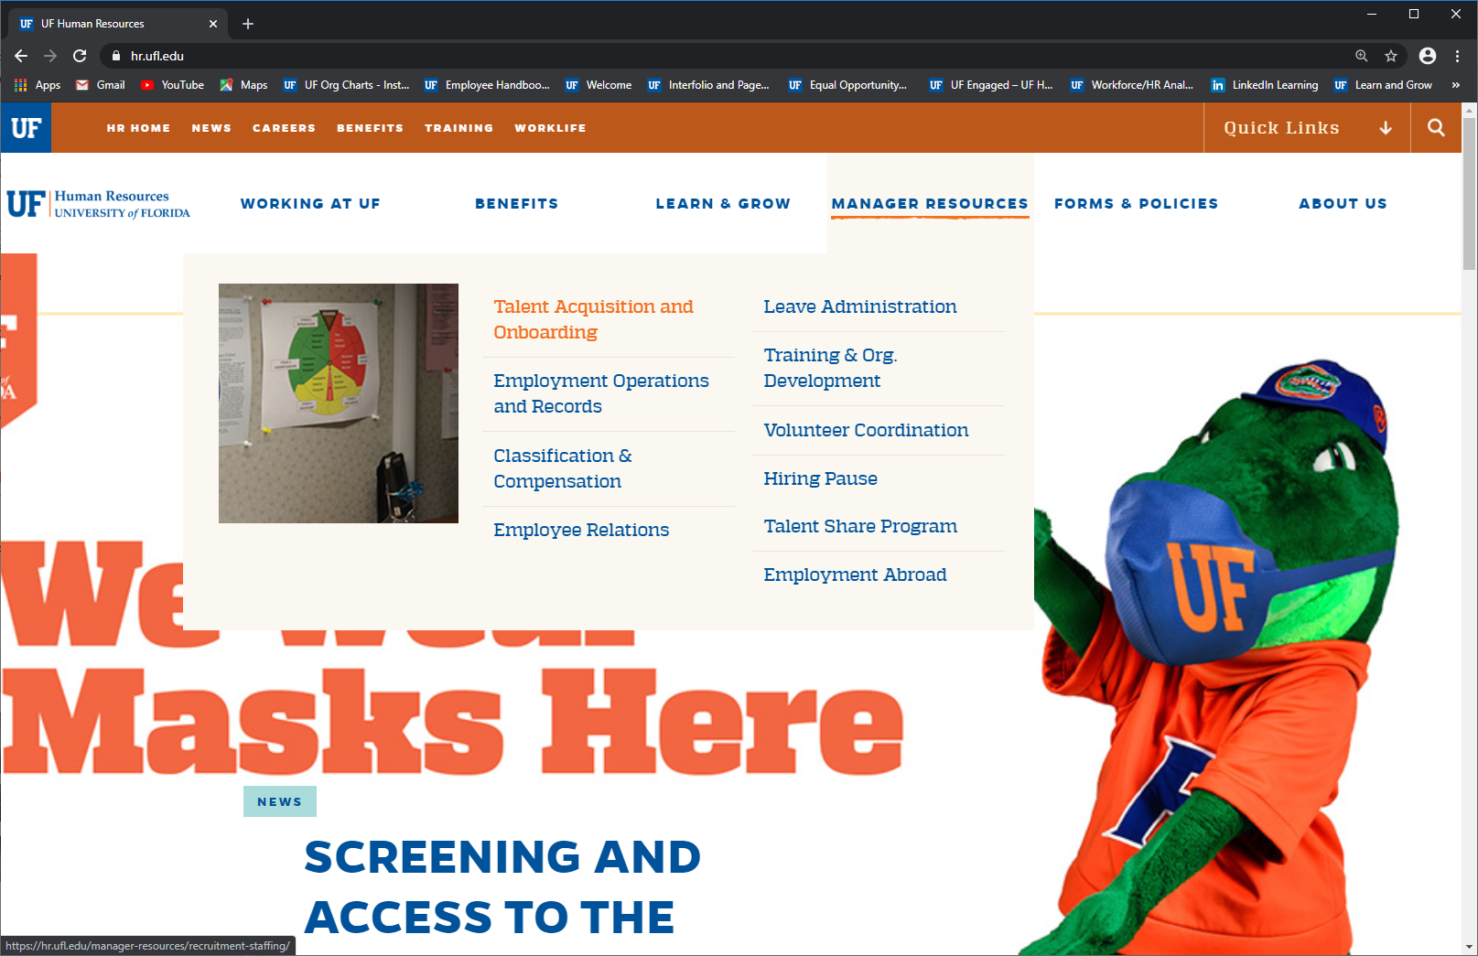
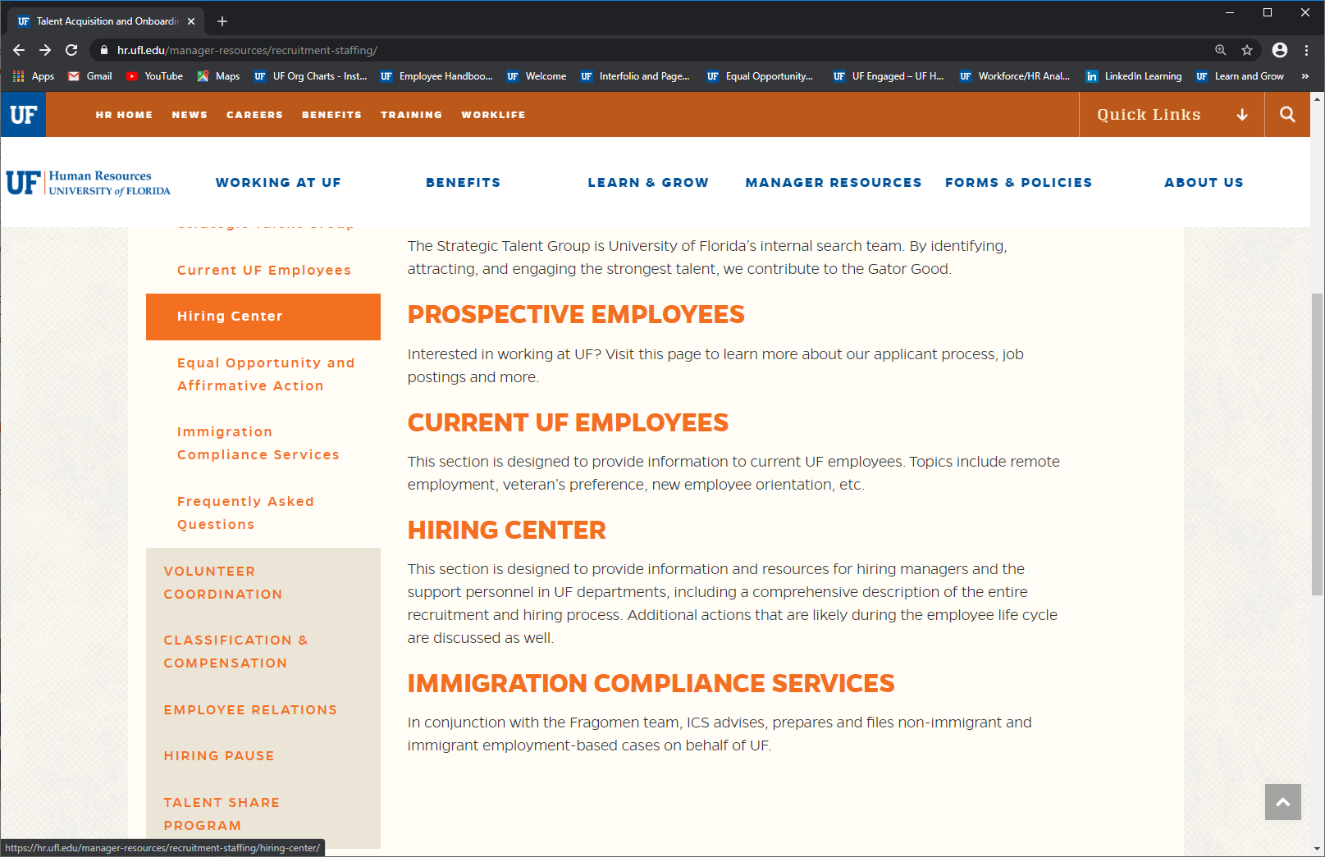
Hiring During COVID-19
Additional information can be found at: https://hr.ufl.edu/manager-resources/recruitment-staffing/hiring-center/new-hire-and-covid-19-screening/
For clearance information, contact:
Talent@hr.ufl.edu

Slide 13
Interfolio Home Page Updates
Effective Wednesday, August 5th
New dashboard feel that makes better use of screen space.
Highlights:
Your Action Items has been renamed Your Tasks. Your Tasks displays a count of all current tasks.
Above the table, two panels display a count of Read Tasks and Unread Tasks. These provide counts of the tasks that users have clicked on and tasks users have not clicked on.
Instead of showing all tasks on the Home page, seven are shown. You may click View All to see all tasks on the new expanded tasks page.
A Search bar above the table allows keyword searching of all tasks. Search terms are highlighted in the results.

Slide 14
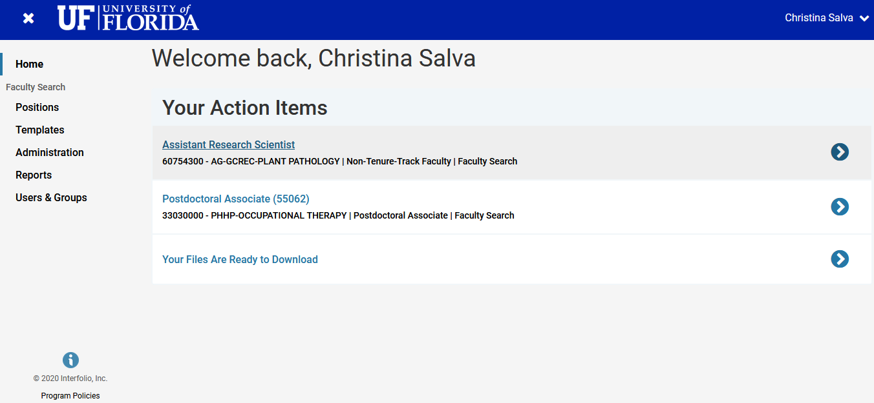
Current Interfolio Home Page

Slide 15
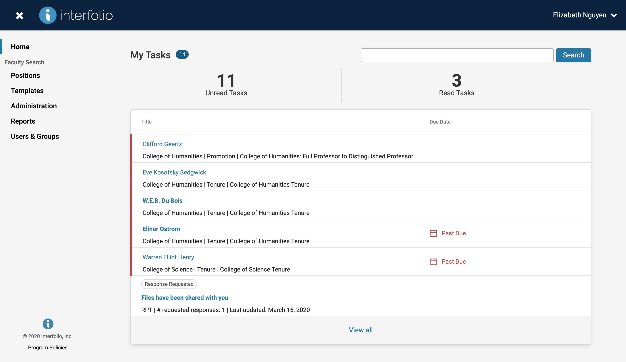
Updated Interfolio Home Page

Slide 16
Interfolio Home Page Updates
Effective Wednesday, August 5th
Only impacts the home page
Questions? Contact your assigned Talent Specialist or talent@hr.ufl.edu.

Slide 17
Class and Comp
Supervisor ID Updates

Slide 18
Supervisor ID Updates
As of Monday, UFHR reviewed supervisor ID information in myUFL and found that 427 employees (1.2%) are missing supervisor information.
Several processes including UF Engaged, UFOLIO, and the Screen, Test, & Protect Program utilize supervisor ID information.
Incorrect supervisory information in myUFL can cause supervisors to not receive important communication regarding their employees.
Please take a moment to review supervisory information and update as appropriate.
UFHR preeminence through people

Slide 19
Supervisor ID Updates
Supervisor ID
To aid in updating and maintaining supervisor information in myUFL a report has been made available in Enterprise Reporting
myUFL / Main Menu / Enterprise Reporting / Access Reporting / Human Resources Information / Workforce Information / Staff List with Supervisor Info by Department
Depending on the number of reports available to you, you may have to advance to the next page to find the report
UFHR preeminence through people

Slide 20
Questions
Please contact Classification & Compensation at compensation@ufl.edu or by phone at (352)273-2842.
UFHR preeminence through people

Slide 21
COVID-19 Screening Questionnaire

Slide 22
New Questions Added
Effective August 1, 2020
New hires and any remaining employees that have not gone through the RTC process.
Additional questions are only visible if a person selects the option to schedule a test.
UFHR preeminence through people

Slide 23
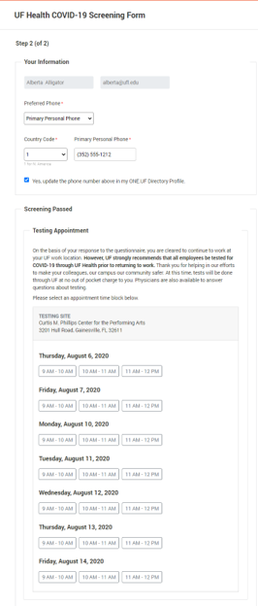
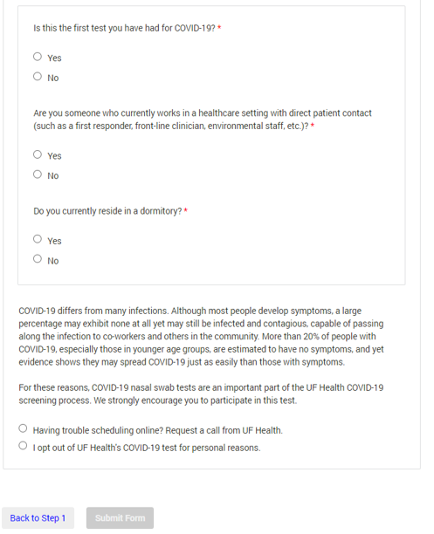
Questionnaire: Step 2 (Scheduling Test)
Is this the first test you have had for COVID-19?
Are you someone who currently works in a healthcare setting with direct patient contact (such as a first responder, front –line clinician, environmental staff, etc.)
Do you currently reside in a dormitory?
UFHR preeminence through people

Slide 24
Important Dates
Upcoming HR Forums – Zoom information provided prior to each.
September 2, 2020 – 10 a.m.
October 7, 2020 – 10 a.m.

Slide 25

Thank you for attending the HR Forum

