Slide 1


HR Forum
September 2, 2020
WWW.HR.UFL.EDU

Slide 2

Today’s agenda
Furloughs Policy
Benefits: Fall 2020 Change Management
Competitive Retirement

Slide 3

Furloughs Policy

Slide 4
furloughs policy
Minimizing financial impact to preserve faculty and staff jobs
UF is considering a variety of measures to prepare for possible budgetary challenges
Furloughs are mandatory unpaid partial or full leaves of absence
Benefits furloughs provide include:
Preserving continuous service, length of service and hire anniversary date
Continued access to health benefits and employer contributions to health insurance
Potential eligibility for unemployment and expanded CARES Act benefits
Currently no plans for implementing across-the-board furloughs
Policy is being drafted and reviewed as a preparatory measure

Slide 5
Benefits: fall 2020 change management

Slide 6
Helping faculty and staff navigate multiple changes
A fall semester like no other
We’ve already adjusted to significant unexpected change
Several initiatives, already in motion, need to continue to move forward
Changes being discussed this fall for phased implementation in 2021:
Paid family leave
Paid time off with medical leave accounts
Voluntary/supplementary retirement plan administration
Open Enrollment

Slide 7



Return to the workplace
May 1
President Fuchs announces plans to begin bringing more faculty and staff back to the workplace
UF Health Screen, Test & Protect initiative introduced
May 18 Board of Governors announces reopening of State University System
June 1 UF formally announces reopening plan

Slide 8



Moving forward
June 25
United Faculty of Florida and UF agree to move forward with adding 8 weeks paid family leave and conversion to paid time off with medical leave accounts
Spring/Summer
UF committee comprising faculty and staff with financial and HR expertise evaluate UF-administered retirement plans

Slide 9
Our dilemma
Summer 2020 — a season of unprecedented change
Returning 26,000 faculty and staff back to the university
Returning 75% of our students to campus facilities
Faculty navigating new ways of teaching—whether in the classroom or online
More than 400 new faculty this fall
Secondary school reopening evolves to hybrid offerings, delayed start
How do we communicate in a way that helps faculty and staff assimilate new information without becoming overwhelmed or missing the messages?

Slide 10
a consolidated approach
Using principles of change management, beginning Fall 2020:
Inform the entire institution that the University of Florida is elevating its approach to its benefits offerings and providing enhanced information about the full range of benefits available to faculty and staff
Engage faculty and staff so they understand their full range of benefits, are clear about changes that are coming and understand how they may be impacted
Prepare those affected through opportunities for personal consultation; prepare administrators through training and guidance
Integrate changes into current infrastructure (websites, forms, Employee Handbook, etc.)

Slide 11
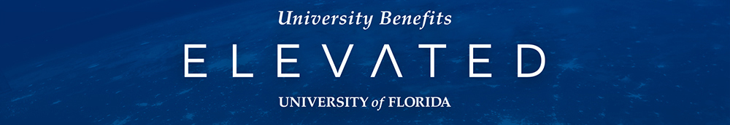
Key messages
As UF aspires to become one of the nation’s top public research universities, we are dedicated to elevating our suite of benefits offerings to support the wellbeing of our faculty and staff and to be responsive to a range of individual and family needs.
With this in mind, we’re introducing some exciting enhancements and changes to our leave and investment plans that will take effect in 2021.
We know navigating the full range of benefits UF already has to offer can sometimes be overwhelming, and we want you to know that we’re here to help.
This fall, we’ll be providing opportunities for you to learn more about what’s changing as well as more about all UF has to offer through a series of informational events and resources.

Slide 12
Timeline
September 8 | Admin Memo: Leave, leave webpages launched
September 9 | Announce town halls with form, link in UF at Work, Faculty Update
September 10 | First Town Hall
September 11 | Town Hall follow-up, further details on future engagement opportunities
September 16 | Special HR Forum: Open Enrollment changes and other updates
September 21 | UF Benefits Elevated website, communications launch
September 22 | Faculty-specific town hall on leave changes
September 24 | Staff-specific town hall on leave changes

Slide 13
Late september-october
Further learning and engagement opportunities planned include:
Introductory videos
Webinar series
Q&A / “drop-in” sessions offered via Zoom
Enhanced customer service – dedicated staff member available “on-call” throughout the day to field questions, exploring chat functionality for website
Provide tools & talking points for administrators to ensure communications are consistent

Slide 14
We want to hear from you
Ideas that would help?
Thoughts to share?
Hearing consistent concerns?
Email hrcommunications@hr.ufl.edu

Slide 15
Competitive retirement

Slide 16
COMPETITIVE RETIREMENT
Contracted with Sibson Consulting to evaluate competitiveness of state and university‐sponsored benefits
State of Florida’s retirement benefit lags
As an aside: Added a 401(a) plan that would allow additional employer contributions for retirement when the institution is ready
Alongside this evaluation of our retirement landscape, we reviewed the infrastructure surrounding all of UF‐sponsored defined contribution plans
A need for more formal governance to support those plans

Slide 17
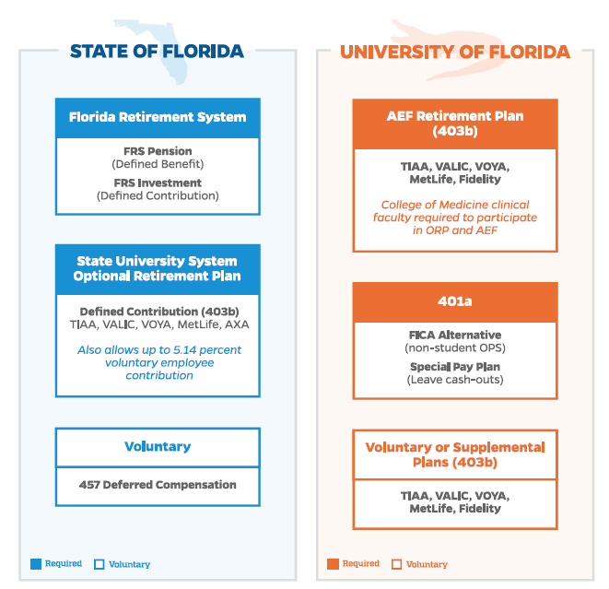

Slide 18
UF-SPONSORED DEFINED CONTRIBUTION PLANS
To better support employees, are adopting a more formal governance and review process for our four UF‐sponsored defined contribution plans, which have more than $1 billion in assets
The University of Florida 403(b) plan (voluntary)
The J. Hillis Miller Health Center 403(b) plan
The University of Florida Board of Trustees 401(a) FICA Alternative and Special Pay Plan
The University of Florida 401(a) Retirement Contribution Plan (yet to be funded)

Slide 20
WHY?
Clarify roles and responsibilities
Provide a more formal framework for effective decision‐making by:
Instituting formal fiduciary investment governance to include a Governing Board, Investment Advisory Group, and professional investment advisors
Implementing regular reviews of our UF‐sponsored defined contribution plans
Leveraging economies of scale of UF‐sponsored investments more effectively to ensure transparency and competitiveness of any service provider fees and associated terms
Reducing the number of record‐keepers and investment options to improve clarity about investment choices

Slide 21
NATIONALLY…
Concerns about
Retirement plan fees
Multiple record‐keepers
Hundreds of investment options
UF has five record‐keepers for their voluntary 403(b) plans with more than 500 available investment options
To do what’s best for our employees, we need to maintain appropriate investment policies as well as monitor and review plan investments, service provider fee terms, and similar fiduciary matters on a regular basis

Slide 22
IMPACT ON EMPLOYEES
One recordkeeper—reduce participant administration fees, simplify participant enrollment
Fees will be more transparent
New streamlined investment menu will be offered—best-in-class investment options, organized in tiers, from which employees can create a diversified portfolio
A self-directed brokerage window will also be available for investors who want access to additional options
Some funds will automatically transfer; others will stay where they are unless employees elect to move them (which will be made as easy as possible)

Slide 23
Town hall today

Slide 24
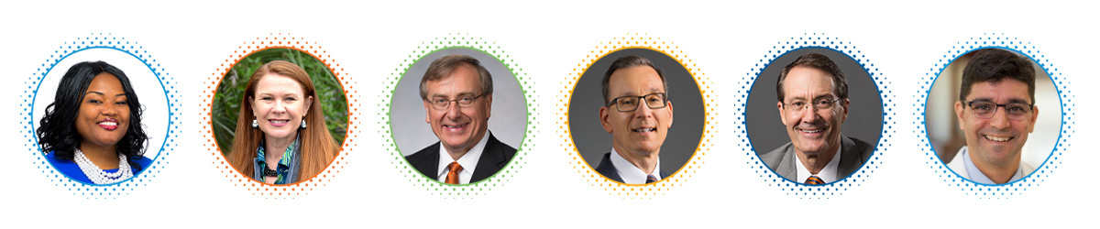
University town hall
Wednesday, September 2, 4-5 p.m.
Email hrcommunications@hr.ufl.edu
Look for link in today’s issue of UF at Work.
Recording will be available for those unable to attend in person.
For recordings of town halls held throughout the summer:
https://hr.ufl.edu/covid-19/screening-and-return-to-campus/town-halls-and-online-events

Slide 25

THANK YOU
WWW.HR.UFL.EDU

