Slide 1

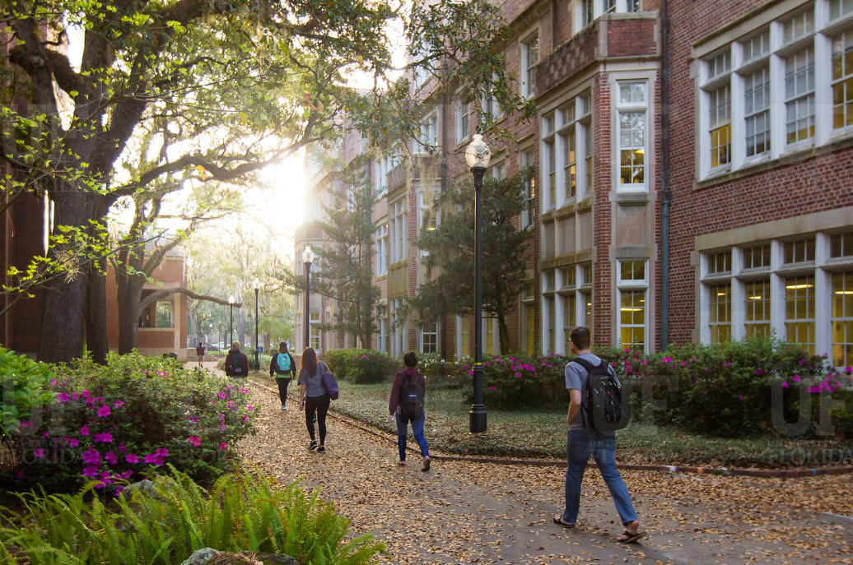

HR Forum
November 4, 2020

Slide 2
Today’s Agenda Items
GBAS Update – Gwynn Cadwallader
Employee Assistance Program & Additional Resources – Angie Brown
Florida Minimum Wage Increase – Brent Goodman
Foreign National Hire Process Reminder – Cynthia Mendoza
Upload Documents in ePAF Changes – Cynthia Mendoza
Termination File – Cynthia Mendoza
I-9 COVID Flexibility Update – Cynthia Mendoza
Upcoming Changes for E-Verify – Cynthia Mendoza
Benefits Open Enrollment – Shannon Edwards
December Leave Cashout – Shannon Edwards
403(b) Voluntary Deductions – Shannon Edwards
Important Dates
UFHR preeminence through people

Slide 3
Training and Organizational Development
GBAS Update
Notes:
Section slide

Slide 4
Strategic Budgeting
November 10, 2020 from 1:00 to 3:00pm
A transparent conversation about aligning resources to UF’s strategic vision priorities.
Register in myTraining: UF_GBS600
Registration Closes on November 6th at 5:00pm
Contact: gcadwallader@ufl.edu
UFHR preeminence through people
Notes:
Join UF leaders, Gator Business Administrator Services (GBAS), and MainSpring (UF Research) for an impactful session on strategic budgeting. Practicing fiscal responsibility and thinking critically about how we manage UF’s resources are key themes at GBAS events, and now more than ever, these skills will make all the difference in how UF moves forward together. For this session, we will hear from several core offices to help you think through strategies for how best to allocate your area’s precious resources in these challenging times.
Meet Chris Cowen, UF’s new CFO and Senior Vice President, as he shares his vision of creating a culture of transparency and communication regarding financial matters. Assistant VP for Financial Analysis and Budget, George Kolb, will highlight our current state and actions taken since March 2020. Jodi Gentry, Human Resources VP, will discuss the HR tools available to support resource decisions related to employees and demystify how these tools can be used during times of constrained resources.
Our current reality provides both a challenge and an opportunity. While we always think about how to manage our resources, let’s gather to reimagine and realign for UF’s priorities in the Decade Ahead.

Slide 5
At UF, By UF, For UF.
May 11-12, 2021
Connect, Learn, and Share in Real Time.
Professional Development for financial, human resources, research, and academic professionals.
UFHR preeminence through people
Notes:
The University of Florida will host the inaugural biannual conference for UF leaders, business & research administrators in May 2021.
This 2-day conference will provide highly impactful professional development for financial, human resources, research and academic professionals led by their peers and university experts in the field. The GBAS (Gator Business Administrator Services), MainSpring (UF Research), and UFLN (UF Leadership Network) communities will come together to share successful and innovative business and leadership strategies and explore ways to work more efficiently.
At UF’s core is an abundance of experts who are willing to share their expertise with members of our communities to further enhance UF practices and procedures. Our conference will showcase UF talent with peer presentations that aim to expand everyone’s professional development. UF’s ascendance to become one of the nation’s leading public universities has inspired long-term goals of establishing the REALITY conference as a biannual event and eventually expanding our network to include the entire state of Florida and beyond.
We invite you to join your peers to present your expertise, attend to learn, and network to build new relationships at this unique experience. Come and connect with your peers at the first ever community of practice conference, At UF, By UF, For UF.

Slide 6
GBAS Update
Looking Ahead to Spring Semester – Watch for the Video
November 10th from 1:00-3:00pm – Strategic Budgeting
December 15th from 2:30-4:00pm – Mindfulness
Mid November – Call for presenters
December 11th and 16th – Presenter Support Session
May 11th and 12th – Conference
UFHR preeminence through people

Slide 7
Communications & Worklife
Employee Assistance Program
Additional Resources
Notes:
Section slide

Slide 8
Employee Assistance Program
Support when you and your loved ones need it most
24/7 access to a licensed counselor
Telehealth services available
6 free visits per person, per household, per event, per calendar year
Available to faculty, staff, grad assistants, non-student OPS, house staff/residents, postdocs as well as their household members
Call 833.306.0103 and visit https://eap.ufl.edu for more information

Slide 9
Additional Resources
In-person or on-demand
Introduction to Mindfulness: 1- hour session for interested faculty and staff
UF Mindfulness: Weekly sessions on Monday evenings at 5:30
Guided meditation: 10-minute recordings available on our Wellness Toolkits
The Resilient Gator: Available for departments in-person or individually on demand
Wellness Library: includes recordings of previously held “Wellness Wednesday” sessions featuring UF faculty experts as well as recorded EAP webinars.
Sort by “Emotional” to discover sessions related to stress relief

Slide 10

We’re here to help
Request a program or reach out to let us know your needs
Bring an EAP introductory session to your department or faculty meeting
Request Introduction to Mindfulness or Resilient Gators for 8 or more faculty and staff
Watch for more information and resources later this month
Contact us at hrs-wellness@ufl.edu

Slide 11
Classification and Compensation
Florida Minimum Wage Increase
OPS Update
Notes:
Section slide

Slide 12
Florida Minimum Wage
On January 1, 2021, the state minimum wage will increase from $8.56 to $8.65 per hour and applies to all employees including FWSP, STAS, and OPS.
UFHR will process pay increases for all employees currently below $8.65 with an effective date of January 1, 2021.
UFHR preeminence through people

Slide 13
OPS Update
Earlier this year, the non-student hourly OPS hours threshold was paused due to the pandemic and the implementation of a hiring pause.
While the pandemic and hiring pause will continue to present challenges, we feel it’s important that we reimplement the hours threshold in order to ensure compliance with the policy.
Employees in the OPS Sponsored Project Non-Clerical, Clerical, Time-limited, and Special Risk classifications are subject to the 4,176 hour threshold.
Units with employees in these classifications who are at or approaching the threshold should begin working with their college/unit human resources team to develop a plan in order to achieve compliance.
Non-Student Hourly OPS Policy can be found at, https://hr.ufl.edu/wp-content/uploads/2018/08/Non-student-hourly-OPS-policy.pdf.
UFHR preeminence through people

Slide 14
OPS Update
Supervisors and administrators can track OPS hours using the OPS Hours Report found in PeopleSoft.
Main Menu
Enterprise Reporting
Access Reporting
Human Resources Information
Workforce Information
Working Hours Report OPSN
UFHR preeminence through people

Slide 15
Questions
Please contact Classification & Compensation at compensation@ufl.edu or by phone at (352)273-2842.
UFHR preeminence through people

Slide 16
Employment Operations and Records
Foreign National Hire Process Important Reminder
Upload Documents in ePAF Changes
Termination File
I-9 COVID Flexibility Update
Upcoming Changes for E-Verify
Notes:
Section slide

Slide 17
Foreign National Hire Process Important Reminder!
Social Security Number Field
Must contain an actual social security number or the UF TempID
Submitting an ePAF with an already created UFID that does not have this data will require the ePAF to be denied as it can’t go to Equifax without the SSN or the UF TempID
UFHR preeminence through people

Slide 18
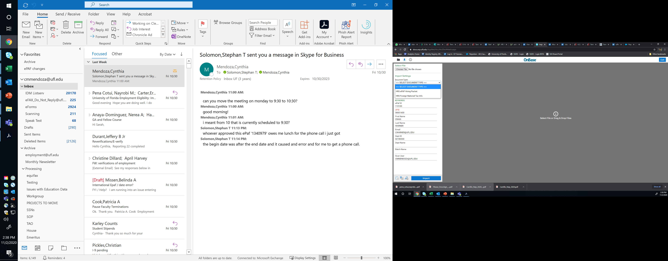
Upload Documents in ePAF Changes
For the past 10 years or so, when uploading documents to ePAF there has been only one option:
HRS ePAF Hiring Packet
With recent changes to the foreign national hiring process, we added 2 other options in the drop-down:
>>>>Select Document Type<<<<<
HRS Foreign National Tax Info
UFHR preeminence through people

Slide 19
Upload Documents in ePAF Changes
You must upload the documents to the correct document type
If the Select Document Type is left as default, the documents are not visible to ePAF approvers and will result in a recycled ePAF
HRS ePAF Hiring Packet
Should be used for all documents outside of tax documents for foreign national hires
HRS Foreign National Tax Info
Example: I-94, SDN List, Visa, DS-2019, I-20, etc.
UFHR preeminence through people

Slide 20
Termination File
Currently, there are about 2400 employment records that have not received a payment in 6 months or more
A termination file is now open through November 20, 2020
Effective date in Job Data: November 27, 2020
Why do we do a termination file?
Help mitigate unnecessary risks
Have an accurate count of our employment population
Assist departments in making good decisions for unit/college
UFHR preeminence through people

Slide 21
Termination File
Departmental HR professionals will need to review the termination file and “uncheck” those individuals who should remain active in the system
As we review the file, we may contact you for justification for requesting to leave certain employees active
The file may contain records of all the salary plans. For example, OPSN, FWS, STAS, OF12, etc.
* This is not an all-inclusive list
UFHR preeminence through people

Slide 22
Termination File
The termination file is located:
Main Menu > Human Resources > Workforce Administration > Job Information > UF Appointment Review
Enter the Year: 2020
Enter your unit’s Department ID
Enter Termination Date: 11/27/2020
Questions?
UFHR preeminence through people

Slide 23
I-9 COVID Flexibility Update
In March 2020, the U.S. Department of Homeland Security (DHS) announced the flexibility to review I-9 supporting documents for COVID-19 reasons
It is possible that this flexibility ends on November 19, 2020
Begin planning on an in-person process to verify those individuals who were reviewed remotely
A remote representative continues to be a viable option for those individuals working remotely
We will keep you up-to-date on the latest developments
UFHR preeminence through people

Slide 24
E-Verify and Tentative NonConfirmations (TNC)
E-Verify
E-Verify is the electronic process that verifies an employee’s eligibility to work in the U.S.
UF participates in E-Verify to maintain our federal contractor status
UF Policy is that all new employees participate!
Federal grants (NIH and NSF) awarded to UF departments are audited on E-Verify compliance regularly
A “Tentative Nonconfirmation” means the information entered by UF in E-Verify from a new employee’s Form I-9 does not match records available to the Department of Homeland Security (DHS) and the Social Security Administration (SSA)
UFHR preeminence through people

Slide 25
TNCs: Immediate Action Needed
Tentative nonconfirmations (TNC) occur regardless of the immigration status of a new employee and it is essential a corrective action is taken right away
As an employer, UF is required to notify the employee as soon as possible within 10 federal government working days
Currently, EOR handles these notifications and works with the new employee and the department to resolve these issues
UFHR preeminence through people

Slide 26

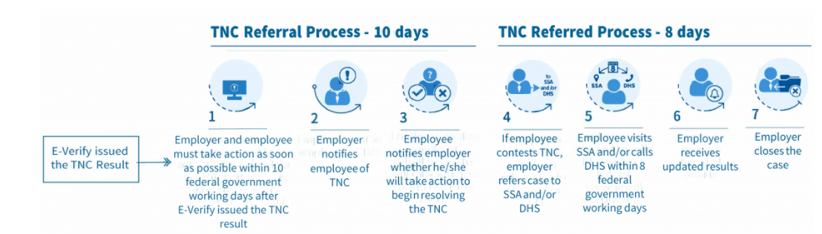
TNCs: The Process
UFHR preeminence through people

Slide 27
TNCs: The Change
Starting November 5, 2020, E-Verify will begin notifying employers not in compliance with this legal requirement
This 10-day requirement is a step-up from the previous timeframe of “a reasonable amount of time” to contest a TNC
EOR is currently testing an electronic process to inform the employees while maintaining departments as part of the communication loop
Previously, we met the employee in person
UFHR preeminence through people

Slide 28
TNCs: Your Role
If you and a new employee receive a TNC notification, prompt the employee to respond as soon as possible
Not responding within the 10-day window is considered choosing not to address the issue and will result in termination of employment
Remain calm so the employee can remain calm
Reassure the employee that usually these issues can be resolved quickly if action is taken right away
The employee will continue to work and get paid until a final response regarding an employee’s case is received
UFHR preeminence through people

Slide 29
Help Prevent TNCs!
Enter the name of the employee as it appears on their supporting documentation (social security card, passport, driver’s license, etc.)
If the employee has two first names and/or two last names, include both
Include other last names used when applicable
Verify all documents used to support the Form I-9 are not expired
Verify the numbers entered for ss card, passport, I-94, EAD card, etc.
Verify the dates entered match the U.S. format of month/date/year
Verify the state for documents such as the driver’s license is selected correctly
UFHR preeminence through people

Slide 30
Questions?
Contact Information
Employment Operations & Records – ufhr-employment@ufl.edu
UFHR preeminence through people

Slide 31
University Benefits
Open Enrollment
December Leave Cashout
403(b) Voluntary Deductions

Slide 32
Open Enrollment (OE) for 2021 Benefits
Last day of OE is 11/6
Make elections by 6 p.m. EST
Helpful information and links to recorded webinars available on the OE website: https://benefits.hr.ufl.edu/my-benefits/open-enrollment/
Thanks to our HR liaisons for your support during this year’s OE!
Questions about benefits? Email benefits@ufl.edu or call (352) 392-2477
UFHR preeminence through people

Slide 33
Payroll Deductions for 2021 Benefits
December & January payroll deductions reflect 2021 benefits elections:
State / People First Deductions
Most plans paid a month in advance
December 4 & December 18 paychecks pre-pay for January 2021 coverage
OE changes to reimbursement accounts reflected beginning on the January 15 paycheck (i.e. Medical Reimbursement, Dependent Care, Limited Purpose, and Health Savings Accounts)
UFSelect and GatorCare Deductions
Paid month of coverage, not paid in advance
Changes made during OE reflected in paycheck beginning January 15
UFHR preeminence through people

Slide 34
December Vacation Leave Cashout
TEAMS employees may cash out up to 16 hours of vacation leave October 30-November 12.
Minimum balance of 40 hours of vacation leave required after end of pay period
No late entries or exceptions permitted:
Employees must enter in system by midnight on 11/12
Supervisor approvals must be completed before 10:00 a.m. on 11/13
Cashout payment included on November 20 paycheck
Instruction Guide: http://training.hr.ufl.edu/instructionguides/time&labor/reporting_december_cashout20.pdf
Questions? Call (352) 392-2477 or email central-leave@ufl.edu
UFHR preeminence through people

Slide 35
403(b) Voluntary Deductions
Beginning January 2021, all UF 403(b) contributions will be managed by Fidelity Investments.
Final contributions sent to current record-keepers on 12/18/20.
Contributions to Fidelity begin on 12/31/20 paycheck (due to blackout period for the transition)
If you do not want to make future UF 403(b) contributions due to the move to Fidelity:
Complete a Salary Reduction Form (SRA) and
Email SRA to benefits@ufl.edu by 12/7/20
Questions? Call (352) 392-2477 or email benefits@ufl.edu
UFHR preeminence through people

Slide 36
Important Dates
December Leave Cashout
TEAMS Employees may enter from October 30-November 12
Upcoming Holidays
Veterans Day Holiday – November 11
Thanksgiving Holidays – November 26 & 27
Homecoming Holiday observed – December 24
Christmas Holiday – December 25
New Year’s Day Holiday – January 1
Upcoming HR Forum – December 2 @ 10 a.m. (Zoom details TBA)

Slide 37

Thank you for attending the HR Forum

