Slide 1

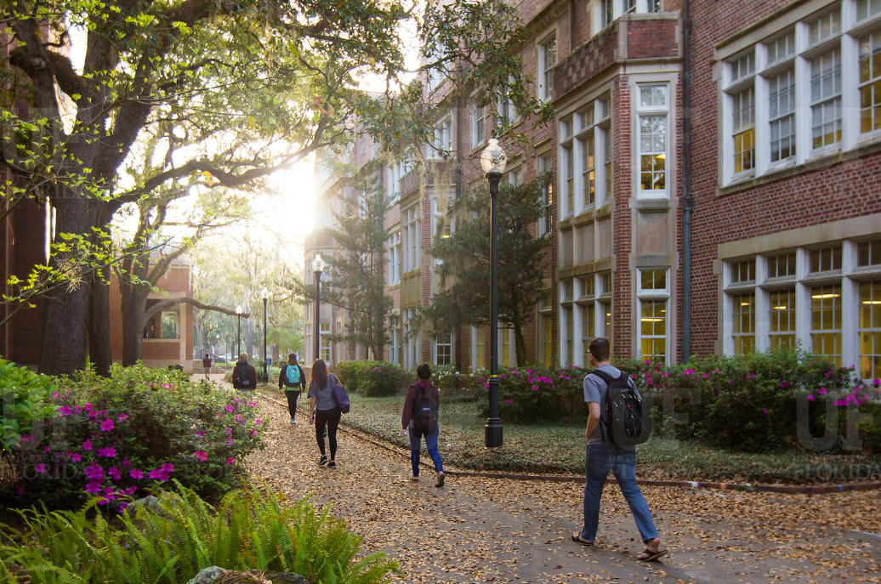

HR Forum
December 2, 2020

Slide 2
Today’s Agenda Items
Benefits Updates – Shannon Edwards
GBAS Update – Gwynn Cadwallader
Training Updates – Bob Parks
Spring New Hire Screening – Brent Goodman
Holiday Schedule for Postings and Background Checks – John Sun
Mask Distribution – Jodi Gentry
Important Dates
UFHR preeminence through people

Slide 3
University Benefits
Payroll Deductions for 2021 Benefits
Voluntary Savings Plan Limits for 2021
403(b) Voluntary Deductions/Fidelity Transition
December Personal Leave
Year-End Vacation Leave Conversion
Paid Family Leave
Leave Requests

Slide 4
Reminder: Payroll Deductions for 2021 Benefits
December & January payroll deductions reflect 2021 benefits elections:
State / People First Deductions
  Most plans paid a month in advance
  December 4 & December 18 paychecks pre-pay for January 2021 coverage
  OE changes to reimbursement accounts reflected beginning on the January 15 paycheck (i.e. Medical Reimbursement, Dependent Care, Limited Purpose, and Health Savings Accounts)
UFSelect and GatorCare Deductions
  Paid month of coverage, not paid in advance
  Changes made during OE reflected in paycheck beginning January 15
Reminder: No deductions on 12/31/20 (3rd paycheck in December)
Questions about benefits or deductions? Email benefits@ufl.edu or call (352) 392-2477
UFHR preeminence through people

Slide 5
Voluntary Savings Plan Limits for 2021
2021 annual limits:
  $19,500 each for 403(b) plan & 457 Deferred Compensation plan contributions (no change)
  Age 50 & over catchup is $6,500 (no change)
  415C & Special Pay Plan Limit $58,000 (increased $1,000)
To change 403(b) contributions for 2021--complete a new Salary Reduction Agreement (SRA)
  Beginning 12/28/20, no SRAs are required. Elections will be made directly with Fidelity
To stop 403 (b) contributions effective 12/31/20, SRA must be received by 12/7/20
To change 457 Deferred Comp contributions for 2021--contact Deferred Comp or increase contributions on their website
UFHR preeminence through people

Slide 6
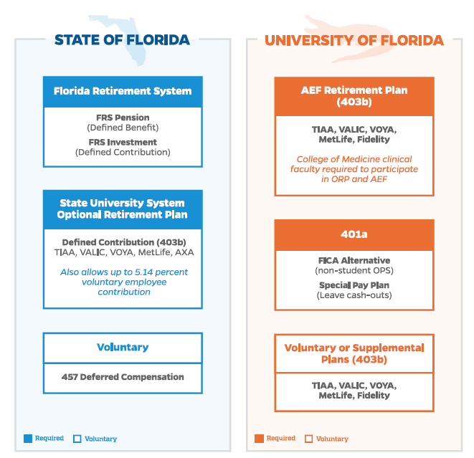

Slide 7
403(b) Voluntary Deductions/
Fidelity Transition
Beginning January 2021, all UF 403(b) contributions will be managed by Fidelity Investments
Final contributions sent to current record-keepers on 12/18/20
Early Election window starting 12/4 to 12/18
Contributions to Fidelity begin on 12/31/20 paycheck (due to blackout period for the transition)
If you do not want to make future UF 403(b) contributions due to the move to Fidelity:
  Complete a Salary Reduction Form (SRA) and
  Email SRA to benefits@ufl.edu by 12/7/20
Additional information regarding the transition available:
  Fidelity Website (includes Transition Guide)
  UF HR Benefits and Rewards Website
Questions? Call (352) 392-2477 or email benefits@ufl.edu
UFHR preeminence through people

Slide 8
December Personal Leave
Holiday closing period from 12/26 – 12/31
Personal leave days auto-populated for eligible TEAMS and Faculty
System does not require approval for personal leave days for exempt employees -- hours automatically populated
Time reporting code (TRC) – DPL-270
NOTE: Departments with employees whose hire approvals are not fully executed by November 24th must contact Leave Administration to manually load DPL hours
Instruction guide “Personal Leave Days” http://training.hr.ufl.edu/instructionguides/time&labor/personal_leave_days.pdf
UFHR preeminence through people

Slide 9
Year-End Vacation Leave Conversion
The annual conversion for accrued vacation leave over the maximum will occur after the pay period ending January 7, 2021
Accruals over the max amounts convert to sick leave
Annual maximum hours are as follows:
TEAMS and out-of-unit faculty | 352
In-unit faculty | 480
USPS | 240
UFHR preeminence through people

Slide 10
Reviewing Leave Balances
Employees may review their leave balances in PeopleSoft:
Main Menu > My Self Service > Payroll and Compensation > UF Leave History
Payroll Processors may review employee leave balances in PeopleSoft:
  Main Menu > Human Resources > Benefits > Manage Leave Accruals > Review Accrual Balances
  Enterprise Reporting > Access Reporting ‎> Human Resources Information ‎> Benefit Information ‎> Leave > Leave Accruals, Usage, and Balances By Pay Period, Department
UFHR preeminence through people

Slide 11
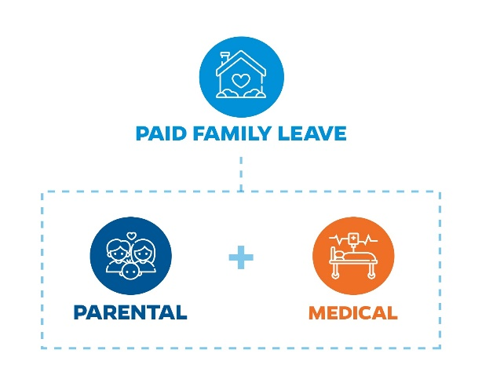
Paid Family Leave
Starting January 1st
Eligible Staff and Faculty awarded up to eight (8) weeks of Paid Family Leave in a rolling 24-month period
Request Leave via our new UF Leave Request Form
UFHR-Central Leave will be responsible for awarding benefits
UFHR preeminence through people

Slide 12
Leave Requests
Look for changes coming to the UFHR-Central Leave website
Updated UF Leave Request form available online
All requests requiring an Extended Leave of Absence other than conventional time off will be tracked by UFHR-Central Leave
New Medical Authorizations and Extended Leave of Absence Forms
UFHR-Central Leave will be responsible for drafting and sending out forms to employees, departments and HRLs
Leave Questions? Email central-leave@ufl.edu or call (352) 392-2477
UFHR preeminence through people

Slide 13
Training and Organizational Development
GBAS Update
Notes:
Section slide

Slide 14
Connected by UF (CxUF)
May 11-12, 2021
Connect, Learn and Share in Real Time
Professional Development for financial, human resources,
research and academic professionals
UFHR preeminence through people
Notes:
The University of Florida will host the inaugural bi-annual conference for UF leaders, business & research administrators in May 2021. Connected by UF, a conference at UF, by UF, for UF.
This 2-day conference will provide highly impactful professional development for financial, human resources, research, and academic professionals. Gator Business Administrator Services (GBAS), UF Research (MainSpring), and UF Leadership Network (UFLN) will come together to share successful and innovative business and leadership strategies and explore ways to work more efficiently. We invite you to join your peers for this unique experience, At UF, For UF, By UF.
At UF’s core is an abundance of experts who are willing to share their expertise with members of our communities to further enhance UF practices and procedures. Our conference will showcase UF talent with peer presentations that aim to expand everyone’s professional development. UF’s ascendance to become one of the nation’s leading public universities has inspired long-term goals of establishing the Connected by UF (CxUF) conference as a biannual event and eventually expanding our network to include the entire state of Florida and beyond.
We invite you to join your peers to present your expertise, attend to learn, and network to build new relationships at this unique experience. The Connected by UF (CxUF) Conference: Connect, Learn, and Share in Real Time.

Slide 15
Call for Presenter Proposals
Conference Theme: Keeping It Real
The current environment at UF
Ideas and solutions about ways to manage and refine processes
The challenges you are solving
Real data and outcomes
Presenter proposal deadline: January 8, 2021
https://learn-and-grow.hr.ufl.edu/connected-by-uf-cxuf-conference-call-for-proposals/
UFHR preeminence through people
Notes:
The theme for our inaugural conference is Keeping It Real, including topics such as:
The current environment at UF
Ideas and solutions about ways to manage and refine processes
The challenges you are solving
Real data and outcomes
Have a great idea for a session, discussion group, or workshop? Do you have a strategy, process, or skills that you have been perfecting? Do you have an area of expertise that you would be willing to share? Looking to grow your presentation skills? Being a presenter is a great UF Engaged Goal!

Slide 16
Session Formats
Poster Presentation (15 minutes)
Workshop Session (60 minutes)
Case Study (60 minutes)
Foundation (90 minutes)
Advanced Deep Dive (90 minutes)
UFHR preeminence through people
Notes:
Poster Presentation (15 minutes): Using artistic/graphical representation, design an informal poster to share your work and ideas related to the conference theme. Posters will be displayed virtually in an open area and presenters will be expected to provide a short elevator speech for the people who join their session at various times.
Workshop Session (60 minutes): Presenters share topics of interest related to the conference themes. The presenters can share process improvements, lessons learned, or evidence of impact, while actively engaging attendees throughout the session. Attendees participate in group discussion with defined learning outcomes.
Case Study (60 minutes): Presenters share their experience with a real-life business issue describing the strategy, planning, development, solution delivery, and outcomes. Attendees participate in group discussion with defined learning outcomes.
Foundation (90 minutes): Workshop style session designed for beginners or those who want to learn the "foundation basics" of a specific discipline, process, or tool. Sessions are highly interactive, and attendees participate in hands-on application of learning with defined outcomes.
Advanced Deep Dive (90 minutes): Workshop style session designed for attendees with intermediate to advanced experience and knowledge of topic area. Sessions are facilitated by a senior thought leader and are highly interactive with defined outcomes.

Slide 17
Guidance Sessions
December 11 from 4-5pm – Presenter Support Session
  https://ufl.zoom.us/j/93080759928?pwd=QThmQ3BScjA4ZS8yZVYrcUFqWVpBZz09
December 16 from 3-4pm – Presenter Support Session
  https://ufl.zoom.us/j/91810309253?pwd=TTdRcEcyeXFSN0ErTlRlNFhhQVRxQT09
Practice Sessions in the Spring
UFHR preeminence through people
Notes:
Poster Presentation (15 minutes): Using artistic/graphical representation, design an informal poster to share your work and ideas related to the conference theme. Posters will be displayed virtually in an open area and presenters will be expected to provide a short elevator speech for the people who join their session at various times.
Workshop Session (60 minutes): Presenters share topics of interest related to the conference themes. The presenters can share process improvements, lessons learned, or evidence of impact, while actively engaging attendees throughout the session. Attendees participate in group discussion with defined learning outcomes.
Case Study (60 minutes): Presenters share their experience with a real-life business issue describing the strategy, planning, development, solution delivery, and outcomes. Attendees participate in group discussion with defined learning outcomes.
Foundation (90 minutes): Workshop style session designed for beginners or those who want to learn the "foundation basics" of a specific discipline, process, or tool. Sessions are highly interactive, and attendees participate in hands-on application of learning with defined outcomes.
Advanced Deep Dive (90 minutes): Workshop style session designed for attendees with intermediate to advanced experience and knowledge of topic area. Sessions are facilitated by a senior thought leader and are highly interactive with defined outcomes.

Slide 18
GBAS Dates
December 15 from 2:30-4:00pm – Mindfulness
  Registration will go out to the GBAS list serv this week
January 8 – Presenter proposal deadline for CxUF
May 11 and 12 – CxUF Conference
UFHR preeminence through people

Slide 19
Training and Organizational Development
Required Trainings
Managing Bias
Spring Calendar
Employee Education Program
Strategic Communications Academy

Slide 20
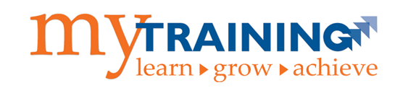
Required Trainings
Several online trainings for faculty and staff right now
  Compliance & Ethics: Doing Your Part for the
  Gator Good (OOC101)
  At-Risk for Faculty & Staff Kognito Training (KOG100)
  Protecting UF: Information Security Training (ITT102)
  Managing Bias (RJE101)
Main tip! Use Chrome or Firefox
UFHR preeminence through people

Slide 21

Managing Bias
Related to President Fuchs’ commitment in June
Part of UF’s broader efforts to build a more racially just UF
One piece of a broader Racial Justice Education Initiative
  Series of webinars and other resources to be launched in January by UFHR in collaboration with colleagues and areas across campus
  Student training launched in the spring
UFHR preeminence through people
Notes:
Join your GBAS colleagues to explore the Power of Microsoft Planner. We will start with an overview of the Planner app and discuss how it integrates with many other Microsoft features to improve the efficiency of your workflow.
We will explore the thinking behind several Planners built for Fiscal and HR tasks. Then you will interact with a group to build a practice planner before you select a project or process from your area. Working collectively, your group will build a Planner for your process/project/work and share your thinking with the large group.
If you can attend as a team, you will get a start on ways to organize and manage the work in your area.

Slide 22

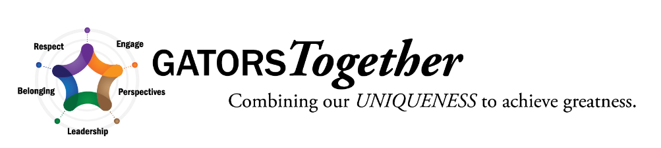


Spring Calendar
Spring calendar of courses available for
registration starting December 7
Several certification tracks for
different roles
Register in myTraining
View HR calendar for course dates (https://calendar.hr.ufl.edu/events/category/training-organizational-development/)
UFHR preeminence through people

Slide 23

Employee Education Program
Spring EEP information session hosted by the APA
  This Friday (12/4) from 2-4PM
  Register here, or on the EEP website (SFC/UF pages)
EEP deadlines are approaching for the Spring semester
  Visit the Employee Education Program for program deadlines and eligibility.
      Santa Fe College 12/11
      Outside Alachua county 12/18
      UF 1/8
UFHR preeminence through people
Notes:
Join your GBAS colleagues to explore the Power of Microsoft Planner. We will start with an overview of the Planner app and discuss how it integrates with many other Microsoft features to improve the efficiency of your workflow.
We will explore the thinking behind several Planners built for Fiscal and HR tasks. Then you will interact with a group to build a practice planner before you select a project or process from your area. Working collectively, your group will build a Planner for your process/project/work and share your thinking with the large group.
If you can attend as a team, you will get a start on ways to organize and manage the work in your area.

Slide 24

SCA Applications Open
Communicate in order to make a difference!
  Helps faculty and staff develop next-level
  communication skills to build communities,
  communicate persuasively, and drive positive change
  Led by faculty and staff from the Center for Public Interest Communications in the College of Journalism
Applications open until January 25
Program runs March to September 2021
Visit SCA website for more information (http://hr.ufl.edu/leadership@uf/programs/sca/)
UFHR preeminence through people

Slide 25
Classification and Compensation
Spring New Hire Screening
Notes:
Section slide

Slide 26
Spring New Hire COVID-19 Screening
With the start of the spring term, January is typically the second busiest month in terms of hiring activity.
Colleges and Units should plan for the Screen, Test & Protect testing sites to be unavailable during the December break.
As a result, departments should plan to initiate the hiring ePAF in myUFL as soon as possible in order to provide new faculty and staff the ability to complete the screening process prior to the break.
While testing will be available at the start of the spring term, faculty and staff may experience limited availability due to required student testing.
UFHR preeminence through people

Slide 27
Questions
For questions related to faculty and staff screening, please email UFReturnToWork@hr.ufl.edu.
For questions related to student screening, please email student-screening@ufl.edu.
UFHR preeminence through people

Slide 28
Talent Acquisition and Onboarding
Holiday Schedule

Slide 29
Posting and Background Check
Service | Date
Job Posting/Careers at UF | Friday, December 18
Clearance for Hire | Friday, December 18
FBI Livescan | Fingerprinted by Thursday, December 17
435 Livescan | Fingerprinted by Thursday, December 10
UFHR preeminence through people

Slide 30
Vice President’s Office
Mask Distribution

Slide 31
Important Dates
Upcoming Holidays/Closings
  Homecoming Holiday observed – December 24
  Christmas Holiday – December 25
  Holiday closing period – December 26-31
  New Year’s Day Holiday – January 1
Effective date for benefits elections for 2021 – January 1
Upcoming HR Forum – January 6 @ 10 a.m. (Zoom details TBA)

Slide 32

Thank you for attending the
HR Forum

