Slide 1
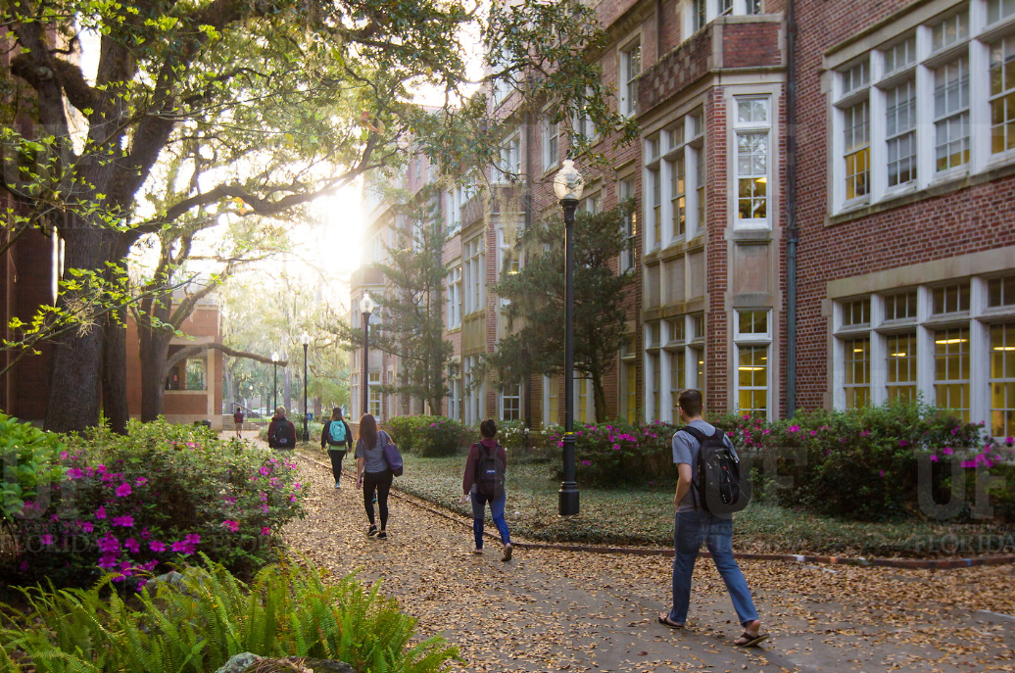
HR Forum
January 6, 2021

Slide 2
Today’s Agenda Items
APA Updates – Corina Velasquez
GBAS Updates – Barbara Mitola
2020 W-2 Updates – Olga Weider
Remote Work Location Agreements – Kenya Williams
Leave Updates – Nadja Schimmel-Cruz
Vaccines – Jodi Gentry
Important Dates
UFHR preeminence through people

Slide 3
Academic & Professional Assembly (APA)
2021 Updates

Slide 4
APA – for Staff, by Staff!
Would you like to get involved on campus? Are you searching for ways to put your talent and skills toward a professional cause? Do you want to advance new skills and to interact with colleagues from other units?
Whether you have a few minutes to connect with colleagues, or specific talents you'd like to use we invite you to consider joining the APA board.
UFHR preeminence through people

Slide 5
APA in 2021 – Statewide Outreach
Stay tuned for our 2021 event lineup
Find ways to get involved with APA
Check our website for updates:
Academic and Professional Assembly (APA) » University of Florida (ufl.edu)
UFHR preeminence through people

Slide 6
Training and Organizational Development
GBAS Updates
Notes:
Section slide

Slide 7
New Horizons
This Photo by Unknown Author is licensed under CC BY-SA
Notes:
2 minutes
I'm stepping down as GBAS Director as of July 1, 2021
This past November was the end of my 5th year as GBAS Director.
It's time. We know the inclusion of new and different perspectives is key to real growth and improvement.
It's just too great of an opportunity to hoard.

Slide 8
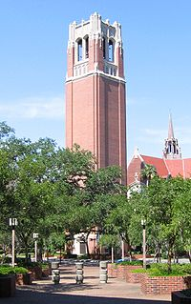
GBAS Director
.10 FTE (about 4-5 hours/week) OPS Exempt Position
Applications open mid-January and close sometime in the first week of February
Announce new GBAS Director in May 2021 at the CxUF Conference
Serve as the subject matter consultant and strategic planning partner for GBAS on UF business processes in the areas of human resources, finance and accounting, and sponsored programs.
Consult on professional development activities that build UF business administrators’ skills and capacity and assist UF business administrators in the execution of their responsibilities to move the mission of the University forward.
This Photo by Unknown Author is licensed under CC BY-SA
Notes:
5 min
It's your turn on the GBAS Director mic!
Apply! We are opening it up for a full, competitive search process – posting it on Jobs @ UF!
Go over the slide
For current UF exempt employees who have been at UF for 2 or more years and have been supervisors for a year or more.
Pay will be around 10% of your current primary employment pay

Slide 9
Notes:
3 min
I don't think I really need to "sell" this role as the exceptional opportunity that it is.
But I do want to help you all understand the specific opportunities it opens up so you know what you are applying for
Like all of you, I get to learn from excellent colleagues in my role in my college. I work with great people doing working I know and love.
This part-time (and might I add...paid) position, allows you to keep your current role while also growing in new ways.
You don't have to change your whole world, just add to it in a very sustainable way – 4-5 hours a week.
This position creates new levels of engagement with outstanding administrators outside of your unit – across and up the org chart.
The role of GBAS Director requires that you ask your colleagues how they do their jobs. And the answers, to me, were practical, smart and innovative.
I got the pleasure of getting to hear these great ideas from you...and then steal them.
And there are additional opportunities as Director – such as getting to brainstorm deeply with our Advisory Council members - to build deep and lasting relationships that crossed traditional silos and helped me grow as an administrator, supervisor, leader, and a better advocate and support to all my colleagues.
I have build so many more relationships, thanks to this role, with people who have become feedback partners and partners in helping each other get our jobs done.

Slide 10
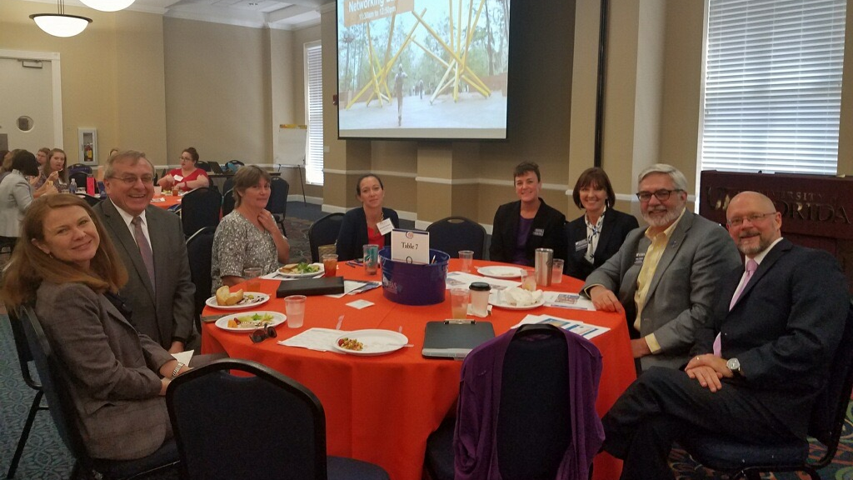
Notes:
1 min
And the opportunity to interact with high level leadership in deep ways – Everyone in this picture and I that empty chair there by Stephanie Grey – I guess Tiffany was still standing in line for food. haha
And all the other leaders not pictured, including Alan West and Chris Cowen -
– to get to hear their perspectives, brainstorm with them, witness and learn from a level of professional experience well beyond your own.
You know the old adage, surround yourself with people who are better than you. I also once heard - dress for the job you want, not the job you have.
The idea is that this job allows you to practice an engagement level with the C-suite as a C-suite member, without the added fear of having this new gig be your sole bread-winner.
This is my infomercial “All this and more, from the comfort of your current job!”

Slide 11
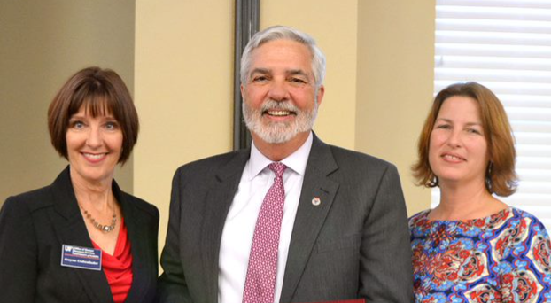
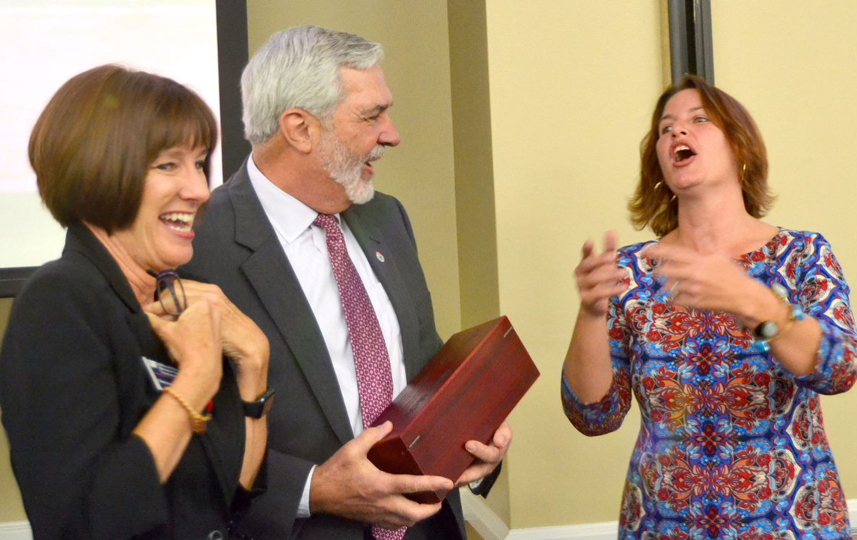
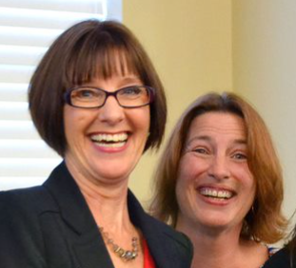
Notes:
3 min
Now I will embarrass Gwynn. Because one of the biggest opportunities of this position is getting to work with Gwynn.
First – I basically had the opportunity to do an advanced internship with an expert in instructional design! And we know that all of our jobs include some aspect of teaching people to do things. This is invaluable experience!
In addition to that education, I got to witness her exceptionally high level of strategic thinking and planning. I’ll be unpacking the experience I gained by working with Gwynn over these last five years for the rest of my career.
Second – If you enjoy creative problem solving, you could not have a better partner! It’s special – that connection and trust that allows you to be comfortable enough to take risks with what you say, to shoot out some pretty half baked and sometimes just flat-out bad ideas. To think through out loud with someone as you both are trying to get to a common goal. To wonder "what if" and get a gleam in your eye with excitement and be excited to hear what that other person will think. To feel safe and inspired. To know that we will consider all of our ideas and help each other to evolve together into ideas that lead to results that we ended up being so so proud to be able to offer to you.
…….
I was surrounded, as GBAS director, with an expanded group of leadership and colleagues who value ideas over titles, people over position, solutions over blame, and caring and quality over “checking a box” AND who consider it their job to help the Director position grow into leadership. I never once felt "on my own" or "you should know this". Every high level leader, Gwynn and advisory council members were offering their wisdom at every turn.
You can’t not benefit tremendously from that!
It’s an invaluable growth experience that will make you more of an asset to your unit, UF and most importantly, to yourself.
If you think it might be the right time for you, do yourself a favor and don’t let this opportunity slip by.

Slide 12
Notes:
30 seconds
I’ll close with this, a reminder to myself as I get sad about leaving this role, that I’m only stepping down from a particular way of being at the table.
I’ve had this seat with this nice view for a while. It’s time to let someone else have this view.
I really am just changing seats…because the beauty of our wonderful GBAS community and UF leadership is that we are already all at the table.

Slide 13
Call for Presenter Proposals
Conference Theme: Keeping It Real
The current environment at UF
Ideas and solutions about ways to manage and refine processes
The challenges you are solving
Real data and outcomes
Presenter proposal deadline: January 18, 2021 @11:55pm
https://learn-and-grow.hr.ufl.edu/connected-by-uf-cxuf-conference-call-for-proposals/
UFHR preeminence through people
Notes:
Connected by UF May 11 & 12
The theme for our inaugural conference is Keeping It Real, including topics such as:
The current environment at UF
Ideas and solutions about ways to manage and refine processes
The challenges you are solving
Real data and outcomes
Have a great idea for a session, discussion group, or workshop? Do you have a strategy, process, or skills that you have been perfecting? Do you have an area of expertise that you would be willing to share? Looking to grow your presentation skills? Being a presenter is a great UF Engaged Goal!

Slide 14
University Payroll Services
2020 W-2 Updates
Notes:
Section slide

Slide 15
2020 W-2 Updates
Form W-2 & Year End Statement
Former Employees
Department W-2 Access
*Coming Soon: Updated W-2 website for instructions and frequently asked questions
https://www.fa.ufl.edu/directives/w-2-information
UFHR preeminence through people

Slide 16
Form W-2
Payroll Services will start processing W-2s on 1/19/2021
Electronic W-2s will be available on 1/20/2021
Paper W-2s will be mailed on 2/1/2021
As some may have seen, we have been actively encouraging employees to consent to receive their W-2 electronically
UFHR preeminence through people

Slide 17
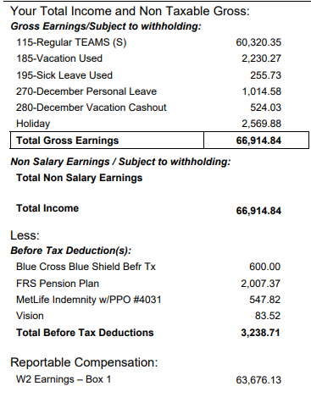
Employee Year End Statement (EYES)
In myUFL: My Self Service > Payroll and Compensation > UF Employee Year End Statement
Provides detail of:
W-2, Box 1 reportable compensation
Taxes and other deductions
Total net pay
UF’s contributions on behalf of the employee
UFHR preeminence through people

Slide 18
Former Employees
Former employees must keep their mailing addresses current in the UF Directory to receive any mailed W-2s
Employees with myUFL access can update their address at: My Account > Update My Directory Profile
Both the Local and Permanent Home Data addresses should be updated
Employees who no longer have myUFL access should go to: “Former Employee Address Change Request Form” found on the HR website
https://hr.ufl.edu/wp-content/uploads/2018/04/former_employ_address.pdf
UFHR preeminence through people

Slide 19
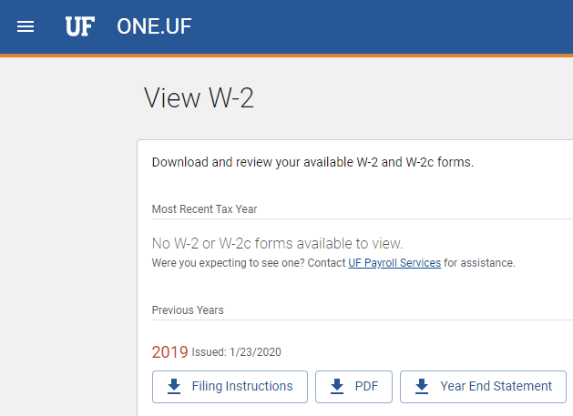
Former Employees – What’s Changing?
Access for former employees who have left UF within the last 18 months will be available through OneUF to retrieve their W-2 form electronically
Anticipated to be available for 2020 W-2s
UFHR preeminence through people

Slide 20
Department W-2 Access
UF_PY_PAYROLL_INQUIRY role holders can view or print W-2s for their department’s current or former employees, as needed
In myUFL: Payroll for North America > U.S. Annual Processing > Create W-2 Data > View W-2/W-2c Forms
UFHR preeminence through people

Slide 21
Department W-2 Access
Due to personal privacy concerns:
You may not
email the W-2, unless you have fully redacted the SSN
fax the W-2 internationally
You may
fax the W-2 domestically without redaction
mail the W-2 domestically or internationally without redaction
UFHR preeminence through people

Slide 22
Questions?
Contact Information
Payroll Services – payroll-services@ufl.edu
Phone: 352-392-1231
UFHR preeminence through people

Slide 23
Classification and Compensation
Remote Work Location Agreements
Notes:
Section slide

Slide 24
Remote Work Location Agreements
Alternate Work Location Agreement is now known as Remote Work Location Agreement
Authorizes an employee to work from an approved remote location instead of physically traveling to a central UF workplace
Academic Personnel, TEAMS, USPS, and OPS employees are eligible to work at a remote location immediately upon hire
Supervisor and the employee have a clear, shared understanding of the employee’s remote work location arrangement
Working arrangement mutually benefits both the college/unit and the employee
Director or Department Chair and VP/Dean Approval
UFHR preeminence through people

Slide 25
Remote Work Location Agreements
New Remote Work Location Agreement form has been implemented via OnBase
You may locate the new electronic form on the HR website at: https://hr.ufl.edu/manager-resources/alternate-work-location/
Electronic form may be completed then submitted by employee or supervisor/manager
Employees are still expected to follow college/administrative unit procedures, if appropriate
UFHR preeminence through people

Slide 26
Kudos
OnBase Team
UFIT
Payroll Services
College of Medicine
IFAS
University Libraries
College of Business
UFHR preeminence through people

Slide 27
Questions
Please contact Classification & Compensation via email at RemoteWorkAgreement@hr.ufl.edu
UFHR preeminence through people

Slide 28
University Benefits
Leave Updates

Slide 29
Year-End Vacation Leave Conversion
The annual conversion for accrued vacation leave over the maximum will occur after the pay period ending January 7, 2021
Accruals over the max amounts convert to sick leave
Annual maximum hours are as follows:
TEAMS and out-of-unit faculty | 352
In-unit faculty | 480
USPS | 240
UFHR preeminence through people

Slide 30
Reviewing Leave Balances
Employees may review their leave balances in PeopleSoft:
Main Menu > My Self Service > Payroll and Compensation > UF Leave History
Payroll Processors may review employee leave balances in PeopleSoft:
Main Menu > Human Resources > Benefits > Manage Leave Accruals > Review Accrual Balances
Enterprise Reporting > Access Reporting ‎> Human Resources Information ‎> Benefit Information ‎> Leave > Leave Accruals, Usage, and Balances By Pay Period, Department
UFHR preeminence through people

Slide 31
Paid Family Leave
Starting January 1st
Eligible Staff and Faculty awarded up to eight (8) weeks of Paid Family Leave in a rolling 24-month period
Request Leave via our new UF Leave Request Form
UFHR-Central Leave will be responsible for awarding benefits
Those Staff and Faculty covered under a Collective Bargaining Agreements who are not eligible still have the option to borrow Parental Leave as outlined in the terms of the agreements
UFHR preeminence through people

Slide 32
Leave Requests
Look for changes coming to the UFHR-Central Leave website
Updated UF Leave Request form available online
All requests requiring an Extended Leave of Absence other than conventional time off will be tracked by UFHR-Central Leave
New Medical Authorizations and Extended Leave of Absence Forms
UFHR-Central Leave is responsible for drafting and sending out forms to employees, departments and HRLs
Leave Questions? Email central-leave@ufl.edu or call (352) 392-2477
UFHR preeminence through people

Slide 33
Families First Coronavirus Response Act
Paid Emergency Sick Leave & Emergency family Medical leave Expansion Act (EFMLEA) expired on December 31, 2020.
UF COVID-19 Leave donation will run through the current Public Health Emergency declaration through January 20, 2021.
Eligible employees can request leave at hr.ufl.edu
Leave Questions? Email central-leave@ufl.edu or call (352) 392-2477
UFHR preeminence through people

Slide 34
Vice President’s Office
Vaccines

Slide 35
Important Dates
Upcoming Holidays/Closings
Martin Luther King Jr. Holiday – January 18
Upcoming HR Forum – February 3 @ 10 a.m. (Zoom details TBA)

Slide 36
Thank you for attending the HR Forum

