Slide 1



HR Forum
February 3, 2021

Slide 2
Today’s Agenda Items
Emergency Checks – Linda Smith
GBAS Updates – Alicia Wood
Financial Literacy Series/Wellness Group Coaching – Yusuf Al-Wadei
UF Engaged Updates – Jennifer Munroe/Lily Lewis
Benefits Updates – Jason Talbert
Important Dates
UFHR preeminence through people

Slide 3
University Payroll Services
Emergency Checks
Notes:
Section slide

Slide 4

New – Electronic Emergency Check Form

Slide 5
Electronic Emergency Check Form
Collaborative effort with Payroll & Tax Services and UFIT OnBase Team
Other forms - being reviewed for any improvement opportunities and will also transition to an Electronic Format

Slide 6
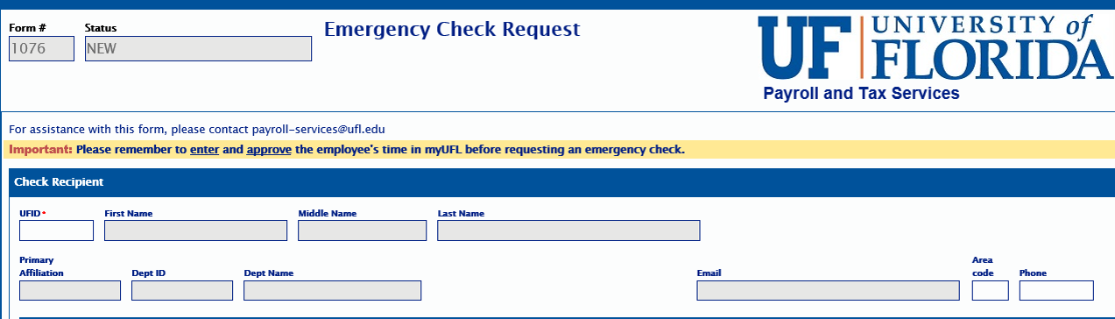

Emergency Check Form - OnBase
Location: Payroll Forms & Resources Page
Auto populates: Simply type in the UFID and the remaining fields in this section will auto-fill

Slide 7
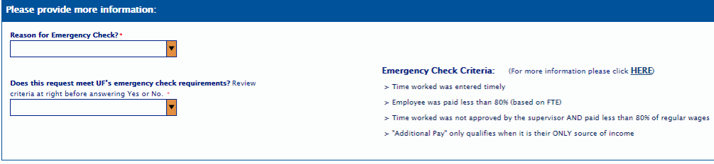
Emergency Check Form - OnBase
What’s new?
Emergency Check Criteria is now located on the form for easy reference
A dropdown box with Reasons for Emergency Check Request
Additional question: does the request meet the criteria for an emergency check

Slide 8
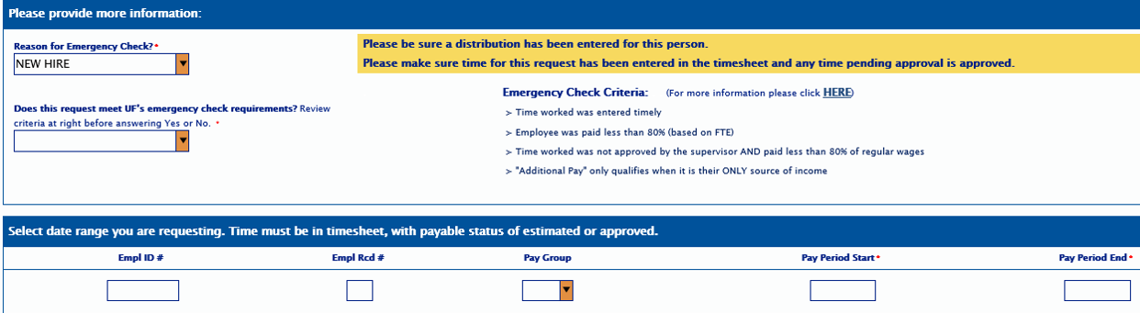
Emergency Check Form - OnBase
New Hire: a reminder popup will appear for both the distribution and time to be entered
UFHR preeminence through people

Slide 9
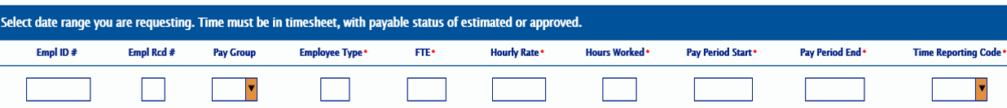
Emergency Check Form - OnBase
Original Check Cancelled
Beneficiary
Other
Number of fields required to process remains the same as the SharePoint version
UFHR preeminence through people

Slide 10

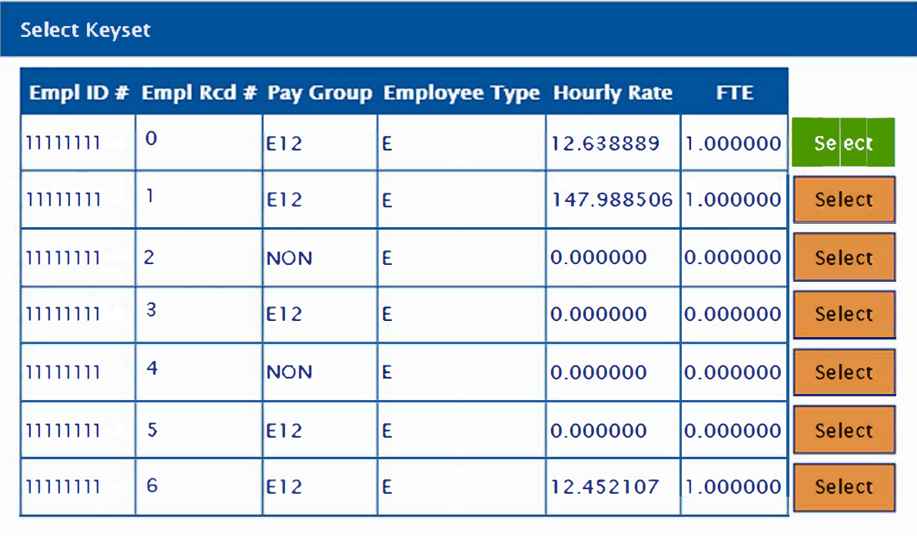
Emergency Check Form - OnBase
Multiple employee records: select which employee record you are processing
UFHR preeminence through people

Slide 11
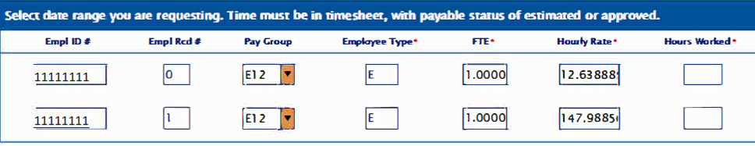
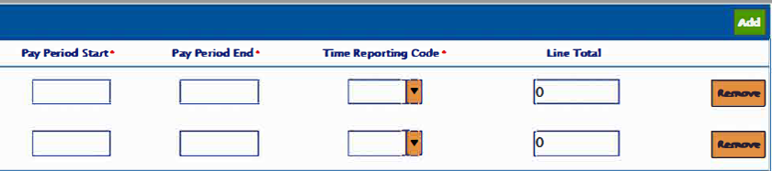
Emergency Check Form - OnBase
Multiple Employee Records: Select “add” button and select the next record from the keyset list.
UFHR preeminence through people

Slide 12
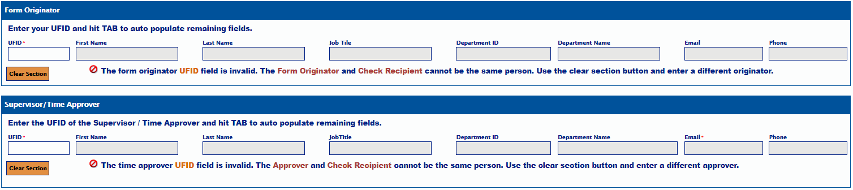
Emergency Check Form - OnBase
Required UFID: Originator and Supervisor/Time Approver
Auto populates: Simply type in the UFID and the remaining fields in this section will auto-fill
UFHR preeminence through people

Slide 13
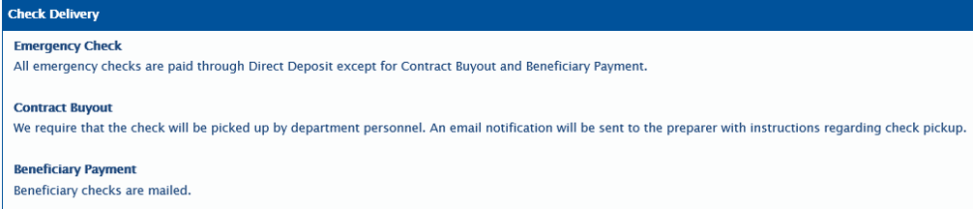
Emergency Check Form - OnBase
UFHR preeminence through people

Slide 14
Emergency Check Form - OnBase
Status emails
Denial – detailed reason for denial
Distribution needed
Time Entry needed
Time Approval needed
Complete – you will receive an email when the form is processed

Slide 15

Questions?
Contact Information
Payroll Services – payroll-services@ufl.edu
Phone: 352-392-1231
UFHR preeminence through people

Slide 16
Training and Organizational Development
GBAS Updates
Notes:
Section slide

Slide 17

Spring Workshop Series
Resilience at Work
Holistic Approach
Series of five 2-hour sessions
Attend all sessions
Light homework
Integrating Mindfulness
Start on February 23th and end on April 20th
UFHR preeminence through people
Notes:
One thing is clear today: The need for Resilience and Mindfulness is here to stay. With the increasing frequency and severity of shocks and changes that can shake us up, learning to be more resilience can enhance the quality of our work experience.
The GBAS Resilience at Work series will take a holistic approach to consider all aspects of resilience – physical, cognitive, emotional and spiritual (purpose and values) within the professional context. Throughout the five sessions we will incorporate concepts of work resilience with opportunities for increased self-awareness through mindfulness. You will also be able to explore ideas and gain support from group conversations with the community of participants as well as a smaller cluster of peers at each session.
Participants are expected to attend all sessions and carve aside time for self-reflection and light homework between meetings. At the end of the series, you will have gained a deeper understanding of how to nurture your resilience for wellbeing and sustained work performance.
The sessions will be on Tuesdays from 10 to noon, running every other week from Feb 23 to April 20.

Slide 18

Resilience at Work
Learning Objectives
Learn about the importance of personal work resilience and recognize its 7 components
Increase self-awareness through self-reflection and mindfulness
Discover ways to build resources that strengthen resilience
Make lasting changes for proactive transformation and sustained performance
Registration is Open
Limited spots are available for this opportunity, so sign up today!
UFHR preeminence through people
Notes:
By participating in this series, you will:
Learn about the importance of personal work resilience and recognize its 7 components
Increase self-awareness through self-reflection and meditation
Discover ways to build resources that strengthen resilience
Make lasting changes for improvement
The full details of this event will be sent to the GBAS list serv today.

Slide 19

Save the Date, May 11 & 12
Keeping It Real
Planning and selection committees have selected the presentations
Twenty learning opportunities to select from
Keynote Guest Speakers each day
Networking opportunities
UFHR preeminence through people
Notes:
The Connected by UF conference planning committee would like to thank everyone who submitted an application to present.
The selection and planning committees did a great job rating and selecting from the many amazing applications that were received and you will have about 20 learning opportunities to choose from.
We will have a keynote guest speaker each day.
There will also be opportunities to connect with your peers across campus for some networking.
Please mark your calendars today and save May 11 & 12 from 9:30am to around 3:30 or 4.
So Save the Date!

Slide 20
Communications & Worklife
Financial Literacy Series
Wellness Group Coaching
Notes:
Section slide

Slide 21

Financial Literacy Series
Knowledge is power
A series of workshops lead by financial experts to support and increase financial literacy and improve financial wellness
February 9th @ 11 am – Budget & Savings
February 23rd @ 1 pm – 5 Questions to Ask Before You Retire
March 9th @ 12 pm – Let’s Talk Credit
April 6th @ 11 am – Fundamentals of Investing
April 8th @ 11 am – Protecting Your Self from Identify Theft
More sessions will be added

Slide 22
Wellness Group Coaching
Online live wellness coaching
Join a small group of 4-12 colleagues to establish wellness goals, receive feedback, gain support, and maintain accountability for four sessions.
4 sessions will start in mid-February and meet at the same time, with the same facilitator and group, once a month through May.
Registration is open now through next Sunday, February 7.
Sign up individually or with your coworkers as a group for your preferred time slot.
Register here.

Slide 23

We’re here to help
Request a program or reach out to let us know your needs
Visit our website at https://wellness.hr.ufl.edu
Contact us at hrs-wellness@ufl.edu

Slide 24
Employee Relations / Office of Postdoctoral Affairs
UF Engaged
Notes:
Section slide

Slide 25
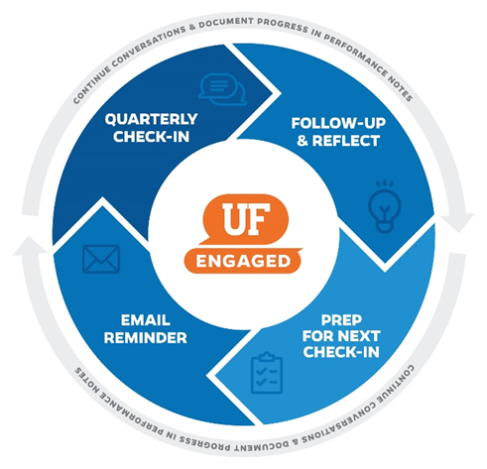

UFHR preeminence through people

Slide 26

EXCITING NEWS!
Beginning March 1st
Postdoc Associates will be included in UF Engaged
UFHR preeminence through people

Slide 27
Postdoc Associates
Postdoc Associate Appointment Policy
Professional development plan
Evaluated by supervisor
Maximum of 4 years
Exceptions – New Opportunities:
Moving to a new UF Lab allows for 2 additional years
Up to 2 year extension may be requested (Form)
Requires evidence postdoc is being mentored
Evaluations
Professional Development Plan
Justification (new skills & opportunities)
Exit/transition plan
UFHR preeminence through people

Slide 28
We need your help!
Supervisor IDs, check for accuracy and keep them up-to-date.
UF Engaged pulls the supervisor ID from myUFL Job Data
If the supervisor ID is inaccurate then an individual’s Quarterly Check-in will go to the wrong supervisor
Update via ePAF
UFHR preeminence through people

Slide 29
Resources
UF Engaged Website – offers a variety of guides, simulations, and available trainings to aide in the success of leaders and staff.
Utilize your Department Human Resources representative
Email us at: UFEngaged@hr.ufl.edu
UFHR preeminence through people

Slide 30
University Benefits
Benefits Updates

Slide 31
Double Deductions for 9/10 Month Employees
Active 9/10-month employees have double premium deductions during the spring to cover summer when no payroll is issued
Double deductions begin on 2/12/21 and end on 5/7/21 paycheck
Departments with new 9/10-mo. employees whose hires are executed between February 1st and the start of the Fall term should advise their new hires to contact UFHR Benefits for assistance regarding benefit premiums
If no action is taken, premiums will be underfunded, and coverages may be suspended
Questions? Contact UFHR Benefits at (352) 392-2477 or email benefits@ufl.edu
UFHR preeminence through people

Slide 32
IRS Reporting Form 1095-C
Employer Provided Insurance Offer and Coverage
Reports employees’ health insurance information for prior calendar year
State of Florida and GatorCare plan participants will receive forms within the next several weeks
State 1095s available in PeopleFirst beginning 1/31, if you opted for electronic delivery
GatorCare 1095s are sent by postal mail only (no electronic option)
Employees may file income tax returns prior to receiving 1095-C if they know they had coverage for the entire year
Employees enrolled in ACA Marketplace plans must report UF’s offer of employer-sponsored health coverage to IRS
UFHR preeminence through people

Slide 33
Marketplace Tax Credit Notices
Employees using Healthcare Marketplace may qualify for premium tax credit
UF is subject to penalty if full-time employee offered coverage by UF receives the tax credit
If tax credit notice received by departmental UF campus location, forward to UFHR Benefits immediately (fax, email, or postal mail):
Physical Address:
UFHR Benefits
Attn: Shannon Edwards
903 W. University Ave.
Gainesville, FL 32606
Campus Mailing Address:
UFHR Benefits
Attn: Shannon Edwards
P.O. Box 115007
Email: shannon.edwards@ufl.edu
Fax: (352) 392-5166
UFHR preeminence through people

Slide 34
Flexible Spending Accounts
Healthcare FSAs and Limited Purpose Healthcare
Carryover from 2020 -- Plan Year Members may carry over any unused benefits from plan year 2020 to plan year 2021.
Plan year 2020 carryover benefits must be used by December 31, 2021.
No action is required by the employee. Balances will carry over automatically.
Changes in Election Amount -- For plan year 2021, members may prospectively change contribution amounts without a qualifying status change.
Post-Termination Reimbursements from Health FSAs -- A member who stops participating in the plan mid-year of 2021 may continue to receive reimbursements of their unused contributions through the end of the plan year.
For example, a member who leaves employment April 1, 2021, may continue to receive reimbursements of their unused contributions through the end of 2021.
UFHR preeminence through people

Slide 35
Flexible Spending Accounts
Dependent Care Flexible Spending Accounts
Extension of Grace Periods -- The grace period to incur eligible expenses applicable to plan year 2020 contributions is extended to December 31, 2021.
Eligible Dependent -- If a dependent "aged-out" during the pandemic, the maximum age the child is considered a qualifying dependent is changed from age 12 to age 13, if certain criteria are met.
Changes in Election Amount -- For 2021, members may prospectively change contribution amounts without a qualifying status change.
FSA Questions?
Contact Chard Snyder 855-824-9284 or FloridaAskPenny@chard-snyder.com
UFHR preeminence through people

Slide 36
Important Dates
Upcoming HR Forum – March 3 @ 10 a.m. (Zoom details TBA)

Slide 37

Thank you for attending the HR Forum

