Slide 1



HR Forum
March 3, 2021

Slide 2
Today’s Agenda Items
GBAS and MainSpring Updates – Gwynn Cadwallader/Ronda Mitchell
Short Work Break – Cynthia Mendoza
Summer File – Cynthia Mendoza
Florida Minimum Wage – Brent Goodman
AI Initiative – Audrey Gainey
Interfolio Updates – Audrey Gainey
Important Dates
UFHR preeminence through people

Slide 3
Training and Organizational Development
GBAS & MainSpring Updates
Notes:
Section slide

Slide 4
Spring Institute
Critical Thinking through Data Analysis
April 2 from 9:00am to 12:00pm
Virtual via Zoom
Register by March 5th – myTraining UF_GBS250
UFHR preeminence through people
Notes:
Data-driven decision making is essential for doing business at UF. While running a report may give you information, does it provide the necessary perspective that you need to make a solid decision? Applying critical thinking skills to the information you are analyzing is essential for enabling good decisions.
This pilot training, created in partnership with UF Information Technology, Office of the Controller, and UFHR Training & Organizational Development. This is a critical thinking course, rather than a how to use enterprise analytics.
We encourage all levels for foundational to advanced to attend. While the scenarios that we explore may seem foundation to our advanced members, we hope that you will bring your experience to the discussion. We will use the feedback from this pilot to build a more advance course and work with our partners to build better reports and tools.
The training is organized around 5 areas of financial data:
Consistency/Variances
Accuracy/Errors
Allowability/Compliance
Budget/Available Balance
Data Analytics
We will step you through how to collect, organize, and analyze the information. Collectively, we will discuss some pitfalls, questions the data does not answer, and ways to validate your results. Join the GBAS community as we share this new training and provide your feedback to help us throughout the development of additional courses and data tools!

Slide 5

Registration is Open
Keeping It Real
Registration will close on March 16
CxUF is offered at no cost and is sponsored by three UF communities of practice: GBAS, MainSpring, and UFLN
Conference Target Audience: UF business and research administrations of all levels (foundational to advanced), people working in finance, human resources, sponsored programs, and academic professionals and leaders who participate
in the UFLN
Visit https://learn-and-grow.hr.ufl.edu/connected-by-uf-conference/cxuf-agenda/ to register and for the conference agenda and session descriptions
UFHR preeminence through people
Notes:
Please encourage folks in your areas to join us for the first ever CxUF on May 11 & 12 from 9:30am to 4:00pm
https://learn-and-grow.hr.ufl.edu/connected-by-uf-conference/cxuf-agenda/
Registration Open. Participants will register for the conference as one event. The concurrent sessions have a 300-person capacity, and will be first come, first serve.
Location: CxUF will be held on a virtual web-based platform and Zoom.
CxUF is offered at no cost and is sponsored by three UF communities of practice. GBAS, MainSpring, UFLN
Conference Target Audience: UF business and research administrations of all levels (foundational to advanced), people working in finance, human resources, sponsored programs, and academic professionals and leaders who participate in the UFLN.

Slide 6


MainSpring Launch
MainSpring Launch Event
March 10, 10:00 – 11:30 am
Virtual Teams
Designed for anyone in HR, Finance, or Sponsored Programs who supports research at UF
No registration required
UFHR preeminence through people
Notes:
Data-driven decision making is essential for doing business at UF. While running a report may give you information, does it provide the necessary perspective that you need to make a solid decision? Applying critical thinking skills to the information you are analyzing is essential for enabling good decisions.
This pilot training, created in partnership with UF Information Technology, Office of the Controller, and UFHR Training & Organizational Development. This is a critical thinking course, rather than a how to use enterprise analytics.
We encourage all levels for foundational to advanced to attend. While the scenarios that we explore may seem foundation to our advanced members, we hope that you will bring your experience to the discussion. We will use the feedback from this pilot to build a more advance course and work with our partners to build better reports and tools.
The training is organized around 5 areas of financial data:
Consistency/Variances
Accuracy/Errors
Allowability/Compliance
Budget/Available Balance
Data Analytics
We will step you through how to collect, organize, and analyze the information. Collectively, we will discuss some pitfalls, questions the data does not answer, and ways to validate your results. Join the GBAS community as we share this new training and provide your feedback to help us throughout the development of additional courses and data tools!

Slide 7
Employment Operations & Records
Short Work Break
Summer File
Notes:
Section slide

Slide 8
Short Work Break 2021
UFHR preeminence through people

Slide 9
Short Work Break for 9/10-Month Employees
Short Work Break file will take place on April 23, 2021
9- and 10-month employees (faculty, graduate assistants and TEAMS) will be placed on Short Work Break in the myUFL system for the summer semester
  Individual is still an active employee
  Time Reporting is inactivated and salary is not paid on this record during the short work break period
Effective dates for Short Work Break
  9-month: 5/16/2021
  10-month: 6/1/2021

Slide 10
Short Work Break for 9/10- Month Employees
Action Needed by Departments
  Verify all 9- and 10-month employees who will not return after Spring 2021 are terminated in myUFL
  If necessary, enter end-of-semester terminations PRIOR to April 22, 2021
To review employees on Short Work Break after April 23
  Main Menu > Enterprise Analytics > Access Enterprise Analytics > Team Content > Human Resources Information > Workforce Information > Short Work Break – Return From Break Report
  Instruction Guide http://training.hr.ufl.edu/instructionguides/job_position_actions/shortworkbreak.pdf

Slide 11
Summer Appointment File 2021
UFHR preeminence through people

Slide 12
Faculty and GA Summer Appointments
Summer appointments for 9-month faculty and graduate assistants may be processed via the summer job file
  Summer appointments can also be entered as a Hire ePAF
The file will be available April 23, 2021
The file will close on May 13, 2021
Summer appointments will be reflected in Job Data on May 17, 2021

Slide 13
Faculty and GA Summer Appointments
The file will be available via myUFL system
  Main Menu > Human Resources > Workforce Administration > Job Information > UF Summer Job Review
    Enter the current Calendar Year. For example: 2021
    Enter your Department ID. For example: 62%
    Click the Search button
Instruction Guide
  http://training.hr.ufl.edu/instructionguides/job_position_actions/summerjobreview.pdf
You will be contacted by EOR if there are employees who do not load and may need additional action on your part

Slide 14
Summer Appointment Terminations
A termination row will be applied at the same time the summer appointment is applied in job data
  If a job edit is completed during the summer, it might mean you will need to enter a termination ePAF for that employee
Reminder: Enter distributions for summer appointments
Questions?
  Ufhr-employment@ufl.edu
  352-273-1079

Slide 15
Classification and Compensation
Florida Minimum Wage
Notes:
Section slide

Slide 16
Florida Minimum Wage
Florida voters approved amendment 2 in November 2020 which increases the minimum wage and amends Florida’s Constitution.
Under the new mandate, Florida’s minimum wage, currently $8.65, will increase to $10 an hour on September 30, 2021.
After which the minimum wage will increase $1 each year until it reaches $15 an hour in 2026.
The minimum wage applies to all public and private sector employers, regardless of size or number of employees.
UFHR preeminence through people

Slide 17
Florida Minimum Wage
In January, a bill was introduced to the Florida Senate that would limit who is eligible for the minimum wage.
If the bill is approved, it would allow individuals, including youth under the age of 21, convicted felons, and prison inmates to be paid less than minimum wage.
UFHR preeminence through people

Slide 18
Florida Minimum Wage
As of February 22nd, there are 2,166 appointments below the new minimum wage. The cost-plus fringe of bringing the population to the new minimum wage is approximately $2.063M.
Some of the top units are Student Affairs, Housing & Residence Education, O’Connell Center, Reitz Union, IFAS, and UFIT.
This estimate is very conservative as our student employee headcount is down dramatically due to COVID-19. This time last year, there were 38% more appointments with hourly rates less than $10 per hour.
UFHR preeminence through people

Slide 19
Questions
Please contact Classification & Compensation via email at compensation@ufl.edu.
UFHR preeminence through people

Slide 20
Talent Acquisition & Onboarding
AI Initiative
Interfolio Updates
Notes:
Section slide

Slide 21
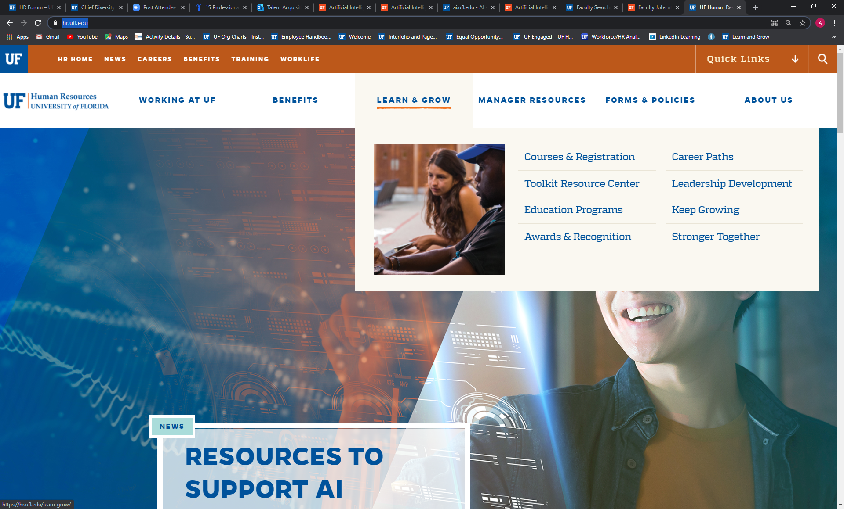
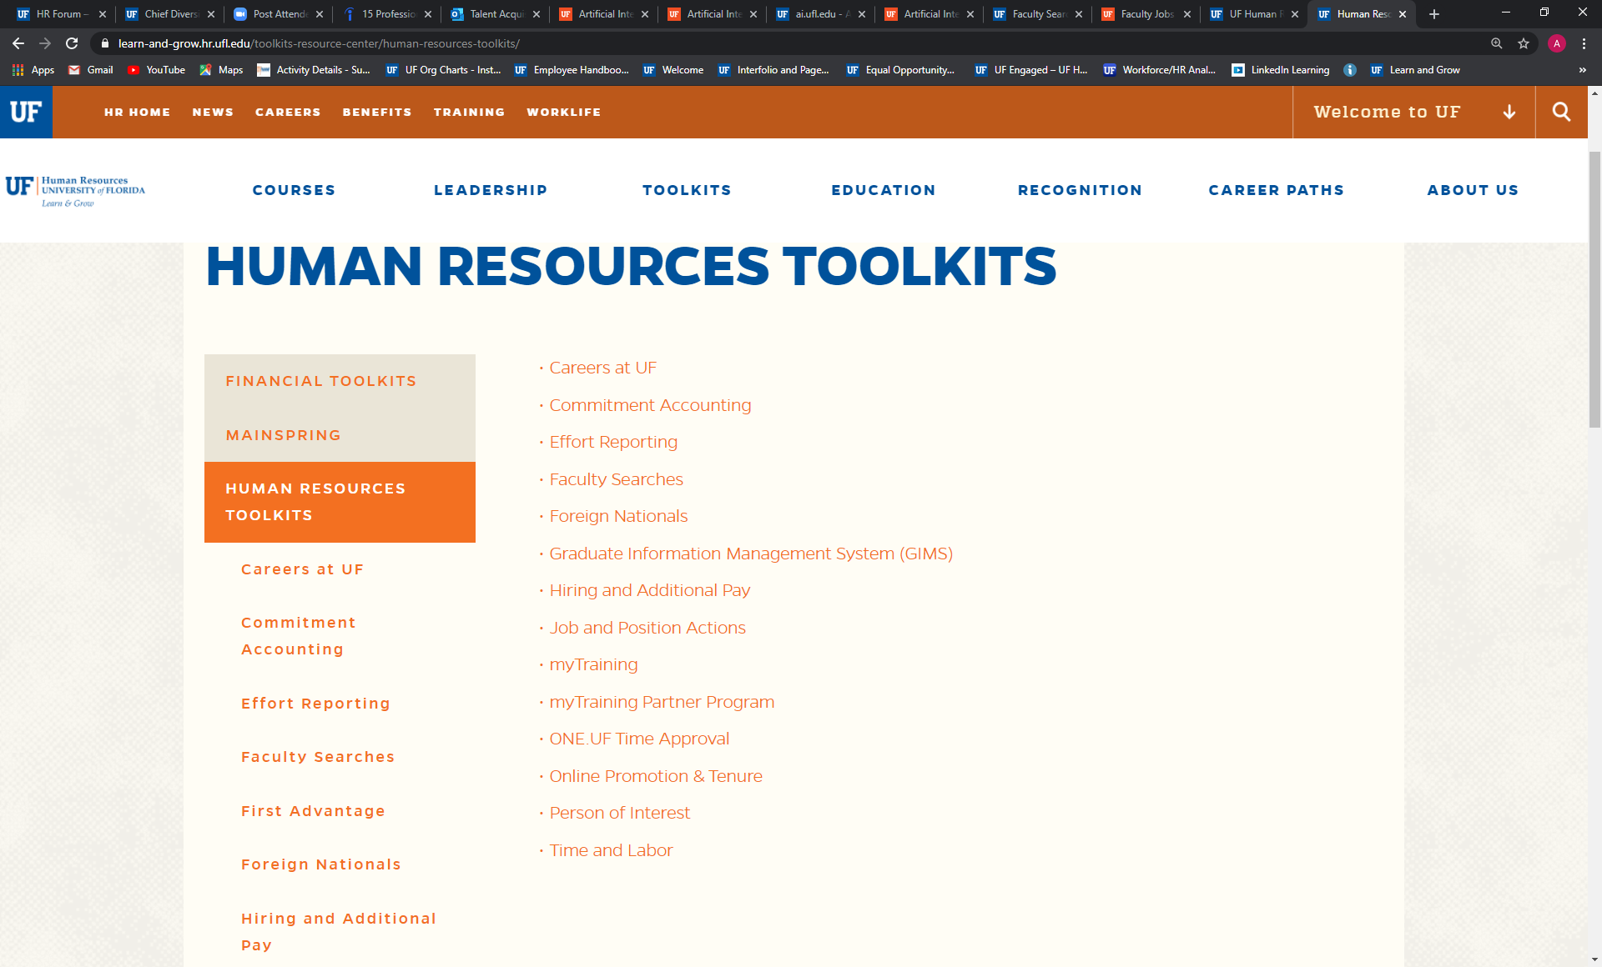
AI Faculty Hiring Resources
AI Jobs Website ai.jobs.ufl.edu/
UF Faculty Searches Toolkit hr.ufl.edu/

Slide 22
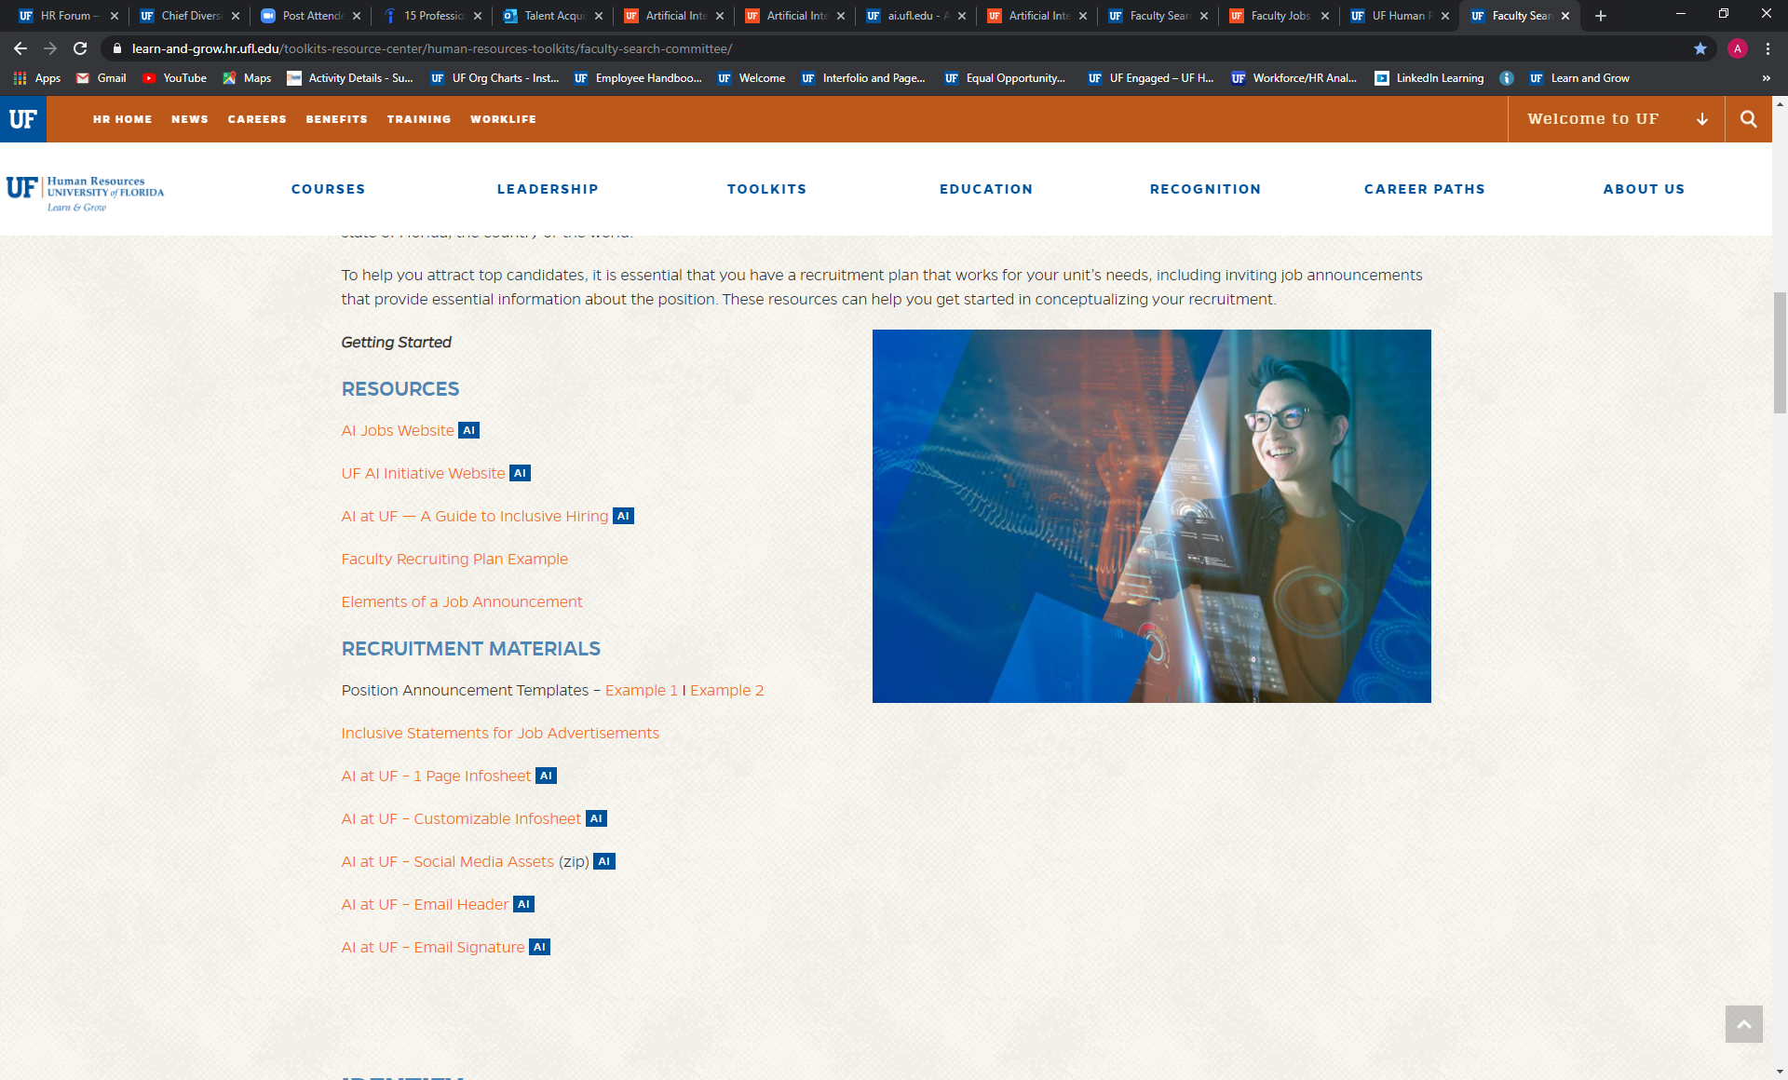
AI Faculty Hiring Resources

Slide 23
Interfolio
System Advantages
  Interfolio dossier allows for shared stored materials between candidates and committee members without uploading documents
  Interfolio dossier provides letter of recommendation solicitation and delivery through confidential links
System Opportunities
  Access to candidate contact data limited
  Minimal Reporting Capability
  Narrow datasets can be downloaded at one time
  User and applicant support is limited
  Restricted customization and systems configuration
UFHR preeminence through people
Notes:
One thing is clear today: The need for Resilience and Mindfulness is here to stay. With the increasing frequency and severity of shocks and changes that can shake us up, learning to be more resilience can enhance the quality of our work experience.
The GBAS Resilience at Work series will take a holistic approach to consider all aspects of resilience – physical, cognitive, emotional and spiritual (purpose and values) within the professional context. Throughout the five sessions we will incorporate concepts of work resilience with opportunities for increased self-awareness through mindfulness. You will also be able to explore ideas and gain support from group conversations with the community of participants as well as a smaller cluster of peers at each session.
Participants are expected to attend all sessions and carve aside time for self-reflection and light homework between meetings. At the end of the series, you will have gained a deeper understanding of how to nurture your resilience for wellbeing and sustained work performance.
The sessions will be on Tuesdays from 10 to noon, running every other week from Feb 23 to April 20.

Slide 24

Interfolio
Service Option
  Engaging in a one-year extension with the option to renew
  Optimization of support and on-going training
  Quarterly assessment of value and utilization
Contact Information
  Talent Acquisition and Onboarding
  talent@hr.ufl.edu
UFHR preeminence through people
Notes:
One thing is clear today: The need for Resilience and Mindfulness is here to stay. With the increasing frequency and severity of shocks and changes that can shake us up, learning to be more resilience can enhance the quality of our work experience.
The GBAS Resilience at Work series will take a holistic approach to consider all aspects of resilience – physical, cognitive, emotional and spiritual (purpose and values) within the professional context. Throughout the five sessions we will incorporate concepts of work resilience with opportunities for increased self-awareness through mindfulness. You will also be able to explore ideas and gain support from group conversations with the community of participants as well as a smaller cluster of peers at each session.
Participants are expected to attend all sessions and carve aside time for self-reflection and light homework between meetings. At the end of the series, you will have gained a deeper understanding of how to nurture your resilience for wellbeing and sustained work performance.
The sessions will be on Tuesdays from 10 to noon, running every other week from Feb 23 to April 20.

Slide 25
Important Dates
Upcoming HR Forum – April 7 @ 10 a.m. (Zoom details TBA)

Slide 26

Thank you for attending the
HR Forum

