Slide 1
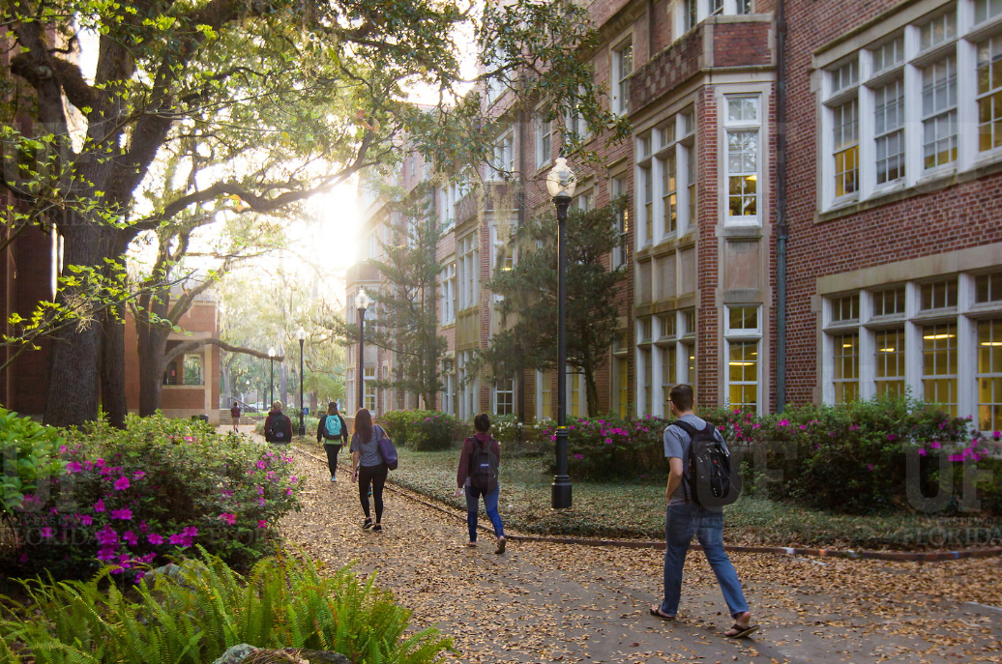
HR Forum
April 7, 2021

Slide 2
Today’s Agenda Items
GBAS Update – Barb Mitola
Training Updates – Bob Parks
Employment Operations and Records Updates –
Cynthia Mendoza/Johannes Traster
Classification and Compensation Updates – Brent Goodman
Benefits Updates – Shannon Edwards
Important Dates
UFHR preeminence through people

Slide 3
Training and Organizational Development
GBAS Update
Notes:
Section slide

Slide 4
GBAS Director
Welcome
Terry Moore
Starting January 2022
UFHR preeminence through people
Notes:
Welcome Terry
Highlights of the search process - - multiple groups – Open call posted. Gwynn, myself and two advisory council members determined and did initial interviews. From there, determined second round with Jodi, Chris and Bob. We were lucky to have such a highly qualified applicant pool and we are happy to have Terry as the Director.
Then hand it over to Terry to hear from here.
Diff areas she’s worked in
Her involvement with GBAS
Her passion for the work
We’ll see Terry in events as we move into 2022.
One event we’d like to quickly highlight today is the CxUF conference.

Slide 5
Are You Ready?
Keeping It Real
Mark the time on your calendar on May 11 & 12
Encourage participation to all who registered
Your Conference Group (YCG)
YCG Facilitator opportunity
We encourage you to visit https://learn-and-grow.hr.ufl.edu/connected-by-uf-conference/cxuf-agenda/ for the conference agenda and session descriptions
UFHR preeminence through people
Notes:
Plan for full participation

Slide 6
Training & Organizational Development
UF Leadership Program Applications Open
Summer Calendar
Stronger Together

Slide 7
Leadership Program Applications
“Leadership and learning are indispensable to each other.”—John F. Kennedy
Now through April 30 we are accepting applications for
UF Academy
Advanced Leadership for Academics and Professionals (ALAP)
Managers Cohort

Slide 8
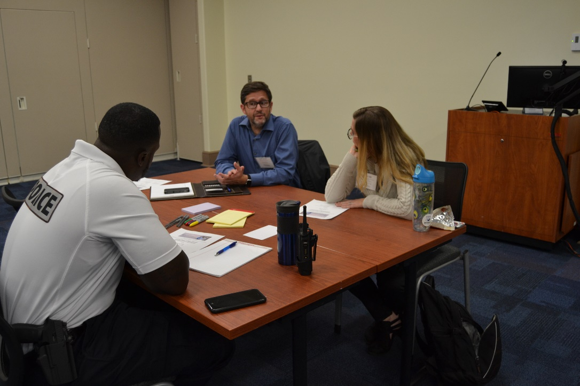
Leadership Program Applications
UF Academy
Entering its 17th year
Designed for faculty and professional staff who are “emerging leaders”

Slide 9
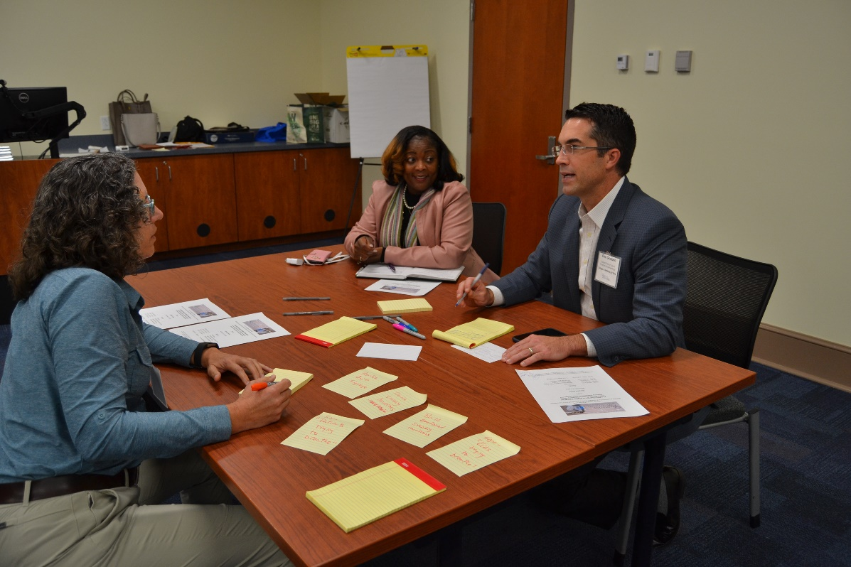
Leadership Program Applications
Advanced Leadership for Academics and Professionals (ALAP)
Entering its 12th year
Designed for established UF professional and academic leaders looking to further develop leadership skills

Slide 10
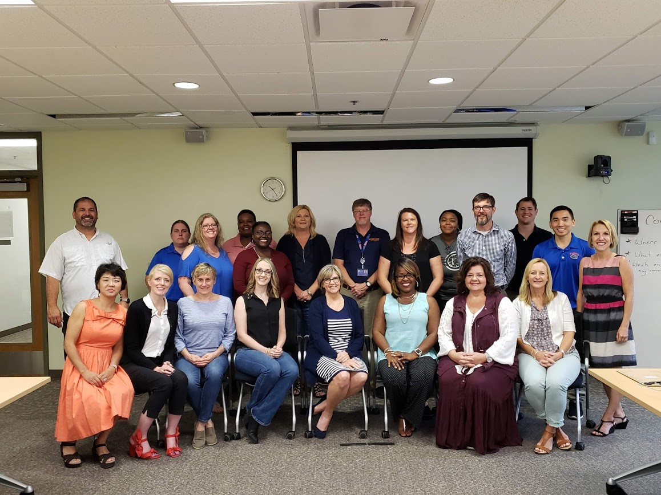
Leadership Program Applications
Managers Cohort
Entering its 11th year
Managers can participate in the Managing at UF curriculum as a cohort

Slide 11
Leadership Program Applications
For more information or to access the application, visit the Leadership @ UF program page on the UFHR site http://hr.ufl.edu/leadership@uf/programs/

Slide 12
Summer Calendar
Summer calendar of courses available for registration starting Monday, April 5
Several certification tracks for different roles
Register in myTraining
View HR calendar for course dates (https://calendar.hr.ufl.edu/events/category/training-organizational-development/)
UFHR preeminence through people

Slide 13
Stronger together sessions:
Managing Biases in Hiring with Audrey Gainey
April 13th from 1:30-3pm
Understanding Your Racial Identity with Dr. Rivera-Ramos
April 29th from 10:30am-12pm
Understanding and Taking Action Against Anti-Black Racism with Dr. Della Mosley
May 25th from 12-1:30pm
www.learn-and-grow.hr.ufl.edu/courses-registration/stronger-together/

Slide 14
Employment Operations & Records
Short Work Break
Summer File
OnBase Forms
Website Renovations
Notes:
Section slide

Slide 15
Short Work Break Reminders!
Short Work Break file will take place on April 23, 2021
Action Needed by Departments
Verify all 9- and 10-month employees (faculty, graduate assistants, and TEAMS) who will not return after Spring 2021 are terminated in myUFL
If necessary, enter end-of-semester terminations PRIOR to April 22, 2021

Slide 16
Short Work Break Reminders!
To review employees on Short Work Break after April 23rd
Main Menu > Enterprise Analytics > Access Enterprise Analytics > Team Content > Human Resources Information > Workforce Information > Short Work Break – Return From Break Report
Instruction Guide
http://training.hr.ufl.edu/instructionguides/job_position_actions/shortworkbreak.pdf

Slide 17
Faculty and GA Summer Appointment Reminders!
Summer appointments for 9-month faculty and graduate assistants may be processed via the summer job file
Summer appointments may also be entered as a Hire ePAF
The file will open on April 23, 2021
The file will close on May 13, 2021
Summer appointments will be reflected in Job Data on May 17, 2021

Slide 18
Faculty and GA Summer Appointment Reminders!
The file will be available via myUFL system
Main Menu > Human Resources > Workforce Administration > Job Information > UF Summer Job Review
Instruction Guide
http://training.hr.ufl.edu/instructionguides/job_position_actions/summerjobreview.pdf
You will be contacted by EOR if there are employees who do not load and may need additional action on your part

Slide 19
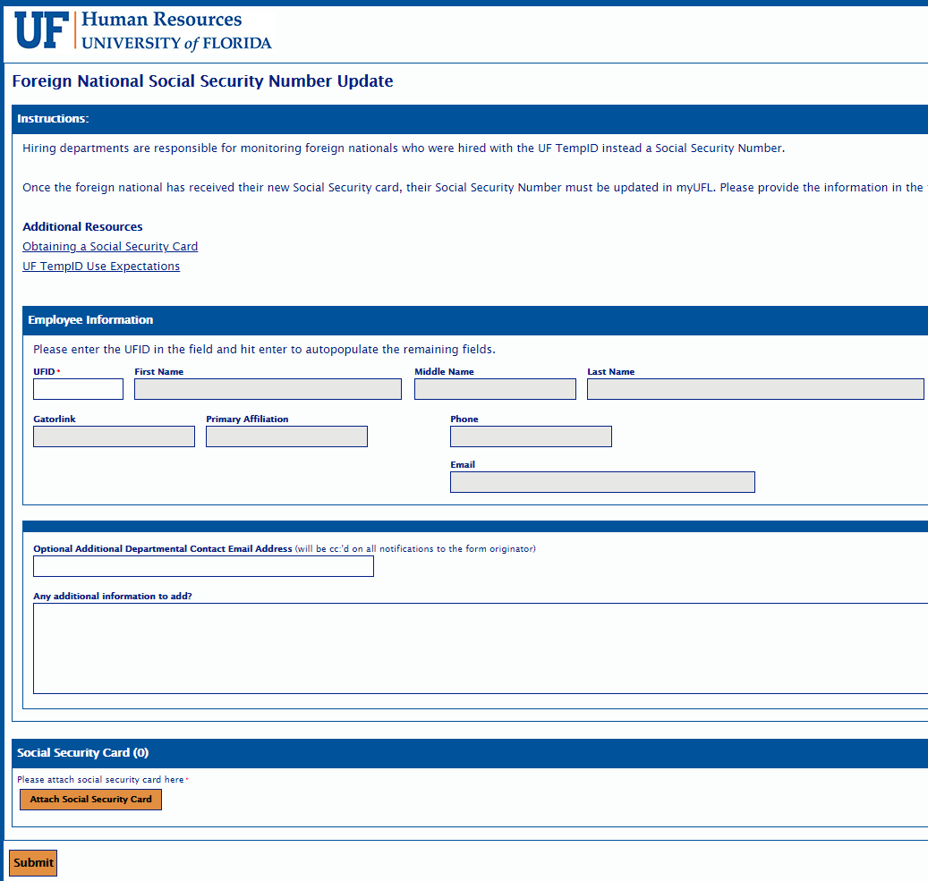
OnBase Self-Service Forms
Foreign National SSN Updates
Employees using a UF TempID that need their SSN updated in myUFL
Simple eForm to upload SS card
Available to use now; previous process will retire by April 16th
Name and/or Gender Changes
Previous paper version of the form is no longer in use
No changes to requirements; SS card is still required for name changes

Slide 20
Employment Operations & Records Website Renovations
Previous Navigation Menu
Hiring a Foreign National
Hiring Center
Employment Verification
I-9 Verification
Employment Data
Retention
Scanning
Records Request
Employment of Relatives Petition
New Navigation Menu
Hiring Center
Hiring a Foreign National
Employment Data Updates New!
Employment of Relatives Petition
Employment Verifications & Records New!
Employment Operations & Records Website

Slide 21
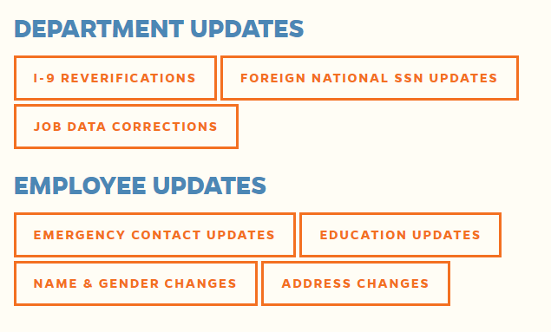
Employment Data Updates
Newly renovated website for your department and employee needs
Employment Data Updates
hr.ufl.edu
Manager Resources
Employment Operations & Records
Employment Data Updates
Previous reverification website and portal now lives on this page
Reverification email has been migrated over to our main EOR listserv: ufhr-employment@ufl.edu

Slide 22
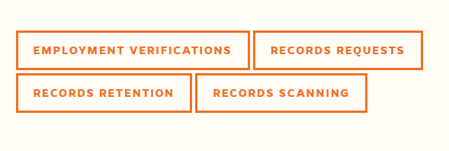
Employment Verifications & Records
Employment Verifications Employment Verifications & Records
Public Service Loan Forgiveness
The Work Number
UF Related Entities
Self-Service Verifications
Records Management
Public Records
Personnel Records
Retention Schedules

Slide 23
Classification and Compensation
Notes:
Section slide

Slide 24
Class & Comp Updates
UFHR’s is implementing a market pricing tool in support of the strategic commitment to design and implement a fair and competitive compensation strategy to help attract, retain, and reward high-performing faculty and staff.
This tool will provide leaders across campus in data-driven decision making by providing comprehensive market data.
UFHR preeminence through people

Slide 25
Class & Comp Updates
Why is this important?
UF’s month salary expenditure, including fringe, is approximately $89M each pay period.
While monetary rewards is only one aspect of the total value an employee receives, it is often the largest expense.
As a leader, maximizing the return on this resource is critical to the success of your unit and the university.
UFHR preeminence through people

Slide 26
Class & Comp Updates
In 2019, the University of Florida engaged Segal Consulting (formally Sibson Consulting) to conduct a competitive assessment of base salaries and develop a new staff salary structure.
Following a comprehensive market assessment that covered approximately 80-85% of incumbents, UFHR and Segal developed a salary structure for staff positions.
We found that UF’s aggregate compensation spend was 96% of the market median and that 73% of incumbent salaries were within a competitive range or leading the market.
UFHR preeminence through people

Slide 27
Class & Comp Updates
Earlier this year, UFHR implemented a market pricing tool called Payfactors in order to support our ongoing efforts in the compensation space.
As part of the implementation, UFHR priced 54% of staff jobs which covers 82% of current incumbents.
As of February 1st, UF’s aggregate spend is 98% of the market median and 79% of incumbent salaries are within a competitive range or leading the market.
UFHR preeminence through people

Slide 28
Class & Comp Updates
UFHR preeminence through people

Slide 29
Class & Comp Updates
Market Competitiveness by Job Family
Accounting & Finance | Admin & Mgmt. | Ag & IFAS Operations | Animal & Vet Care | Comm, Sales & Marketing | Development & Alumni Aff | Education & Training | Facilities Operations | Healthcare | Human Resources
101.6% | 104.4% | 92.6% | 102.9% | 90.6% | 97.5% | 95.9% | 105.4% | 98.2% | 97%
Information Technology | Legal & Audit Services | Libraries & Museums | Life, Physical & Social Sciences | Office & Business Adm | Public & Env Safety | Research & Grants | Student & Academic Svc
91.4% | 107.0% | 89.3% | 85.0% | 101.2% | 102.5% | 102.8% | 109.7%
UFHR preeminence through people

Slide 30
Class & Comp Updates
Market Competitiveness by College/Administrative Unit
UF Advancement | Busines Services | Office of the CFO | COTA | IFAS | Business | Dentistry | DCP | Education | Engineering | HHP
99.4% | 100.6% | 99.6% | 94.4% | 92.3% | 106.5% | 98.5% | 101.8% | 106.2% | 100.5% | 106.2%
Journalism | Law | CLAS | Medicine | Medicine – JAX | Nursing | Pharmacy | PHHP | Veterinary Medicine | Housing | Emergency Management
110.3% | 106.4% | 92.9% | 99.8% | 99.4% | 105.8% | 100.3% | 105.2% | 94.4% | 100.3% | 101.7%
EH&S | Facilities | Facilities Planning & Construction | Accounting & Finance | FLNHM | Graduate School | UF Human Resources | UFIT | International Center | Reitz Union | Military Units
101.9% | 107.3% | 112.6% | 98.5% | 95.4% | 95.7% | 91.2% | 91.6% | 93.9% | 105.6% | 90.2%
Enrollment Management | Health Affairs | Office of the President | Office of the Provost | Student Affairs | PHHP-COM | COO’s Office | Student Health Care Center | Business/Vendor Diversity | O’Connell Center | Student Government
95.7% | 96.8% | 116.6% | 98.4% | 98.2% | 107.5% | 99.7% | 92.0% | 90.7% | 98.0% | 99.7%
Office of Teaching & Technology | Type One Centers | UF Research | Libraries | UPD | Florida Press | Strategic Comm & Marketing | VP, Business Affairs | General Counsel | Government Relations
94.0% | 101.5% | 105.3% | 88.2% | 103.0% | 86.8% | 104.8% | 94.5% | 121.4% | 128.3%
UFHR preeminence through people

Slide 31
Class & Comp Updates
To support the effective use of UF’s salary expenditure, UFHR will be adding several new services that will occur throughout the year.
May – UFHR will provide Deans and Vice Presidents with aggregate market data for their units to support salary planning.
July – UFHR will update the University’s salary structure, if appropriate, based on market information.
September – UFHR will provide Deans and Vice Presidents with market data, with incumbent level detail, to support merit-based salary increases as part of university wide pay programs.
Ad-hoc – UFHR’s compensation team will provide ad-hoc market information upon request.
UFHR preeminence through people

Slide 32
Class & Comp Updates
The market data includes the Mercer/Gartner IT, Compdata, CUPA-HR, Oklahoma State Faculty Salary Survey, and Wamser University Foundation/Development survey.
CUPA-HR survey data includes administrators, professionals, staff and faculty salary data by 2-, 4-, and 6-digit discipline.
UFHR selected multiple peer groups that include the following:
All Institutions
Association of American Universities (AAU)
Land-grant Institutions
Very High & High Research Institutions
Institutions in the 4th quartile for operating expenditures, faculty FTE, student FTE, and staff FTE
UFHR preeminence through people

Slide 33
Class & Comp Updates
Compdata survey data includes their College & University, Benchmark Pro (general industry), and Healthcare salary surveys.
Data slices include the southeast region and national markets
UFHR preeminence through people

Slide 34
Class & Comp Updates
The Payfactors systems also provides useful information regarding the cost of labor and cost of living throughout the country.
This will allow UFHR to identify trends such as changes in the cost of labor over time.
In this example, Gainesville’s cost of labor is 7.8% lower then the national average, an increase of 1.8% from the previous year.
UFHR preeminence through people

Slide 35
Class & Comp Updates
Next Steps
UFHR will be identifying ways to integrate market information into daily operations. For example, compensation and talent acquisition teams are working to identify ways to leverage market data.
UFHR will be partnering with HRLs to provide market pricing training and access to the Payfactors system.
UFHR is working with key campus stakeholders to refine the data architecture in order to leverage Payfactors reporting features including internal pay equity
UFHR preeminence through people

Slide 36
UFHR Data Services & People Analytics
UF Human Resources Data Services & People Analytics team works to connect campus administrators and supervisors with robust HR data and analytics to assist campus partners in making data-driven decisions.
Current Initiatives
Develop baseline dashboard metrics and workforce analytics.
Engage campus partners and UFIT Enterprise Reporting to leverage existing reporting systems in order to maximize and streamline supervisor access and utilization.
Streamline internal HR data requests from campus administrators and supervisors.
UFHR preeminence through people

Slide 37
UFHR Data Services & People Analytics
The UFHR team is not a substitute or replacement to the existing public records request process.
UFHR’s data team will assist leaders and supervisors with a direct job-related need for such data such as university administrators, managers, and supervisors. Typically, data requests will be limited to those areas for which the requestor supervises or has departmental access privileges in myUFL.
UFHR preeminence through people

Slide 38
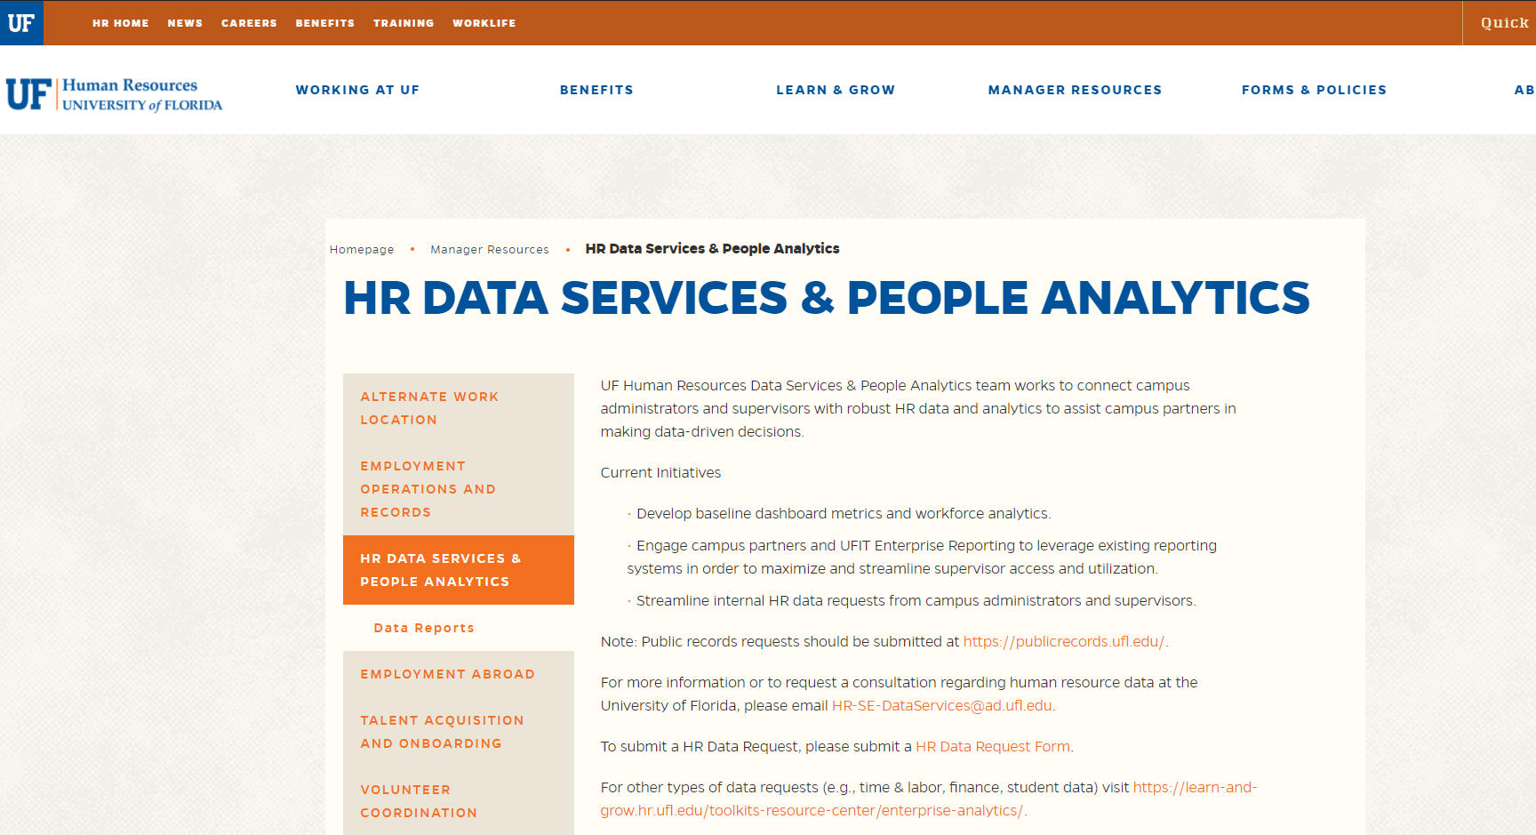
UFHR Data Services & People Analytics
HR Data Services & People Analytics Website
https://hr.ufl.edu/manager-resources/hr-data-services-people-analytics/
UFHR preeminence through people

Slide 39
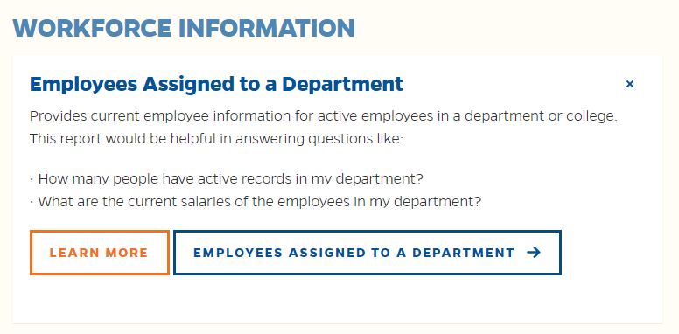
UFHR Data Services & People Analytics
Standard Reports Library
UFHR’s data team has created a catalog of existing Enterprise Analytics reports that provides data regarding a variety of HR related information including leave and workforce information.
UFHR preeminence through people

Slide 40
UFHR Data Services & People Analytics
People Analytics
UFHR’s data team is working to develop a set of HR metrics to help leaders make data-driven decisions about their workforce.
These metrics include:
Retention Metrics – such as turnover
Total Rewards Metrics – such as market competitiveness
Workforce Engagement Metrics – UF Engaged completion rates
Workforce Data – Headcount and demographic trends
Operational Effectiveness – HR actions
UFHR preeminence through people

Slide 41
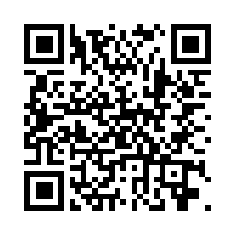
UFHR Data Services & People Analytics
If there are specific metrics or reports that you would like to see included, visit https://ufl.qualtrics.com/jfe/form/SV_7WpsP6wvi4kzRLE.
UFHR preeminence through people

Slide 42
University Benefits
FY20-21 Comp Leave Cash-Out
Paid Family Leave
Paid Time Off
New Hire Reminders
Notes:
Section slide

Slide 43
FY 20-21 Comp Leave Cash-Out
Overtime, regular, and compensatory leave will be cashed out on the final paycheck of FY 20-21 (06/18/2021).
Accrued balances (less use) as of the end of PPE 5/27/21 will be paid out.
To prevent negative balances and payroll corrections, TRCs pertaining to comp leave will be unavailable during PP 05/28/21 - 06/10/21.
Any approved use of comp time for PP 06/11/21 - 06/24/21 must be submitted to Central Leave and entered directly by Payroll.
UFHR preeminence through people

Slide 44
FY 20-21 Comp Leave Cash-Out Departmental Preparation
In most cases, units can adjust work schedules to prevent compensatory leave from accruing.
Accrued comp leave can be taken in place of other leave types.
Review accruals anytime (recommended on at least a per-pay basis): Enterprise Reporting > Access Reporting > Human Resources Information > Benefit Information > Leave > Leave Accruals, Usage, and Balances By Pay Period, Department - COMP ONLY.
Correct negative balances as quickly as possible by working with Central Leave.
For assistance with Leave Cash-Outs:
Contact the UFHR Central Leave: central-leave@ufl.edu or (352) 392-2477
UFHR preeminence through people

Slide 45
Paid Family Leave
Paid Family Leave was successfully introduced to eligible TEAMS and Faculty on January 8, 2021.
Paid Family Leave provides up to 8 weeks of paid leave every 24 months for parental or medical reasons – the best and worst of times
More than 200 employees have qualified for and are benefitting from UF's Paid Family Leave program
Not funded through Fringe Benefits Pool
For more information regarding this new leave benefit, please visit https://benefits.hr.ufl.edu/time-away/paid-family-leave/.
UFHR preeminence through people

Slide 46
Paid Time Off
As we continue to navigate through the pandemic's challenges together, we have listened to your feedback and have decided to pause our efforts to transition to a Paid Time Off (PTO) model of leave until a later date.
UFHR wants to make sure the transition goes smoothly and is implemented during a more stable period for everyone.
During this time, we plan to assess the various parts of PTO (i.e. PTO cap, sick leave savings account, etc.) to ensure that they function as intended
Please reach out to UFHR Central Leave with any questions or concerns central-leave@ufl.edu.
UFHR preeminence through people

Slide 47
Spring/Summer New Hire Reminders
Due to double deductions, any new 9- and 10-month hires effective prior 8/16/2021 must be coordinated with Benefits to ensure proper enrollment and summer coverage.
All new OPS hires with combined FTEs ≥0.75 are eligible for State benefits.
The State does not consider salary plan changes (i.e., OPS to TEAMS or Faculty) for benefits-eligible employees as a Qualifying Status Change. Employees may have to wait until Open Enrollment to enroll in State benefits.
Questions? Contact us at benefits@ufl.edu, 352-392-2477, or reach out to your dedicated Benefits Specialist.
UFHR preeminence through people

Slide 48
Important Dates
Upcoming HR Forum – May 5 @ 10 a.m. (Zoom details TBA)

Slide 49
Thank you for attending the HR Forum

