Slide 1

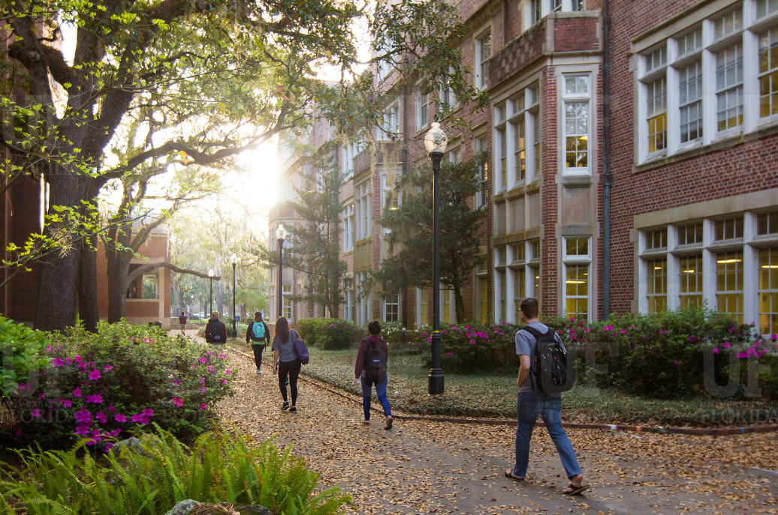

HR Forum
May 5, 2021

Slide 2
Today’s Agenda Items
Federal Work Study – Christina Lamb
GBAS Update – Lyz Lynch
Training Updates – Bob Parks/Brandon Telg
Termination File – Cynthia Mendoza
Name Fields in PersonHub – Cynthia Mendoza
Benefits Updates – Shannon Edwards/Nadja Schimmel-Cruz
Return to Standard Operations – Jodi Gentry
Important Dates
UFHR preeminence through people

Slide 3

F E D E R A L W O R K - S T U D Y
Christina Lamb, Ph.D. Senior Associate Director
Office of Student Financial Aid and Scholarships

Slide 4

WHY D O ES
FEDERAL WORK-STUDY
MAT T ER ?
Engagement & Support
Experiential Learning
Positive Financial Impact
Alignment with Institutional & State Values

Slide 5

75% of work-study wages are federally funded—the hiring department pays just 25% of the student’s wages
Student success is only one part of the equation.
Student employees help to diversify offices, provide relevant viewpoints, and meet changing staffing needs

Slide 6
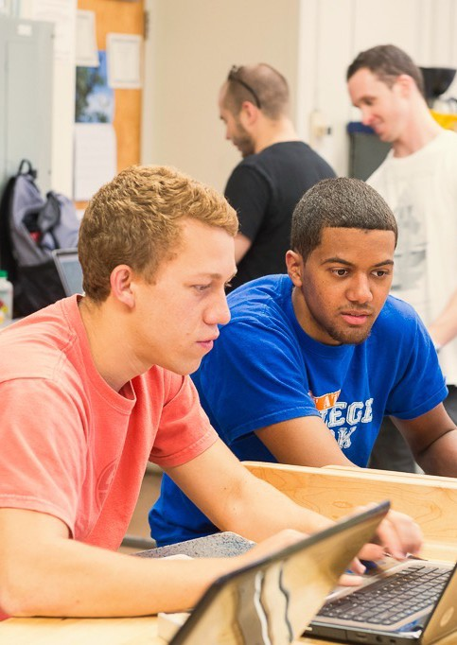
FEDERAL WORK-STUDY (FWS) ELIGIBILITY
Complete an error-free FAFSA and be Title IV eligible
Have financial need
Enroll at least half-time in a degree-seeking program
Make satisfactory academic progress

Slide 7
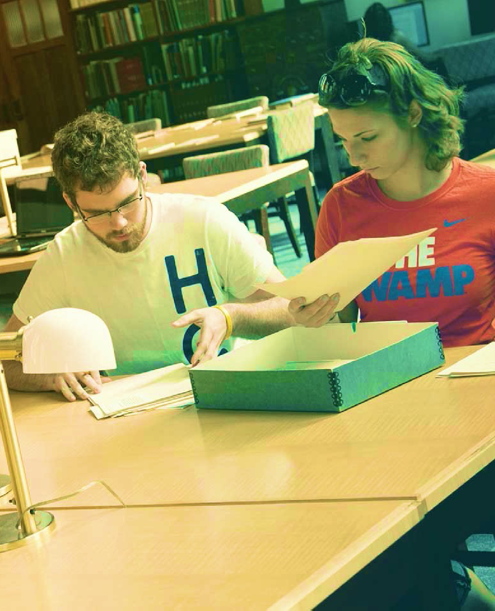
UTILIZING FWS
Students can view their FWS award on One.UF
Financial Aid Advisers may add or increase an award
Standard work hours limited to 20 per week
Students may only work up to their awarded FWS amount
Both student and employer should monitor earnings

Slide 8

“As we become even more selective,
more competitive— we must become more personal.”
UF P R ESI D EN T
W. K E N T F U C H S
In an address to the UF Communicators Network
How can a work-study student benefit
my organization?

Slide 9

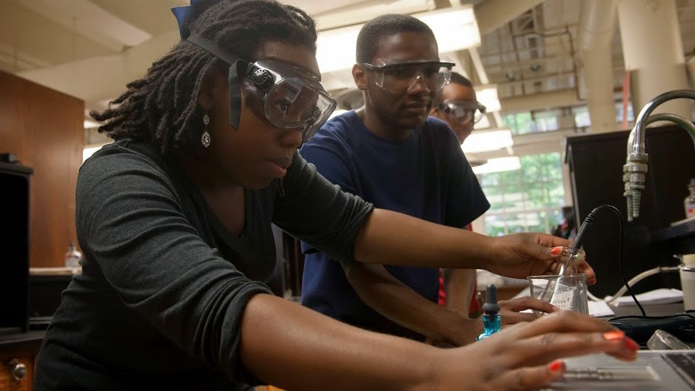
ADMINISTRATION
Communications & Marketing
Student Services & Advising
Database Management & Technical Support
RESEARCH
Lab Technician
Clinical Data Management
Qualitative Interviewer

Slide 10
Ready, Set, Work-Study!
The Office of Student Financial Aid and Scholarships
Student Employment Coordinator Van Thai: nublavt@ufl.edu, 392-0296

Slide 11
Training and Organizational Development
GBAS Update
Lyz Lynch – GBAS Advisory Council
Notes:
Section slide

Slide 12

CxUF is HERE!
Next Week – May 11 & 12
The website will be open Monday, May 10 for pre-conference exploration.
You will need a conference password – ONLY for those who are registered.
Please do NOT share.
Why should I attend the peer learning groups called YCG groups?
Find Your Conference Group (YCG) https://learn-and-grow.hr.ufl.edu/connected-by-uf-conference/your-conference-group/
Visit https://learn-and-grow.hr.ufl.edu/connected-by-uf-conference/cxuf-agenda/ to see the session descriptions and speaker’s bios.
UFHR preeminence through people
Notes:
Hi everyone, my name is Lyz Lynch, I’m a member of the GBAS Advisory Council.
You’ve been hearing us talk about this forever, but I am extremely excited to announce that the Connected by UF Conference is finally here!
The event is next Tuesday and Wednesday, May 11th and 12th. I do want to mention that registration is completely closed. If you aren’t already registered, you’ll have to wait for the next CxUF conference will be in about …. [I’m planning to look humorously at my watch during this pause] 2 years, I’m afraid.
People who are registered for the conference will receive an email that includes a password for the conference website. The website will be open on Monday 5/10 for you to explore, so once you get your password, take a look on Monday!
The conference website was specially built for us and has limited capacity, which is why we’ve set up password-only access. Please DO NOT share your password with anyone else, because if we have extra unregistered people logging on, it’s possible people who did register might not be able to access everything they need to on the website. So please don’t share your password.
One of the exciting things in this conference is what we’re calling “Your Conference Group or YCG.” In an in-person conference, one of the big benefits is being able to network and have ad-hoc conversations with others attending the conference, and that’s almost always lost in remote conferences because there isn’t a “space” where you can have this type of productive discussion.
That’s what YCGs are all about! Not only do we have set times to log into the YCG rooms where you’ll be guided through discussions to share your ideas and what you’ve learned, and how it all can be put into practice, there are also fun activities to perform with your group with the chance of winning some TRULY excellent prizes. And on top of that, when the YCG rooms are NOT officially in session, the rooms will still be open, so you can jump into one of those rooms with colleagues to have your own ad-hoc conversations as well.
I am personally very introverted, so I’m always tempted to skip small group work in this type of event. But I am legitimately excited about these groups and the opportunities they’ll give participants – we got to test it out a bit, and it was great. If that still doesn’t convince you to participate, I’m quite certain the prizes will! So don’t miss out.
Your Conference Group is assigned already and there will be no substitutions. You can find who will be in your conference group on the first HR link on this slide – just search by your last name.
The second link on the slide is for the conference agenda, which lists all the concurrent sessions and speaker biographies. If you haven’t looked, go check it out to see the exciting sessions we’ll have!
I have had the pleasure of seeing some of the concurrent session presentations and content already, and I am so thrilled! When we already have a unit on campus who’s handling a difficult process nearly perfectly, there’s no reason other units on campus should have to reinvent the wheel to master that process in their own unit, but that’s what’s often happening. This conference is a huge opportunity to benefit from others’ expertise and resources that have already been developed that can directly translate into making our jobs easier.
Whatever concurrent sessions you decide to attend, we’re confident you will get useful information that will help you do your job better.
Are there any questions about CxUF?

Slide 13
Training & Organizational Development
Stronger Together

Slide 14

Upcoming Sessions
Racial Trauma Panel: 5/20 at 9am
Understanding and Taking Action Against Anti-Black Racism with Dr. Della Mosley: 5/25 at 12pm

Slide 15

The Racial Healing Handbook
Book Club
  Weekly readings and discussion
  Tuesdays, June 15th – August 17th at 12pm
  Register in myTraining
http://learn-and-grow.hr.ufl.edu/courses-registration/stronger-together/
Notes:
As part of the Stronger Together training series, join Training & Organizational Development in a guided book club reading of The Racial Healing Handbook by Anneliese A. Singh, PhD LPC. The Racial Healing Handbook is a unique book that aims to take you on a journey of healing from racism. Through weekly readings and introspective questions, the handbook will lead you towards racial liberation and resilience. As a group, we will discuss what the book is teaching us and engage in critical conversations around racial healing.
In this book club, we will read one chapter of the book per week for 10 weeks, meeting each Tuesday June 15-August 17 to discuss and engage with the material.
Please note that you are free to attend any sessions that you are able to come to. If you are unable to attend every session but can come to some of them and want to register, please do! We look forward to taking this journey with you.

Slide 16
Employment Operations & Records
Termination File
Changes to Name Field in PersonHub
Notes:
Section slide

Slide 17
Termination File
A termination file will be open from May 10th – May 28th, 2021
The file lists active employees who have not received payment in 6 months or more
Effective date in Job Data: June 1, 2021
Why do we do a termination file?
  Help mitigate unnecessary risks
  Have an accurate count of our employment population
  Assist departments in making good decisions for unit/college
It is NOT an alternative to timely terminations in the system

Slide 18
Termination File
Review the termination file and “uncheck” those individuals who should remain active in the system
  As EOR reviews the file, we may contact you for additional justification on leaving certain employees active
The file may contain records of all the salary plans. For example, OPSN, FWS, STAS, OF12, etc. (This is not an all-inclusive list)

Slide 19
Termination File
The termination file is located:
Main Menu > Human Resources > Workforce Administration >
Job Information > UF Appointment Review
  Enter the Year: 2021
  Enter your unit’s Department ID
  Enter Termination Date: 06/01/2021
Questions?

Slide 20
Changes to Name Fields in PersonHub
UFHR preeminence through people

Slide 21
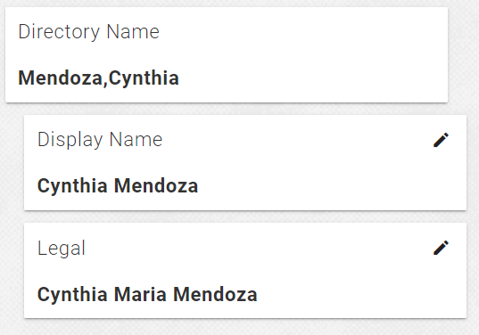
Names in Person Hub – Current State
In effort to streamline our systems, the field labeled “Display Name” is changing to “Chosen Name”
This change will take effect on May 6, 2021

Slide 22
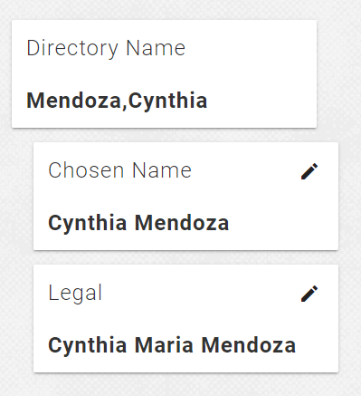
Names in Person Hub – May 6, 2021
What does this mean for our operations?
  We will experience minimal change if any
  Hiring experience will continue as it is currently (using legal name)
  Campus users have access to make changes to their “Display/Chosen” name currently
Questions?

Slide 23
University Benefits
Short Work Break
ARP Act of 2021 COBRA & Dependent Care FSA
Fiscal Year End Leave Processes
Notes:
Section slide

Slide 24
Short Work Break for 9/10 Month Employees
SWB preserves benefits eligibility during the summer months for active 9/10 month employees
No benefit deductions taken over the summer months, even if additional compensation is provided (such as OPS employment)
Benefit coverage extends through September for employees on short work break
Last benefits deductions for 9/10 month employees:
    April 23 paycheck for UFSelect and/or GatorCare plans
    May 7 paycheck for State plans and GatorGradCare (GA plan)
Normal deductions resume in September
UFHR preeminence through people

Slide 25
ARP – COBRA Premium Assistance
The American Rescue Plan includes a provision for premium assistance for employees and their qualified dependents of 100% of the COBRA premium for group health, dental, and vision plan coverages.
Only available to those who are eligible for COBRA because of an involuntary termination or a reduction in hours (does not apply to OPS employees who did not measure enough hours) and who are, or could have been, eligible for COBRA during 4/1/21 - 9/30/21.
COBRA Administrators (People First and Payflex) will notify individuals who may potentially qualify.
UFHR preeminence through people

Slide 26
Benefits Termination & COBRA
  Entering job terminations in a timely manner expedites timely benefits termination and appropriate payroll deductions
  Termination dates for benefits vary depending on plan type
      State plans—health plans terminate end of the month after job termination
          Example—job termination date 5/15, state health plan termination date 6/30
      UFSelect/GatorCare plans—health plans terminate at end of month of job termination
          Example—job termination date 5/15, GatorCare health plan termination date 5/31
  Termination processing
      Job termination in myUFL triggers termination of employee benefits in UF system
      Benefits termination then transfers to plan administrators, and COBRA packets sent when applicable
    Be sure to use the correct reason code (termination, lay off, etc.) instead of using “end of temporary job” to ensure COBRA offer is generated
UFHR preeminence through people

Slide 27
ARP – Dependent Care FSA
The ARP includes a provision for raising pretax contribution limits for DCFSA for calendar year 2021.
New 2021 limits:
  Single and Married Filing Jointly: increased from $5000 to $10,500
  Married Filing Separately: increased from $2,500 to $5,250
Chard Snyder will communicate these changes to participants and participants would change their amount through Chard Snyder.
Have questions about benefits eligibility, enrollment, or effective dates?
Contact the UFHR Benefits Office: benefits@ufl.edu or (352) 392-2477
UFHR preeminence through people

Slide 28
Preparing for 2021 Fiscal Year End Leave Processes
Personal Holidays (USPS) and December Personal Leave Days (Teams & Eligible Faculty)
    USPS Personal Holidays must be used in full day increments
    December Personal Leave Days can be used in less than full-day increments
    “Use it or lose it”--use by June 30, 2021 or will expire
UFHR preeminence through people

Slide 29
FY 20-21 Comp Leave Cash-Out
    Overtime, regular, and compensatory leave will be cashed out on the final paycheck of FY 20-21 (06/18/2021)
    Accrued balances (less use) as of the end of PPE 5/27/21 will be paid out
    To prevent negative balances and payroll corrections, TRCs pertaining to comp leave unavailable during PP 05/28/21 - 06/10/21
    Any approved use of comp time 05/28/21 - 06/30/21 must be submitted to Central Leave and entered directly by Payroll
UFHR preeminence through people

Slide 30
FY 20-21 Comp Leave Cash-Out Departmental Preparation
    In most cases, units can adjust work schedules to prevent compensatory leave from accruing
    Accrued comp leave can be taken in place of other leave types
    Review accruals anytime (recommended on at least a per-pay basis): Enterprise Reporting > Access Reporting > Human Resources Information > Benefit Information > Leave > Leave Accruals, Usage, and Balances By Pay Period, Department - COMP ONLY
    Correct negative balances as quickly as possible by working with Central Leave
For assistance with Leave Cash-Outs:
Contact the UFHR Central Leave: central-leave@ufl.edu or (352) 392-2477
UFHR preeminence through people

Slide 31
Preparing for 2021 Fiscal Year End Leave Processes
Toolkit available:
Homepage > Toolkit Resource Center > Human Resources > Toolkits > Time and Labor > Web Simulations and Instruction Guides > Time and Labor Approvers/Processors >Preparing for Fiscal Year Leave Processes
Additional Help:
UFHR Benefits Central Leave | Payroll and Tax Services
352-392-2477 | 352-392-1231
central-leave@ufl.edu | payrollhelp@admin.ufl.edu
https://benefits.hr.ufl.edu | https://www.fa.ufl.edu/departments/payroll-tax-services/
UFHR preeminence through people

Slide 32
Vice President’s Office
Return to Standard Operations
Notes:
Section slide

Slide 33
Important Dates
Upcoming HR Forum – June 2 @ 10 a.m. (Zoom details TBA)

Slide 34

Thank you for attending the
HR Forum

