Slide 1

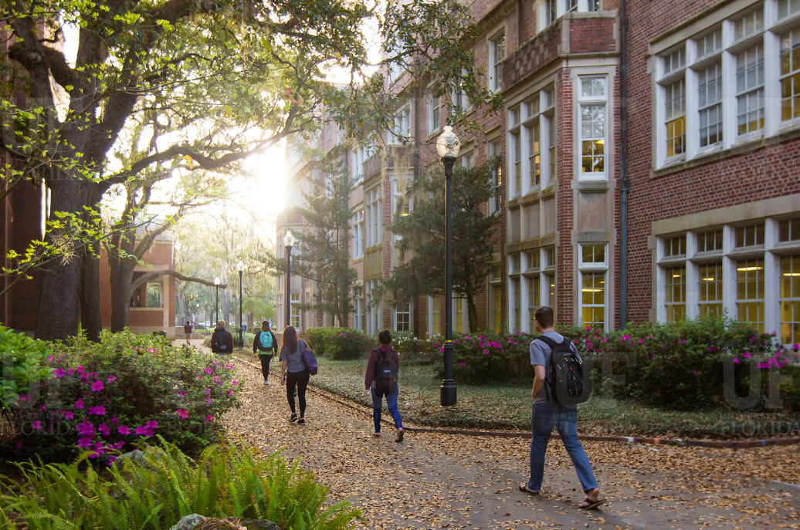

HR Forum
August 4, 2021

Slide 2
Today’s Agenda Items
HB 7017 Visitors – Cassandra Farley
GBAS Updates – Nicole Harris
2021-22 Pay Program – Brent Goodman
HR-600 Reminder – Brent Goodman
Florida Minimum Wage– Brent Goodman
Florida Bonus Statute and Proposed BOG Regulation – Brent Goodman
First Advantage – Christina Salva
AI Tracking Updates and Upgrades – Audrey Gainey
Benefits Reminders – Shannon Edwards
Important Dates
UFHR preeminence through people

Slide 3
HB 7017--Visitors
Cassandra Farley
Director, UF Research Integrity, Security & Compliance (RISC)

Slide 4
1010.35--Screening foreign researchers
UF RISC required to review and approve all applications for research and research support positions, including
  Applicants seeking employment in research or research-related support positions
  Graduate and undergraduate students applying for research or research-related support positions;
  Applicants for positions of visiting researcher (international visitors)
Review must be completed before interviewing or offering position
An applicant may not be employed by the university if he or she fails to disclose material information in their application

Slide 5
1010.35--Screening foreign researchers
UF RISC must review and take reasonable steps to verify applicant materials, which include
  Academic attendance and employment since 18th birthday
  Publications
  Ongoing professional affiliations and outside activities
  Current and pending funding
UF RISC may also approve applicants for hire using a risk-based system that considers the nature of their research and the background and ongoing affiliations of the applicant

Slide 6
1010.35--Screening foreign researchers
Phased rollout of screening requirements
Phase 1: International Visitors
  New International Visitor policy and procedure starting in August
  All applications for international visitors on a J-1, J-2 or B visa must be reviewed and approved by UF RISC prior to visa processing and arrival
  In the coming weeks UF will launch policy release, application portal and department trainings
Screening of other populations in future phases; continue to follow current UF policies & processes for faculty, staff and student applications for now

Slide 7
Implementation Timeline
Beta Testing
Phase I
Vet Med.
Phase II
CLAS
College of the Arts
Engineering
College of Medicine
Phase III
Campus Wide
Pharmacy
IFAS
July
Begin Review of Current/Initial J-1 Visitors
Aug-Sept
New Policy Announced
Phased roll out begins
Oct
Campus-wide Implementation
Final Salesforce Testing
Policy and Implementation Plan to FID Task Group
Training begins

Slide 8
Questions?

Slide 9
Training & Organizational Development
GBAS Updates
Notes:
Section slide

Slide 10
Root Cause Analysis
GBAS Fall Workshop 2021
Learn how to determine what is really causing the problem you are encountering so that you can solve the real issue.
We are designing a scenario to analyze, which will apply to every business administrator at UF either directly or indirectly.
You will have an opportunity to discuss and apply Root Cause Analysis tools to the scenario with UF experts.
Mark the time on your calendar for September 23 from 9am to 12 noon.
The workshop will be a Virtual Training in Zoom.
Registration will open on August 31.
UFHR preeminence through people
Notes:
You might want to consider making this less technical language in the powerpoint slide. More like "Learn how to figure out what is really causing the problem you are encountering so that you can solve that problem quicker" Then the talking points to that bullet would be. We'll be learning both the principles of good root cause analysis and introducting you to three tools that are specifically designed to help you ask the right questions and pinpoint the underlying cause. I wouldn't name the tools in either the slide or the talking points. A lot of people think they already know these tools or have blown them off as "extra" that are not necessary to figuring this type of thing out.
Partnering with colleagues from UF JAX
Learn tools such as the 5 Whys, Fishbone Diagrams, and Flow Charting
Attend this hands-on session designed around a challenge at UF

Slide 11
Classification & Compensation
2021-2022 Pay Program
HR-600 Reminder
Florida Minimum Wage
Florida Bonus Statute and Proposed BOG Regulation
Notes:
Section slide

Slide 12
2021-2022 Pay Program
In May, UF communicated to Deans and Vice Presidents a salary increase program that will provide a 3% salary increase pool for merit increases effective July 1st for 12-month; July 30th for 10-month; and August 16th for 9-month employees.
Salary increases for employees in a bargaining unit are subject to union negotiation.
  UF has reached a tentative agreement with AFSCME for a 3% salary increase for covered USPS employees.
  UF has reached a tentative agreement with UFF that will provide a 1.5% across-the-board and 1.5% merit pool for in-unit faculty.
  Both agreements are pending ratification by the union membership and Board of Trustees.
UFHR preeminence through people

Slide 13
2021-2022 Pay Program
Eligibility Criteria
To be eligible for a salary increase, employees must be hired on or before March 1, 2021.
Employees who have received notification of non-renewal or layoff are not eligible for a merit increase.
Employees who have received discipline in the form of a written reprimand or who have been suspended since January 1, 2021, are also not eligible for a merit increase.
Faculty who are currently on a performance improvement plan are not eligible for a merit increase.
OPS employees are not considered eligible for the salary increase program.
UFHR preeminence through people

Slide 14
2021-2022 Pay Program
Implementation Considerations
Actions that modify an employee’s job data record and have an effective date after July 1, 2021, can cause an error to occur when the raise file is executed. As a result, departments should minimize job and position actions that impact employee job data records.
In order to ensure units have an opportunity to review individual salary increases, salary increases will be viewable in myUFL on August 30th.
Adjustments or corrections should be submitted to salaryincrease@ufl.edu by August 20th.
UFHR preeminence through people

Slide 15
2021-2022 Pay Program
Implementation Timeline
Monday, August 2nd – Raise file opens to departments
Friday, August 20th 5:00 PM – Raise file closes to departments
Monday, August 30, 2021 – Raises viewable in myUFL
Friday, September 10, 2021 – Salary increases in employee paychecks
UFHR preeminence through people

Slide 16
2021-2022 Pay Program
Additional Materials
This week, we will publish several supporting documents on Classification & Compensation’s website. These include:
  Raise File Instruction guide – Provides additional guidance on how to access and enter raises in myUFL
  Manager Guide – Provides recommendations on determining individual merit increases
  FAQs – Answers to frequently asked questions
UFHR preeminence through people

Slide 17
2021-2022 Pay Program
Recommendations for Managers and Departments
As a manager, providing fair and competitive compensation is vital to attracting, retaining, and rewarding your employees. While there are a variety of approaches, including monetary and non-monetary rewards, it’s important that salary increases recognize each employee’s contribution to university.
While colleges and units have the flexibility to establish salary increase criteria for their units, UF Human Resources (UFHR) recommends that managers differentiate rewards based on individual contributions/performance and that units calibrate rewards in order to ensure fair and consistent implementation. Please contact your college or department HR representative for unit specific salary increase guidelines.
UFHR preeminence through people

Slide 18
2021-2022 Pay Program
Differentiate Rewards based on Individual Performance and Contribution
Performance is a combination of the outcomes and behaviors which can be assessed using the following four quadrants:
  High Outcomes – High Behaviors
  High Outcomes – Low Behaviors
  Low Outcomes – High Behaviors
  Low Outcomes – Low Behaviors
UFHR preeminence through people

Slide 19
2021-2022 Pay Program
Questions?
  If you have questions, please contact Classification and Compensation at (352) 273-2842 or by email at salaryincrease@ufl.edu.
UFHR preeminence through people

Slide 20
HR-600 Reminder
Additional University Employment
If an employee’s primary position is non- exempt, the secondary department is often required to pay overtime for the secondary position.
Whenever the employee’s primary rate of pay increases, you must increase the rate of pay on the secondary appointment.
UFHR preeminence through people

Slide 21
HR-600 Reminder
Additional University Employment
You do not need to send an updated HR-600 form; however, you must complete an ePAF to adjust the rate of pay.
If would like to request a list of employees with dual compensation appointments in your area, please email your request to compensation@ufl.edu.
UFHR preeminence through people

Slide 22
Questions
Please contact Classification & Compensation at compensation@ufl.edu or by phone at (352) 273-2842
UFHR preeminence through people

Slide 23
Florida Minimum Wage
Florida voters approved amendment 2 in November 2020 which increases the minimum wage and amends Florida’s Constitution.
Under the new mandate, Florida’s minimum wage, currently $8.65, will increase to $10 an hour on September 30, 2021.
After which the minimum wage will increase $1 each year until it reaches $15 an hour in 2026.
The minimum wage applies to all public and private sector employers, regardless of size or number of employees.
UFHR preeminence through people

Slide 24
Florida Minimum Wage
As of February 22nd, there are 2,166 appointments below the new minimum wage. The cost-plus fringe of bringing the population to the new minimum wage is approximately $2.063M.
The top 5 units are Student Affairs, Housing & Residence Education, O’Connell Center, Reitz Union, and the College of Law.
This estimate is very conservative as our student employee headcount is down dramatically due to COVID-19. This time last year, there were 38% more appointments with hourly rates less than $10 per hour.
UFHR preeminence through people

Slide 25
Questions
Please contact Classification & Compensation at compensation@ufl.edu or by phone at (352) 273-2842
UFHR preeminence through people

Slide 26
Florida Bonus Statute and Proposed Board of Governors Regulation
During this year’s legislative session, a bill was passed that addresses bonuses for state university system employees.
  1012.978 Bonuses for state university system employees. - Notwithstanding s. 215.425(3), a university board of trustees may implement a bonus scheme based on awards for work performance or employee recruitment and retention. The board of trustees must submit to the Board of Governors the bonus scheme, including the evaluation criteria by which a bonus will be awarded. The Board of Governors must approve any bonus scheme created under this section before its implementation.
UFHR preeminence through people

Slide 27
Florida Bonus Statute and Proposed Board of Governors Regulation
The Board of Governors has proposed regulation 9.015 University Bonus Plans which delegates approval of university bonus plans to each institution’s Board of Trustees.
UFHR is currently working with the General Council’s Office to revise UF’s compensation regulation and implement policies that meet the new requirements.
While this regulation provides UF the ability to provide a variety of one-time payments, some payments will be delayed until the appropriate policies are approved by the BOT.
UFHR preeminence through people

Slide 28
Questions
Please contact Classification & Compensation at compensation@ufl.edu or by phone at (352) 273-2842
UFHR preeminence through people

Slide 29
Talent Acquisition & Onboarding
First Advantage
AI Tracking Updates & Upgrades
Notes:
Section slide

Slide 30
Screening/Verification Packet Status
Effective August 6th, after three attempts First Advantage will begin notifying requestors via email when a verification is deemed “unable to verify.”
Effective August 16th, status of “Decisional” will be replaced with the following statuses:
  Criminal Pending: Packet contains criminal records that require review by UFHR.
  Dept Verification Review: Criminal screening is clear, if requested, and requestor/requesting department needs to review the findings for both education and employment verifications.

Slide 31
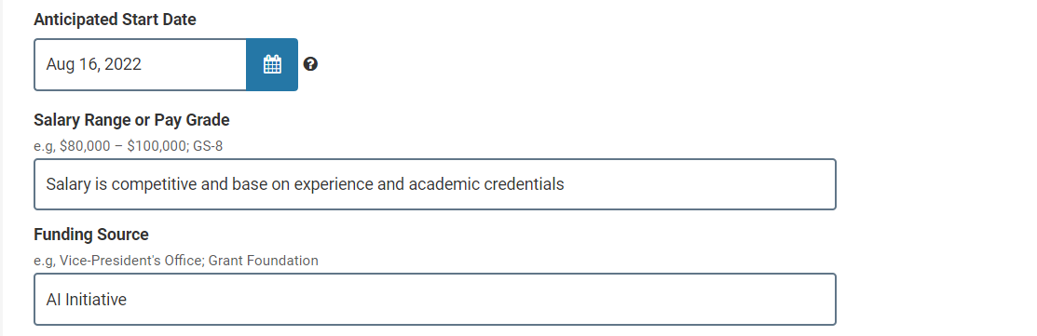
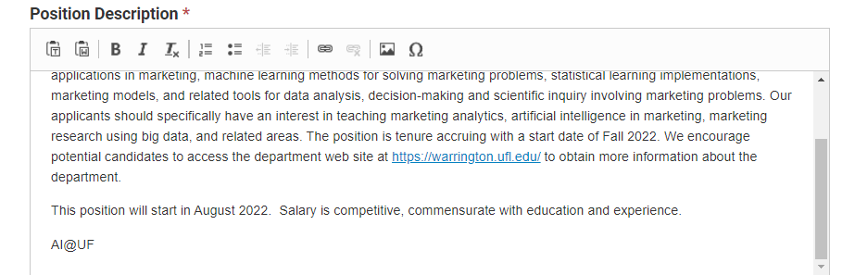
AI Tracking - Updates
Options for tracking new hires for AI positions have been expanded.
Current Efforts:
  Designating the funding source on the requisition as “AI Initiative”.
  Notating the Job posting for AI positions with the “AI@UF” tagline.
  Partnering with college representatives to verify Provost allocations and confirm new hire information.
UFHR preeminence through people

Slide 32
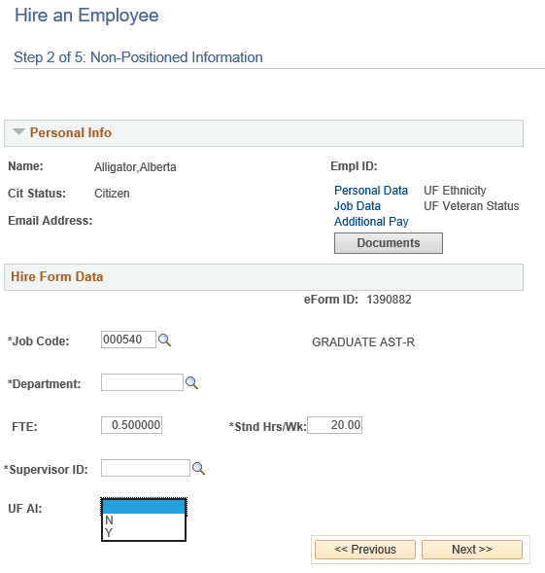
AI Tracking – ePAF Upgrades
Hire and Employee/Position Updates
  AI flag will be added for Hire and Position Update ePAFs; this flag will be a required field
  In addition to the AI flag on Hire ePAFs, an optional text box will be added for job requisition numbers
  This change will take effect on September 1, 2021

Slide 33
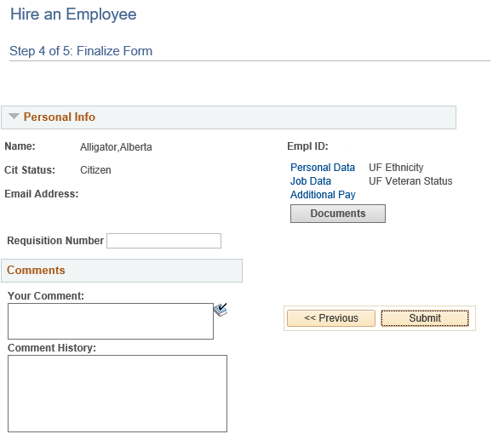
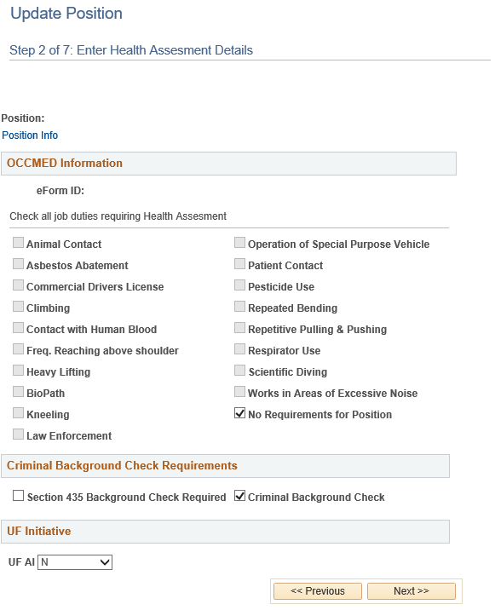
AI Tracking – ePAF Upgrades

Slide 34
Additional Questions?
  Talent Acquisition and Onboarding
    talent@hr.ufl.edu
UFHR preeminence through people
Notes:
One thing is clear today: The need for Resilience and Mindfulness is here to stay. With the increasing frequency and severity of shocks and changes that can shake us up, learning to be more resilience can enhance the quality of our work experience.
The GBAS Resilience at Work series will take a holistic approach to consider all aspects of resilience – physical, cognitive, emotional and spiritual (purpose and values) within the professional context. Throughout the five sessions we will incorporate concepts of work resilience with opportunities for increased self-awareness through mindfulness. You will also be able to explore ideas and gain support from group conversations with the community of participants as well as a smaller cluster of peers at each session.
Participants are expected to attend all sessions and carve aside time for self-reflection and light homework between meetings. At the end of the series, you will have gained a deeper understanding of how to nurture your resilience for wellbeing and sustained work performance.
The sessions will be on Tuesdays from 10 to noon, running every other week from Feb 23 to April 20.

Slide 35
University Benefits
Notes:
Section slide

Slide 36
Benefits Reminders
  Update Mailing Address in ONE.UF
  Update Beneficiaries
  Open Enrollment
  People First Dependent Eligibility Audit
  Collective Bargaining Agreement Ratification
  COVID Leave Donation Program Extended
  Benefit Deductions for 9/10 Month Employees
UFHR preeminence through people

Slide 37
Important Dates
Upcoming HR Forum – September 1st @ 10 a.m.

Slide 38

Thank you for attending the
HR Forum

