Slide 1
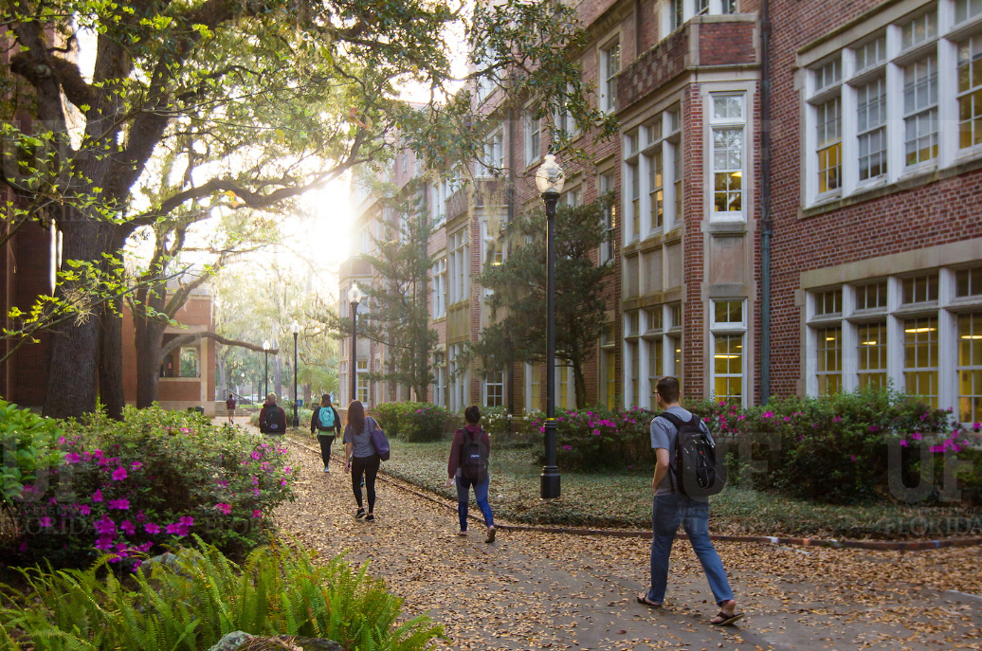
HR Forum
September 1, 2021

Slide 2
Today’s Agenda Items
GBAS Updates – Aigi Adesogan, GBAS Advisory Council member
2021-2022 Pay Program – Brent Goodman
HR-600 Reminder – Brent Goodman
Florida Minimum Wage – Brent Goodman
Open Enrollment – Nadja Schimmel-Cruz
Vacation Leave Cashout – Nadja Schimmel-Cruz
Important Dates
UFHR preeminence through people

Slide 3
Training & Organizational Development
GBAS Updates
Notes:
Section slide

Slide 4
GBAS Fall Workshop
How many times has your team worked through a problem only to realize that you are working on a symptom rather than the root cause of the issue?
In the workshop we will discuss Root Cause Analysis. We will:
Dive into problem identification, which is a critical step in process improvement and problem solving.
Partner with experts from UF Jax Root Cause Analysis Faculty to explore tools and strategies.
Practice root cause analysis using a scenario that can be applied to any area.
UFHR preeminence through people
Notes:
GBAS Fall Workshop is September 23 from 9-12 and the topic is Root Cause Analysis
Registration Description
How many times has your team worked through a problem only to realize that you are working on a symptom rather than the root cause of the issue? We know that problem identification is a critical step in process improvement and problem solving. We also know that this is the most overlooked step that would help prevent the problem from reoccurring. We are partnering with UF Jax RCA Faculty to explore tools and strategies to apply to situations that can guide us to better problem-solving outcomes. We will practice root cause analysis using a scenario that can be applied to all areas.
Registration is open and closes on September 16 at 5pm.

Slide 5
Root Cause Analysis
GBAS Fall Workshop 2021
September 23 from 9am to 12 noon The workshop will be a Virtual Training in Zoom.
Registration is open and closes on September 16 at 5pm
In myTraining, go to UF_GBS350 Root Cause Anaylsis
UFHR preeminence through people
Notes:
GBAS Fall Workshop 2021
September 23, 2021 from 9:00am – 12 noon
Registration link
https://mytraining-ufshands.sumtotal.host/core/pillarRedirect?relyingParty=LM&url=app%2Fmanagement%2FLMS_ActDetails.aspx%3FActivityId%3D54926%26UserMode%3D0

Slide 6
Classification & Compensation
2021-2022 Pay Program
HR-600 Reminder
Florida Minimum Wage
Notes:
Section slide

Slide 7
2021-2022 Pay Program
Last month, the Board of Trustees (BOT) and AFSCME ratified the tentative agreement which cleared the way for UF to implement salary increase for employees covered under the collective bargaining agreement (CBA).
Increase for these employees were loaded into myUFL on Friday, August 27th.
Employees will see the increase, including retro pay, on Friday, September 10th.
UFHR preeminence through people

Slide 8
2021-2022 Pay Program
Last month, the Board of Trustees (BOT) and UFF ratified the tentative agreement which cleared the way for UF to implement salary increase for employees covered under the collective bargaining agreement (CBA).
The agreement calls for the following:
1.5% across-the-board (ATB) salary increases
1.5% pool for merit-based salary increases
9-month faculty earning less than $55,000 will receive a $250 raise on a 1.0 FTE equivalent and all 12-month faculty earning less than $67,000 will receive a $400 raise on a 1.0 FTE equivalent.
Salary increases will be effective July 1, 2021, for 12-month faculty, July 30, 2021, for 10-month faculty and August 16, 2021, for 9-month faculty.
To be eligible for an increase, employees must have been hired on or before May 15, 2021, for 9-month, July 1, 2021, for 12-month, and July 30, 2021, for 10-month employees.
UFHR preeminence through people

Slide 9
2021-2022 Pay Program
Eligibility Criteria for Merit
The employee must have, at a minimum, a satisfactory overall evaluation rating for two (2) of the last three (3) years and been employed by the University for at least one (1) semester.
Faculty who have been employed at the University for fewer than three (3) years must have, at a minimum, a satisfactory overall evaluation rating for the most recent academic year.
Employees are not eligible if they are visiting faculty members; if they have been issued a notice of non-renewal, termination or layoff; or if they have resigned for any reason regardless of effective date.
UFHR preeminence through people

Slide 10
2021-2022 Pay Program
Implementation Timeline
Tuesday, August 31th – Raise file opens to departments
Friday, September 17th – Raise file closes to departments
Monday, September 27th – Raises viewable in myUFL
Friday, October 8th – Salary increases in employee paychecks
UFHR preeminence through people

Slide 11
2021-2022 Pay Program
Additional Materials
The Article 24 can be accessed online at https://hr.ufl.edu/wp-content/uploads/2021/08/Article-24-2021-Salary-Reopener.pdf
Appendix E can be accessed at https://hr.ufl.edu/wp-content/uploads/2021/08/Appendix-E-2021-Salary-Reopener.pdf.
UFHR preeminence through people

Slide 12
Questions
Contact Classification and Compensation at (352) 273-2842 or by email at salaryincrease@ufl.edu.
UFHR preeminence through people

Slide 13
HR-600 Reminder
Additional University Employment
If an employee’s primary position is non- exempt, the secondary department is often required to pay overtime for the secondary position.
Whenever the employee’s primary rate of pay increases, you must increase the rate of pay on the secondary appointment.
UFHR preeminence through people

Slide 14
HR-600 Reminder
Additional University Employment
You do not need to send an updated HR-600 form; however, you must complete an ePAF to adjust the rate of pay.
If would like to request a list of employees with dual compensation appointments in your area, please email your request to compensation@ufl.edu.
UFHR preeminence through people

Slide 15
Florida Minimum Wage
Florida voters approved amendment 2 in November 2020 which increases the minimum wage and amends Florida’s Constitution.
Under the new mandate, Florida’s minimum wage, currently $8.65, will increase to $10 an hour on September 30, 2021.
After which the minimum wage will increase $1 each year until it reaches $15 an hour in 2026.
Later this month, UFHR will implement a process to increase all employees earning less $10 per hour to the new minimum wage.
UFHR preeminence through people

Slide 16
Questions
Contact Classification and Compensation at compensation@ufl.edu or by phone at (352)273-2842.
UFHR preeminence through people

Slide 17
University Benefits
Open Enrollment
Vacation Leave Cashout
Notes:
Section slide

Slide 18
Open Enrollment (OE) for 2022 Benefits
Open Enrollment will be 10/11-10/29.
The State is releasing OE updates on 9/9 and we anticipate little changes to plans and premiums.
There will be a virtual benefits fair with various vendors offering on-line sessions.
Additionally, Benefit Specialists will be reaching out to Colleges & Departments to schedule OE presentations.
UFHR preeminence through people

Slide 19
Vacation Leave Cashout
Vacation Cashout available to Teams, USPS, and 12-month Faculty
Amounts are lifetime maximums.
Amounts over $5,000 go to Special Pay Plan. (Information can be found here: https://benefits.hr.ufl.edu/retirement/special-pay-plan/).
This is not subject to employee request, but of total amount of the cashout.
Employees will receive an information letter once the funds are available at Fidelity.
UFHR preeminence through people

Slide 20
Important Dates
UF Holidays – September 6th, Labor Day
Upcoming HR Forum – October 6th @ 10 a.m.

Slide 21
Thank you for attending the HR Forum

