Slide 1

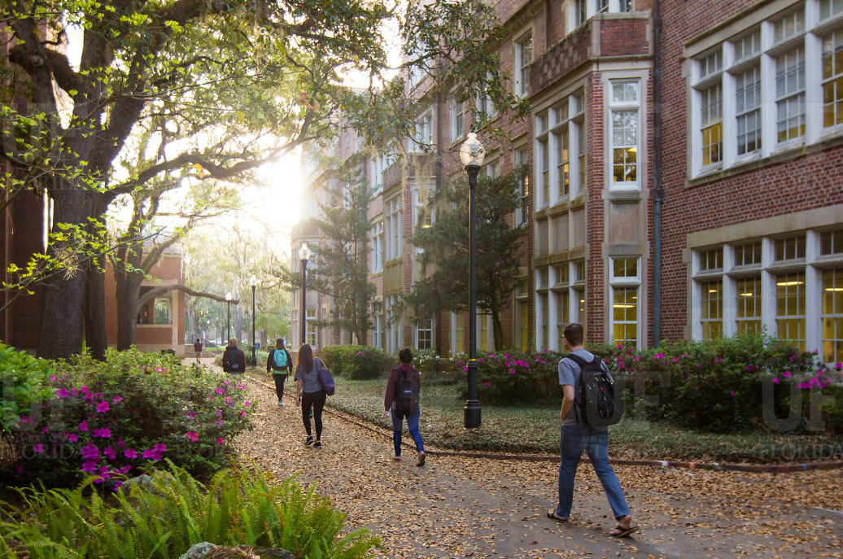

HR Forum
October 6, 2021

Slide 2
Today’s Agenda Items
Employee Relations & Engagement Update – Brook Mercier
Payroll Form Updates – Linda Smith, Payroll Manager
GBAS Fall Institute – Michelle Romeo, GBAS Community Member
Superior Accomplishment Awards – Verlissa Ford
Foreign National Hire Process – Johannes Traster
Updated Hiring Resources – Johannes Traster
Offer Letter Updates– Johannes Traster
Open Enrollment – Shannon Edwards
December Vacation Leave Cashout – Shannon Edwards
Vaccination Buttons – Jodi Gentry
Important Dates
UFHR preeminence through people

Slide 3
Employee Relations & Engagement
New Director
Notes:
Section slide

Slide 4
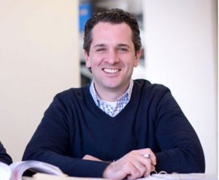
Employee Relations and Engagement
Robert Cancellieri
Director, Employee Relations & Engagement
UFHR preeminence through people

Slide 5
University Payroll Services
Electronic On-Cycle &
Check-Advice Cancellation Forms
Notes:
Section slide

Slide 6
Electronic On-Cycle & Check/Advice Cancellation Forms
Collaborative effort continues with Payroll & Tax Services and UF IT OnBase Team
Part of continuous improvement process to review all forms for potential to transition to an Electronic Format

Slide 7
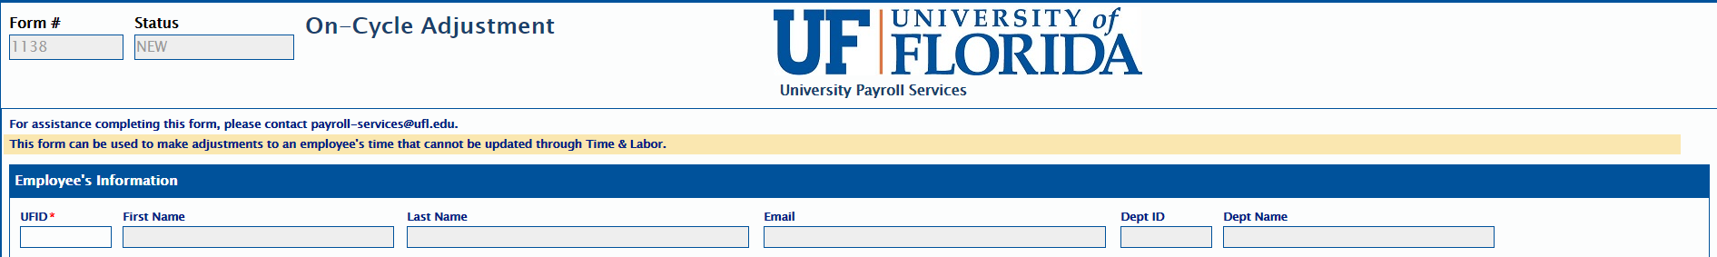

On-Cycle Form - OnBase
Location: Payroll Forms & Resources Page
Auto populates: Simply type in the UFID and the remaining fields in this section will auto-fill

Slide 8
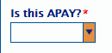
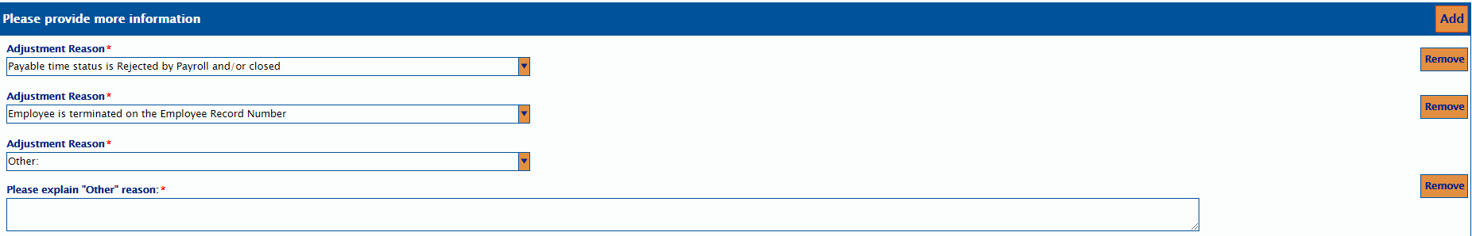
On-Cycle Form - OnBase
What’s new?
Dropdown box to signify if the request is for an Additional Pay (APAY)
Dropdown box to select from seven adjustment reasons – simply add a row if more than one reason applies
“Other” is an available option and there is a box for you to type in additional information

Slide 9
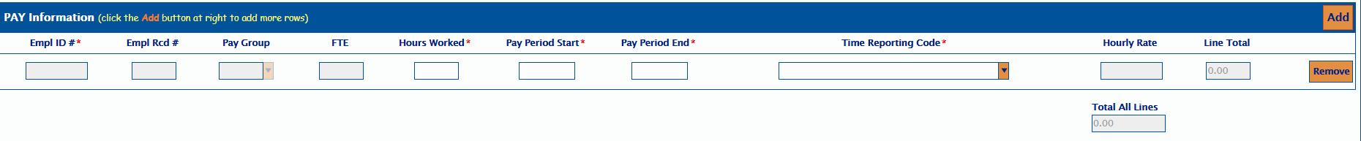
On-Cycle Form - OnBase
The fields with asterisks are required to be completed.
UFHR preeminence through people

Slide 10

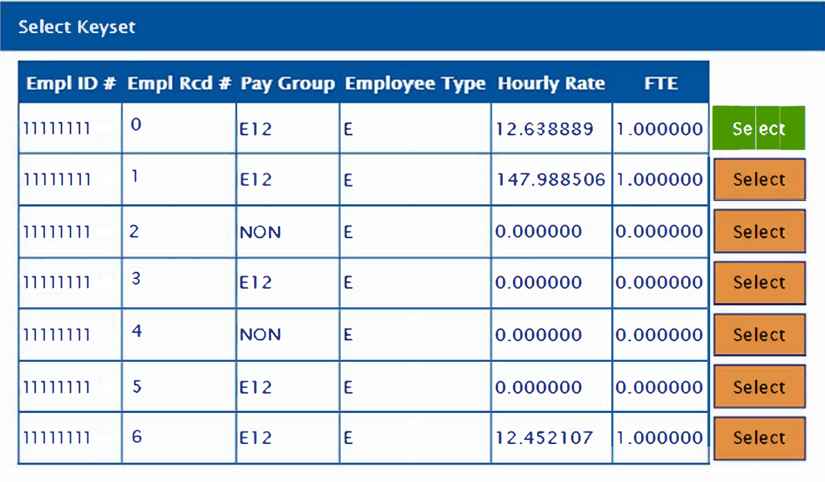
On-Cycle Form - OnBase
Multiple employee records: select which employee record you are processing
UFHR preeminence through people

Slide 11
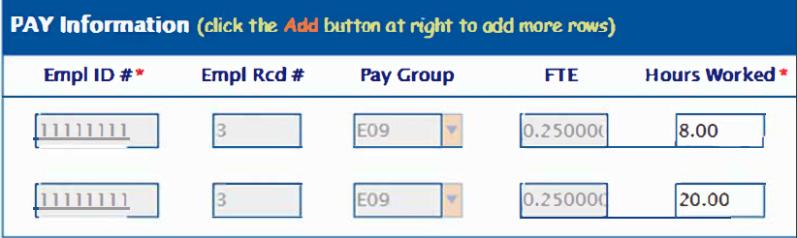
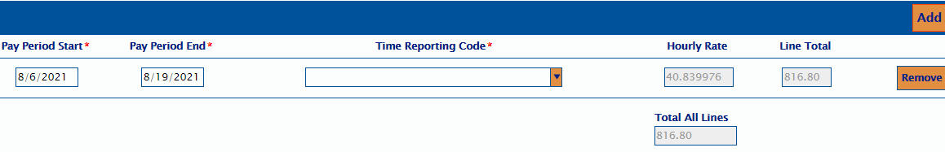
On-Cycle Form - OnBase
Multiple Employee Records: Select “add” button and select the next record from the keyset list.
UFHR preeminence through people

Slide 12
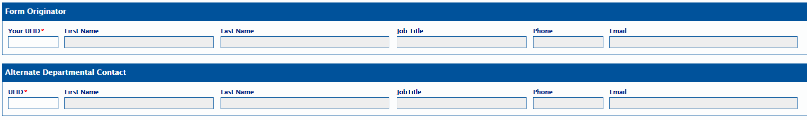
On-Cycle Form - OnBase
Required UFID: Originator and Alternate Departmental Contact
Auto populates: Simply type in the UFID and the remaining fields in this section will auto-fill
UFHR preeminence through people

Slide 13
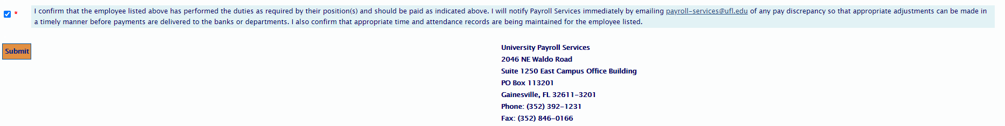
On-Cycle Form - OnBase
UFHR preeminence through people

Slide 14
On-Cycle Form - OnBase
Status emails
Denial – detailed reason for denial
Custom email – questions or request for more information
Complete – sent after form is processed

Slide 15
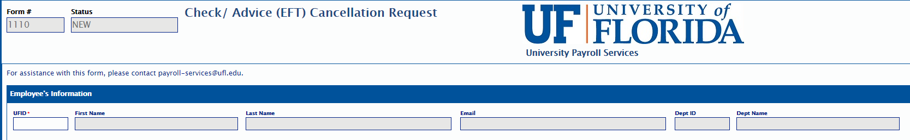
Check-Advice Cancellation Form - OnBase
Location: Payroll Forms & Resources Page
Auto populates: Simply type in the UFID and the remaining fields in this section will auto-fill

Slide 16
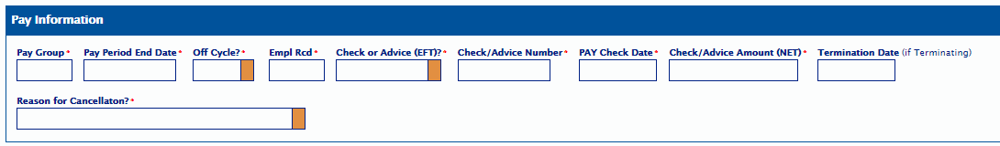
Check-Advice Cancellation Form - OnBase
What’s new?
Dropdown box to select a cancellation reason
Keyset to select Check/Advice to be cancelled

Slide 17
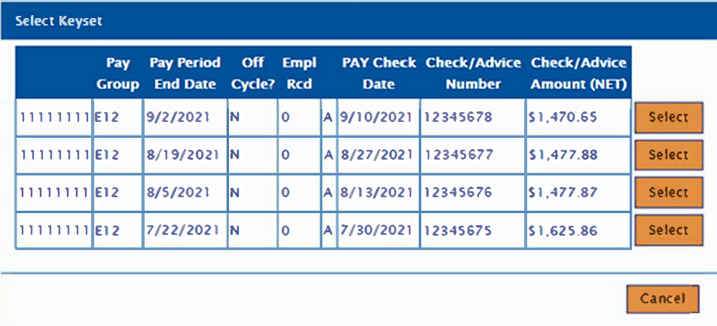
Check-Advice Cancellation Form - OnBase
Select from the Keyset which Check/Advice you are requesting to be cancelled.

Slide 18
Check-Advice Cancellation Form - OnBase
Auto populates: Most of the fields in this section will auto-fill

Slide 19
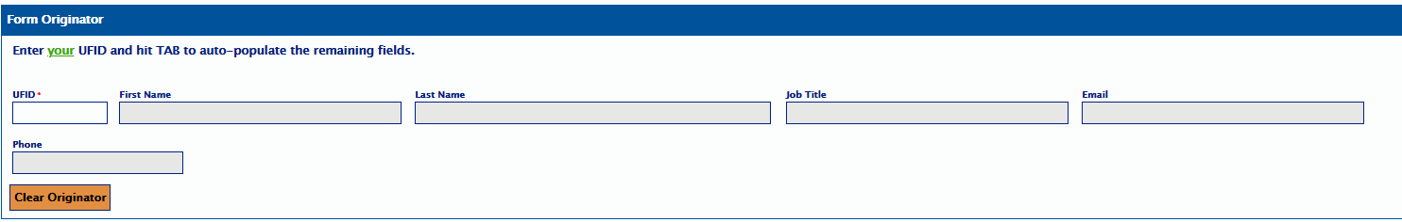
Check-Advice Cancellation Form - OnBase
Required UFID: Originator
Auto populates: Simply type in the UFID and the remaining fields in this section will auto-fill

Slide 20
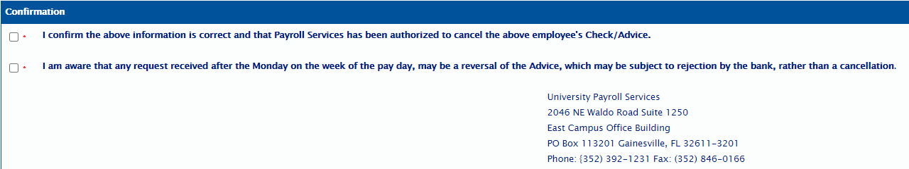
Check-Advice Cancellation Form - OnBase

Slide 21
Check-Advice Cancellation Form - OnBase
Status emails
Request Denied – detailed reason for denial
Request Rejected – detailed reason for rejection
Complete – sent after form is processed

Slide 22

Questions?
Contact Information
Payroll Services – payroll-services@ufl.edu
Phone: 352-392-1231
UFHR preeminence through people

Slide 23
Training & Organizational Development
GBAS Fall Institute
Notes:
Section slide

Slide 24
GBAS Fall Institute 2021
Decoding Program Codes:
The Myths, The Clean Up, The Truths
October 27th from 10:00 a.m. to 12:00 p.m. The workshop will be a Virtual Training in Zoom.
Registration is open and closes on October 20th at 5:00 p.m.
In myTraining, go to UF GBS250 Program Codes
Save the Date: November 16th from 9:00 a.m. to 12:00 p.m.
UFHR preeminence through people
Notes:
GBAS Fall Institute 2021
We will be offering two topics this fall as virtual sessions for the GBAS Institute. One in October and one in November.
For the October 27th event, we are so excited to bring you, “Decoding Program Codes: The Myths, The Clean Up, The Truths.”
We will start with the myths around how the codes are frequently used and why using the correct program codes is so important to the University of Florida. Did you know that when the codes are incorrectly used it causes thousands of corrections from some of our very best friends? Brenda, Gene and Tiffany!
While they do not complain (a lot), we think it is more important to recognize how this impacts UF’s goal to stay in the Top 5. This session will include interactive activities that will show you what program codes tell us about UF’s activities and let you compete against your colleagues to see how much you’ve learned.
One of the things we know about our community of practice is that you pride yourselves on getting it right! No one shows up to go “oooh, how can I mess this up!?
We have some topics under discussion for November 16 from 9-12, so stay tuned for more information.
https://mytraining-ufshands.sumtotal.host/core/pillarRedirect?relyingParty=LM&url=app%2Fmanagement%2FLMS_ActDetails.aspx%3FActivityId%3D55409%26UserMode%3D0

Slide 25


Slide 26
Superior Accomplishment Awards
Nomination Period: September 15, 2021 – October 29, 2021
Submit nomination forms and support letters to Divisional Chairs for outstanding performance and contributions of staff and faculty to the university community during the previous academic year, August 1, 2020 – July 31, 2021
Nomination Awards
Employment Performance (six category awards)
Diversity & Inclusion (one category)
Community Service (one category)
Cash Awards
Division-level awards
University-level awards
Division-level Award Winners receive cash awards of $200 each then compete for one of eight $2,000 University-level Winner cash awards, or one of eight $1,000 cash awards for University-level Special Recognition
UFHR preeminence through people

Slide 27
Divisional Chairs
Division 1 – Pres Office, COO Office, CFO Office, CIO Office, Research and Grad Prog, VP for Govt & Comm Relations, VP for Strategic Comm & Marketing, Gen. Counsel, HR, Office of Chief Diversity Officer, and Advancement ─ Melissa Orth
Division 2 – UF Health Shands, UF Health Jacksonville, UF Jacksonville Physicians, Inc. ─ Kristi Gaver
Division 3 – Academic Affairs ─ Jonathan Peine
Division 4 – IFAS – Ann Hartman and Sam Murray
Division 5 – Health Affairs – Shannon Pettit and Lavina Gramig
Division 6 – Student Affairs – Karley Counts
Division 7 – Business Affairs – Dwan Courtney
Community Service Award – Jack Causseaux
Diversity & Inclusion Award – Florida Bridgewater-Alford

Slide 28
Superior Accomplishment Awards
Visit the Superior Accomplishment Award website:
Nomination Period and Deadlines
Nomination Form and Process
Award Categories and Selection Criteria
Contact Information for Division Chairs and University Committee Administrators

Slide 29
Contact Us!
University Committee Administrators
Verlissa Ford, (352) 273-0149, v.ford@ufl.edu
Jennifer Munroe, (352) 273-1780, jennajs@ufl.edu
Leticia V. Forster, (352) 273-3437, lvforster@ufl.edu

Slide 30
Employment Operations & Records
Foreign National Hire Process
Updated Hiring Resources
Offer Letter Updates
Notes:
Section slide

Slide 31
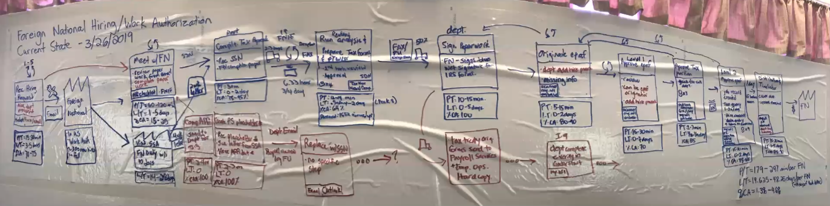
Foreign National Hire Process
October marks one year since foreign nationals entered our GatorStart electronic onboarding system

Slide 32
The Improvement Process –Recap
In March 2019, a group composed of representatives from Payroll Services, UFHR, PHHP, IFAS, and CLAS met for 3 days to discuss and re-imagine what the foreign national process could be
We had one objective:
Reduce the length of time it takes for a foreign national to receive their first paycheck
Two essential goals:
Reduce process and wait time by 50%
Move foreign national hiring online
UFHR preeminence through people

Slide 33
Issues Identified –Recap
A lot of paper forms
A lot of wait time due to how the paperwork is transmitted
Duplication of documents
Not a consistent process when working on a foreign national hire
Lack of resources/guide to help departments navigate the process
UFHR preeminence through people

Slide 34
Outcome –Improvement Made?
During the Fall 2021 rush, we saw more foreign nationals submitted to our level during the pay period they started in than ever before
Many units have improved by 50% (10-day average) or more*
The colleges with the largest foreign national volume (amounts for 64% of the hires) improved by an average of 29%*
In summary, the pay period in which foreign national hires started in, was the same pay period the majority were approved in.
*Percentages are based on when the hire was approved compared to the effective date of an ePAF. Time frame compares FY ‘18-19 to FY ‘20-21.

Slide 35
UF TempID: Why Must We Update?
Temporary ID numbers can only be used for hiring purposes at UF
It is meant to be a placeholder while the foreign national employee obtains a social security number
Temporary IDs do not mean anything to the IRS
If we do not update, the earnings for this employee cannot be reported correctly
Can create a liability for the university
Being out of compliance with federal, state and university employment laws and guidelines could result in fines or other penalties

Slide 36
UF TempID Data Cleanup
Hiring departments are responsible for following-up with the foreign national employee to obtain a copy of the issued social security card.
Once presented, a copy should be uploaded to the SSN Update Portal on the HR website to update their Social Security number.
SSN Update Portal located on: https://hr.ufl.edu/managerresources/employment-operations-and-records/employment-data/
A current list of anyone who still has a UF TempID in myUFL will be emailed this afternoon to HR liaisons.

Slide 37
Updated Hiring Resources
New Hires Checklist – updated links and language
https://hr.ufl.edu/wp-content/uploads/2021/10/UFHR_NewHireChecklist_10-4.xlsx
Letter of transmittals are no longer required for Adjuncts and Post-Doctoral Associates
Pay Rate Justification Form will be revised to reflect the new state minimum wage of $10/hr. for student employment
Current forms on file do not need to be updated
Form is now only required for more than $20/hr. (double minimum wage)

Slide 38
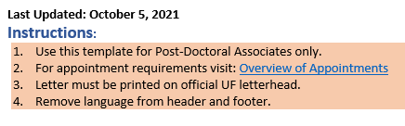
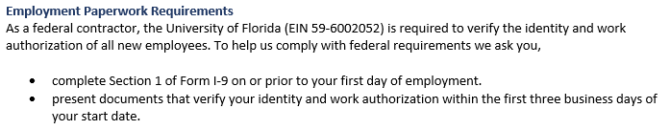
Offer Letter Updates
Graduate Assistant letters
Now includes outside activities section with COI information
Must be used starting 10/29/21
All templates now include the following updates:
University of Florida’s Employer Identification Number (EIN)
Instructions section with “Last Updated” date for easier tracking
An added reminder that letters must be printed on official UF letterhead

Slide 39
Questions
Contact Employment Operations and Records at
ufhr-employment@ufl.edu or by phone at (352) 273-1079.

Slide 40
University Benefits
Open Enrollment
December Vacation Leave Cashout
Notes:
Section slide

Slide 41


Slide 42


Open Enrollment is your opportunity to make benefits enrollment changes for the upcoming 2022 calendar year.
Updates to State benefits elections → People First
Updates to UF Select benefits elections → Self-Service in myUFL
The State of Florida and UFHR are offering webinars between September 27th and October 22nd in lieu of an in-person Benefits and Wellness Fair this year.

Slide 43
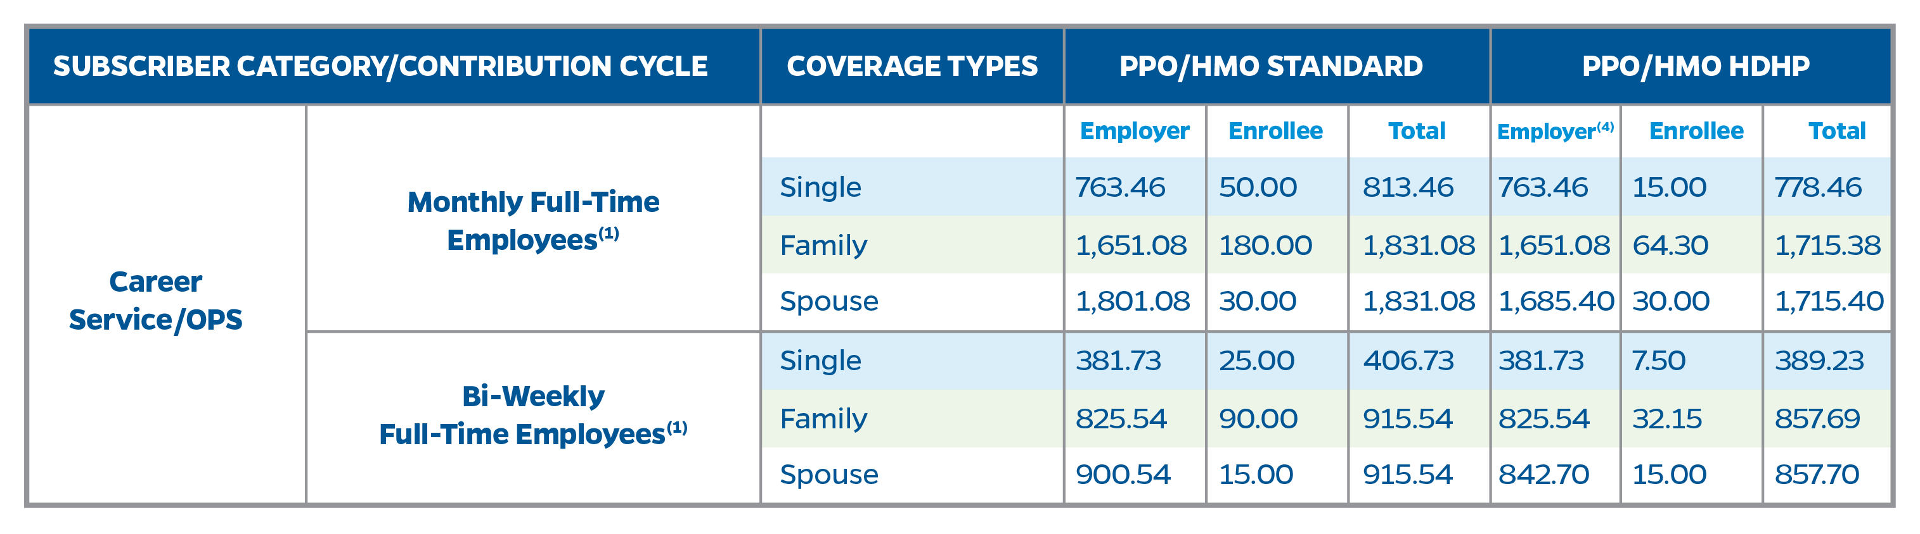
WHAT IS NOT CHANGING IN 2022
No increase to employee health insurance premiums for State or GatorCare plans.
The Spouse Program is only available to those employees whose spouse is also a benefits eligible state employee.

Slide 44
WHAT IS NOT CHANGING IN 2022
No premium increases for vision and supplemental insurance plans
This includes those offered by both the State and University
No premium increases for optional life and disability insurances, (other than those that are typically tied to age and/or salary)

Slide 45
WHAT IS CHANGING IN 2022
Premiums for Ameritas and MetLife PPO Dental plans will increase.
Additionally, Eagles Dental Reimbursement plan offered through UF will also increase.

Slide 46
WHAT IS CHANGING IN 2022
Employees who participate in the State’s High Deductible Health Plans (HDHP) will be able to increase their Health Savings Account contributions:
$3,650* ($3,150 EE/ $500 ER) 2022 limit for individual coverage (an increase of $50)
$7,300* ($6,300 EE / $1,000 ER) 2022 limit for family coverage (an increase of $100)
Catch Up contribution remains at $1,000 for participants who turn 55 prior to 12/31/22.
* Includes ER portion

Slide 47
WHAT IS CHANGING IN 2022
The State Dependent Care Flexible Spending Account annual contribution maximum has been reduced from $10,500 to $5,000 for the 2022 calendar year.
Over-the-counter drugs have been permanently reinstated as eligible for reimbursement under the FSA or HSA.

Slide 48

MAKE SURE YOU…
Review your current benefit elections to ensure they continue to meet your (and your family’s) needs.
Review your mailing address in myUFL.
If incorrect, visit https://benefits.hr.ufl.edu/life-events/updating-directory/ for instructions on how to update your contact information.
Review your beneficiaries.
A toolkit for UF products is available at https://benefits.hr.ufl.edu/my-benefits/enrollment/. Resources regarding State beneficiaries are available through the People First portal.
Contact UFHR Benefits with any questions – benefits@ufl.edu

Slide 49
REMINDERS:
Any State of Florida benefit changes will be reflected in the December 10 paycheck
Any changes to a flexible spending account or health savings account will be reflected in the January 7 paycheck
Any UF Select benefit changes will be reflected in the January 7 paycheck
Ensure your paycheck matches your benefit changes

Slide 50
December Vacation Leave Cashout
TEAMS employees may cash out up to 16 hours of vacation leave October 30-November 10.
Minimum balance of 40 hours of vacation leave required after end of pay period
No late entries or exceptions permitted:
Employees must enter in system by midnight on 11/09
Supervisor approvals must be completed before 10:00 a.m. on 11/10
Cashout payment included on November 19 paycheck
Instruction Guide: https://learn-and-grow.hr.ufl.edu/toolkits-resource-center/human-resources-toolkits/time-and-labor/
Questions? Call (352) 392-2477 or email central-leave@ufl.edu
UFHR preeminence through people

Slide 51
Vice President’s Office
Vaccination Buttons
Notes:
Section slide

Slide 52

COVID-19 Vaccination Buttons
Vaccination buttons are available for pickup at the UFHR Building (903 W. University Ave.)
Monday-Friday 8am-5pm
Please send a departmental or college representative rather than having individuals pick up for themselves
UFHR preeminence through people

Slide 53
Important Dates
UF Holidays – October 8th, UF Homecoming
Upcoming HR Forum – November 3rd @ 10 a.m.

Slide 54

Thank you for attending the HR Forum

