Slide 1

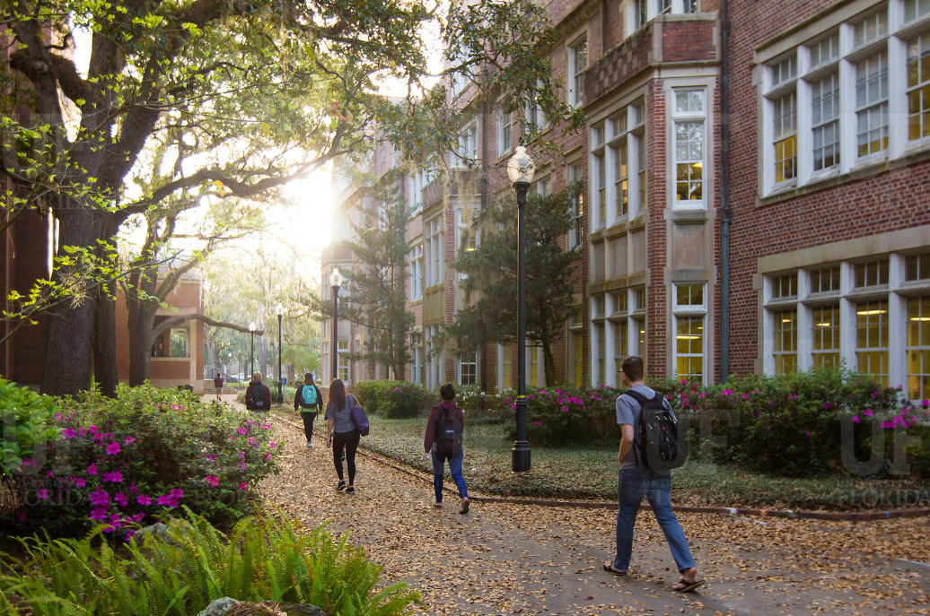

HR Forum
November 3, 2021

Slide 2
Today’s Agenda Items
Benefits Updates – Shannon Edwards
December Vacation Leave Cashout – Shannon Edwards
Foreign Influence – Audrey Gainey
Guide to Greater Gainesville – Audrey Gainey
GBAS Updates – Melissa Long and Gwynn Cadwallader
Important Dates
UFHR preeminence through people

Slide 3
University Benefits
Benefits Updates
December Vacation Leave Cashout
Notes:
Section slide

Slide 4
Benefits Updates
Welcome Kenya Williams – Assistant Director of Benefits
Open Enrollment Correction Period: November 1-12
Benefit Deduction Reminders:
  State of Florida changes: December 3 paycheck
  FSA or HSA changes: January 14 paycheck
  UF Select changes: January 14 paycheck
UFHR preeminence through people

Slide 5
December Vacation Leave Cashout
TEAMS employees may cash out up to 16 hours of vacation leave October 30-November 10.
Minimum balance of 40 hours of vacation leave required after end of pay period
No late entries or exceptions permitted:
  Employees must enter in system by midnight on 11/09
  Supervisor approvals must be completed before 10:00 a.m. on 11/10
Cashout payment included on November 19 paycheck
Instruction Guide: https://learn-and-grow.hr.ufl.edu/toolkits-resource-center/human-resources-toolkits/time-and-labor/
Questions? Call (352) 392-2477 or email central-leave@ufl.edu
UFHR preeminence through people

Slide 6
Talent Acquisition and Onboarding
T
Foreign Influence
Guide to Greater Gainesville

Slide 7
Screening Foreign Researchers
UF RISC (Research Integrity, Security & Compliance) is required to review and approve all applications for research and research support positions.
Administratively, Interfolio does not support the process required for research applicant screening, vetting and required compliance review.
UF will be transitioning all Faculty recruitment from Interfolio to PageUp.
All Faculty Postings should be transitioned to PageUp by December 23, 2021.

Slide 8
Screening Foreign Researchers
College/Unit Administrators and Originators will be able to transition requisitions as early as Mid-November.
Application data may be retrieved from Interfolio throughout the Interfolio contract period of March 31, 2022.
TA&O and Communications will begin reviewing and updating toolkits, career websites, and user resources as early as next week.

Slide 9

Guide to Greater Gainesville
2021 Guide to Greater Gainesville Magazines may be picked up from the lobby at UFHR or you may contact Talent Acquisition and Onboarding at talent@hr.ufl.edu and we can arrange drop off.

Slide 10
Additional Questions?
  Talent Acquisition and Onboarding
    talent@hr.ufl.edu
UFHR preeminence through people
Notes:
One thing is clear today: The need for Resilience and Mindfulness is here to stay. With the increasing frequency and severity of shocks and changes that can shake us up, learning to be more resilience can enhance the quality of our work experience.
The GBAS Resilience at Work series will take a holistic approach to consider all aspects of resilience – physical, cognitive, emotional and spiritual (purpose and values) within the professional context. Throughout the five sessions we will incorporate concepts of work resilience with opportunities for increased self-awareness through mindfulness. You will also be able to explore ideas and gain support from group conversations with the community of participants as well as a smaller cluster of peers at each session.
Participants are expected to attend all sessions and carve aside time for self-reflection and light homework between meetings. At the end of the series, you will have gained a deeper understanding of how to nurture your resilience for wellbeing and sustained work performance.
The sessions will be on Tuesdays from 10 to noon, running every other week from Feb 23 to April 20.

Slide 11
Training & Organizational Development
GBAS Updates
Notes:
Section slide

Slide 12
Getting Real about Retention in an ever-changing workforce.
November 16, 2021 from 10:00am to 12:00pm
Learn best practices to solve retention issues and discuss an engagement tool that may be useful in your unit.
Register in myTraining: UF_GBS600. Registration closes on November 12th at 5:00pm
Contact: gcadwallader@ufl.edu or harrisn@ufl.edu
UFHR preeminence through people
Notes:
We will be offering the fall institute topic this November.
For this November 16th event, we are so excited to bring you, “Getting Real About Retention in an Ever-Changing Workforce.”
We will examine the trend now dubbed as “The Great Resignation” and discuss the factors that are leading so many people to leave their jobs, how it affects UF directly, and what can be done to tackle this problem and retain employees with an engagement tool that leaves them feeling empowered with realistic paths for growth.
According to a study by Gettysburg College, the average person will spend 90,000 hours at work over a lifetime. That translates to 1/3 of your entire life at work! But even so, it is far too common that people come to work every day yet don’t feel known and valued.
This session will include interactive activities to help managers rethink their approach to use a Talent Review in tandem with UF Engaged as a way to make sure employees are heard, treated with empathy, and seen as a whole person.
Registration is open in myTraining and will close on November 12th at 5pm.
https://mytraining-ufshands.sumtotal.host/core/pillarRedirect?relyingParty=LM&url=app%2Fmanagement%2FLMS_ActDetails.aspx%3FActivityId%3D55808%26UserMode%3D0
Gwynn/Nicole is putting the direct link into the chat now.

Slide 13
Save the Date
Inclusive Hiring
December 8, 2021 from 10:30am to 12:00pm
If you are a manager, supervisor, or serve on hiring committees,
this session is a must.
Registration will open in mid-November.
Watch the GBAS list serv for the announcement.
UFHR preeminence through people
Notes:
Gwynn/Nicole
In partnership with Audrey Gainey and her team, the GBAS December session will be about Inclusive Hiring. We will outline the process, why each step is important and introduce the tools for this important topic. This is an overview session to orient managers, supervisors and business administrators to the resources available to support UF’s IDEAS goals.
We will be “socializing” the work. We recommend that everyone in your unit that participates in hiring (committees, panels or leading a search) take the online course and be familiar with the resources available on the website.
From there, you can work with your unit to determine the best way to implement these best practices.

Slide 14
Important Dates
UF Holidays
  November 11, Veteran’s Day
  November 25-26, Thanksgiving Holidays
Upcoming HR Forum – December 1 @ 10 a.m.
Jodi’s Retirement – December 17

Slide 15

Thank you for attending the
HR Forum

