Slide 1

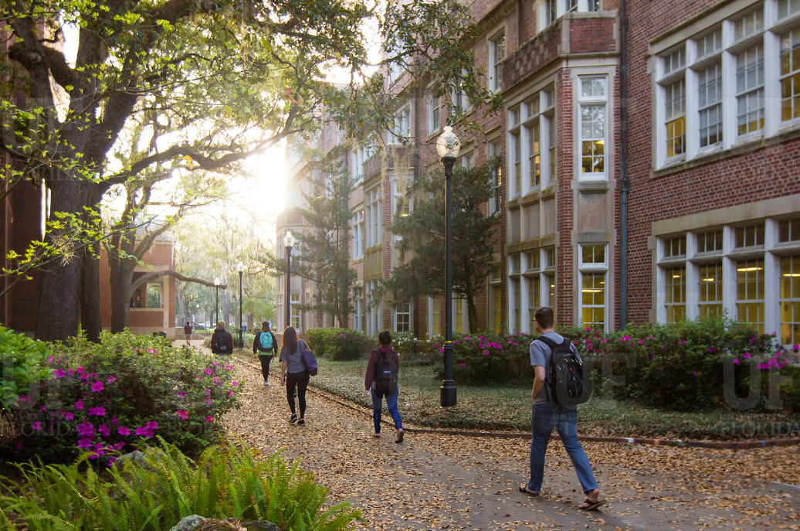

HR Forum
February 2, 2022

Slide 2
Today’s Agenda Items
UF Core Values – Bob Parks
Researcher/Research Support Screening – John Sun
Benefits Updates – Shannon Edwards
Important Dates
UFHR preeminence through people

Slide 3

UF Core Values
Increasing communications on UF’s core values
Role of values—Who we are
Guiding principles and a challenge

Slide 4






UF Core Values
EXCELLENCE
Strive for greatness as an institution that brings out the best in each individual.
Our standard is to be the best by doing our best. We strive to lead with integrity and distinction in all our endeavors. Excellence requires continuous improvement, accountability, and the courage to recognize that there is always more we can do to deliver the highest quality performance.
FREEDOM & CIVILITY
Embrace the freedom to inquire and express ideas without condemnation, and to show respect for the right of others to do the same.
We are a community that affirms and embraces openness to an inclusive range of viewpoints. An open-minded culture is the foundation of freedom of expression and affirms our commitment to academic freedom, which is rooted in mutual respect of others. We encourage curiosity in research, scholarship and exploration, and we create the conditions where inquiry can flourish. We should guard others’ right to express themselves as unequivocally as we expect that right for ourselves.
Making the values real
  Talk about them
  Reinforce
  Recognize
  Examples
  Stories
DISCOVERY & INNOVATION
Collaborate on the uncharted frontiers of knowledge to seek truth and make the world a better place.
Discovery is at our core. We are driven to bring fresh perspectives that create new knowledge and understanding in the classroom and beyond. It is our creative risk-taking that creates transformative change. We are constantly looking for ways to drive scholarship and service that push our campus, community and the world forward. We should never be satisfied with the status quo, but always look for inspiration and new ways of doing things.
COMMUNITY
Create a safe, welcoming community and a shared purpose that builds a sense of belonging and togetherness.
We work together toward the betterment of our local community and the world around us. Our community has a shared sense of purpose that unites everyone around goals that are held in common. Those goals elevate the collective and are greater than any one of us alone. We utilize our intellect, creativity, skills, strength and compassion to create a supportive community that serves the common good.
INCLUSION
Celebrate differences in identities, thoughts, and abilities, and seek to provide equitable access to opportunity.
Excellence is only possible by including people who bring diverse backgrounds and perspectives. Our growing diversity enhances discovery and innovation. It is reliant on freedom and civility. It enriches the UF community. It is rooted in stewardship. It is the connective tissue for all of our Core Values.
STEWARDSHIP
Show respect for those who came before us, responsibility for those now with us, and the commitment to leave a just and habitable world for those who come after us.
We were founded as a land-grant university, which carries with it an obligation to leave the State of Florida and the world better than we found it. Our aim is to operate with utmost respect for the resources provided us, and utilize them in a humane, respectful and responsible way. This is how we create an environment that gives students the opportunity to develop the intellectual, physical and social skills that will enrich their lives.

Slide 5
UF Core Values
Watch for further communications—create conversations!

Slide 6
Talent Acquisition and Onboarding
T
Researcher/Research Support Screening

Slide 7

Screening/Review Process
On January 3, the following changes were made in PageUp to accommodate the process for Researcher/Research Support Screening:
  Addition of “Researcher Recruitment Process”
  Addition of Supervisor field
  Addition of “Is this posting for a position that is for a researcher or research support?” question
  Addition of following applicant statuses:
    Request Clearance for Researcher Hire
    Researcher Hire Under Core HR Review
    Under RISC Review
    Cleared for Offer by RISC

Slide 8
Researcher/Research Support Positions
Definition for Researcher/Research Support:
  “a person who directs or conducts research or receives training in the conduct of research or a person who collects, manipulates or controls access to research data.”
A listing of researcher/research support positions can be found by visiting https://hr.ufl.edu/wp-content/uploads/2022/01/Listing-of-Researcher-and-Research-Support-Positions.pdf
This link can also be found on a job card in PageUp

Slide 9
Researcher/Research Support Positions
Will continue to evaluate the positions on the listing
  Clinical Assistant/Associate/Full Professor positions for patient care only in HSC are exempt.
    Review on case-by-case and by college
Final personnel screening (RISC & HR) review is only conducted on finalist
  Visual Compliance screening on all researcher/research support applicants – coming soon!
Non-recruited hires, including OPS faculty and staff, will continue to as usual.
  Personnel Screening process – more to come!

Slide 10

Important Note
Hires for Researcher/Research Support positions from Interfolio
  Email the name of your hire along with the requisition number to talent@hr.ufl.edu
  Collecting supplemental information outside of PageUp
Special note regarding Graduate Assistant appointments
  GA hires will not go through the personnel screening process via HR. They will have gone through the process based on their student status.

Slide 11
Postings Migrated to PageUp
Be sure to assign postings in Interfolio that migrated to PageUp with the status of “Posted in PageUp”
For all Interfolio postings that are closed and added to PageUp, add the notation “@Interfolio<requisition number in Interfolio>” under the Note tab in PageUp
Confidential letters can continue to be initiated and collected in Interfolio until March 30
Faculty candidates hired out of Interfolio – indicate the requisition number in the hire ePAF
Faculty searches that will go beyond March 30:
  Download applicant materials from Interfolio well in advance

Slide 12
Questions?
For further assistance, please contact: talent@hr.ufl.edu

Slide 13
University Benefits
Double Deductions for 9/10 Month Employees
IRS Form 1095-C
Marketplace Tax Credit Notices
Notes:
Section slide

Slide 14
Double Deductions for 9/10 Month Employees
    Active 9/10-month employees have double premium deductions during the spring to cover summer when no payroll is issued
    Double deductions begin on 2/11/22 and end on 5/6/22 paycheck
    Departments with new 9/10-mo. employees whose hires are executed between February 1st and the start of the Fall term should advise their new hires to contact UFHR Benefits for assistance regarding benefit premiums
    If no action is taken, premiums will be underfunded, and coverages may be suspended
  Questions? Contact UFHR Benefits at (352) 392-2477 or email benefits@ufl.edu
UFHR preeminence through people

Slide 15
IRS Reporting Form 1095-C
Employer Provided Insurance Offer and Coverage
Reports employees’ health insurance information for prior calendar year
State of Florida and GatorCare plan participants will receive forms within the next several weeks
  State 1095s available in PeopleFirst beginning 1/31, if you opted for electronic delivery
  GatorCare 1095s are sent by postal mail only (no electronic option)
Employees may file income tax returns prior to receiving 1095-C if they know they had coverage for the entire year
Employees enrolled in ACA Marketplace plans must report UF’s offer of employer-sponsored health coverage to IRS
UFHR preeminence through people

Slide 16
Marketplace Tax Credit Notices
Employees using Healthcare Marketplace may qualify for premium tax credit
UF is subject to penalty if full-time employee offered coverage by UF receives the tax credit
If tax credit notice received by departmental UF campus location, forward to UFHR Benefits immediately (fax, email, or postal mail):
Physical Address:
UFHR Benefits
Attn: Shannon Edwards
903 W. University Ave.
Gainesville, FL 32606
Campus Mailing Address:
UFHR Benefits
Attn: Shannon Edwards
P.O. Box 115007
Email: shannon.edwards@ufl.edu
Fax: (352) 392-5166
UFHR preeminence through people

Slide 17
Important Dates
Upcoming HR Forum – March 2 @ 10 a.m.

Slide 18

Thank you for attending the
HR Forum

