Slide 1
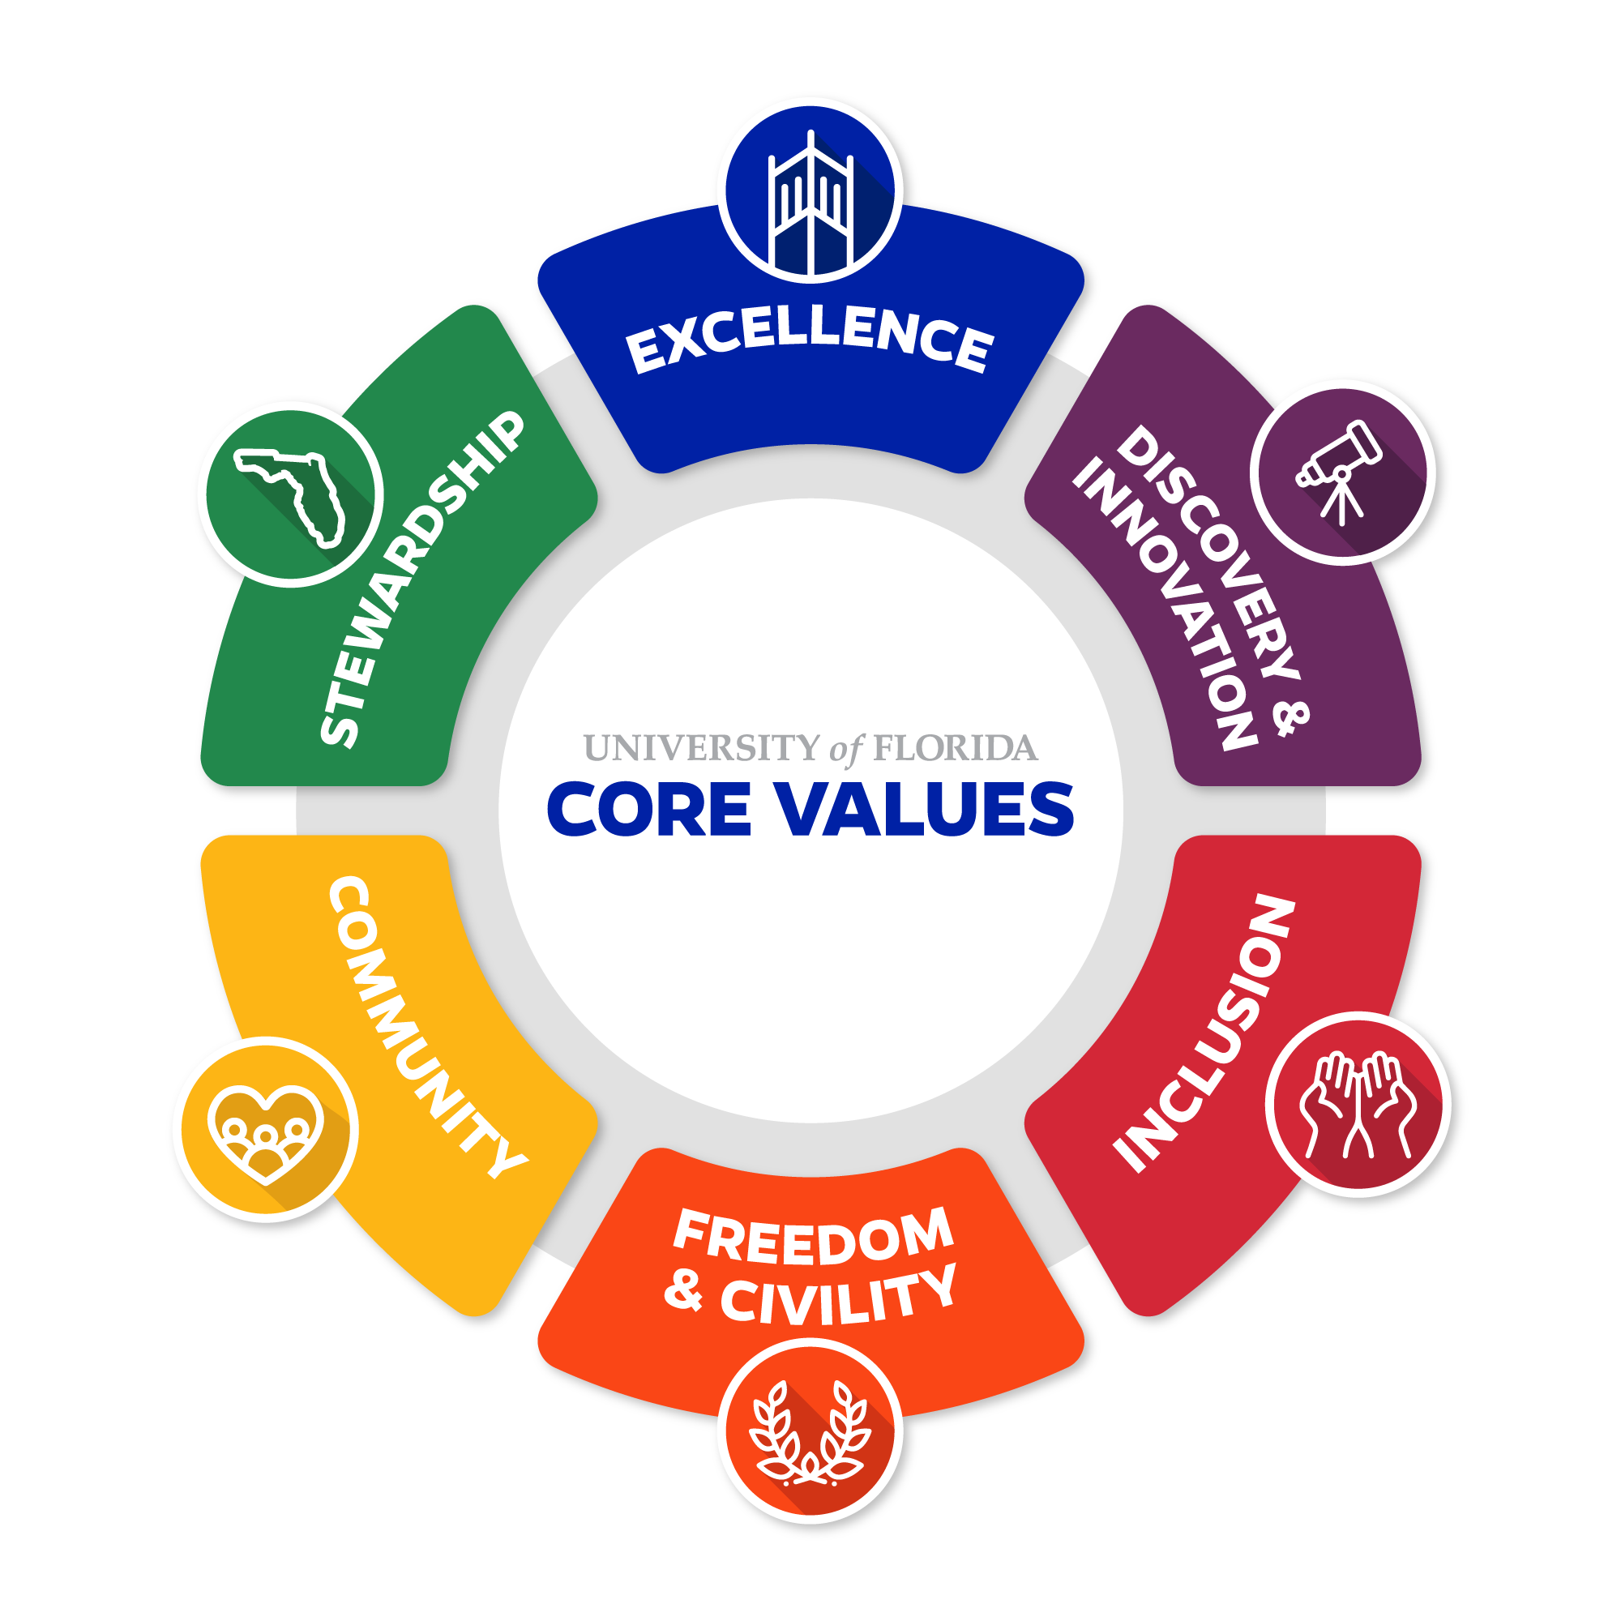
UF CORE VALUES
The University of Florida in 2015 adopted “The Decade Ahead” strategic plan comprising seven university wide goals and objectives and one overarching aspiration: That the University of Florida will be a premier university that the state, nation and world will look to for leadership.
The university in 2020 augmented the plan with the “UF Core Values” underpinning its goals and overarching aspiration with six central values. The values were shaped by input from all of UF’s key stakeholders to ensure they reflect the diverse UF community.

Slide 2
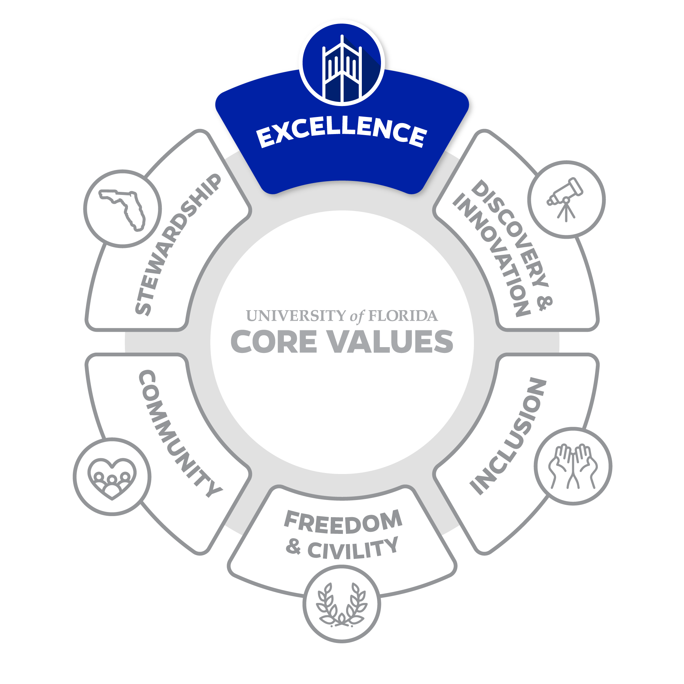
EXCELLENCE
Strive for greatness as an institution that brings out the best in each individual.
Our standard is to be the best by doing our best. We strive to lead with integrity and distinction in all our endeavors. Excellence requires continuous improvement, accountability, and the courage to recognize that there is always more we can do to deliver the highest quality performance.

Slide 3
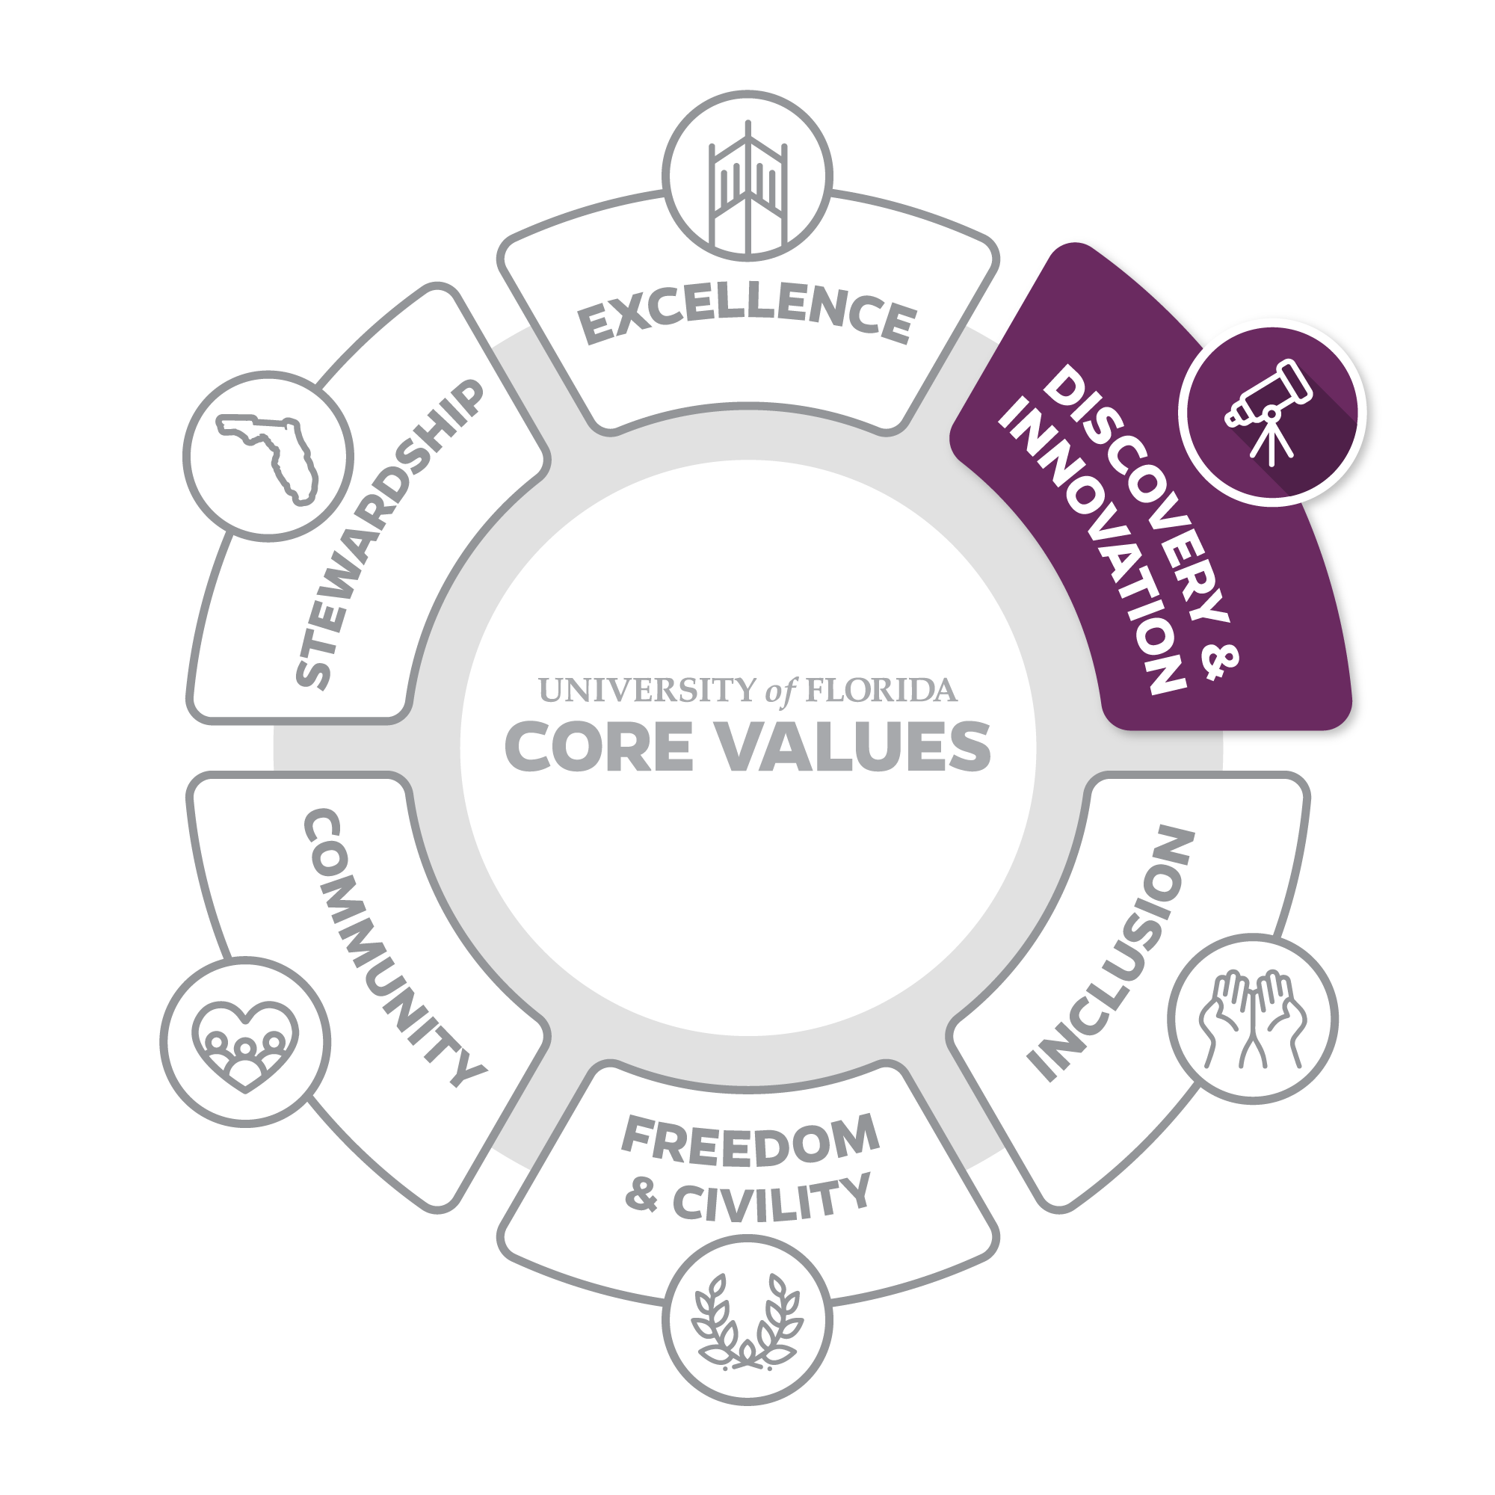
DISCOVERY & INNOVATION
Collaborate on the uncharted frontiers of knowledge to seek truth and make the world a better place.
Discovery is at our core. We are driven to bring fresh perspectives that create new knowledge and understanding in the classroom and beyond. It is our creative risk-taking that creates transformative change. We are constantly looking for ways to drive scholarship and service that push our campus, community and the world forward. We should never be satisfied with the status quo, but always look for inspiration and new ways of doing things.

Slide 4
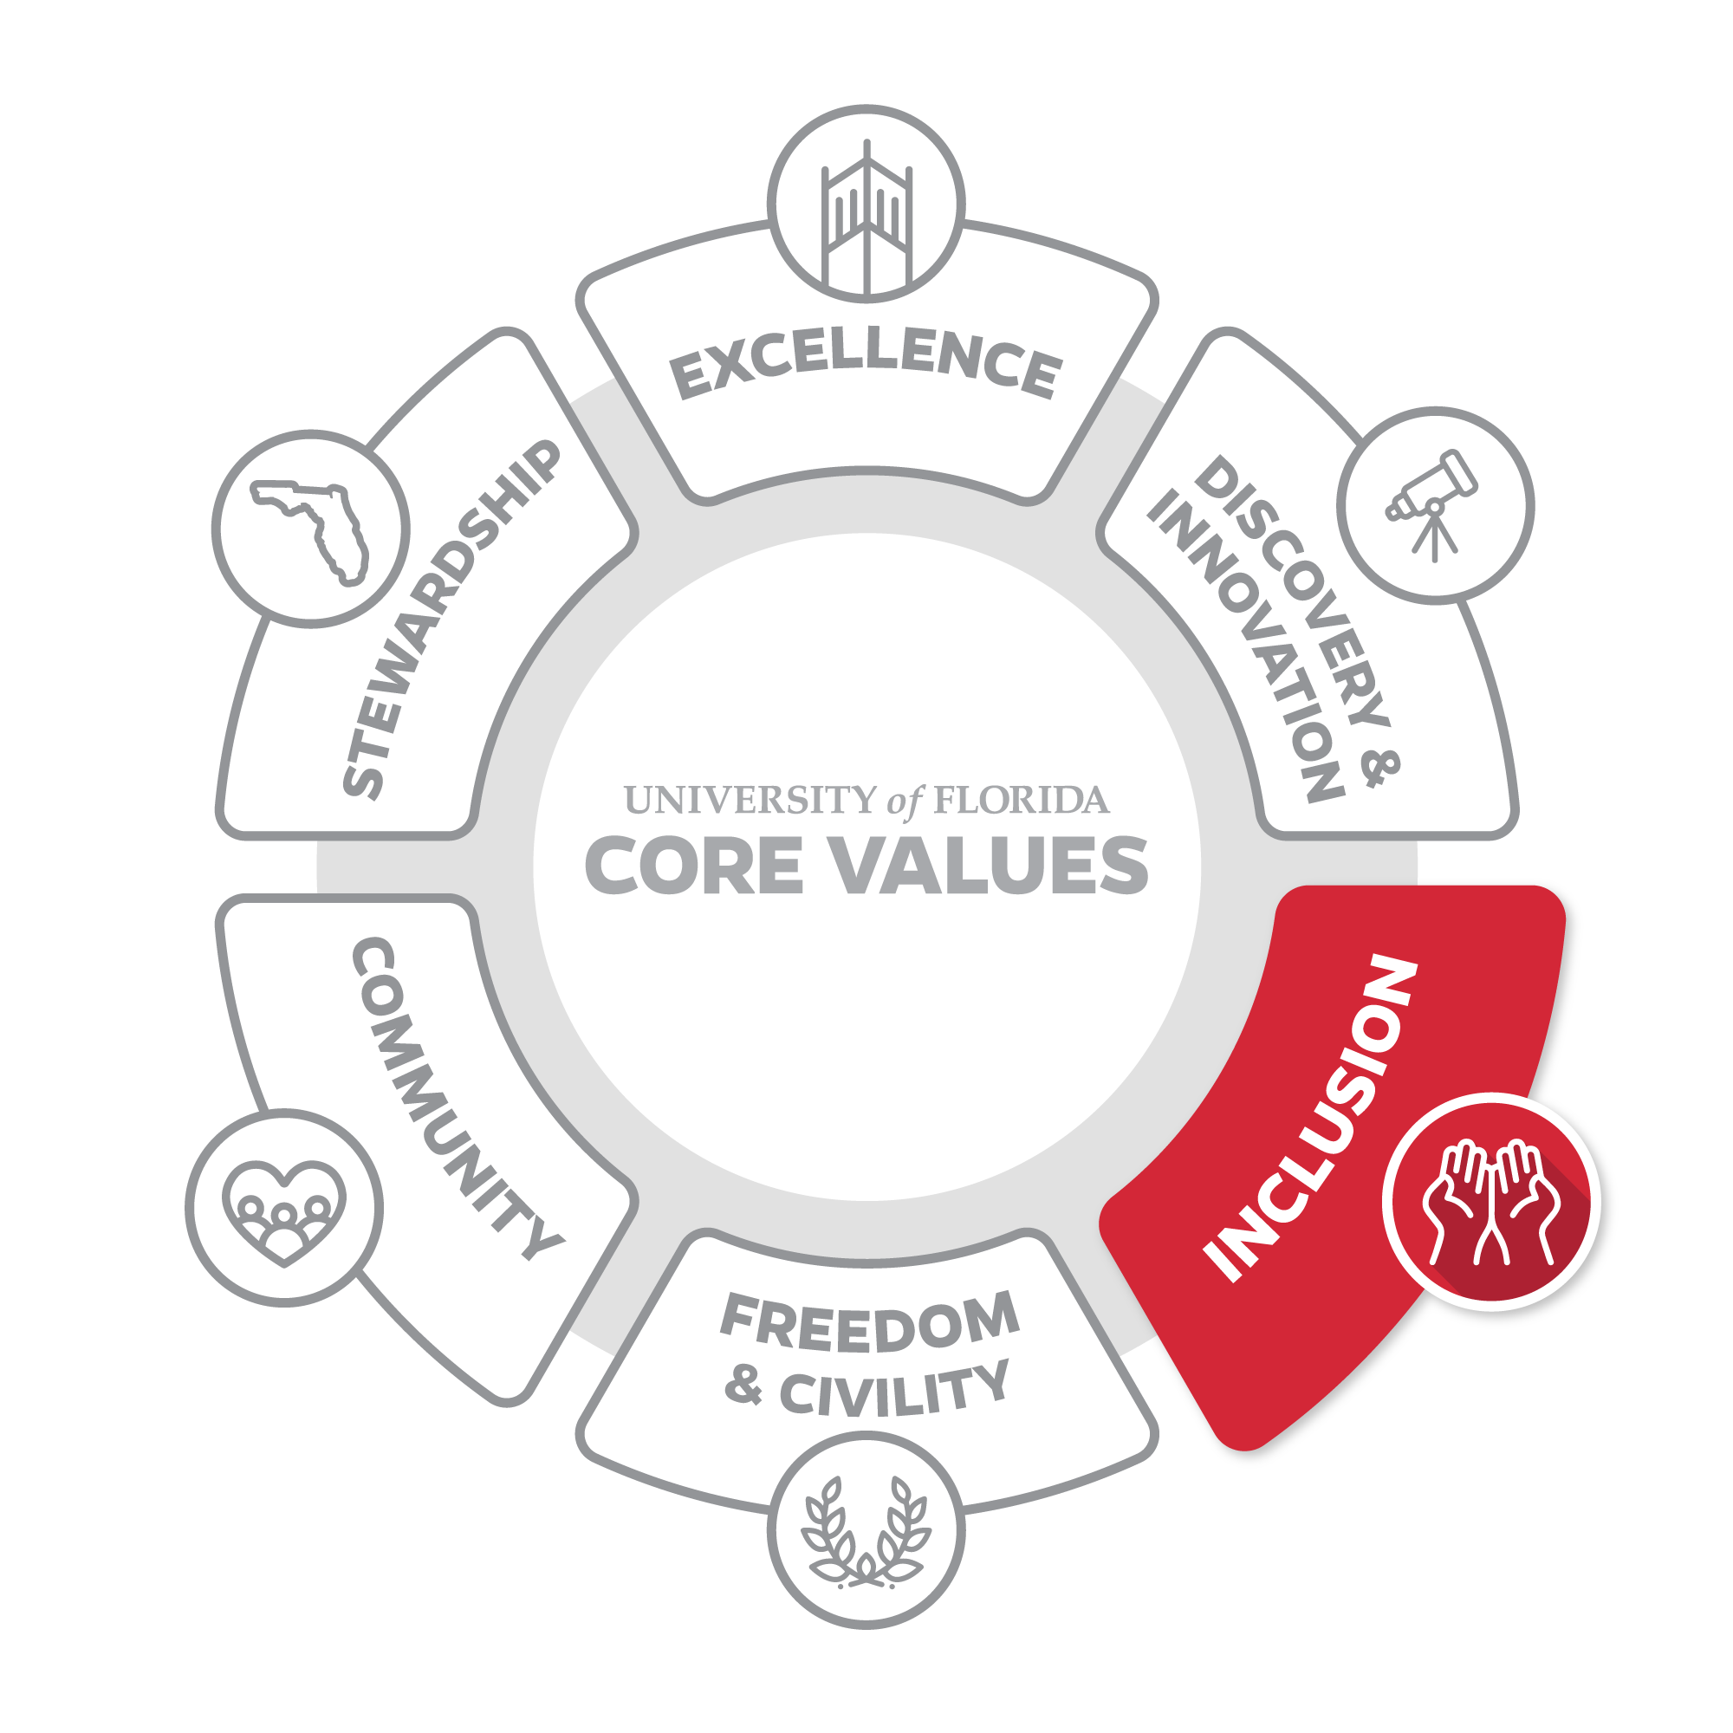
INCLUSION
Celebrate differences in identities, thoughts, and abilities, and seek to provide equitable access to opportunity.
Excellence is only possible by including people who bring diverse backgrounds and perspectives. Our growing diversity enhances discovery and innovation. It is reliant on freedom and civility. It enriches the UF community. It is rooted in stewardship. It is the connective tissue for all of our Core Values.

Slide 5
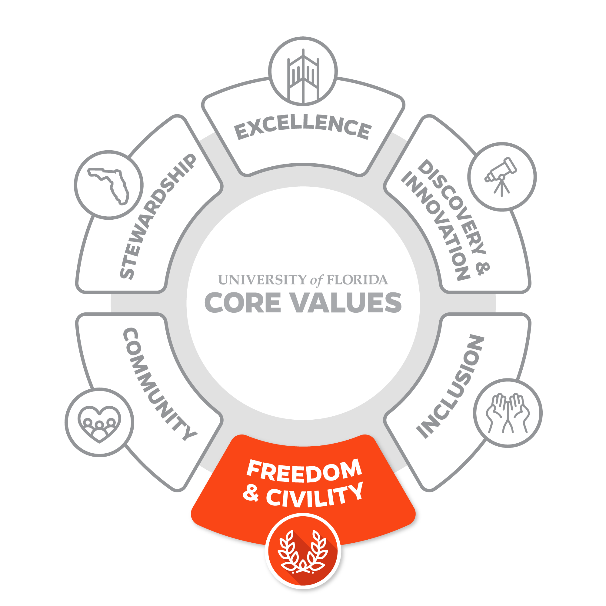
FREEDOM & CIVILITY
Embrace the freedom to inquire and express ideas without condemnation, and to show respect for the right of others to do the same.
We are a community that affirms and embraces openness to an inclusive range of viewpoints. An open-minded culture is the foundation of freedom of expression and affirms our commitment to academic freedom, which is rooted in mutual respect of others. We encourage curiosity in research, scholarship and exploration, and we create the conditions where inquiry can flourish. We should guard others’ right to express themselves as unequivocally as we expect that right for ourselves.

Slide 6
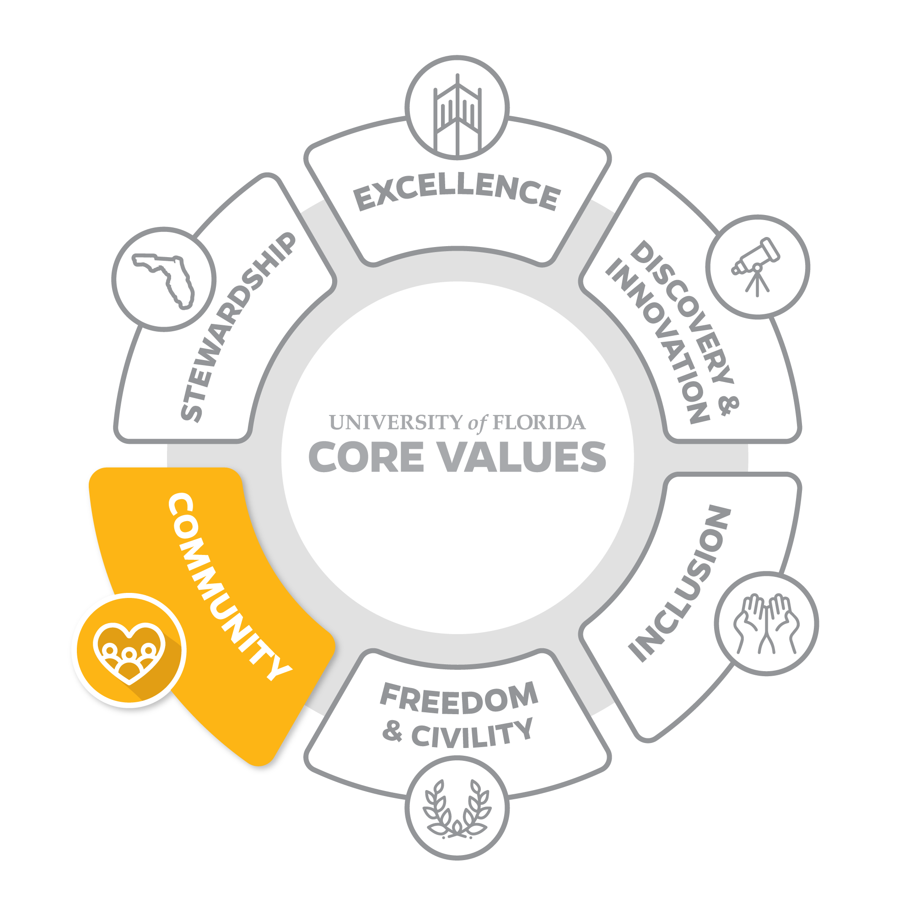
COMMUNITY
Create a safe, welcoming community and a shared purpose that builds a sense of belonging and togetherness.
We work together toward the betterment of our local community and the world around us. Our community has a shared sense of purpose that unites everyone around goals that are held in common. Those goals elevate the collective and are greater than any one of us alone. We utilize our intellect, creativity, skills, strength and compassion to create a supportive community that serves the common good.

Slide 7
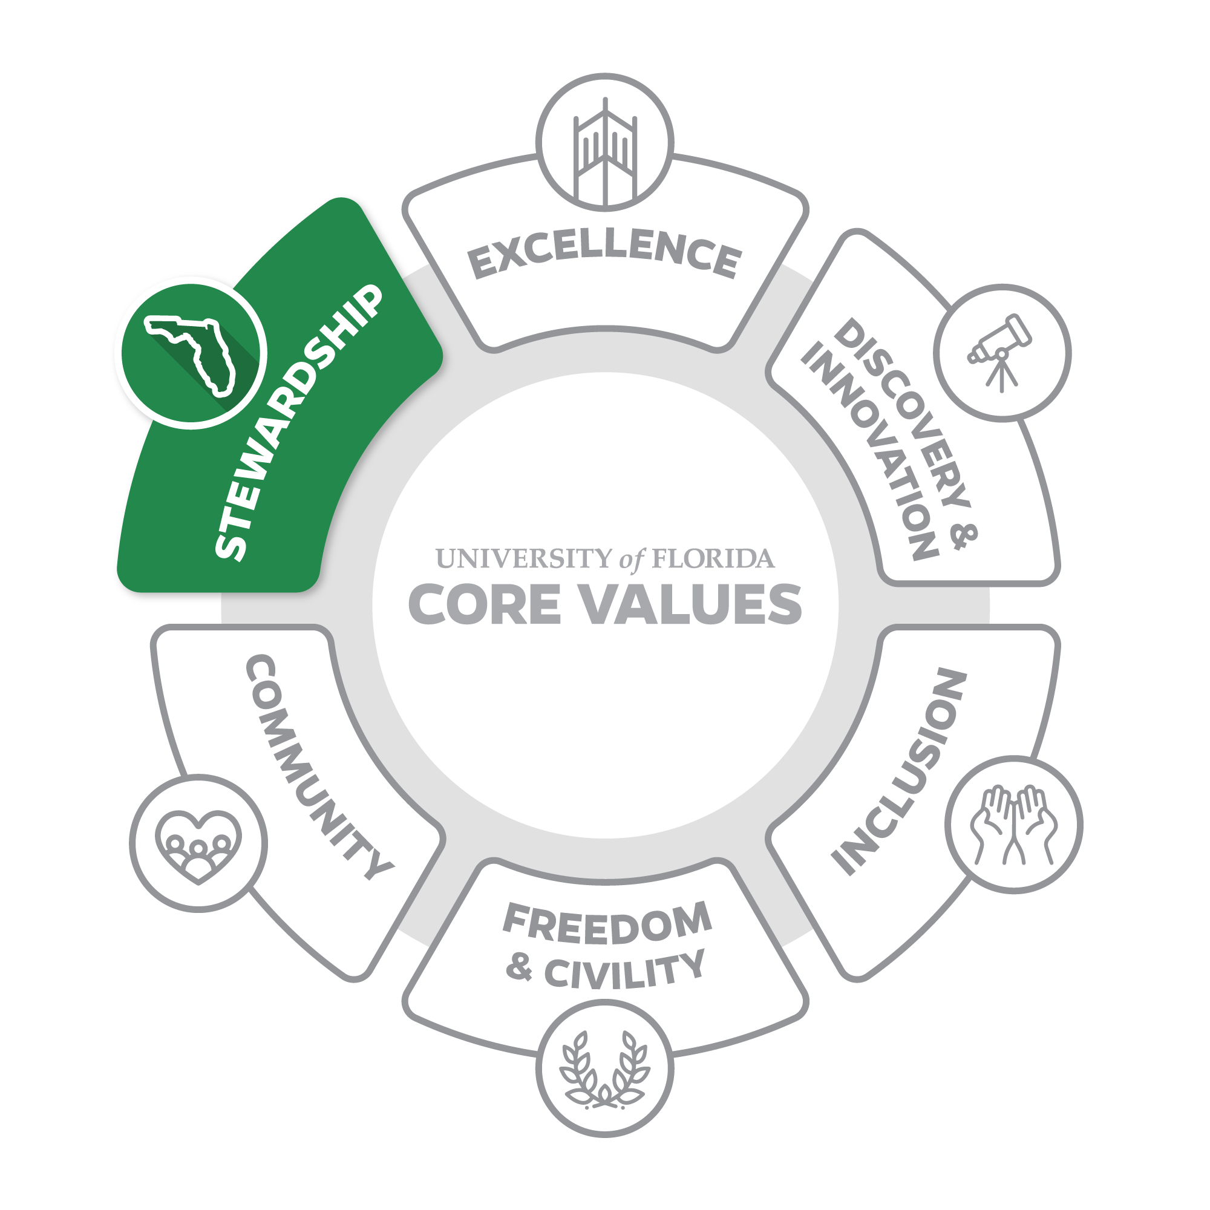
INCLUSION
Show respect for those who came before us, responsibility for those now with us, and the commitment to leave a just and habitable world for those who come after us.
We were founded as a land-grant university, which carries with it an obligation to leave the State of Florida and the world better than we found it. Our aim is to operate with utmost respect for the resources provided us, and utilize them in a humane, respectful and responsible way. This is how we create an environment that gives students the opportunity to develop the intellectual, physical and social skills that will enrich their lives.

Slide 8
UF CORE VALUES
EXCELLENCE
Strive for greatness as an institution that brings out the best in each individual.
Our standard is to be the best by doing our best. We strive to lead with integrity and distinction in all our endeavors. Excellence requires continuous improvement, accountability, and the courage to recognize that there is always more we can do to deliver the highest quality performance.
FREEDOM & CIVILITY
Embrace the freedom to inquire and express ideas without condemnation, and to show respect for the right of others to do the same.
We are a community that affirms and embraces openness to an inclusive range of viewpoints. An open-minded culture is the foundation of freedom of expression and affirms our commitment to academic freedom, which is rooted in mutual respect of others. We encourage curiosity in research, scholarship and exploration, and we create the conditions where inquiry can flourish. We should guard others’ right to express themselves as unequivocally as we expect that right for ourselves.
DISCOVERY & INNOVATION
Collaborate on the uncharted frontiers of knowledge to seek truth and make the world a better place.
Discovery is at our core. We are driven to bring fresh perspectives that create new knowledge and understanding in the classroom and beyond. It is our creative risk-taking that creates transformative change. We are constantly looking for ways to drive scholarship and service that push our campus, community and the world forward. We should never be satisfied with the status quo, but always look for inspiration and new ways of doing things.
COMMUNITY
Create a safe, welcoming community and a shared purpose that builds a sense of belonging and togetherness.
We work together toward the betterment of our local community and the world around us. Our community has a shared sense of purpose that unites everyone around goals that are held in common. Those goals elevate the collective and are greater than any one of us alone. We utilize our intellect, creativity, skills, strength and compassion to create a supportive community that serves the common good.
INCLUSION
Celebrate differences in identities, thoughts, and abilities, and seek to provide equitable access to opportunity.
Excellence is only possible by including people who bring diverse backgrounds and perspectives. Our growing diversity enhances discovery and innovation. It is reliant on freedom and civility. It enriches the UF community. It is rooted in stewardship. It is the connective tissue for all of our Core Values.
STEWARDSHIP
Show respect for those who came before us, responsibility for those now with us, and the commitment to leave a just and habitable world for those who come after us.
We were founded as a land-grant university, which carries with it an obligation to leave the State of Florida and the world better than we found it. Our aim is to operate with utmost respect for the resources provided us, and utilize them in a humane, respectful and responsible way. This is how we create an environment that gives students the opportunity to develop the intellectual, physical and social skills that will enrich their lives.

