Slide 1
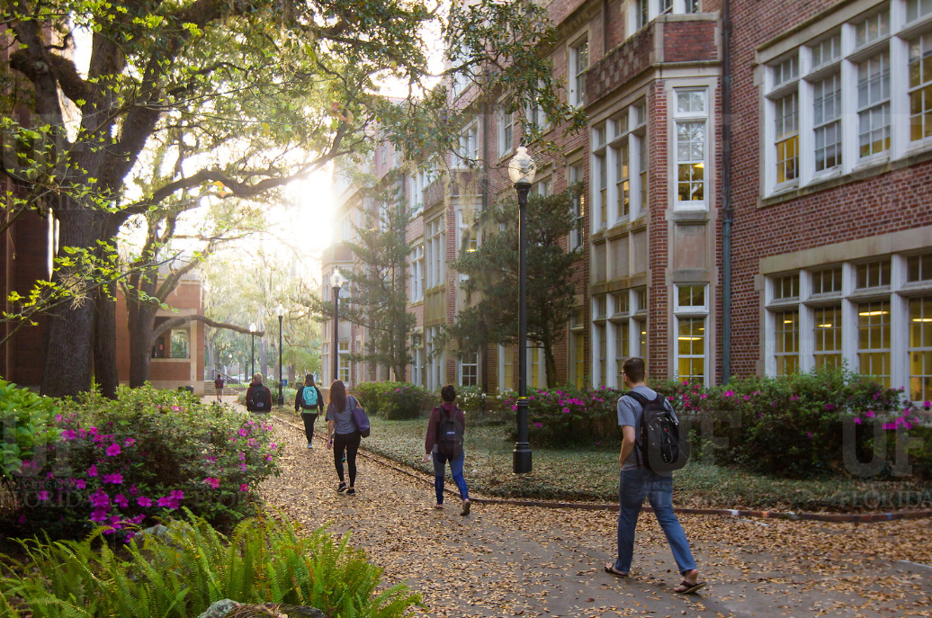
HR Forum
March 2, 2022

Slide 2
Today’s Agenda Items
HR Liaison Support Team – Barb Mitola
Youth Compliance – Sophia Andrews
Wage Overpayment – Kim Alderson
Manager Onboarding – Becky Younglove
UF GO – Gwynn Cadwallader
Inclusive Hiring Hub – Audrey Gainey
Employment Operations and Records Updates – Johannes Traster/Nerea Anaya-Dominguez
Important Dates
UFHR preeminence through people

Slide 3
HR Liaison Support Team
T

Slide 4
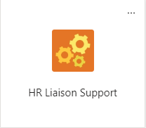
HR Liaison Support Team
Launching a new Microsoft Team (MS Team) called
“HR Liaison Support”
A collaboration between HR Liaisons and UFHR
Why/Used for What:
A space for all HR professionals at UF to share ideas, knowledges, practices and ask each other questions
What it is not used for:
This team would not replace the current means of official communication between core UFHR and other HR professionals at UF
UFHR preeminence through people
Notes:
Launching: Anna Thrombley, Ast Dir of HR for UFIT, and I approached Amber Wuertz and Melissa Curry about creating a Microsoft team that could be a space for HR professionals at UF to share ideas/knowledge. Amber and Melissa were in agreement that this could be a great benefits to HR people at UF so we set up this team.
Why/Used for What: Examples
I could upload the document that explains how my college implemented a form of search advocates and then post to that channel that I’ve upload some resources from my college that might help other units as they consider additional tools for making searches more inclusive/equitable and accessible.
We could add a document that outlines all of the known consequences of the Foreign Influence law and folks can add comments to the document as we learn new things.
You could post to ask who would be attending a particular professional conference. I wanted to know this for the cupa-hr conference in DC this past October but I don’t have a listserv of all the HR people on campus to ask that. The uses of a collaboration space like this, we think, are far and wide.
What it is NOT used for but - It will probably duplicate some of that content in that it could be a great place to keep and announce new policies. And share how we, in our respective units, are implementing any process changes in our units.

Slide 5
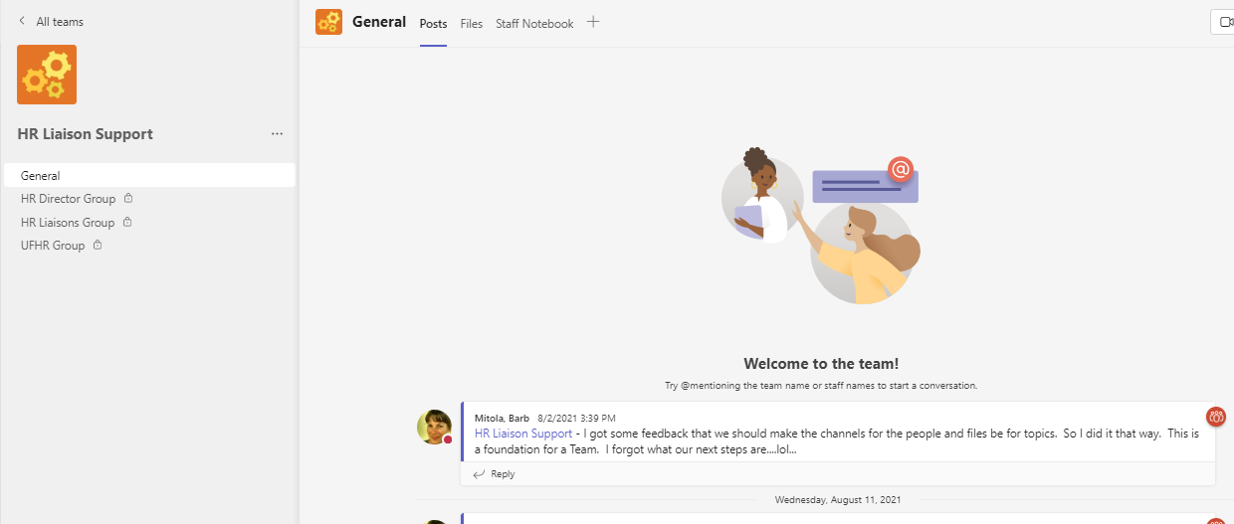
HR Liaison Support Team
UFHR preeminence through people
Notes:
You could post to ask who would be attending a particular professional conference. I wanted to know this for the cupa-hr conference in DC this past October but I don’t have a listserv of all the HR people on campus to ask that.

Slide 6
HR Liaison Support Team
General Channel: Open to anyone who does HR functions at UF. Content viewable by all people who are on the team.
HR Director Group: Open to anyone with an HR Ast Director or HR Director title. Content viewable only by people on that channel.
UFHR Group: Open to anyone working in the UFHR office (core office). Content viewable only by people on that channel.
HR Liaisons Group: Open to anyone designated by UFHR as an HR Liaison and anyone in the UFHR Group. Content viewable ony by people on that channel.
UFHR preeminence through people
Notes:
The channels are the audience you are trying to talk with

Slide 7
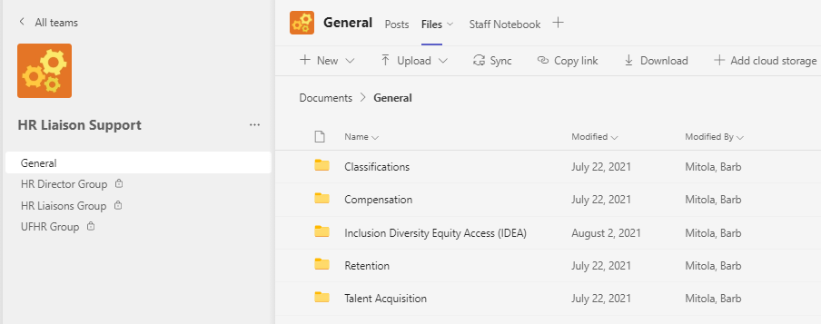
HR Liaison Support Team
UFHR preeminence through people
Notes:
The folders are the topics you are talking about with that audience
I created just a few file folders to start it off in the general channel.
I would leave the creation of more and of folders in the private channels to the users
Examples
I could upload the document that explains how my college implemented a form of search advocates and then post to that channel that I’ve upload some resources from my college that might help other units as they consider additional tools for making searches more inclusive/equitable and accessible.
We could add a document that outlines all the known consequences of the Foreign Influence law and folks can add comments to the document as we learn new things.

Slide 8
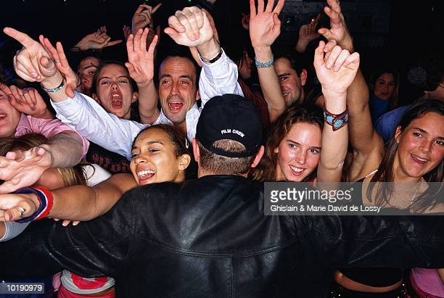
HR Liaison Support Team
When can I start SHARING?
When UFHR adds you, you’ll get an automated email with a link to the team – then use it!
UFHR preeminence through people
Notes:
The next natural question is “how do units get people on the general channel?”
that’s an excellent question
we haven’t decided yet.
We know that only UFHR would add people to the three private channels, based on roles. Maybe we make HR liaisons owners of the general channel so they can add people.
We’ll let you know once we get everyone in the team based on roles.
Continuously give and receive feedback on how the team is helping/not helping and be willing and able to shift/tweak to better fit the needs of the community.
Let’s see how our community develops in this team. What will it be great for and not great for.

Slide 9
Youth Compliance
For HR Forum
March 2, 2022
Sophia Andrews
Compliance and Ethics
Assistant Director

Slide 10
Youth Compliance: Registration
All university affiliated programs or events engaging minors must register with Youth Compliance Services prior to commencing program operations.
Programs are required to register if the activities:
Are sponsored, overseen, supervised, operated, or managed by the University of Florida or any of its Direct Support Organizations or controlled affiliates
Are funded in whole or in part from any UF/Affiliate account
Are related to any academic credit-bearing, certificate-earning, or other activity within the scope of the official UF/Affiliate duties of a UF/Affiliate employee, student, appointee, volunteer or other agents
Require approval by any UF/Affiliate to be conducted
Access
Registration database can be located on the Youth Compliance webpage

Slide 11
Youth Compliance: Training
Youth Protection Training (Annual)
University affiliated youth programs are responsible for ensuring that all program employees, volunteers, and other individuals directly in contact with minors under the age of 18 successfully complete the training.
Training Topics
Safe environment for youth
Recognize the different types and signs of child abuse
Properly respond to suspected child abuse
Supervision and ratios for adults and youth
Overnight accommodations for adults and youth
Youth Privacy in-person, digital devices, and information
Appropriate communication between adults and youth
Access
Via myTraining
Guests accounts available for volunteers and non-UF employees
Successful completion of quiz 90% (90/100)

Slide 12
Youth Compliance: Background Checks
Background checks are required for individuals who engage with university affiliated youth activities
Summer camps require a 435 Livescan screening
Background screening records must be maintained for a minimum of 5 years
Background checks must be completed prior to beginning work with minors

Slide 13
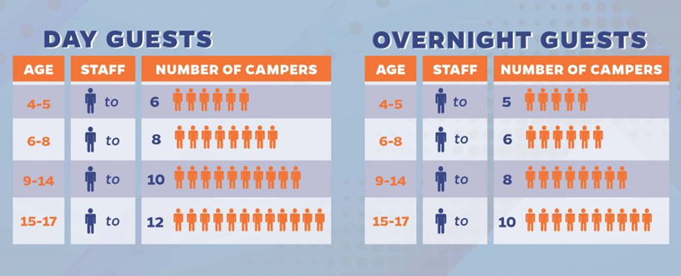
Youth Compliance: Supervision
Appropriate supervision
One-on-one interactions should be eliminated
A minimum of two approved adults should always be present with youth (Two-Deep Leadership)
Programs should establish procedures:
For youth enrollment
For the pick-up and drop-off of youth participants
Waiting rooms for virtual platforms along with passcodes for sign-in
Situations that require personal communication, should be conducted in view of other adults and youth
In-Person: Staff-to-Participant Ratios
*Supervision guidelines must include a minimum of two approved adults

Slide 14
Youth Compliance: Mandated Reporting
Any person who knows, or has reasonable cause to suspect, that a child is abused, abandoned, or neglected by a parent, legal custodian, caregiver, or other person responsible for the child's welfare is a mandatory reporter. § 39.201(1)(a), Florida Statutes.
State of Florida law requires a state university administrator (as defined in the UF policy Vulnerable Persons) upon receiving information from another institution employee, to report known or suspected child abuse, neglect or abandonment (including physical, sexual and/or emotional abuse) that occurred on university property or at a university-sponsored event directly to the Department for Children and Families (DCF).
How to Report Abuse
Telephone: 1-800-962-2873 (24-Hour Hotline)
Fax: 1-800-914-0004
Fax Reporting Form Tips for Successful Fax Reporting
TDD: 1-800-453-5145
Online: https://www.myflfamilies.com/service-programs/abuse-hotline/report-online.shtml
*UF policy on Vulnerable Persons

Slide 15
Contact
UF Compliance and Ethics
Youth Compliance Services
352-294-9162
henriq21@ufl.edu
https://youth.compliance.ufl.edu/

Slide 16
Payroll Services
T
Wage Overpayment

Slide 17
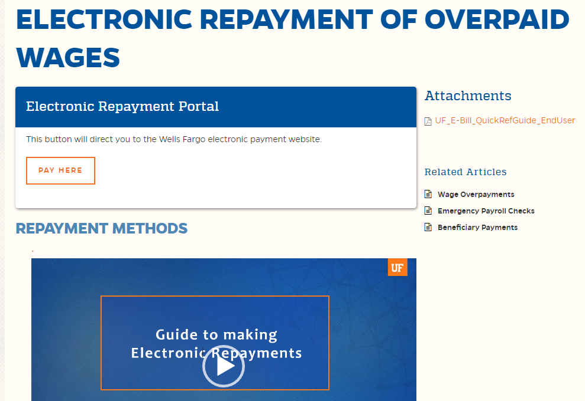
UF’s ELECTRONIC REPAYMENT OF OVERPAID WAGES

Slide 18
Wells Fargo Ebill Express Portal

Slide 19
To Campus
Reduces administrative burden
To Payor
Convenience
Those making regular payments can save their information
To Everyone
Would simplify the process for all parties when we work remotely
ePayment Benefits
To Payroll
Streamlines Process
Improves turnaround time
Improved Internal Controls

Slide 20
Training and Organizational Development
New Manager Onboarding Supports
GBAS – UF GO
Notes:
Section slide

Slide 21
New Manager Onboarding Supports
Provide all new managers with resources, tools, and support as part of their supervisory onboarding process to ensure success in this role immediately and into the future.
Notes:
Hello, this is Becky Younglove, I'm a leadership development professional on the Training and Organizational Development team.
We are very excited to share with you all today about a new initiative we have in the works to support the onboarding efforts related to new managers.
The new manager onboarding supports goal is designed to provide all new managers with resources, tools, and support as part of their supervisory onboarding process to ensure success in this role immediately and into the future.

Slide 22
Purpose
1.) Best practices for managing and leading
2.) Easily accessible resources and tools
Notes:
Getting to the point of being a "top 5" institution isn't easy, and staying there won't be any easier. We need great leadership at all levels of our organization in order to achieve our goals. Entry to middle level managers make up a large portion of this group. And, the old saying, "what got you here won't get you there" is so true. Often times individuals excel in their area and then eventually are promoted into supervisory positions.
The purpose of this initiative is to provide both: (Click to advance)
1.) Best practices for managing and leading
AND
2.) Easily accessible resources and tools
We know that the start of a management career at UF is challenging, there are many things to learn including the functional aspects of managing a team like

Slide 23
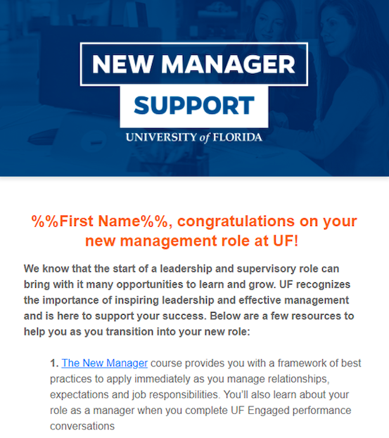
Email
Welcome message within first month:
New Manager Toolkit
New Manager Course
Additional Resources
Notes:
Audience- anyone who was not tied to a paid record the month before, but is now (triggers the inclusion).
At the beginning of each month, we will be sending out a welcome email message to all identified new managers. This message will include a link to the new manager toolkit as well as the new manager course. We will also inform them of the resources available on our leadership toolkit and the Managing@UF program. These are not new resources, but a new manager may not know they exist.

Slide 24
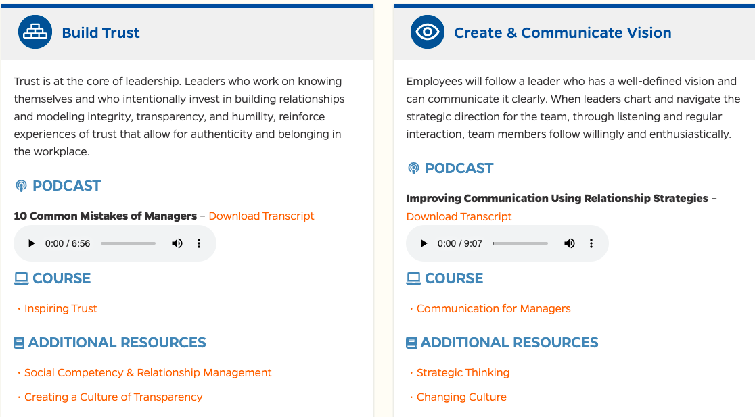
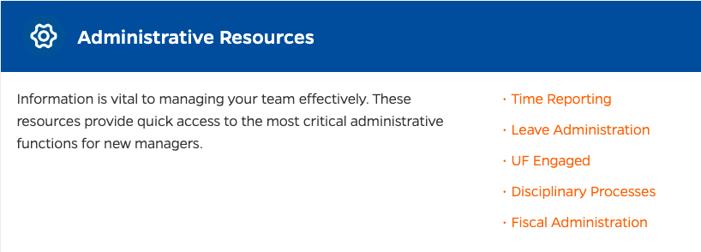
Toolkit
Notes:
The new manager toolkit is a new resource recently developed. This landing page will include quick links to administrative responsibilities as well as targeted resources we have identified as most important for new managers at UF.

Slide 25
New Manager Course
In-person course
3.5 hours
Best practices for managing and leading
Introduction to UF Engaged for managers
Counts as an elective for Supervisory Challenge
Notes:
The new manager course is an elective course, part of the Managing@UF: Supervisory Challenge Program.
This is not a "new" course, but it recently went through a full revision, so the content is fresh and updated.
In this course we cover best practices for managing and leading from a new manager perspective.
A portion of this course also addresses UF Engaged from a new manager perspective.
Our goal is to welcome new managers into their role with open arms as partners in their leadership journey. We hope this course leaves them with a desire to learn more as they embrace this new role and we include recommended courses to take if they haven't already as next steps.

Slide 26
Ways to Support
Encourage course sign-up
Refer to resources and tools
Provide us with ways we can improve
Notes:
As our partners and the first point of contact for new managers, you can help us by encouraging sign-up for the new manager course, refer them to the resources and tools available, and provide us with suggestions on ways we can improve this process and/or the supports as we move this initiative forward.
We hope that this initiative starts a movement to provide more managers and leaders with professional development aimed at increasing their effectiveness and ultimately, elevating the entire organization as a top 5 institution.

Slide 27
Next Steps
Email process will begin in April
HR Liaisons will be provided additional details
Notes:
We will begin the process of emailing new managers at the beginning of April.
Ahead of this launch, we will be sending additional information to HR liaisons including a sample of the email language and links to the resources. We also plan to share a high level overview of the course in the future as well.

Slide 28
Questions?
Contact Human Resources
Training & Organizational Development
Becky Younglove
rebeccayounglove@ufl.edu
Notes:
Any questions?
Feel free to reach out to either myself or my team at any time. We can make ourselves available to provide consultation or answer questions.

Slide 29
UF GO
March 29, 2022, from 1:00pm to 4:00pm
Introduction to UF GO for Travel & PCard
Sneak peek at the system
Discuss with your GBAS colleagues potential adjustments to the workflows in your unit.
Register in myTraining: UF_GBS600. Registration closes on March 24th at 5:00pm
Contact: gcadwallader@ufl.edu or harrisn@ufl.edu
UFHR preeminence through people
Notes:
Gwynn

Slide 30
Talent Acquisition & Onboarding with Training & Organizational Development
Inclusive Hiring Hub
Notes:
Section slide

Slide 31
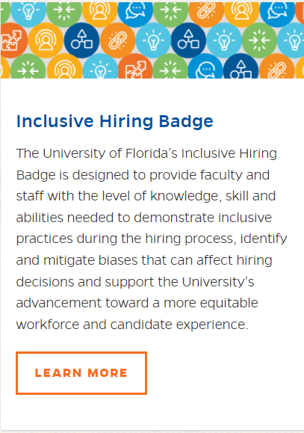
Inclusive Hiring Hub
UFHR preeminence through people
Notes:
Gwynn
Three great resources – designed to assist you whether you are on this journey or path.
Make a recommendation . . . If your department collectively wants to start this journey . . . . Start with the course. And then review the tools and create or edit these for your area.
int

Slide 32
Inclusive Hiring Toolkit
Everything you need for your search committees including:
Video and other resources on common hidden biases
Sample position profile and job descriptions
Gender decoder & sample inclusive language
Screening rubric and Interview Rubric
Behavior based Interview Guide
https://learn-and-grow.hr.ufl.edu/toolkits-resource-center/inclusive-hiring-toolkit/
UFHR preeminence through people
Notes:
Gwynn
https://learn-and-grow.hr.ufl.edu/toolkits-resource-center/inclusive-hiring-toolkit/

Slide 33
Inclusive Hiring at UF Course
The Inclusive Hiring at UF course outlines the hiring process and reviews biases and stereotypes that can impact decisions at each stage.
Notes:
Sarah

Slide 34
Inclusive Hiring Advisor Badge
The Inclusive Hiring Advisor badge serves as a means of motivating employees, recognizing learning and achievement, and communicating success. Completion of the badge requires:
Supervisor approval
Completion of 14 IDEA milestones consisting of any combination of trainings, activities, and/or webinars
Submission of verification of completion
Notes:
Audrey

Slide 35
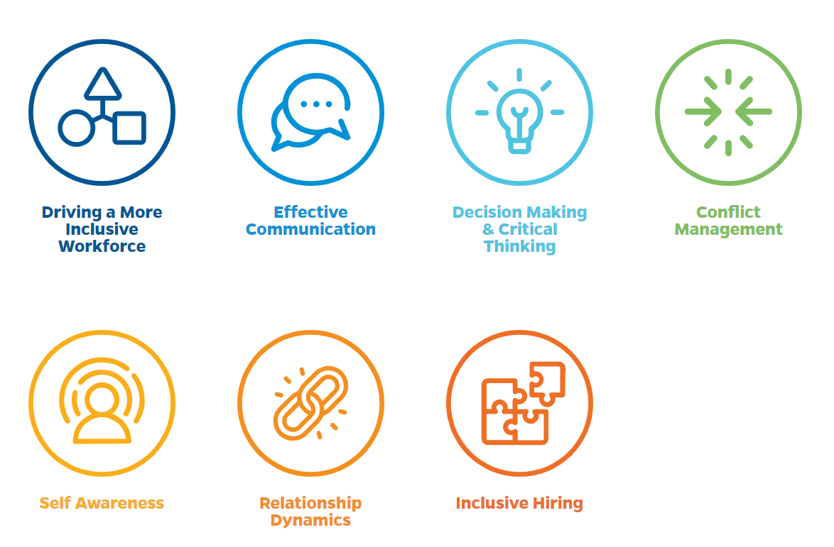
Inclusive Hiring Advisor Badge
Each IDEA Milestone supports seven core competency areas and must be completed within 12 months of participation approval.
Notes:
Audrey

Slide 36
Questions?
For more information or contact UFHR Talent Acquisition and Onboarding at (352)-273-2841 or talent@hr.ufl.edu
Notes:
Audrey

Slide 37
Employment Operations & Records
Core ePAF Approvers
OPS Application Update
Appointment Letter Templates
Form I-9 Deferrals
EOR Website Renovation
Notes:
Section slide

Slide 38
Core ePAF Approvers
Updates to Employment Operation & Records core ePAF approvers for Hires, Job Edits, Terminations, and Additional Pays have been updated
Two separate tabs in the spreadsheet that highlight your ePAF approver for both Staff and Academic appointments
Assigned ePAF approver can assist with all specific actions related to their area of expertise (ePAFs, system assistance, HR consulting, etc.)
https://hr.ufl.edu/wp-content/uploads/2022/03/EOR_DEPT_Distribution_Feb-2022.xlsx
UFHR preeminence through people

Slide 39
OPS Application - Revised
New OPS application is now available
Employment of Relatives (p.1)
Revised the original question; an additional question was added
Employee Agreement (p.3)
Conflicts of Interest and Social Security statements
Application revised by Talent Acquisition & OnBoarding
https://hr.ufl.edu/wp-content/uploads/2018/04/opsapplication.pdf
UFHR preeminence through people

Slide 40
Appointment Letter Templates
In the coming months, new templates will be available for use
OPSN and OPSE letters
Adjunct templates for both the summer term and 9-and 12-month appointments
Graduate Assistant addendums
Useful for compensation and FTE changes during term of appt.

Slide 41
Form I-9 Deferrals
U.S. Immigration and Customs Enforcement (USCIS) extension of its remote I-9 document inspection policy is set to expire on 04/30/2022
https://www.ice.gov/news/releases/ice-announces-extension-i-9-compliance-flexibility-3
Departments who used this feature in I-9 Management must physically inspect an employee’s I-9 documentation within three business days of an employee returning to work
Failure to adhere to federal requirement may result in costly penalties

Slide 42
Form I-9 Deferrals - Report
Departments may run their unit’s report in I-9 Management
GatorStart > I-9 Management > Search for Employees > Type of I-9: COVID-19 Virtual Update > Uncheck Terminated Employees and select Current Location Only > Search

Slide 43
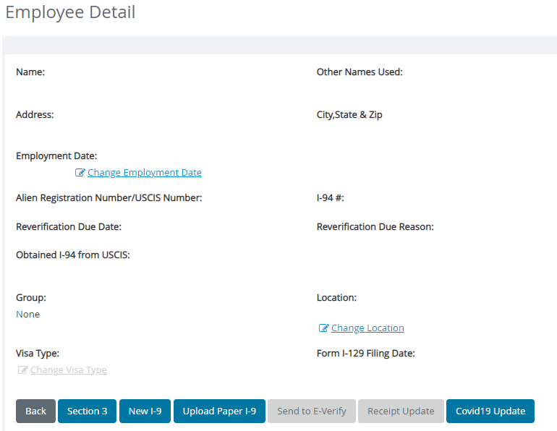
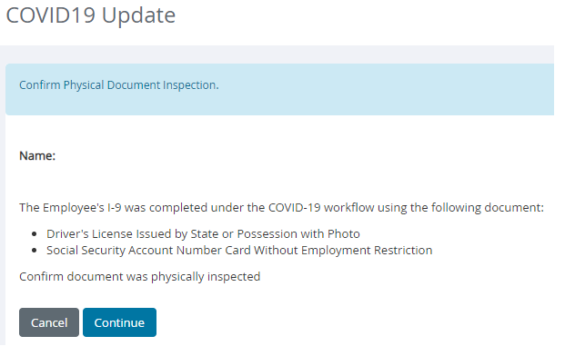
Form I-9 Deferrals – Navigation

Slide 44
EOR Website Renovations
Back in 2020, our team launched a website improvement project that included one goal:
To provide a centralized location for all appointment types that creates easier access to employment practices, processes, and resources.
Many resources are scattered across multiple departments and campus stakeholder webpages.
Current state of EOR website has limited resources on our site with the bulk located under the TAO’s Hiring Center.

Slide 45
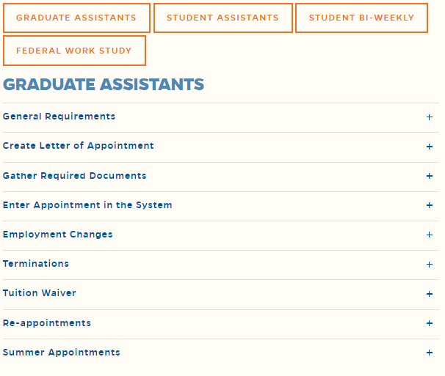
EOR Website Renovations

Slide 46
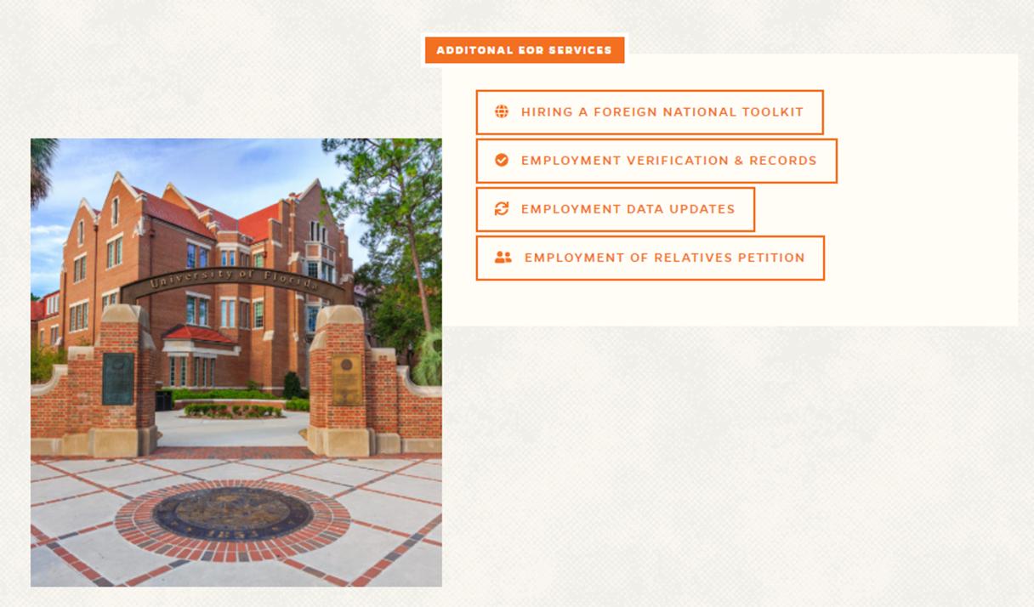
EOR Website Renovations

Slide 47
Questions
Contact Employment Operations and Records at
ufhr-employment@ufl.edu or by phone at (352) 273-1079.

Slide 48
Important Dates
Upcoming HR Forum – April 6 @ 10 a.m.

Slide 49
Thank you for attending the HR Forum

