Slide 1
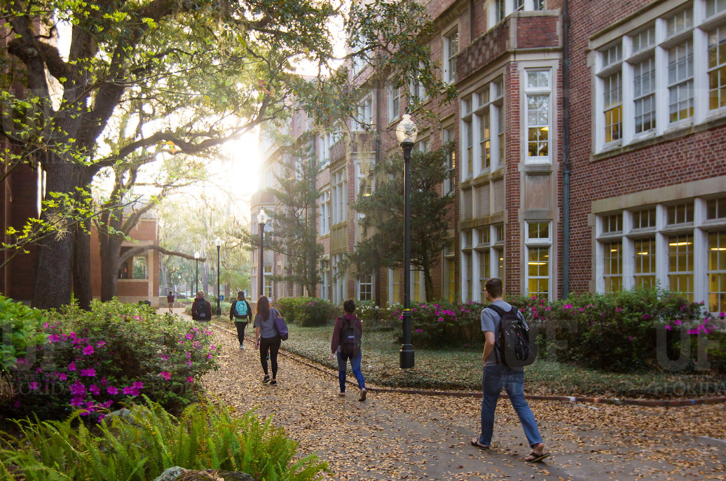
HR Forum
April 6, 2022

Slide 2
Today’s Agenda Items
Leadership Program Applications – Bob Parks
Summer Calendar – Bob Parks
Florida Minimum Wage Reminder – Brent Goodman
New Job Classifications – Brent Goodman
ePAF Approval Changes – Brent Goodman
Short Work Break – Johannes Traster
Summer Job File – Johannes Traster
Comp Leave Cash-Out – Nadja Schimmel-Cruz
Spring/Summer New Hire Reminders – Nadja Schimmel-Cruz
Important Dates
UFHR preeminence through people

Slide 3
Training & Organizational Development
Leadership Program Applications
Summer Calendar

Slide 4
Leadership Program Applications
“Leadership and learning are indispensable to each other.”—John F. Kennedy
Now through May 2
We are accepting applications for
UF Academy
Advanced Leadership for Academics and Professionals (ALAP)
Managers Cohort

Slide 5
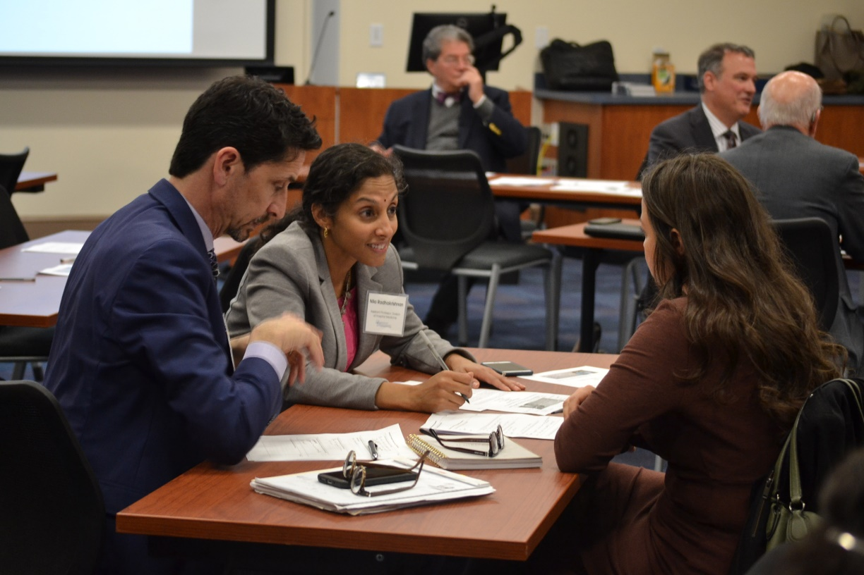
Leadership Program Applications
UF Academy
Entering its 19th year
Designed for faculty and professional staff who are “emerging leaders”

Slide 6
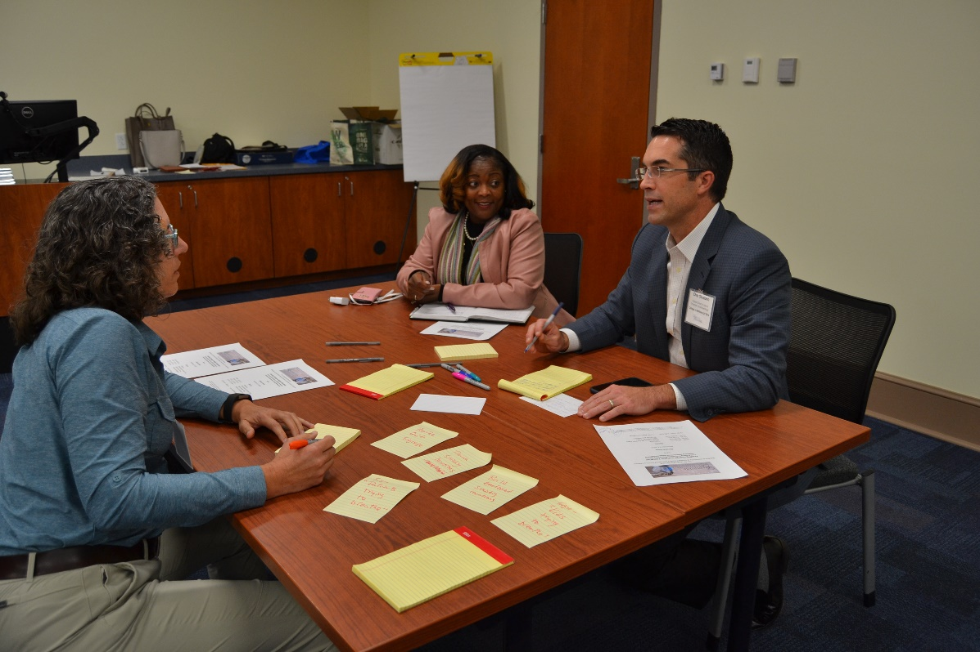
Leadership Program Applications
Advanced Leadership for Academics and Professionals (ALAP)
Entering its 14th year
Designed for established UF professional and academic leaders looking to further develop leadership skills

Slide 7
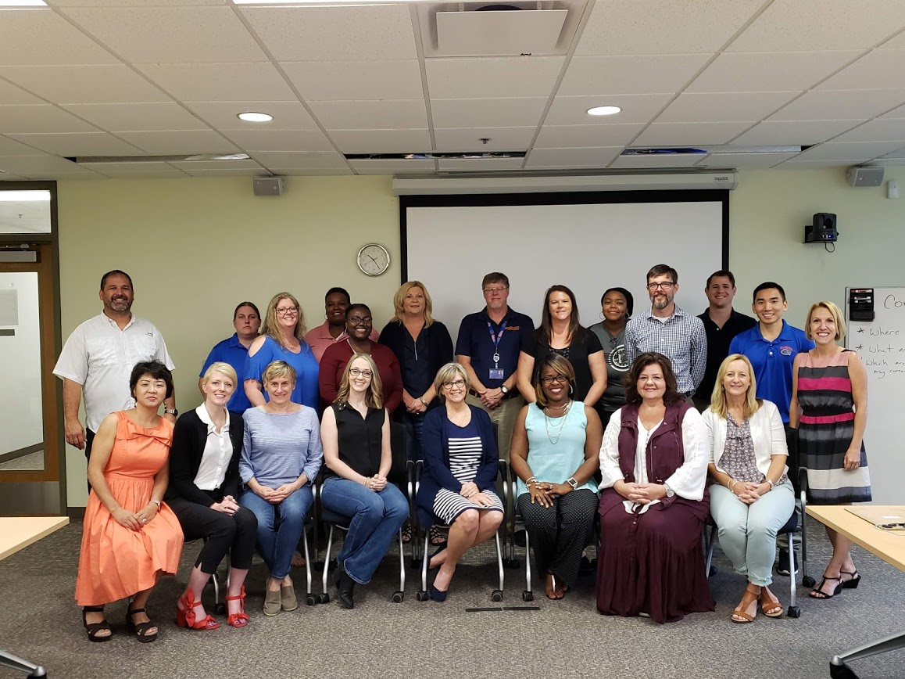
Leadership Program Applications
Managers Cohort
Entering its 12th year
Managers can participate in the Managing at UF curriculum as a cohort

Slide 8
Leadership Program Applications
For more information or to access the application, visit the Leadership@UF program page on the UFHR site https://leadership.hr.ufl.edu/programs/

Slide 9
Summer Calendar
Summer calendar of courses available for registration started Monday, April 4
Courses offered in both virtual and in-person formats
Register in myTraining
View HR calendar for course dates (https://calendar.hr.ufl.edu/events/category/training-organizational-development/)
UFHR preeminence through people

Slide 10
Classification & Compensation
Florida Minimum Wage Reminder
New Job Classifications
ePAF Approval Changes
Notes:
Section slide

Slide 11
Florida Minimum Wage Reminder
Florida voters approved an amendment in November 2020 that increases the minimum wage each year until it reaches $15 per hour in 2026.
Effective September 30, 2022, the minimum wage will increase to $11 per hour.
As of April 4th, 2,339 appointments are below the new minimum wage.
The cost-plus fringe of increasing the population to the new minimum wage is approximate $1.84M.
UFHR preeminence through people

Slide 12
New Job Classifications
Over the past few months, We have added several job classifications to the TEAMS titles website. They include the following:
Bioinformatics Analyst Series
Flow Cytometry Operator Series
HTS Robotics Engineer Series
Research Technician Series
Research Assistant Series
Security Manager
Licensed Mental Health Counselor
Data Scientist (finalizing now)
For more information, please visit https://teams-titles.hr.ufl.edu/
UFHR preeminence through people

Slide 13
ePAF Approval Changes
The Employment Operations & Records (EOR) team identified a variety of ePAFs that could be approved by the college or administrative unit level 1 approvers to increase efficiency.
As a result of their work, core office approval is no longer required for approximately 20% of EOR’s current ePAF volume.
Terminations using select reason codes for ISCR, CTSY, graduate assistants including summer appointments.
Job Edits using select reason codes for OPS, adjunct faculty, graduate, and student assistants.
UFHR preeminence through people

Slide 14
ePAF Approval Changes
Level 1 approvers are expected to review each transaction to ensure accuracy.
For example, it’s essential to confirm that effective dates, compensation rates, and other data elements are consistent with the supporting documentation.
UFHR preeminence through people

Slide 15
ePAF Approval Changes
By submitting or approving a transaction, the Level I approver is certifying the following:​
The request has been approved by the appropriate college/administrative unit leadership​
Request is consistent with UF regulations and applicable policies​
The information is accurate to the best of their knowledge​
UFHR preeminence through people

Slide 16
ePAF Approval Changes
To minimize the potential risks and ensure accuracy, UFHR will periodically audit these transactions. If the audit reveals consistent errors or inconsistencies, ePAF approvers may be required to complete additional training.
UFHR preeminence through people

Slide 17
Questions
Please contact Classification & Compensation at compensation@ufl.edu or by phone at (352)273-2842.
UFHR preeminence through people

Slide 18
Employment Operations & Records
Short Work Break
Summer Job File
Notes:
Section slide

Slide 19
Short Work Break Reminders!
Short Work Break file will take place on April 21st, 2022
Action Needed by Departments
Verify all 9- and 10-month employees (faculty, graduate assistants, and TEAMS) who will not return after Spring 2022 are terminated in myUFL
If necessary, enter end-of-semester terminations PRIOR to April 20th, 2022

Slide 20
Short Work Break Reminders!
To review employees on Short Work Break after April 21st
Main Menu > Enterprise Analytics > Access Enterprise Analytics > Team Content > Human Resources Information > Workforce Information > Short Work Break – Return From Break Report
Instruction Guide
http://training.hr.ufl.edu/instructionguides/job_position_actions/shortworkbreak.pdf

Slide 21
Faculty and GA Summer Appointment Reminders!
Summer appointments for 9-month faculty and graduate assistants may be processed via the summer job file
Summer appointments may also be entered as a Hire ePAF
The file will open on April 25, 2022
The file will close on May 12, 2022
Summer appointments will be reflected in Job Data on the afternoon of May 16th, 2022

Slide 22
Faculty and GA Summer Appointment Reminders!
The file will be available via myUFL system
Main Menu > Human Resources > Workforce Administration > Job Information > UF Summer Job Review
Instruction Guide
http://training.hr.ufl.edu/instructionguides/job_position_actions/summerjobreview.pdf
You will be contacted by EOR if there are employees who do not load and may need additional action on your part

Slide 23
University Benefits
Comp Leave Cash-Out
Spring/Summer New Hire Reminders
Notes:
Section slide

Slide 24
FY 21-22 Comp Leave Cash-Out
Overtime, regular, and compensatory leave will be cashed out on the final paycheck of FY 21-22 (06/17/2022).
Accrued balances (less use) as of the end of PPE 5/26/22 will be paid out.
To prevent negative balances and payroll corrections, TRCs pertaining to comp leave will be unavailable during PP 05/27/22 - 06/23/22.
Any approved use of comp time for PP 06/10/22 - 06/23/22 must be submitted to Central Leave and entered directly by Payroll.
UFHR preeminence through people

Slide 25
FY 21-22 Comp Leave Cash-Out
Department Preparation
In most cases, units can adjust work schedules to prevent compensatory leave from accruing.
Accrued comp leave can be taken in place of other leave types.
Review accruals anytime (recommended on at least a per-pay basis): Enterprise Reporting > Access Reporting > Human Resources Information > Benefit Information > Leave > Leave Accruals, Usage, and Balances By Pay Period, Department - COMP ONLY.
Correct negative balances as quickly as possible by working with Central Leave.
For assistance with Leave Cash-Outs:
Contact the UFHR Central Leave: central-leave@ufl.edu or (352) 392-2477
UFHR preeminence through people

Slide 26
Spring/Summer New Hire Reminders
Due to double deductions, any new 9- and 10-month hires effective prior 8/15/2022 must be coordinated with Benefits to ensure proper enrollment and summer coverage.
All new OPS hires with combined FTEs ≥0.75 are eligible for State benefits.
The State does not consider salary plan changes (i.e., OPS to TEAMS or Faculty) for benefits-eligible employees as a Qualifying Status Change. Employees may have to wait until Open Enrollment to enroll in State benefits.
Questions? Contact us at benefits@ufl.edu, 352-392-2477, or reach out to your dedicated Benefits Specialist.
UFHR preeminence through people

Slide 27
Important Dates
Upcoming HR Forum – May 4 @ 10 a.m.

Slide 28
Thank you for attending the HR Forum

