Slide 1

HR Forum
February 1, 2023

Slide 2

Agenda:
Environmental Health & Safety
Talent Acquisition & Onboarding
Benefits
Employment Operations & Records
Important Dates

Slide 3

Environmental Health & Safety
Tara Hetsler

Slide 4
CareSpot Transition
OccMed & EH&S Update
Opportunities for Improvement
^{Positive Feedback}
^{Phase 2 Objectives}
38 Health Assessments
Vet Med, Facilities, Housing & IFAS
Ease of Scheduling
Results-Quick Turnaround
43 Statewide Locations
Consistency of Results
Bloodwork-LabCorp vs. Quest
Results Given to Employee to Take To Department
Duplication of Services @ All Locations
Additional Staffing @ UF OccMed Clinic
Funding for Future Program & Hiring of OccMed Physician
Support for Program
Post-Employment HA’s
Medical Monitoring Improvements-Pesticide Program & Respiratory Protection
Policy Updates
Website Improvements Ongoing

Slide 5
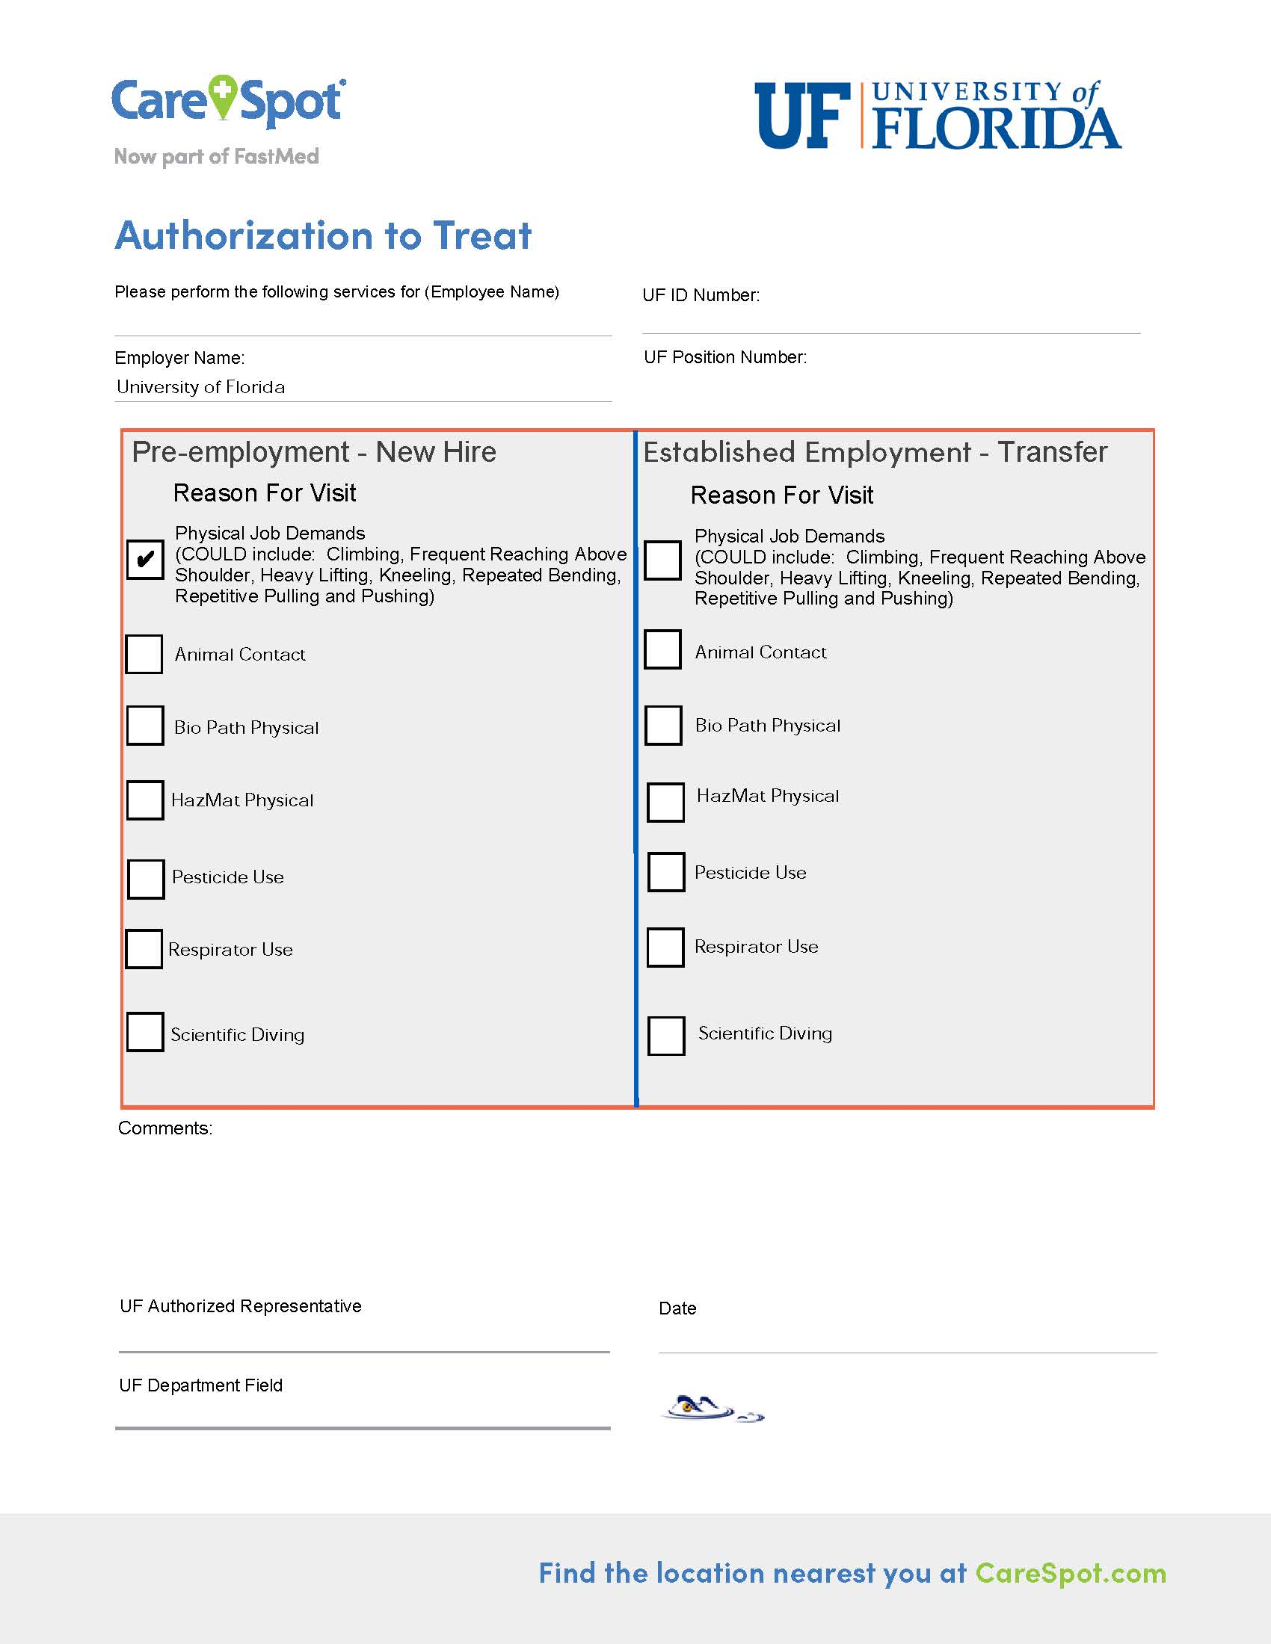
CareSpot Authorization Form
Update
One Physical for All Physical Job Duties-
  Ease of waiver process & cost savings
Position Number
Removal of Patient Contact-OccMed Clinic
Removal of Contact w/Human Blood-Training
Schedule your Information Session:
Phone: 392-1591
Email: Thetsler@ufl.edu

Slide 6

Talent Acquisition & Onboarding
Mercedes Swan

Slide 7
Career Collab
Faculty Partners
Staff Partners
Campus Liaisons
SUPPORTING DUAL CAREER SPOUSES AND PARTNERS
Spouses and Partners of faculty and staff who are new employees of the University of Florida. ​
Benefit to new employees and partners to aid in the relocation and acclimation to the Gainesville Community. ​
Career Collab is separate from the Dual Career Program in the Provosts Office.

Slide 8
Dual Career Services
Career Services for Partners
Career Resources
Community Information
Job search strategy, resume, interview coaching with a talent consultant
On Demand Courses for job search skills
Resources to help transitioning partners connect with the Gainesville community
Elevating Services
Access
Increased awareness
Managing expectations
Streamlined and centralized process
Providing consistent services

Slide 9
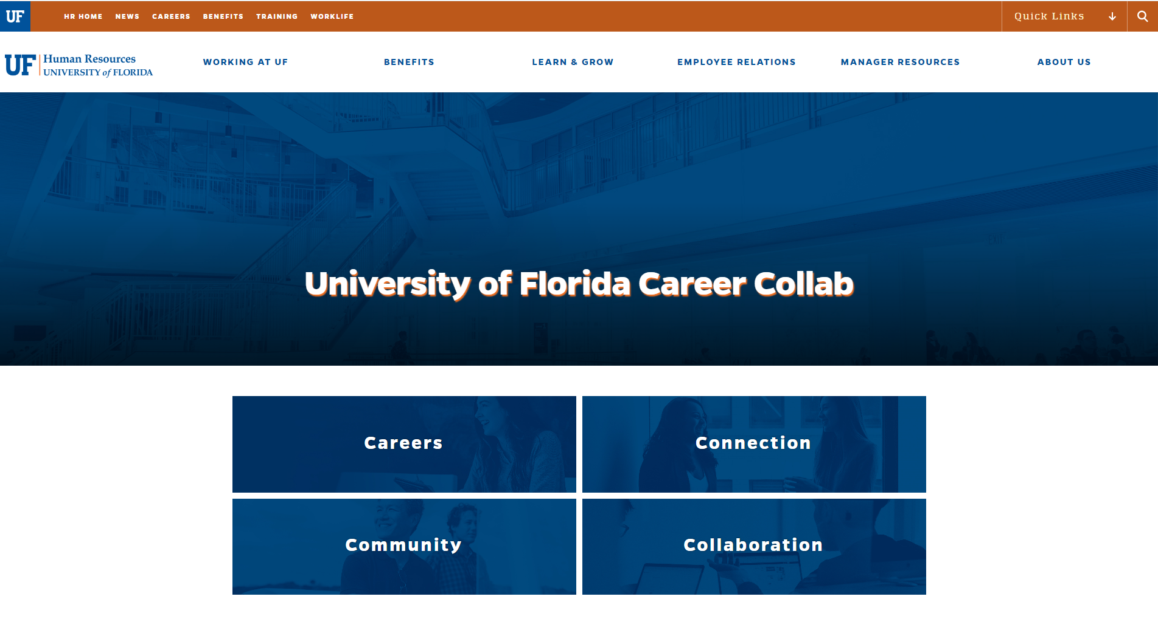
Website
Talent Acquisition and Onboarding invites your feedback at talent@hr.ufl.edu
The website will go live on Monday February 6th
https://hr.ufl.edu/careercollab/

Slide 10

University
Benefits
Crystal Roncek

Slide 11
IRS Reporting Form – 1095-C
Mailing
Employer Provided Insurance Offer and Coverage
Reports employees’ health insurance information for prior calendar year
State of Florida and GatorCare plan participants will receive forms within the next several weeks
  State 1095s available in PeopleFirst beginning 1/31, if you opted for electronic delivery
  GatorCare 1095s are sent by postal mail only (no electronic option)
Employees may file income tax returns prior to receiving 1095-C if they know they had coverage for the entire year
Employees enrolled in ACA Marketplace plans must report UF’s offer of employer-sponsored health coverage to IRS

Slide 12
Services Following UF Retirement

Slide 13
Services Following UF Retirement
In January’s HR Forum, we informed you about the State of Florida Division of Retirement’s (DOR) restrictions on services that can be provided by retired UF employees and emeritus faculty.
The DOR has specified that retirement with the State occurs when:
  An FRS Pension Plan (FRS PP) participant (1) separates employment from all FRS state agencies (2) established a retirement date through the application process with the State, AND (3) has cashed or deposited their defined benefit payment.
    If DROP participant, retirement is defined by when the UF employee separates from service.

Slide 14
Services Following UF Retirement
  An FRS Investment Plan (FRS IP) participant (1) separates employment from all FRS state agencies, AND (2) files a request to receive a distribution or withdrawal from their defined contribution account.
  A State University System Optional Retirement Program (SUSORP) participant (1) separates employment from all FRS state agencies, AND (2) files a request to receive a distribution or withdrawal from their defined contribution account.
  If determined a "retired" participant by the State of Florida, the individual cannot prearrange or accept a role (paid or unpaid) that provides services in any capacity in the first 6 months following retirement.

Slide 15
Services Following UF Retirement
Terms to Know
  Retirement
    UF v. State of Florida
  Form of Payment
    distribution v. withdrawal
  Plan Type
    defined benefit v. defined contribution

Slide 16
Services Following UF Retirement
During months 7-12 following retirement, FRS PP pension plan participants must suspend retirement benefits in order for the retiree to provide services.
FRS Investment Plan and SUSORP participants may provide services in months 7-12, if a distribution was received. However, if the retiree is receiving a withdrawal, the benefit must be suspended in order for the retiree to provide services.
Emeritus status alone does not conflict with the DOR guidance, unless services (paid or unpaid) are provided.
Serving on graduate committees, active participation on departmental committees, volunteering, advising, consulting, participating in poll activities, and fundraising are considered providing 'service' regardless paid or unpaid.
We continue to have dialogue with the DOR.
Comprehensive information will be shared when we receive further guidance from the DOR.

Slide 17

Employment Operations & Records
Johannes Traster

Slide 18
Employment Operations & Records
Business Model
Piloting New Service Model
Student HR Assistants
  Behind the scenes assisting with requests via email and phone
    Employment verifications, system troubleshooting, E-Verify, and much much more!
Campus Visits
  Opportunity to connect, have open discussions on policies and processes, and provide specific trainings on various topics
  Interested? Please contact Johannes Traster at jtraster2-hr@ad.ufl.edu
  For general inquiries please contact us at ufhr-employment@ufl.edu; 352-273-1079

Slide 19

Appointment Letter Library
Updates
New Offer Letters
OPSN & OPSE
Courtesy Faculty
General Addendum
Updated Offer Letters
Graduate Assistants (all templates)
Record of Revisions
Includes date of updates and the description of changes
  Additions, modifications, removals, etc.

Slide 20
Courtesy Faculty Project
History of the Project
Goal – Create Policy & Procedures
Kicked Off in February 2022
HR Liaisons
    IFAS, Engineering, COM, Dentistry, Vet Med, Pharmacy
Evaluation of Current State
    How many do we have?
    Is there a review process?
    Where are they located for?
    What do we use this affiliation for?
    What does this give them access to?
    When do we terminate appointments?

Slide 21
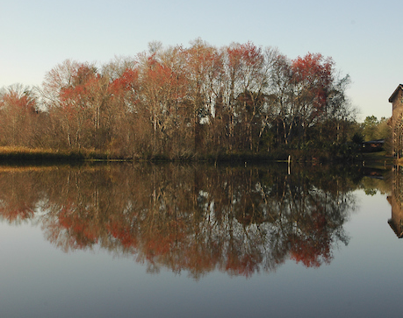
Current Landscape
Courtesy Faculty appointments are used for:
  Preceptors
  County Extension
  Collaborative Research
  Scholars
  Research
  Graduate Faculty
  Patient Care
  Clinic Oversights

Slide 22
Current Landscape
Requirements Varied
Provides Access to:
System Access
  Zoom License
  DUO Authentication
  Microsoft Office 365 (Email)
UFID
GatorLink
P-Card Access
Library Access
Building Access
Wall Street Journal & NY Times
Bachelor’s Degree Master’s Degree Terminal Degree | Offer Letters Voting Background Checks Health Assessments Email Offers | No Time Limit 2-Year Limit 5-Year Limit
Review & Termination
No Cadence For Review
Review Population Quarterly
Review Population Bi-Annually
Review Population Annually

Slide 23
Current Landscape
  Total Courtesy Faculty Headcount – 7,262
  Interesting Data Points
  2,108 courtesy faculty for over 10yrs
  51 courtesy appointments for over 40yrs
  3 courtesy appointments for more than 60yrs
  The oldest age is 121
  The youngest age is 23
  10 courtesy faculty are 100 years old +
  The average courtesy appointment is 8yrs
  The average age of a courtesy faculty is 51

Slide 24
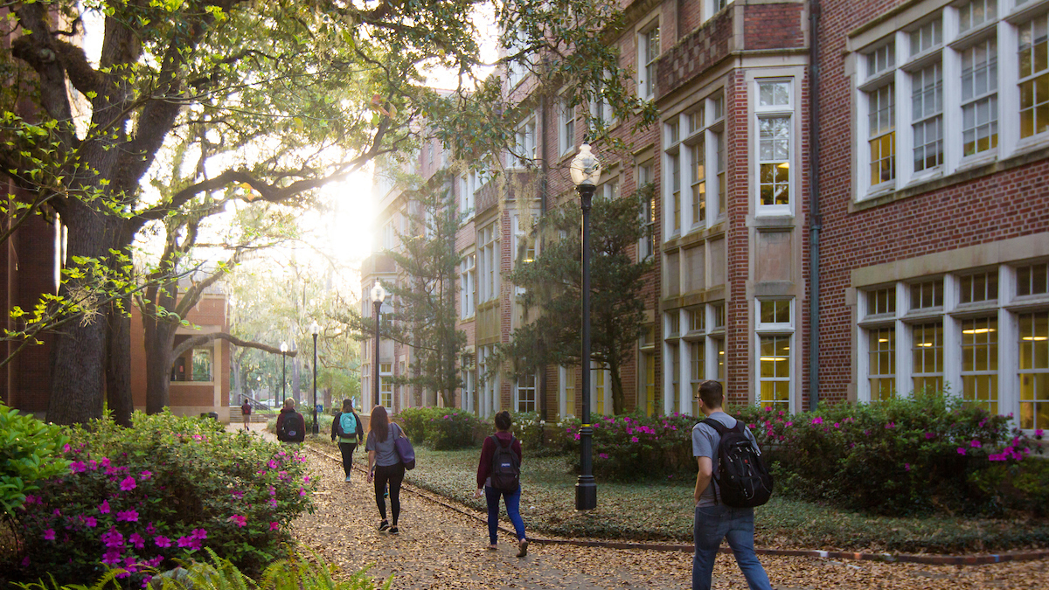
Policy
Policy Statement
University departments and academic units that engage courtesy faculty must enter each courtesy faculty into the myUFL system. Courtesy faculty appointments may be issued for up to 5 years and may be renewable after the initial 5 years. If departments fail to confirm active courtesy appointments on a yearly basis through the Courtesy Faculty Review File, all courtesy appointments in the department will be automatically terminated. Departments and academic units are responsible for oversight of all courtesy faculty services, as well as for assessing risk associated with courtesy faculty services.

Slide 25
Policy
Definitions:
There are 3 types of courtesy faculty modifiers:
Courtesy (CO) - This modifier should be used for those individuals not currently employed by the University of Florida in any other capacity.
Joint* (JNT) – This modifier should be used to designate an employed faculty member who is performing responsibilities in teaching or graduate supervision in another department on a regular basis
Affiliate* (AFFL) – This modifier should be used to designate an employed faculty member’s participation in some function of another department on an infrequent or occasional basis
* The affiliate and joint designations identify those individuals who have another appointment(s) on campus, whereas the standard “CO” courtesy modifiers are exclusive to non-UF employees.

Slide 26

Policy
4.2 Screening
Background checks are recommended. The appropriate level of background check must be completed prior to beginning to work with minors; verification of check shall be on file for a minimum for five years
Research and research support positions are required to undergo additional screening conducted in collaboration between UFHR and UFRISC
Courtesy faculty who are listed as Key Personnel in UFIRST are required to disclose reportable outside activities and financial interests through UFOLIO

Slide 27
Policy
Requirements
Curriculum Vitae
Offer letter with a start and end date
    Approval from dean or vice president, per college of unit policy and procedure
    Outlines responsibilities and assignment, duties
    Include explanation of how the appointment will benefit the applicant, the department, and the college
Social Security number for entry into myUFL – a copy of the card is not needed
If Applicable
Approved Employment of Relatives email, see 4.8 Nepotism
Work authorizations and approvals, see 4.9 Limitations
Verification of rehire-ability
  Only if receiving benefits under the Florida Retirement System (FRS) during the first 12 calendar months after effective retirement date, see 4.9 Limitations

Slide 28
Courtesy Faculty Review File & Process Moving Forward
File Specifics
Opens: March 1, 2023
Closes: March 24, 2023
Termination rows will load on April 3, 2023, with an effective date of March 31, 2023
All courtesy appointments will have the box checked for termination
  The appointments that the college/unit does not want to termination will need to be unchecked
All courtesy appointments older than 5 years must be renewed w/letter
  Reappointments shall be entered via Hire ePAF effective 3/31/23 since initial appointment will be set to term in file
The Courtesy Faculty Review File is located at:
Main Menu > Human Resources > Workforce Administration >Job Information > UF Appointment Review
*New hires entered on 2/1/23 shall adhere to policy with the new requirements
Webpage: https://hr.ufl.edu/manager-resources/employment-hub/non-employee-appointments/

Slide 29

Important Dates
February 17 – GBAS Workshop
March 1st – Courtesy Faculty File Opens
    Closes March 24th
March 1st – Next HR Forum

