Slide 1
HR Forum
March 1, 2023

Slide 2
Agenda:
Talent Acquisition & Onboarding
Communications & Worklife
Strategic Initiatives
Employment Operations & Records
Classification & Compensation
Benefits
UF GO
Important Dates

Slide 3
Talent Acquisition & Onboarding Christina Salva

Slide 4
PageUp - Applicant Progress Board
An updated view(s) of the applicant pool
List view and Card view options
Card view – aggregate view of the progress of all the applications for a job sorted by application status
Quick and easy way to identify the best talent and move them through the hiring process
Easier access to key links and applicant documents
Anonymized profiles

Slide 5
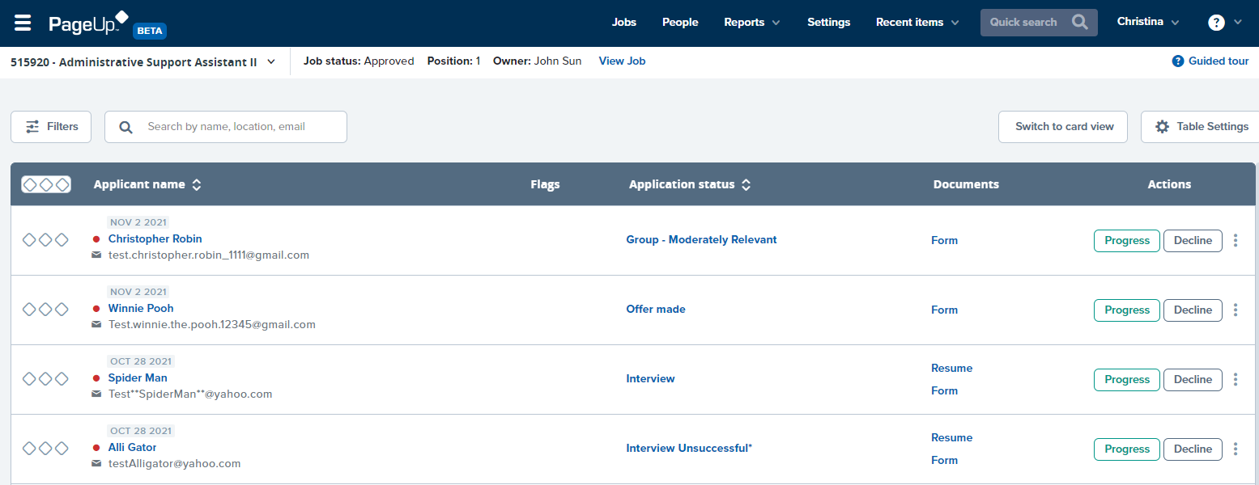
PageUp - Applicant Progress Board
List View Option
Note: Users can easily switch between the two views by clicking either the List view or Card view buttons.

Slide 6
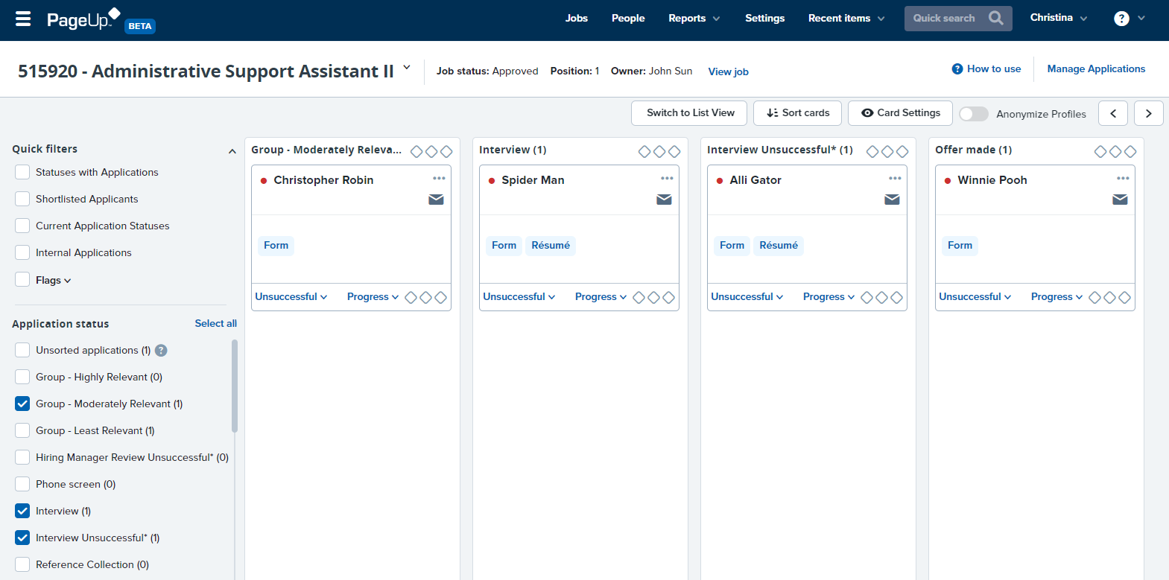
PageUp - Applicant Progress Board
Card View Option
Note: Users can easily switch between the two views by clicking either the List view or Card view buttons.
Users can click and drag applicant “cards” from one column to another to update the status.

Slide 7
PageUp - Applicant Progress Board
Users can switch between the two views by clicking either the List view or Card view buttons.

Slide 8
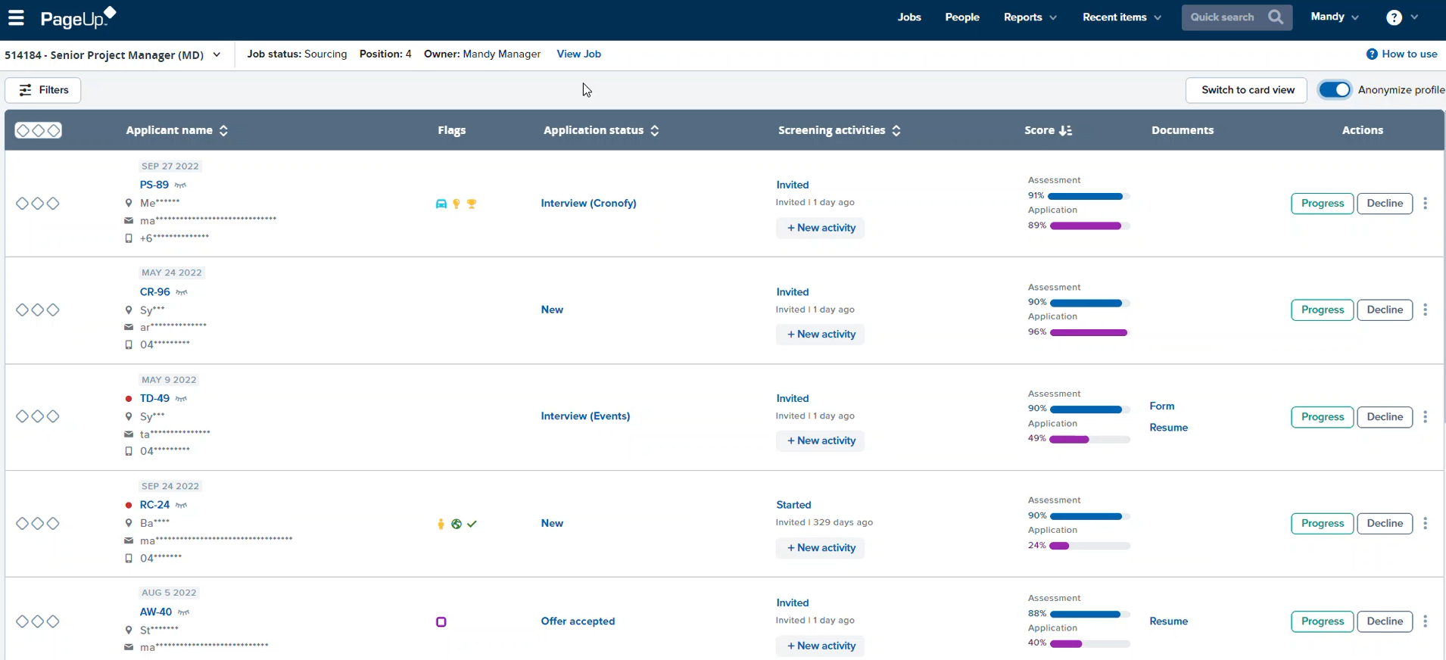
Key Features
Anonymized profiles
If enabled, names and contact details will be hidden with a 'click to reveal' icon.
Available in both List and Card view

Slide 9
PageUp - Applicant Progress Board
Feature available Monday, March 6th
Hiring managers, Originators, and Level 1 Approvers
Questions?
Talent@hr.ufl.edu
352-273-2841

Slide 10
Communications & Worklife Angie Brown

Slide 11
Resilience & Mindfulness at Work
New full-day workshop (it’s free!)
Tuesday, March 28, lunch provided
A holistic approach to physical, cognitive and emotional aspects of resilience at work
Find greater alignment with individual purpose and values
Develop self-awareness and strengthen resilience through reflection and mindfulness practices
One hour of pre-work includes self-assessment
Register today via myTraining; limited to 30 participants

Slide 12
Limited app subscriptions still available
Try an app for added support
Available to all faculty and staff (non-student)
Designed to support wellness and personal goals:
Noom for weight management (2,500 licenses)
Calm for stress reduction and sleep (5,000 licenses—also includes 5 for dependents)
SPOTLYFE for making micro-changes (1,500 licenses)
Choose either a Noom or Calm subscription at: https://worklife.hr.ufl.edu/get-support/noom-and-calm-for-2023/
Faculty and staff may also subscribe to SPOTLYFE: https://worklife.hr.ufl.edu/get-support/spotlyfe-for-2023/

Slide 13
Strategic Initiatives Amber Wuertz

Slide 14
Let’s Try This Again!
Process Improvement
Email
From: IT-ES No-Reply IAM <ES-NoReplyIAM@ad.ufl.edu>
Sent: Monday, January 30, 2023 10:51 AM
To:
Subject: Welcome to UF! Here is your UFID
Welcome to the University of Florida! You have been assigned a UFID. Your UFID is an eight-digit number used to identify who you are. Your UFID is XXXXXXXX. Next, you will receive an email invitation for you to create a GatorLink. A GatorLink account is an individual's computer network identity at the University of Florida. Your GatorLink username will also serve as your email address with @ufl.edu. Once you receive the email, please follow the instructions closely. You will need your UFID to complete the GatorLink registration. If you need assistance, please contact the UF Computing Help Desk at 352-392-4357. Go Gators!
In the past, once a UFID was created department admins would send a separate email to the new employee/affiliate providing them with their UFID
Moving forward the system will generate an email to these new employees/affiliates.
Except for students
This enhancement will go live on Monday, March 6th

Slide 15
Employment Operations & Records Johannes Traster

Slide 16
Courtesy Faculty Review File Now Open!
File Specifics
Opens: March 1, 2023
Closes: March 31, 2023
Termination rows will load on April 3, 2023, with an effective date of March 31, 2023
File will include courtesy appointments from year 2 (day 366 and greater) to year 5 and will have the box checked for termination
The appointments that the college/unit does not want to termination will need to be unchecked
Appointments 1 year or less will not be included in the file

Slide 17
Courtesy Faculty Review File
File Specifics Cont.
All courtesy appointments older than 5 years will be set to term in the file. If appointment is needed beyond 5yrs then it must be renewed w/letter
Reappointments must be entered via Hire ePAF effective 3/31/23 since current appointment will be set to term in file
March 31st reappointments can be entered as early as now and highly encouraged once approved offer letter is obtained

Slide 18
Courtesy Faculty Review File
File Specifics Cont.
Calendar Year: 2023
Department ID: Your unit(s)
Termination Date: 03/31/2023
Salary Plan: CTSY
Navigation: Main Menu > Human Resources > Workforce Administration >Job Information > UF Appointment Review

Slide 19
Courtesy Faculty Review File
Additional Info & Resources
To review your current population and to identify those who may have an active courtesy faculty appointment greater than 5 years, please navigate to the report below:
Main Menu > Enterprise Analytics > Access Enterprise Analytics > Team Content > Human Resources Information > Workforce Information > Job Information for UF
The review file will assess the rehire date of this report if there was a break in service on that Empl Rec
Courtesy Faculty Policy Offer Letter Template Frequently Asked Questions Courtesy Faculty Webpage

Slide 20
Reminder—Sabbaticals
Sabbatical Rows
Use caution when approving job transactions for those faculty on sabbatical
For time to auto-populate, the sabbatical row must always remain as the top row during their time on leave
Approving transactions such as supervisor ID changes or other updates during one’s sabbatical will cause their time to not auto-populate
If the transaction(s) cannot wait until they return from sabbatical, then EOR will need to be contacted in order to readd the sabbatical row on top

Slide 21
Classification & Compensation Kenya Williams

Slide 22
Additional Pay Code Updates
In December, the Board of Trustees (BOT) approved UF regulation 1.202 University Bonus Plans.
The bonus regulation includes three bonus plans.
Work Performance Bonus Plan
Recruitment Bonus Plans
Retention Bonus Plans
To ensure we can accurately report bonuses to the BOT, several existing codes are being repurposed. Moving forward, these payments should be coded using the bonus earnings code using the following reason codes.
Work Performance
Recruitment
Retention

Slide 23
University Benefits Crystal Roncek

Slide 24
Services Following Retirement
As we mentioned in the February HR Forum, the State of Florida Division of Retirement (DOR) has been informing retirees about restrictions on services that can be provided by retired employees and emeritus faculty.
An employee cannot prearrange or accept a role (paid or unpaid) that provides services in any capacity for 12 months after receiving a retirement distribution or benefit.
A notice of restrictions for services after retirement will be shared with HR Liaisons.
UFHR is working with UF Government and Community Relations to lobby the legislature on services following retirement.

Slide 25
Finance & Accounting
Victoria Peprah-Asante

Slide 26
UF GO
What is UF GO?
Overview
How does UF GO impact HR?
Security Roles
Name
Supervisor
Guest Process

Slide 27
What is UF GO? An integrated cloud-based Travel and PCard system that will enable faculty and staff to upload, review and report Travel and PCard expenses on the go.
Notes:
Key selling point is that having both of them on one platform helps close the gap with having a travel expense and a pcard expense not speak to each other which creates fraud risks
- Have more visibility in people’s spend

Slide 28
Project Goals
TRAVEL
Redefine the campus travel and reimbursement experience
Seamless PCard integration
Streamline and simplify processes
Elevate compliance
Increase transparency and spend visibility
Identify cost savings opportunities
APPROVALS
COMPLIANCE
EXPENSE

Slide 29
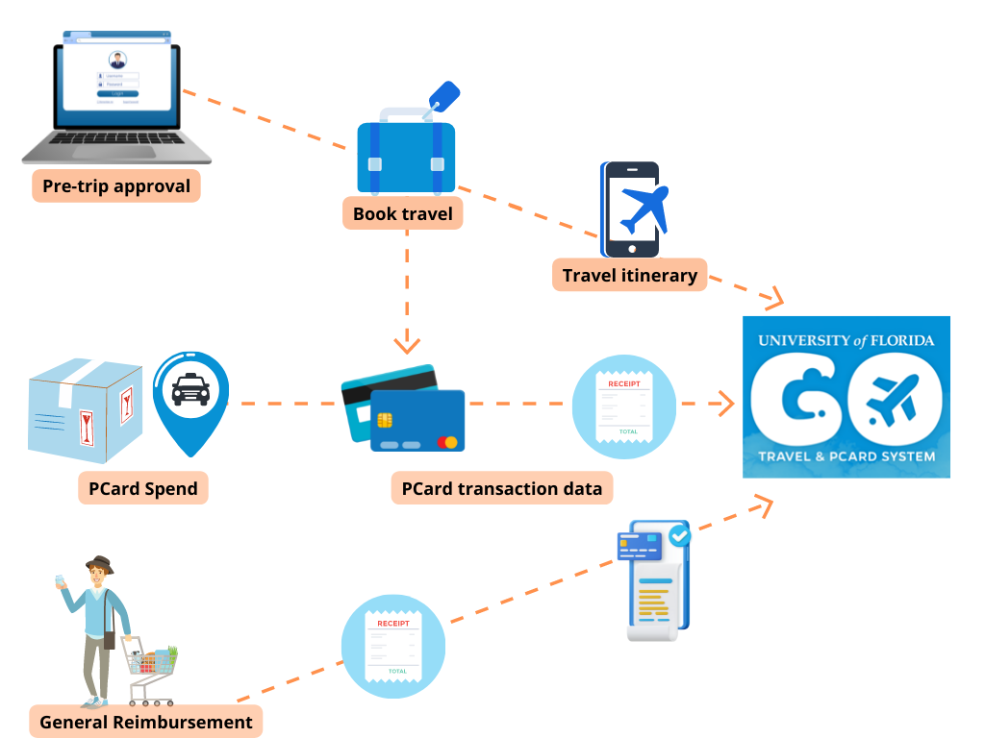
UF GO: How Does it Work?
Notes:
Make a point to say that the more the mobile is used, the more it becomes easier on the admin side

Slide 30
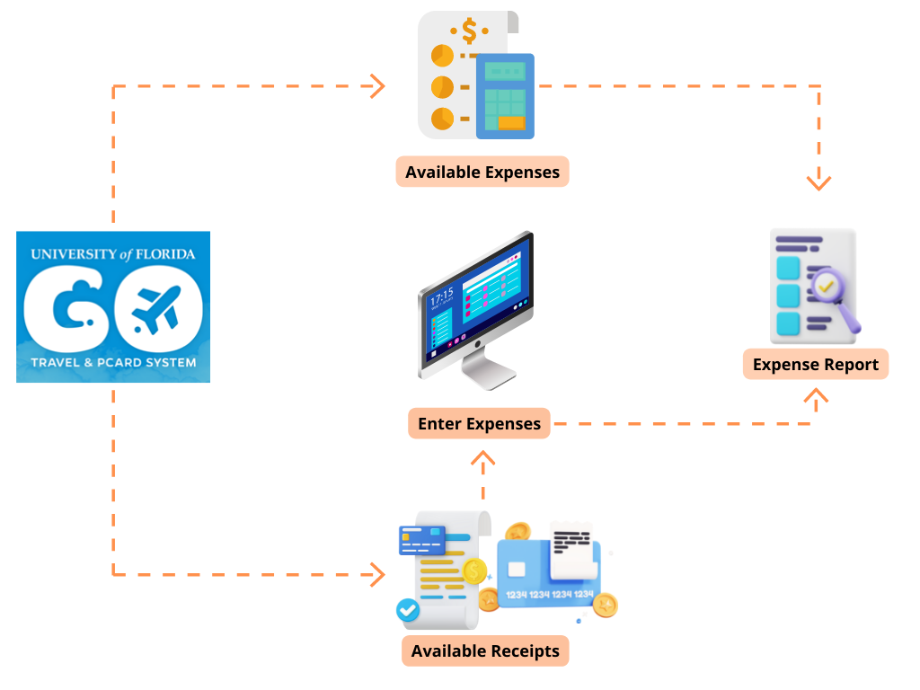
UF GO: How Does it Work?

Slide 31
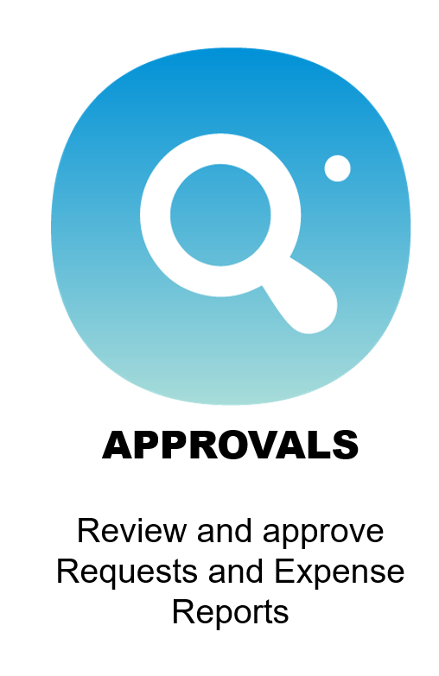
Primary User Modules
UF GO supports all Travel, PCard, and General Reimbursement transactions
Notes:
Managing Travel and Expense at UF through this platform that has three primary modules: Request, Travel, Expense.
Briefly mention we will continue discussing the other modules

Slide 32
HOW DOES UF GO IMPACT HR?

Slide 33
SECURITY ROLES

Slide 34
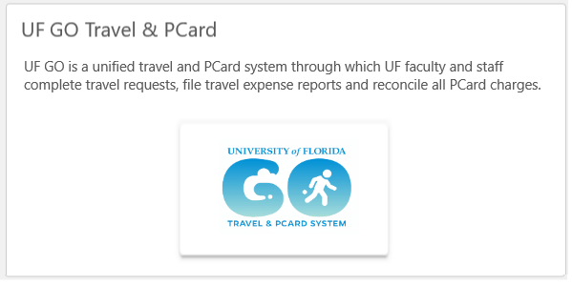
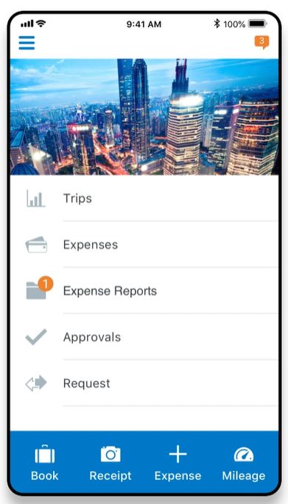
Access to UF GO
Login via myUFL and One.UF
All users must complete training to access the system
Standard User Training (20 minutes)
Staff and Faculty
System will auto-provision access
Approver Training (60 minutes)
Financial Approvers
DSA will need to request security role for access
Training available in March

Slide 35
LEGAL NAME

Slide 36
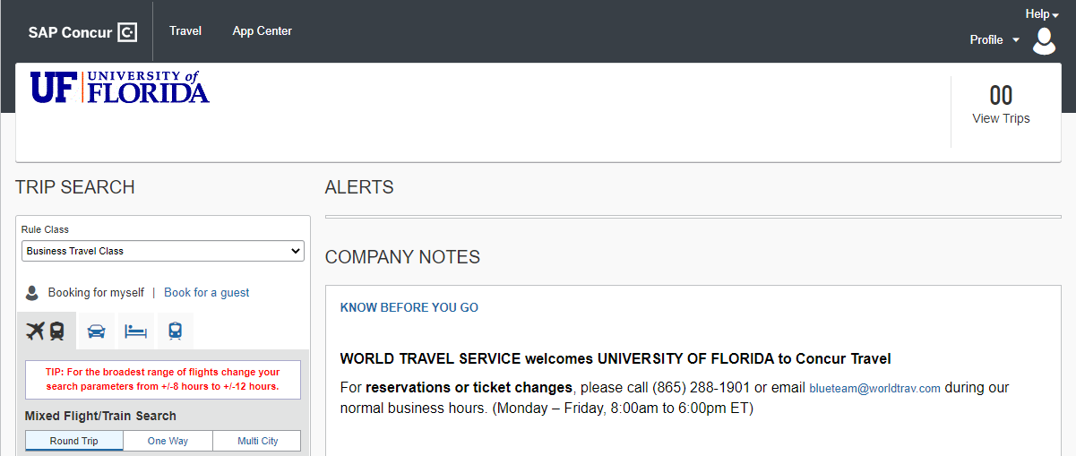
Integrated Booking Tool
Notes:
Booking tool is required
Must match passport

Slide 37
Personal Information: Legal Name
Employee name information feeds directly from HR system
If first or last name change is needed, it must be completed through the process developed by UF HR
Nightly system update
Want to learn more? View Timely Topics Session 4 at https://cfo.ufl.edu/initiatives/uf-go/outreach/
Notes:
Must match passport information

Slide 38
SUPERVISOR

Slide 39
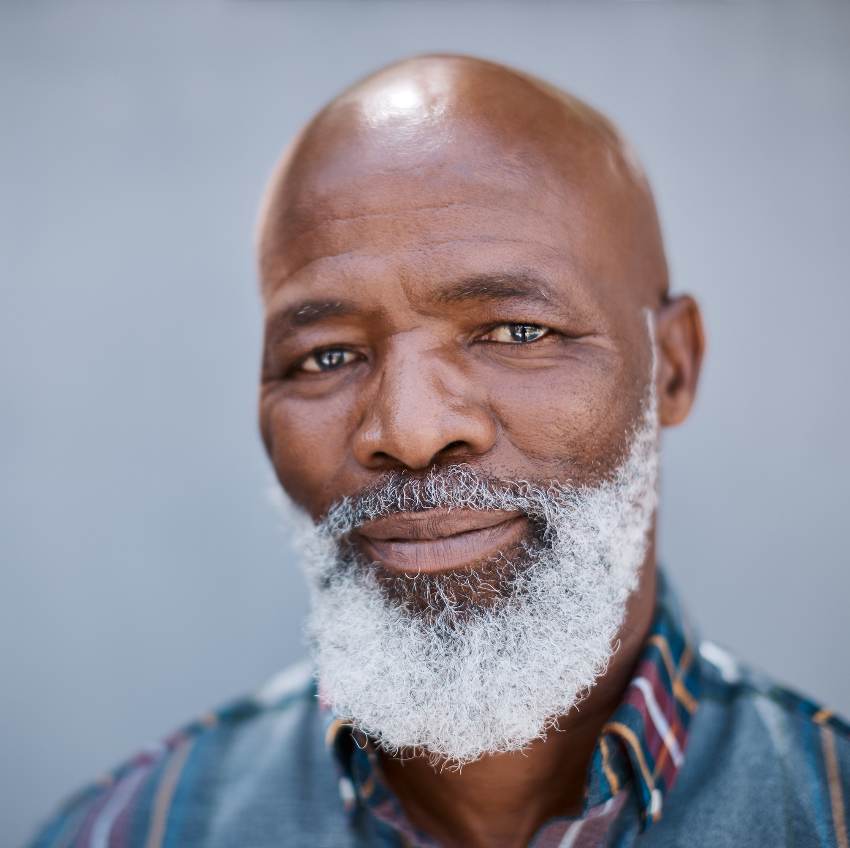
UF GO User Types
Delegate
User
Supervisor
Financial Approver
Prepare (optional)
Prepare/Submit
Approve
Approve
myUFL
Admin, Originator, Proxy, Reconciler
myUFL
Traveler,
PCard holder
myUFL
Supervisor listed in HR data
myUFL
Approver for Travel, Approver for PCard
Notes:
An example/story of who is doing it in your unit -

Slide 40
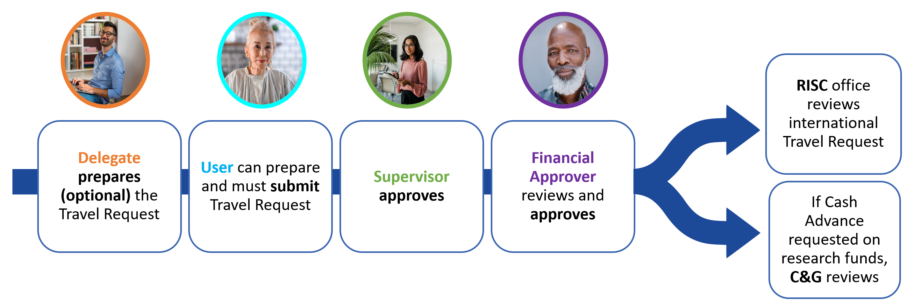
Travel Request Approval Workflow
Notes:
Provides a simpler process within system
Certain tasks can be delegated – provides flexibility to meet your units needs
This is an option; it can complement your current processes

Slide 41
UF GO User Types
Supervisor is part of the standard process for pre-trip approval
Pulling from HR Job Data
Supervisor ID listed in primary appointment
Ad-hoc approvers can be added
Support in UF GO
Approver Delegate: Delegation to someone who can make the decision (ex. Director, manager, vice-chair)
Temporary or permanent assignment
Supervisor
Approve
Want to learn more? View Timely Topics Session 1 at https://cfo.ufl.edu/initiatives/uf-go/outreach/

Slide 42
GUEST PROCESS

Slide 43
UF GO System Populations
Profiled Users
Guests
Individuals with an employment-related or like affiliation
Faculty
Staff (USPS, TEAMS, OPS)
Graduate Assistants (not Grad Students)
Student assistants (STAS/FWS)
Post Docs
Courtesy and Emeritus
Fellows
Job Candidates
Speakers
Consultants
Students on study abroad programs
*Non-employed students (grad and undergrad)
Alert! Study abroad programs will continue using the processes established by UFIC
Notes:
When designing the system, brining the entire student population when they were not required to use the system was advised against by our implementation partners. So we are bringing in the following population into the system

Slide 44
Guest Process is used when…
Travel
Individual is sponsored by a UF employee to travel on UF official business AND is not part of UF GO’s profiled user population
Example: Job interviews, speaking engagements, conferences, etc.
General Reimbursement
Individual is receiving reimbursement for expenses incurred while on official UF business AND is not part of UF GO’s profiled user population
Example: last-minute purchase for an event, services, licenses, etc.
Notes:
GR – there is no travel but there was an expense

Slide 45
UF GO Guest Process
In myUFL: Create POI
1
In UF GO: Enter Transaction
2
Step must be completed even if the individual has a UF ID
New Travel POI Type: 00016
Travel Request
Book Travel
Expense Reports: Travel & General Reimbursement
Overnight process for information to be available in UF GO
Notes:
29999958

Slide 46
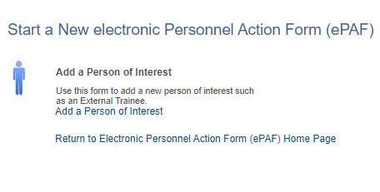
myUFL:
POI Process
Leverage current system
Does not require SSN
POI is active for a year. It will expire after 365 days
Must select new POI type: 00016
If the individual has a POI that is not for POI type: 00016, a new POI must be entered
UF_EPAF_POI_Coordinator
Notes:
Leveraging existing system
You will see additional UF GO POI options for the purposes of this meeting and process the POI Type 00016 allows you to complete the steps for a Guest without their access

Slide 47
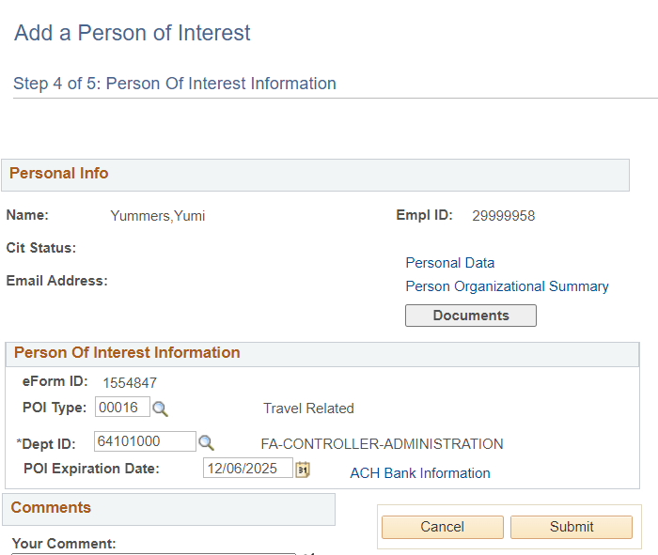
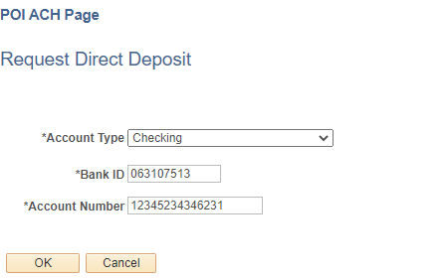
myUFL: POI Process
Optional feature: Gather ACH information for direct deposit payment for guests
Guest information is available in UF GO after an overnight process
POI information will feed to Guest Traveler list in UF GO to reduce duplicative work
Alligator, Albert
12/6/2023
Notes:
Leveraging existing system
You will see additional UF GO POI options for the purposes of this meeting and process the POI Type 00016 allows you to complete the steps for a Guest without their access

Slide 48
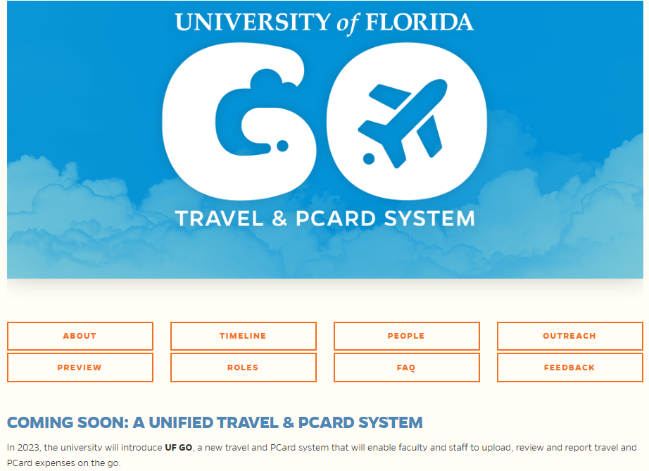
USER APPROVAL EXPERIENCE
Project Website
https://cfo.ufl.edu/initiatives/uf-go/

Slide 49
QUESTIONS?
Victoria Peprah-Asante
Associate Controller – Disbursements
vpa@ufl.edu
Cynthia Mendoza
Project Manager
cmmendoza@ufl.edu

Slide 50
Important Dates
March 6 – Applicant Progress Board
March 31 – Courtesy File Closes
April 5 – Next HR Forum
April 25 – GBAS Spring Institute

