Slide 1
UFHR Forum
April 5, 2023

Slide 2
Agenda:
Talent Acquisition & Onboarding | Youth Compliance
John Sun | Sophia Andrews
Environmental Health & Safety
Tara Hetsler | Amber Wuertz
Employment Operations & Records
Johannes Traster
Training & Organizational Development
Bob Parks | Shannon Powell
Classification & Compensation
Kenya Williams
Benefits
Crystal Roncek
Important Dates

Slide 3
Talent Acquisition & Onboarding | Youth Compliance
John Sun | Sophia Andrews

Slide 4
Youth Compliance

Slide 5
Summer Camps
Recreational, educational, and other enrichment programs operated during summer vacations
F.S. 409.175 F.S
Summer day camps
Summer 24-hour camps

Slide 6
UF Summer Camps
Typically take place April 1 to September 1
Must be registered with Youth Compliance
Registration (30 days prior to start of event)
Supervision (No one-on-one interactions)
Youth Protection Training (annual YCS800)
Parental Consent / Liability Waivers (approved by GC)
Background Screenings

Slide 7
DCF Oversight of Summer Camps
Summer camps are not licensed by the state
DCF requires a Level 2 background screening in the Clearinghouse
Failure to background screen camp staff and volunteers can result in a DCF investigation

Slide 8
Consult with Youth Compliance
Prior to requesting a summer camp/youth activity background screening
If your unit hosts youth activities in any capacity
All faculty, staff, volunteers, and students who will engage with minors must complete the annual Youth Protection Training (YCS800)
Receive departmental approval and Youth Compliance clearance prior to initiating activities with minors

Slide 9
For more information: Phone: (352) 294-8720 Email: youth-compliance@ufl.edu Web: youth.compliance.ufl.edu

Slide 10
Level 2 Screening

Slide 11
What is level 2 screening?
A comprehensive criminal background screening that includes fingerprint-based check for statewide criminal history records through the Florida Department of Law Enforcement (FDLE) and national criminal history records through the Federal Bureau of Investigation (FBI).
Screenings and results are handled in compliance with appropriate Florida State Statutes and state and federal agencies.

Slide 12
Type of Level 2 Screening
Level 2
Level 2 - DCF
In positions of trust or responsibility
Working in a sensitive location
Working in or volunteering with a youth camp or activity outside of the summer period
University positions under contract with the florida department of children and families (DCF)
University positions with UF childcare facilities
All summer camps (youth activities/camps held between April 1st and September 1st)
After school programs, including florida 4-H programs (year-round)

Slide 13
How to Initiate Level 2?
Hiring department must submit Criminal Background Screening Request Form to Talent Acquisition and Onboarding
Have employee schedule an appointment with TA&O via online appointment scheduler
For those in an area outside of Gainesville area or Florida, follow instructions provided by TA&O to schedule an appointment with FieldPrint Florida
Employee must present a state issued identification or a passport

Slide 14
How to Initiate Level 2-DCF:
Summer Camp
Hiring department must submit Criminal Background Screening Request Form or Background Screening Request Form For Youth Camps and Activities to Talent Acquisition and Onboarding
An employee or volunteer should not start until received approval from the Department of Children and Families
A copy of the Clearance Privacy Policy Acknowledgement form along with Care Provider Background Screening Clearinghouse Form must be securely provided to TA&O.
Please don’t schedule an appointment until you receive an email from TA&O to do so.

Slide 15
How to Initiate Level 2-DCF:
Have employee schedule an appointment with TA&O via online appointment scheduler (if needed)
For those in an area outside of Gainesville area or Florida, follow instructions provided by TA&O to schedule an appointment with FieldPrint Florida
Employee must present a state issued identification or a passport

Slide 16
Screening Results
Level 2
Level 2 - DCF
Return within 2 business days
Will receive clear or not clear notification from TA&O
Returns within 7 – 10 business days
Following will be forwarded to you to retain securely in preparation of an audit from DCF:
Clearance from DCF
State record search
Be sure to retain with Attestation of Good Moral Character (summer camp)/ Affidavit of Good Moral Character (childcare/after school) along with the Privacy Policy Acknowledgement form

Slide 17
Ask: Is the employee or volunteer a minor?
Prior to conducting criminal background screening on a minor (under age of 18), hiring departments must obtained a signed copy of the “Background Screening Consent Form for Minors” from the minor and the minor’s parent or legal guardian
Signed forms must be retained by the hiring departments securely in compliance with Florida public schedule.

Slide 18
Where employees go?
Gainesville Area
UF Human Resources Building
903 W. University Ave
Outside of Gainesville Area/Florida
FieldPrint
(3rd Party Provider)

Slide 19
Need Assistance?
Background Screening
Talent Acquisition and Onboarding
Email: HRBackgrounds@admin.ufl.edu
Phone: (352) 392-2477

Slide 20
Environmental Health & Safety
Amber Wuertz | Tara Hetsler

Slide 21
Health Assessments UFHR – Amber Wuertz
Process Change:
Shift from pre-employment to post-employment health assessments as part of the onboarding process (in most cases*). Departments can require health assessments pre-employment by position type at their discretion.
Excludes*: Scientific Divers, CDL, Law Enforcement
The clinic will continue to enter final clearance(s) information into myUFL once all results are received.
Website updates are ongoing, and forms will be updated with this language shortly.

Slide 22
CareSpot Transition EHS – Tara Hetsler
Feedback is positive!
Weekly check-ins continue with CareSpot Customer Service Teams-Feedback is welcomed!
Personal Health Information (PHI): Results will be sent to OccMed Clinic via secure portal.
If employee tries to “give” results to department, please ask them to keep the results.
Please contact EH&S and we will help fast track your results.
Additional changes will be occurring soon, more to come!

Slide 23
Friendly Reminder
For all OPS hires, please remember to send an INOP form via Sharepoint, so that the OccMed Clinic will know what duties are required for the position, even if you are working with CareSpot only.
This will help reduce emails and calls to departments and result in a shorter turn-around time for your results. Help us help you!
Questions
Phone: (352) 392-1591
Email: Thetsler@ehs.ufl.edu

Slide 24
Employment Operations & Records
Johannes Traster

Slide 25
Short Work Break Reminders!
Upcoming Action Items
Short Work Break file will take place on April 20, 2023
Action Needed by Departments
Verify all 9- and 10-month employees (faculty, graduate assistants, and TEAMS) who will not return after Spring 2023 are terminated in myUFL
If necessary, enter end-of-semester terminations PRIOR to April 18, 2023

Slide 26
Short Work Break Reminders!
Navigation & Resources
To review employees on Short Work Break after April 20th
Main Menu > Enterprise Analytics > Access Enterprise Analytics > Team Content > Human Resources Information > Workforce Information > Short Work Break – Return From Break Report
Instruction Guide
http://training.hr.ufl.edu/instructionguides/job_position_actions/shortworkbreak.pdf

Slide 27
Faculty & GA Summer Appointment Reminders!
Summer Job File
Summer appointments for 9-month faculty and graduate assistants may be processed via the summer job file
Summer appointments may also be entered as a Hire ePAF
File opens April 21, 2023
File closes May 11, 2023
Summer appointments will load in Job Data on the afternoon of May 15th, 2023

Slide 28
Faculty & GA Summer Appointment Reminders!
Summer Job File
The file will be available via myUFL system
Main Menu > Human Resources > Workforce Administration > Job Information > UF Summer Job Review
Instruction Guide
http://training.hr.ufl.edu/instructionguides/job_position_actions/summerjobreview.pdf
Departments will be contacted by EOR if there are employees who do not load and may need additional action on your part

Slide 29
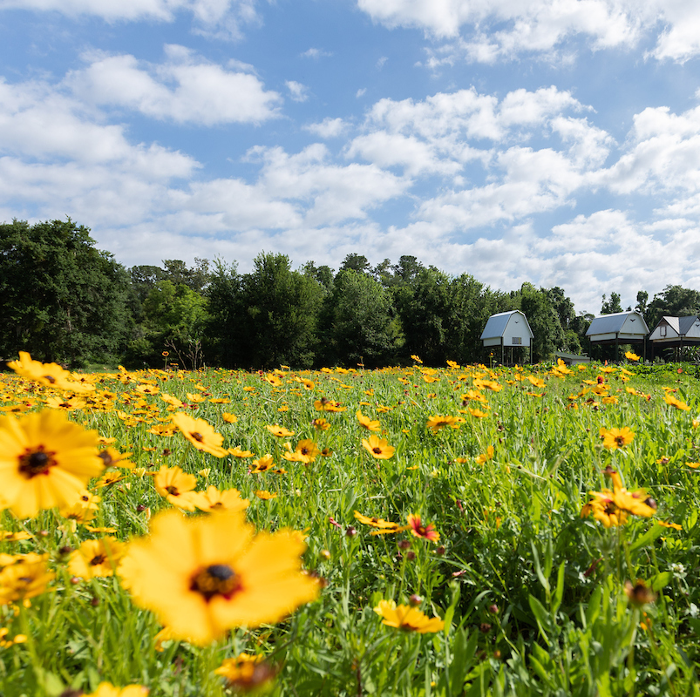
Spring Cleaning: New Hire Checklist & GatorStart
New Hire Checklist
Updates to the New Hire Checklist include revised instructions by appointment type, new checklist tabs for Post-Doc Associates and Courtesy Faculty, and updated links to forms and additional resources
GatorStart
All packet types were recently updated for general maintenance for instructions, links, and imagery
Intellectual Property Agreement is now placed in all packet types | New!
Welcome invitation email currently going through a redesign | Coming Soon!

Slide 30
Update—Notarized Four-in-One Form
The notarized Four-in-One form is no longer required for hire ePAFs created on/after April 5th as the IP agreement has moved to GatorStart and there is a new loyalty oath form.
Intellectual Property Agreement
Revised language
Increased readability while simplifying statements
Notarization no longer needed
Now located in every GatorStart packet
Loyalty Oath Form
Notarization still required
Statement slightly revised with notary instructions
New Form: https://hr.ufl.edu/wp-content/uploads/2023/03/Loyalty-Oath_3-30-23.pdf

Slide 31
Redesign: GatorStart Welcome Invitation
Current State

Slide 32
Redesign: GatorStart Welcome Invitation
Future State (Draft)

Slide 33
Training & Organizational Development
Bob Parks | Shannon Powell

Slide 34
Leadership Program Applications
“Leadership and learning are indispensable to each other.” —John F. Kennedy
Now through May 5
We are accepting applications for
UF Academy
Advanced Leadership for Academics and Professionals (ALAP)
Managers Cohort

Slide 35
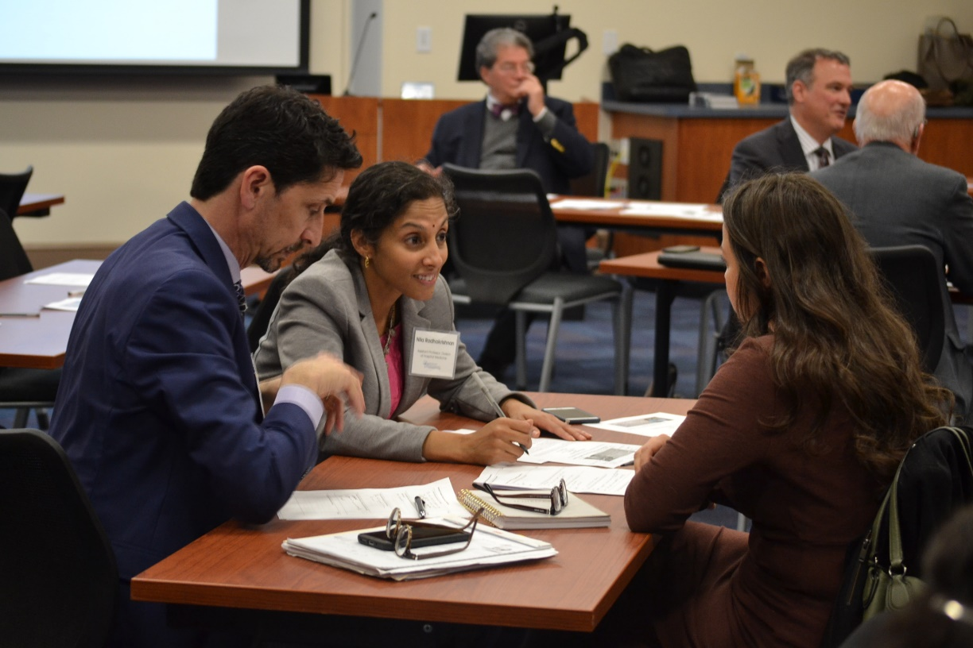
Leadership Program Applications
UF Academy
Entering its 20th year
Designed for faculty and professional staff who are “emerging leaders”

Slide 36
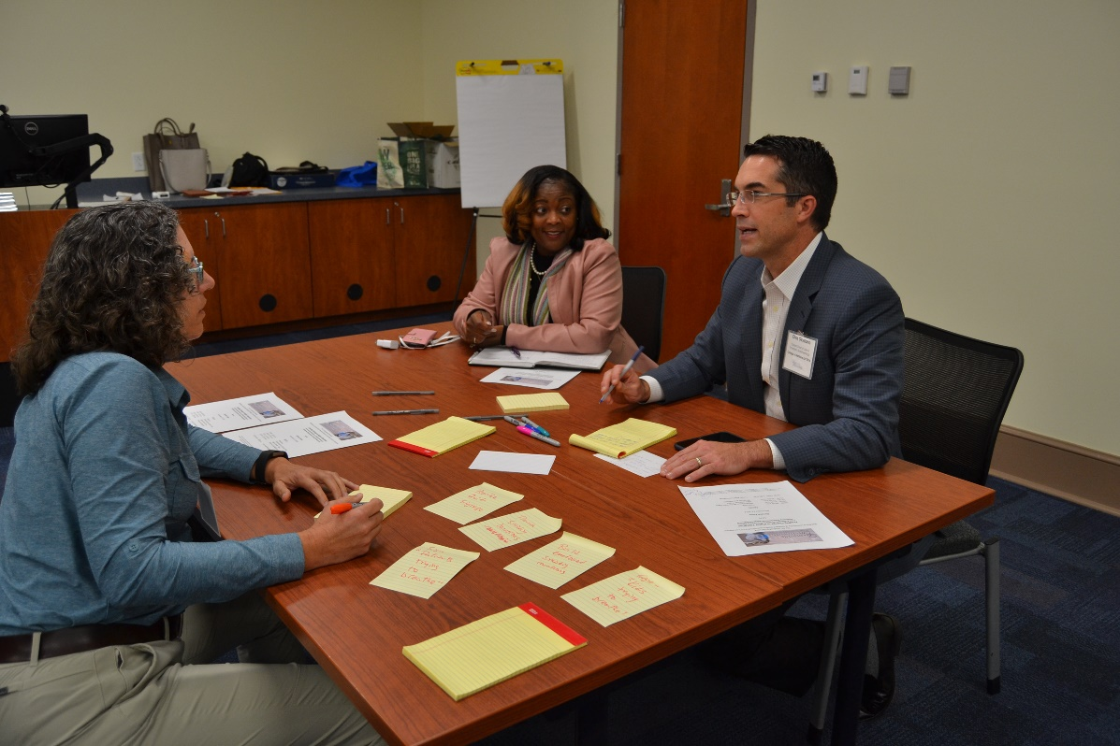
Leadership Program Applications
Advanced Leadership for Academics and Professionals (ALAP)
Entering its 15th year
Designed for established UF professional and academic leaders looking to further develop leadership skills

Slide 37
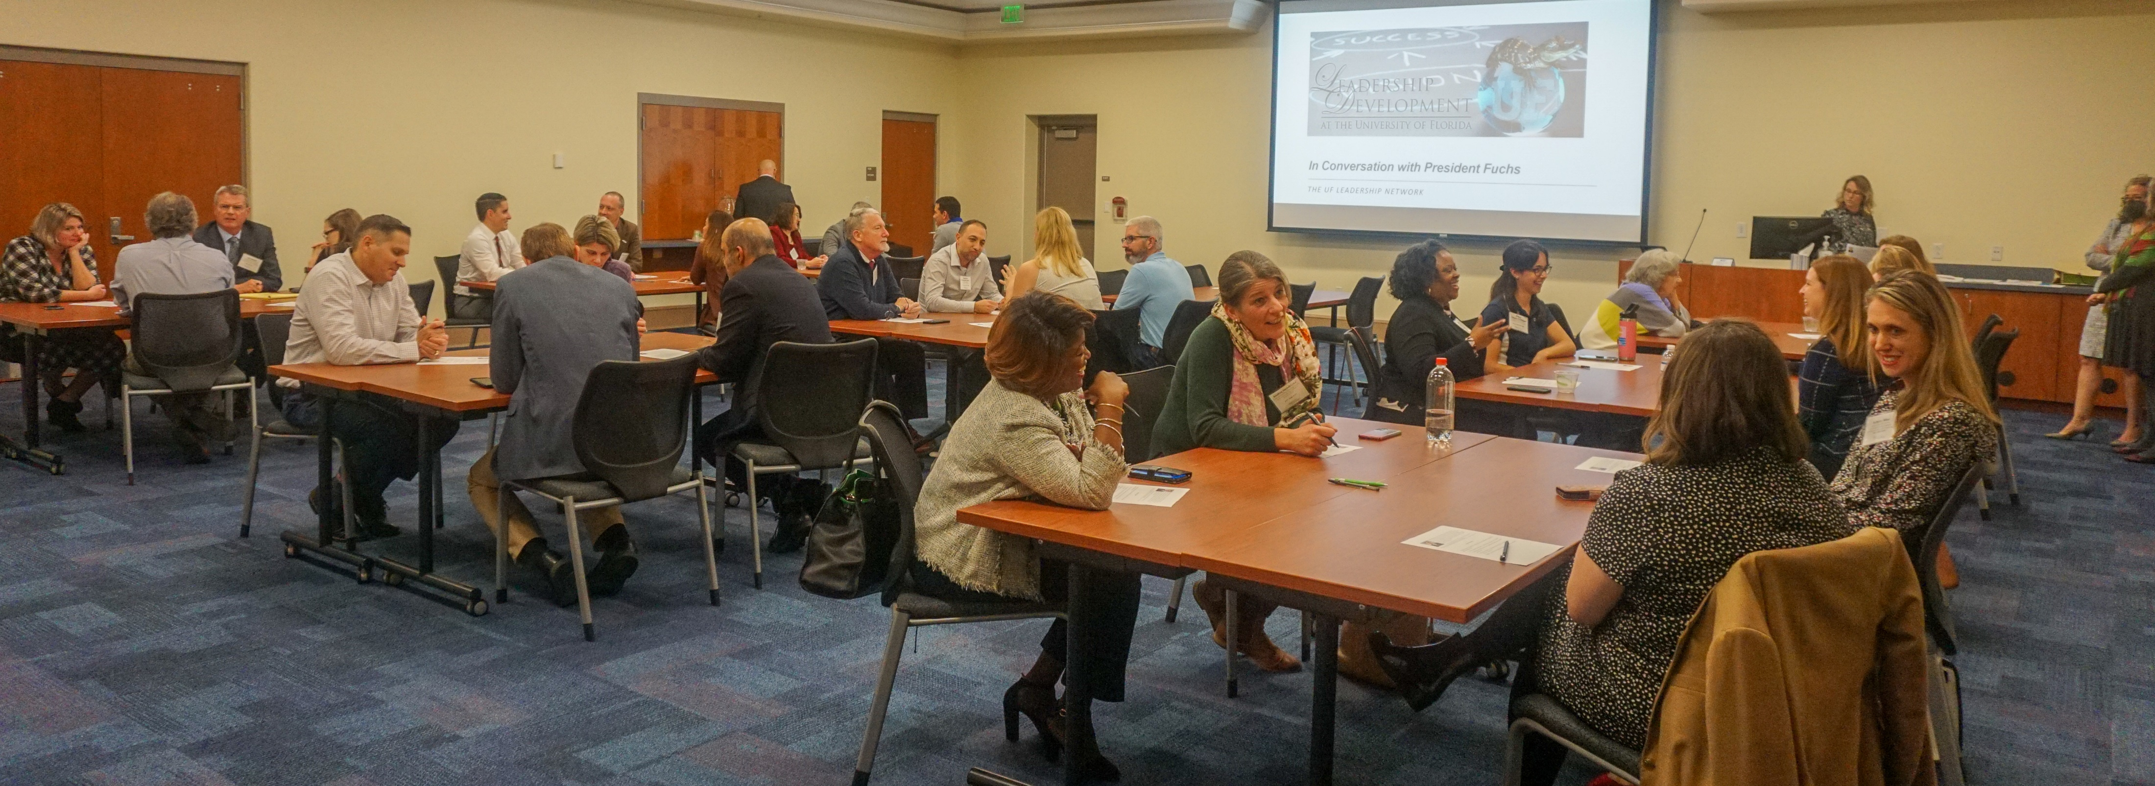
Leadership Program Applications
Managers Cohort
Entering its 13th year
Managers can participate in the Managing at UF curriculum as a cohort

Slide 38
Leadership Program Applications
For more information or to access the application, visit the Leadership@UF program page on the UFHR site https://leadership.hr.ufl.edu/programs/

Slide 39
Summer Calendar
Summer calendar of courses available for registration
Register in myTraining
View HR calendar for course dates (https://calendar.hr.ufl.edu/events/category/training-organizational-development/)

Slide 40
GBAS Spring Institute
Shannon Powell

Slide 41
GBAS Institute Spring 2023 Foundations for the Future
Format: | Hybrid event with both in-person and online offerings
Where: | Emerson Alumni Hall OR Virtually on Zoom
When: | Tuesday, April 25, 2023 8:30 a.m. – 3:30 p.m. (For in-person: 8-8:30 a.m. coffee and networking, lunch provided)
Who: | All business administrators in the areas of HR, Finance, and Sponsored Programs are welcomed

Slide 43
GBAS Institute: Registration Links
Morning Session Registration Links:
[in-person] Click here to register FOR one IN-PERSON MORNING breakout SESSION
OR
[Virtual] CLICK HERE TO REGISTER FOR one VIRTUAL MORNING breakout session
Afternoon Session Registration Links:
[in-person] Click here to register FOR one IN-PERSON Afternoon breakout SESSION
OR
[Virtual] CLICK HERE TO REGISTER FOR one VIRTUAL afternoon breakout session

Slide 44
Classification & Compensation
Kenya Williams

Slide 45
Florida Minimum Wage Reminder
Florida voters approved an amendment in November 2020 that increases the minimum wage each year until it reaches $15 per hour in 2026
Effective September 30, 2023, the minimum wage will increase to $12 per hour
As of March 30, we identified 2,053 appointments below the new minimum wage
Division of Student Life
Housing & Resident Life
College of Law
Warrington College of Business
The cost including fringe of increasing the population to the new minimum wage is approximate $1.87M
Questions? Classification & Compensation - compensation@ufl.edu – 352-273-2842

Slide 46
University Benefits
Crystal Roncek | Brook Mercier

Slide 47
Open Enrollment
Open Enrollment (OE) will run from Monday, October 9 – Thursday, October 27, 2023
Elections must be made by 6:00 pm on October 27
Elections during OE are effective 1/1/2024
Carefully read all materials sent to you from UFHR University Benefits and other vendors
Outside of OE, you may only make changes if you have a qualifying status change (marriage, birth, adoption, etc.)
In July 2023, University Benefits will begin to schedule OE presentations with colleges & departments to discuss updates
The State of Florida has already indicated that they expect to make changes to the medical, prescription, dental, and life insurance plans. Further updates will be shared when the State notifies all FRS participating employers in the summer.
The Benefits & Wellness Fair will be held on Friday, October 13, 2023
Location: The Evans Champions Club at Ben Hill Griffin Stadium
Hours: 9:00 a.m. to 3:00 p.m.

Slide 48
UF 2023 Holidays
UF Homecoming – October 6, 2023
myUFL and the HR website has been updated for all 2023 UF holidays, including UF Homecoming
Holidays and Personal Leave Days – HR Benefits and Rewards (ufl.edu)

Slide 49
Florida Prepaid Plan & the Florida 529 Savings Plan
Florida Prepaid Plan – You may enroll at any time; however, to lock into 2023 rates, you must enroll during the annual Open Enrollment Period, which ends April 30th
Florida 529 Savings Plan – You may enroll any time. Enrollment is offered year-round.
Both options provide for affordable ways to save for your child’s future college expenses, and convenient payroll deductions.
To learn more about these plans, please visit:
Florida Prepaid Plan - Prepaid Plans - Florida Prepaid College Board (myfloridaprepaid.com)
Florida 529 Savings Plan - About 529 College Savings | Florida 529 Plan | Florida Prepaid (myfloridaprepaid.com)

Slide 50
Accessibility to University Benefits Staff
Thank you for your feedback during the Benefits Listening tour with Crystal, Brook, Amber, and Florencia
Improved Accessibility for Employees:
Phone
Walk-in
Online Appointment Scheduler
Fax
Mail
Salesforce – case management
Microsoft Teams Instant Messenger will be disabled

Slide 51
Important Dates
Now thru 5/5
Leadership Program Applications Open
April 21st
Summer Job File Opens
April 25th
GBAS Spring Institute
May 3rd
Next HR Forum

