Slide 1


UFHR Forum
July 12, 2023

Slide 2


Agenda
Vice Presidents Office
Brook Mercier
Strategic Initiatives
Amber Wuertz
Talent Acquisition & Onboarding
John Sun
Employment Operations & Records
Johannes Traster
Benefits
Shannon Edwards
Important Dates

Slide 3

Office of the Vice President
Brook Mercier

Slide 4
Essential Employees
Essential employees provide vital support to the University of Florida in the event of an emergency or disaster that results in the official suspension of classes and/or closing of offices.

Slide 5
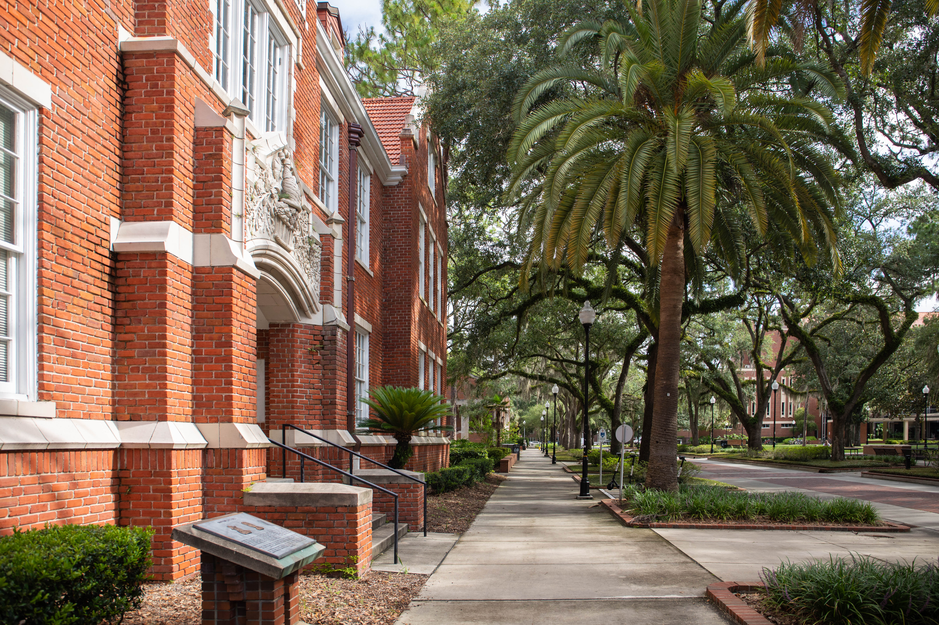
ESSENTIAL EMPLOYEES
Essential employees play an important role in maintaining the safety and well-being of students, faculty, and staff who may be remaining on site throughout emergency events.
During a campus closing, only employees designated as On-Campus Essential may be present on campus.

Slide 6
ESSENTIAL EMPLOYEES
Colleges and Departments are responsible for designating and notifying essential employees.
Essential employees may be required to report to work, be “on call” to report to work, and/or work remotely if required in order to maintain the critical functions of the University during a closure.
In the event of an emergency closing, supervisors notify essential employees if and when they are required to report to work.
Essential employees have a responsibility to monitor official University of Florida communications related to an emergency, including UFAlert and UFL.edu, as well as maintain up to date contact information in myUFL.

Slide 7
ESSENTIAL EMPLOYEES
On-Campus Essential – Working on campus
  Continuation of critical and/or essential services that must be completed on-site
  Maintaining integrity of infrastructure, property or systems on-site
  Necessary on-campus work to maintain the safety and wellbeing of students, faculty and staff
Remote Essential – Working from a remote location, may need periodic access to campus
  Work is required to maintain operations and business continuity of the University and can be completed remotely
  Supervisor approved access to campus may be needed periodically to complete required work
Remote Non-essential – Working from a remote location, does not need access to campus
  Work is important to the University and can be completed remotely, but is not essential to maintain operations and business continuity

Slide 8
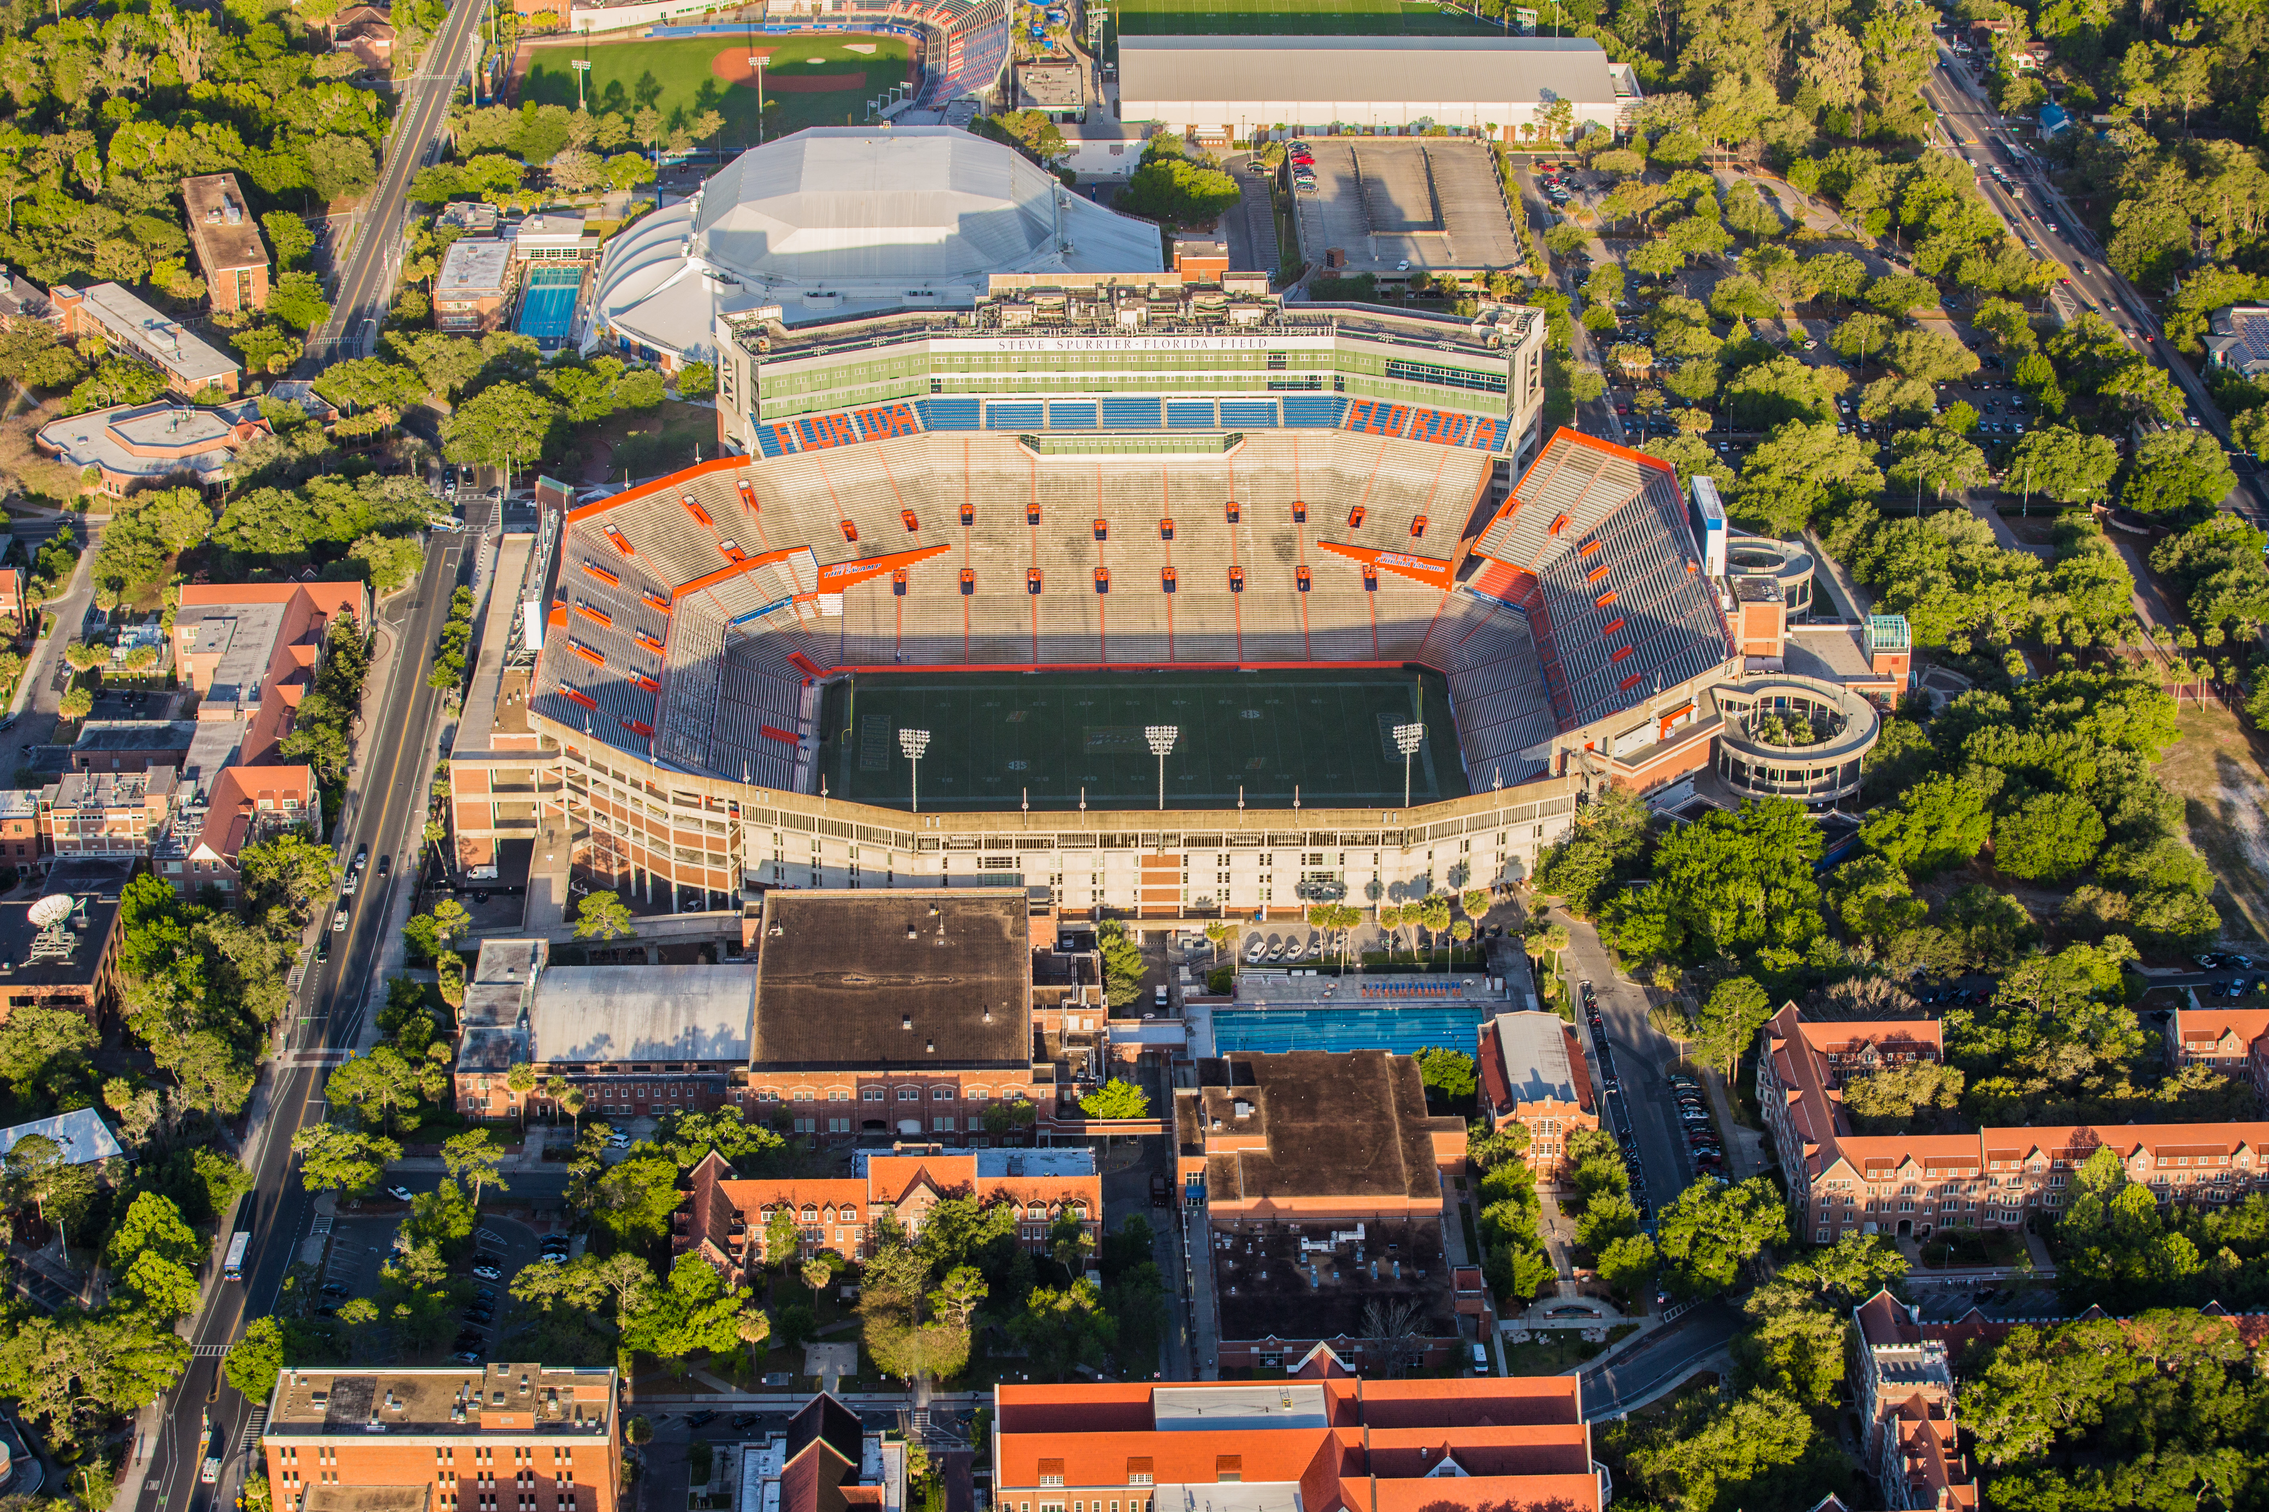
ESSENTIAL EMPLOYEES
Essential employees should receive and acknowledge written designation from their supervisor
A standardized designation letter template is available to departments

Slide 9
ESSENTIAL EMPLOYEES
TEAMS, USPS, and Law Enforcement non-exempt employees who are required to work during an emergency closing will earn one hour of special compensatory leave for each hour worked during the emergency closing, in addition to their normal pay.
If the special compensatory leave is not used by the end of the fiscal year, the employee will be paid for the leave.
TEAMS exempt employees who are required to work during an emergency closing are eligible for compensatory leave at the discretion of the supervisor — although this compensatory leave is handled informally at the department level and not accrued in myUFL.
Faculty and graduate assistants are not eligible for compensatory leave under this policy.

Slide 10
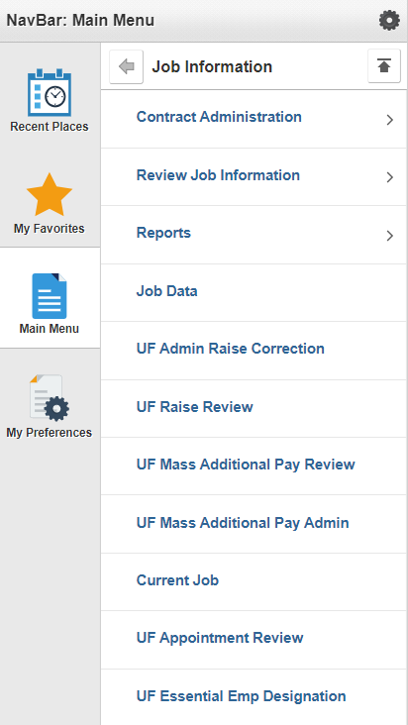
ESSENTIAL EMPLOYEES
HR Liaisons record the designation in the UF Essential Employee Designation file in myUFL.
Navigation-
  myUFL Main menu > Human Resources > Workforce Administration > Job Information > UF Essential Emp Designation

Slide 11
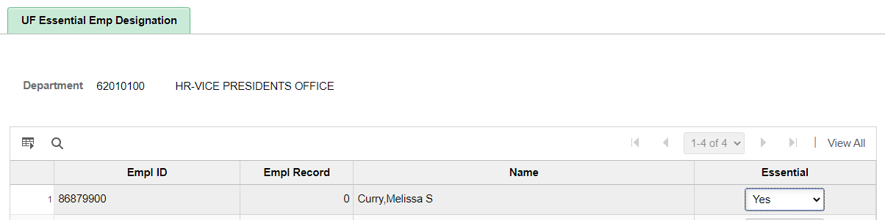
ESSENTIAL EMPLOYEES
Navigation
  myUFL Main menu > Human Resources > Workforce Administration > Job Information > UF Essential Emp Designation

Slide 12
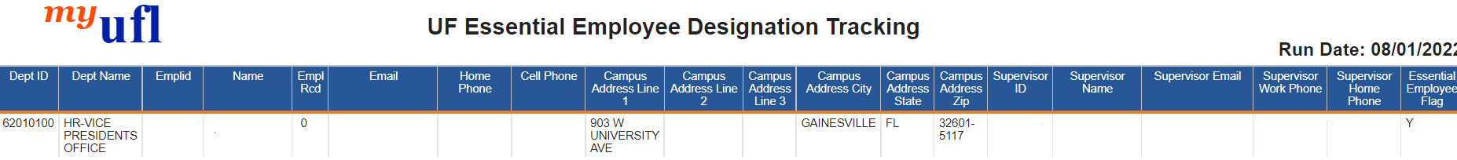
ESSENTIAL EMPLOYEES
myUFL Enterprise reporting
Team Content > Human Resources Information > Workforce Information > UF Essential Employee Designation Tracking

Slide 13

ESSENTIAL EMPLOYEES
Available Resources
https://hub.policy.ufl.edu/s/article/Essential-Employees

Slide 14

Strategic Initiatives
Amber Wuertz

Slide 15
Superior Accomplishment Awards
UFHR will be hosting a series of creativity labs to thoughtfully and creatively discuss how we can enhance and revitalize SAA in both the short-term and long-term.
Three separate labs, each with a specific focus. The goal is to elevate the program and enhance the employee experience.
Here is the schedule for the labs, along with Eventbrite links to register, space is limited so enroll now:
Lab I: Charting the Course – Wednesday, July 26 from 10am-12pm in UFHR Building (Room 120)
Lab II: Foundational Components – Monday, July 31 from 10am-12pm in UFHR Building (Room 120)
Lab III: The Experience (in-person) – Thursday, August 10 from 2pm-4pm in UFHR Building (Room 120)
Lab III: The Experience (virtual) – Tuesday, August 15 from 2pm-4pm via Zoom

Slide 16
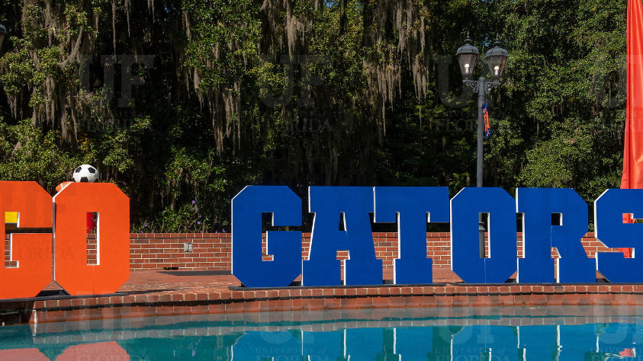
Superior Accomplishment Awards
Intentional focus on enhancing UF’s long-standing employee recognition program.
Goal is to refresh and improve the program through Creativity Labs this summer.
Share your thoughts with us:
What do you like? What do you think could be better?
  Submit your feedback through our anonymous feedback form.
Questions? Email SAA@hr.ufl.edu.

Slide 17

Talent Acquisition & Onboarding
John Sun

Slide 18
HireRight & PageUp
Integration

Slide 19
HireRight & PageUp Integration
Guides, FAQs & Recording available on the website,
Go Live
July 3, 2023
Stabilization Period
Last Day for FADV
July 12th - 12:30
Resources
Information Sessions
Pre-Employment Screening Using HireRight
July 14, 2023
July 4th – 14th, 2023
July 12th – 3:30
July 13th – 1:00
1
2
3
4
5

Slide 20
Questions??
Email: talent@hr.ufl.edu

Slide 21

Employment Operations & Records
Johannes Traster

Slide 22
Return from Short Work Break—Now Back!
Short Work Break
Appointments that were placed on short work break for both 9- and 10-month employees were returned in Job Data last Monday, July 3rd.
Job actions that may have been placed on hold during the summer break may now be performed with an effective date of their return (or beyond).
  9-month effective date: 8/16/23
  10-month effective date: 8/1/23

Slide 23
Terminate Summer Appointments
End of Summer Assignments
As the end of summer quickly approaches, be sure to enter terminations for summer appointments completed through individual ePAFs and not through the Summer File.
Summer appointments created by the Summer Job File already have a termination row in myUFL (unless JDC was submitted to modify summer appointment).
  Salary plans include FASU, OFSU, and GASU
  Termination reason should be “End of Summer Assignment” (ESA)
  ESA terminations will execute at Level 1
    Important! Careful review is necessary by Level 1 approvers; i.e., GASU terminations will kick out tuition waiver if incorrect termination effective date is used.
    Correct termination dates: Summer A: 7/1/23; Summer B/Summer C: 8/16/23

Slide 24

New Resource: Appointment Letter Clauses
Appointment Letter Library
Specific template clauses with instructions are now available on our Appointment Letter Library
Clauses include tenure upon hire, relocation allowances, administrative supplements, and much more!
Resource:
  https://hr.ufl.edu/wp-content/uploads/2023/06/appt-letter-clauses_6-22-23.pdf

Slide 25
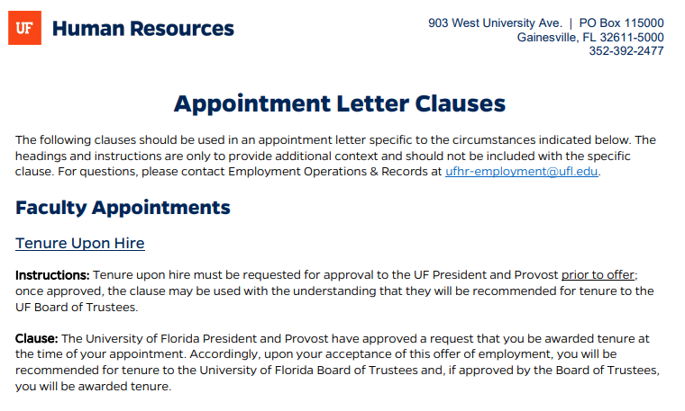
New Resource: Appointment Letter Clauses

Slide 26
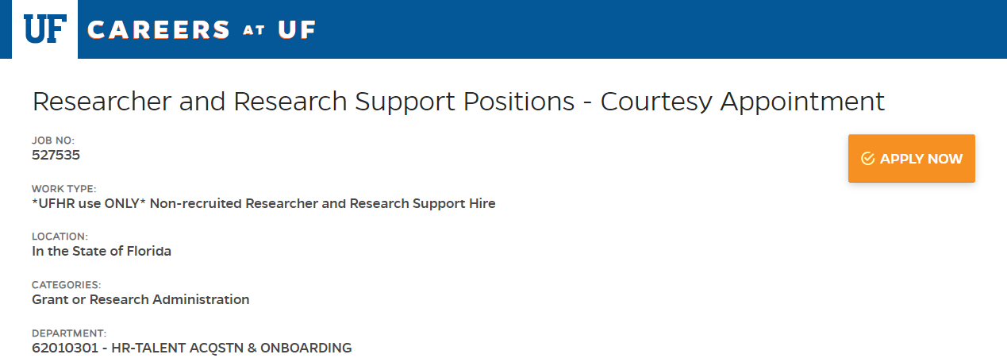
Courtesy Appointments
Researcher & Research Support Screening
New Job Requisition
Courtesy faculty who are performing research or who are in research support positions must complete form in PageUp
  Job Req #527535
Review will be conducted by UFHR and UF Research Integrity, Security and Compliance (RISC)
Researcher and research support screening information can be found at
  https://hr.ufl.edu/manager-resources/recruitment-staffing/researcher-screening/
Please Note:
Instructions will be forthcoming on the website.

Slide 27
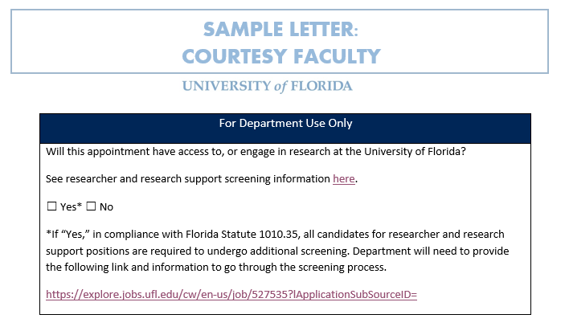
Courtesy Appointments
Researcher & Research Support Screening
New Offer Letter Attestation
New section for departmental use added at the bottom of the courtesy faculty offer letter template
Updated templates must be in use by Friday, July 28th
  If offer letter has already been presented prior to July 28th then there is no need to redo the letter
  Courtesy faculty hires may be delayed if new letter is not in use beginning July 28th

Slide 28
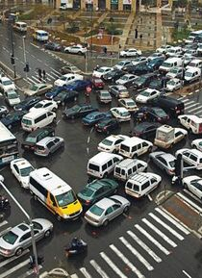
Preparing for the Fall Rush
Enter Appointments Now
Hire ePAFs may be submitted up to 60 days in advance
Submitting hires far earlier with all required paperwork will assure they are in the system by first day with no paycheck delay
EOR Business Model Improvements Underway
Cross training between staff and academic teams
All team members will be knowledgeable and able to assist with all salary plans
  Will allow for quicker point of contact solutions
  Department assignments will be updated later this fall

Slide 29

University Benefits
Shannon Edwards

Slide 30
Summer New Hire Reminders
Due to double deductions, any new 9- and 10-month hires effective prior to 8/15/2023 must be coordinated with Benefits to ensure proper enrollment and summer coverage
  Please send your new hire notification to UFHR at benefits@ufl.edu as soon as possible.
All new OPS hires with combined FTEs ≥0.75 are eligible for State benefits
The State does not consider salary plan changes (i.e., OPS to TEAMS or Faculty) for benefits-eligible employees as a Qualifying Status Change
  Employees may have to wait until Open Enrollment to enroll in State benefits
If possible, hire employees closer to the beginning of the month to ensure ability to elect early effective date for health insurance.

Slide 31
Open Enrollment
During a recent call with the State University System (SUS), representatives from the Department of Management Services (DMS) provided several updates regarding this years’ open enrollment.
Open Enrollment Dates: October 9, 2023 – October 27, 2023
UF’s Benefits Fair: October 13, 2023
While the DMS representatives were not able to provide details, they have indicated that there will be changes and that we should expect an “active” open enrollment.

Slide 32
Open Enrollment
There will also be changes to how employees receive communication related to open enrollment.
  Employees who have an email address in PeopleFirst will no longer receive printed enrollment materials. Rather, open enrollment information will be communicated by email.
  Only employees who do not have an email address on file with PeopleFirst will receive printed open enrollment materials.

Slide 33
DROP Changes
In the 2023 Regular Legislative Session, the Florida Legislature passed bills affecting members and employers of the Florida Retirement System (FRS) and other state-administered retirement plans.
Deferred Retirement Option Program (DROP) Participation – Eligible members can now elect to participate in DROP for no longer than 96 calendar months (8 years) versus 60 months (5 years) beginning any time after their normal retirement date.
  Impacted members have received communication from the State regarding the change
Drop Extension Request form and a revised Drop Election form (DP-ELE) needs to be returned to UFHR Benefits
  DROP – HR Benefits and Rewards (ufl.edu)
The Drop Extension Request form does require Supervisor and Dean/VP approval

Slide 34
Services After Retirement
The Florida legislature passed SB 1156: Florida Retirement System, which authorizes employers to establish volunteer programs for retirees
UFHR is preparing additional communication, but we anticipate that the law will allow retired and emeritus faculty to provide voluntary services to the university within specific parameters:
  The services cannot be prearranged
  Compensation and benefits cannot be provided
  The number of volunteer hours per week, including training, is limited to no more than 20 percent of time per week before the date of retirement.
  A clear distinction between the duties of a volunteer and the duties of an employee is required.
  Volunteers must maintain control of their volunteer schedule, including the number of hours volunteered and assignments for which they agree to volunteer.

Slide 35

Important Dates
August 2 • Next HR Forum
October 9-27 • Open Enrollment
October 13 • UF Benefits Fair

